Slide 1
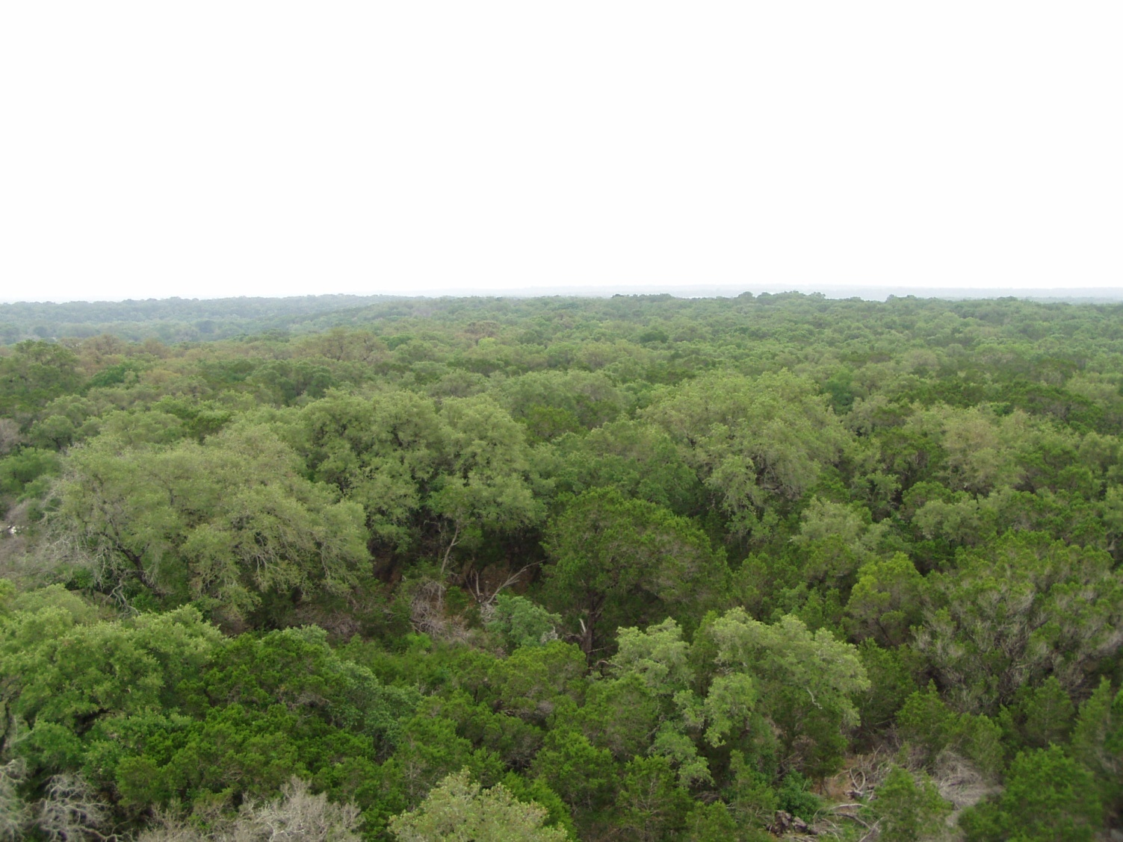

Temperature acclimation of respiration in a warming world:
What do experiments tell us?
Mark G. Tjoelker
Department of Ecosystem Science & Management
Texas A&M University
1st INTERFACE Workshop
How Do We Improve Earth System Models: Integrating Earth System Models, Ecosystem Models, Experiments and Long-Term Data
Tween Waters Inn
Captiva Island, Florida
February 28 – March 3, 2011

Slide 2
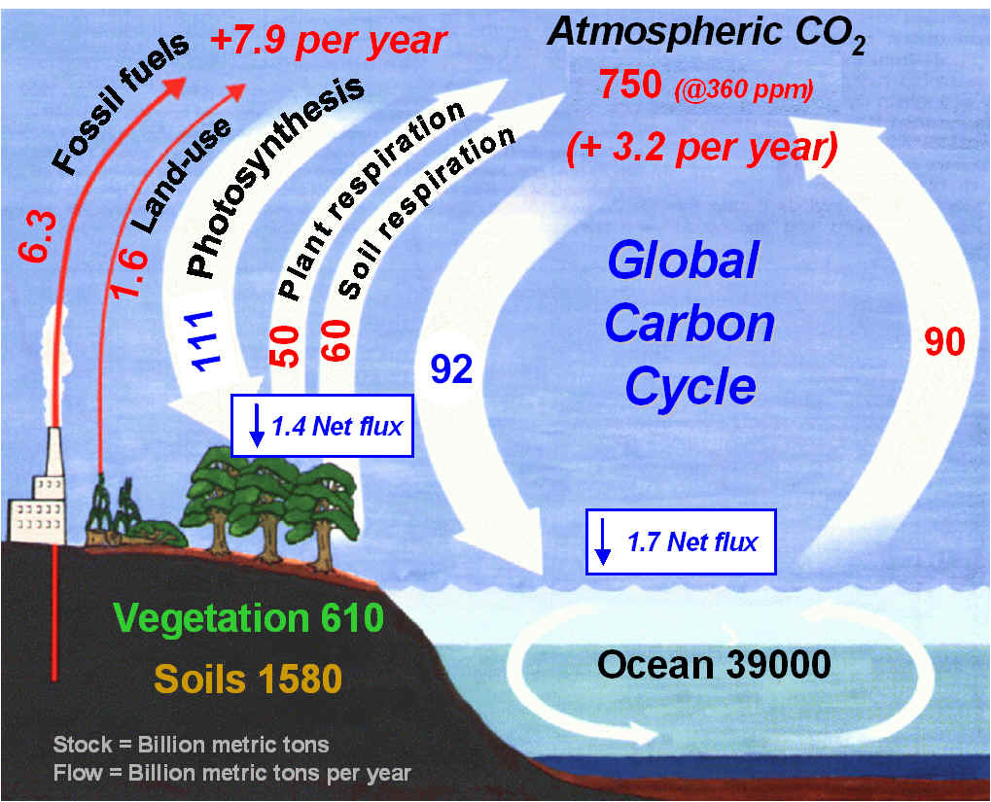
Intergovernmental Panel on Climate Change 2007

Slide 3
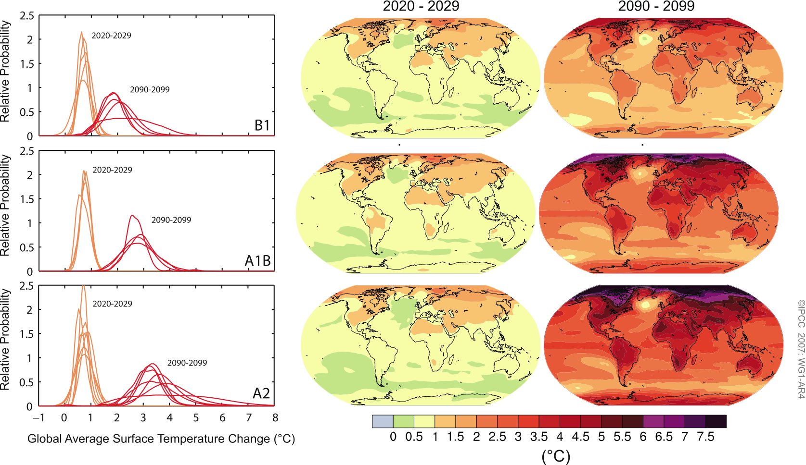
A warmer future Earth
2020 - 2029
2090 - 2099
Intergovernmental Panel on Climate Change 2007
Notes:
Figure SPM.6. Projected surface temperature changes for the early and late 21st century relative to the period 1980–1999. The central and right panels show the AOGCM multi-model average projections for the B1 (top), A1B (middle) and A2 (bottom) SRES scenarios averaged over the decades 2020– 2029 (centre) and 2090–2099 (right). The left panels show corresponding uncertainties as the relative probabilities of estimated global average warming from several different AOGCM and Earth System Model of Intermediate Complexity studies for the same periods. Some studies present results only for a subset of the SRES scenarios, or for various model versions. Therefore the difference in the number of curves shown in the left-hand panels is due only to differences in the availability of results. {Figures 10.8 and 10.28}

Slide 4
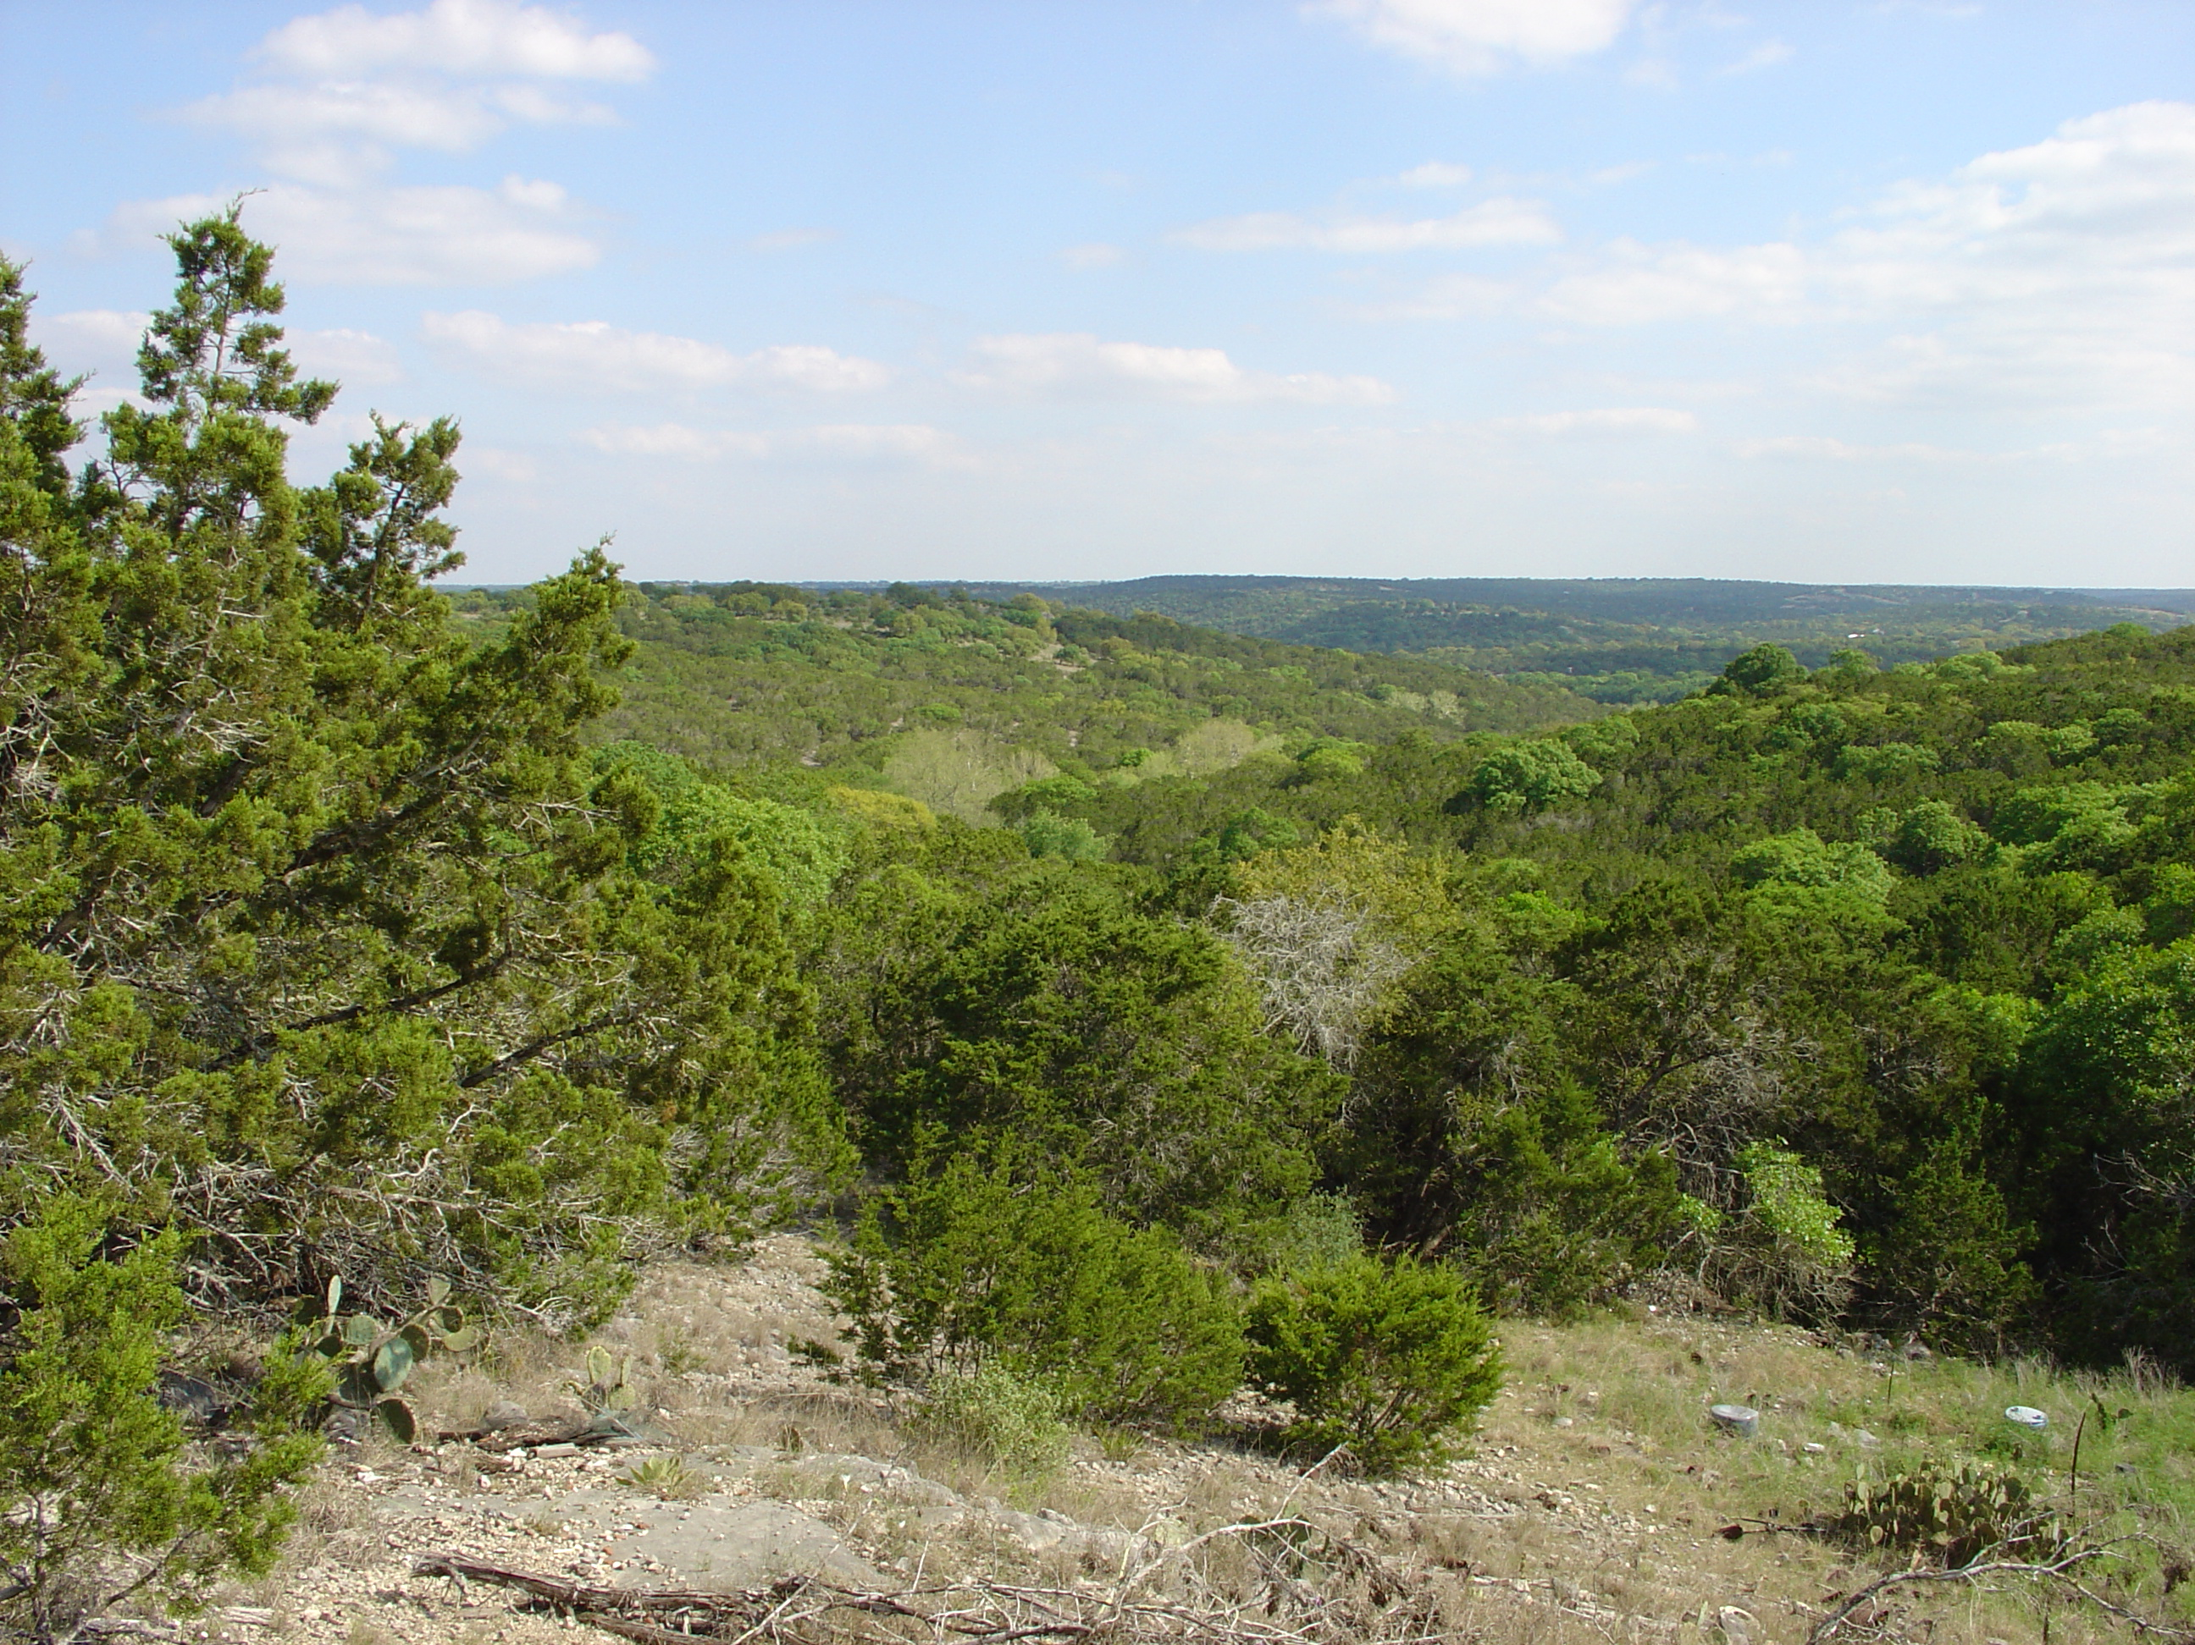
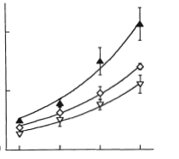

Will climate warming lead to runaway respiration?
Jack pine (Pinus banksiana)
growth chamber experiment
Respiration
20
Q₁₀ ≈ 2
Respiration
(nmol g⁻¹ s⁻¹)
10
0
Temperature
12
18
24
30
Measurement temperature (°C)
Q₁₀: proportional change in respiration with a 10 °C change in temperature
Tjoelker et al. 1999, Plant, Cell & Environment

Slide 5
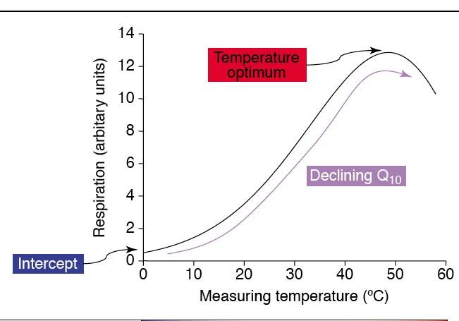
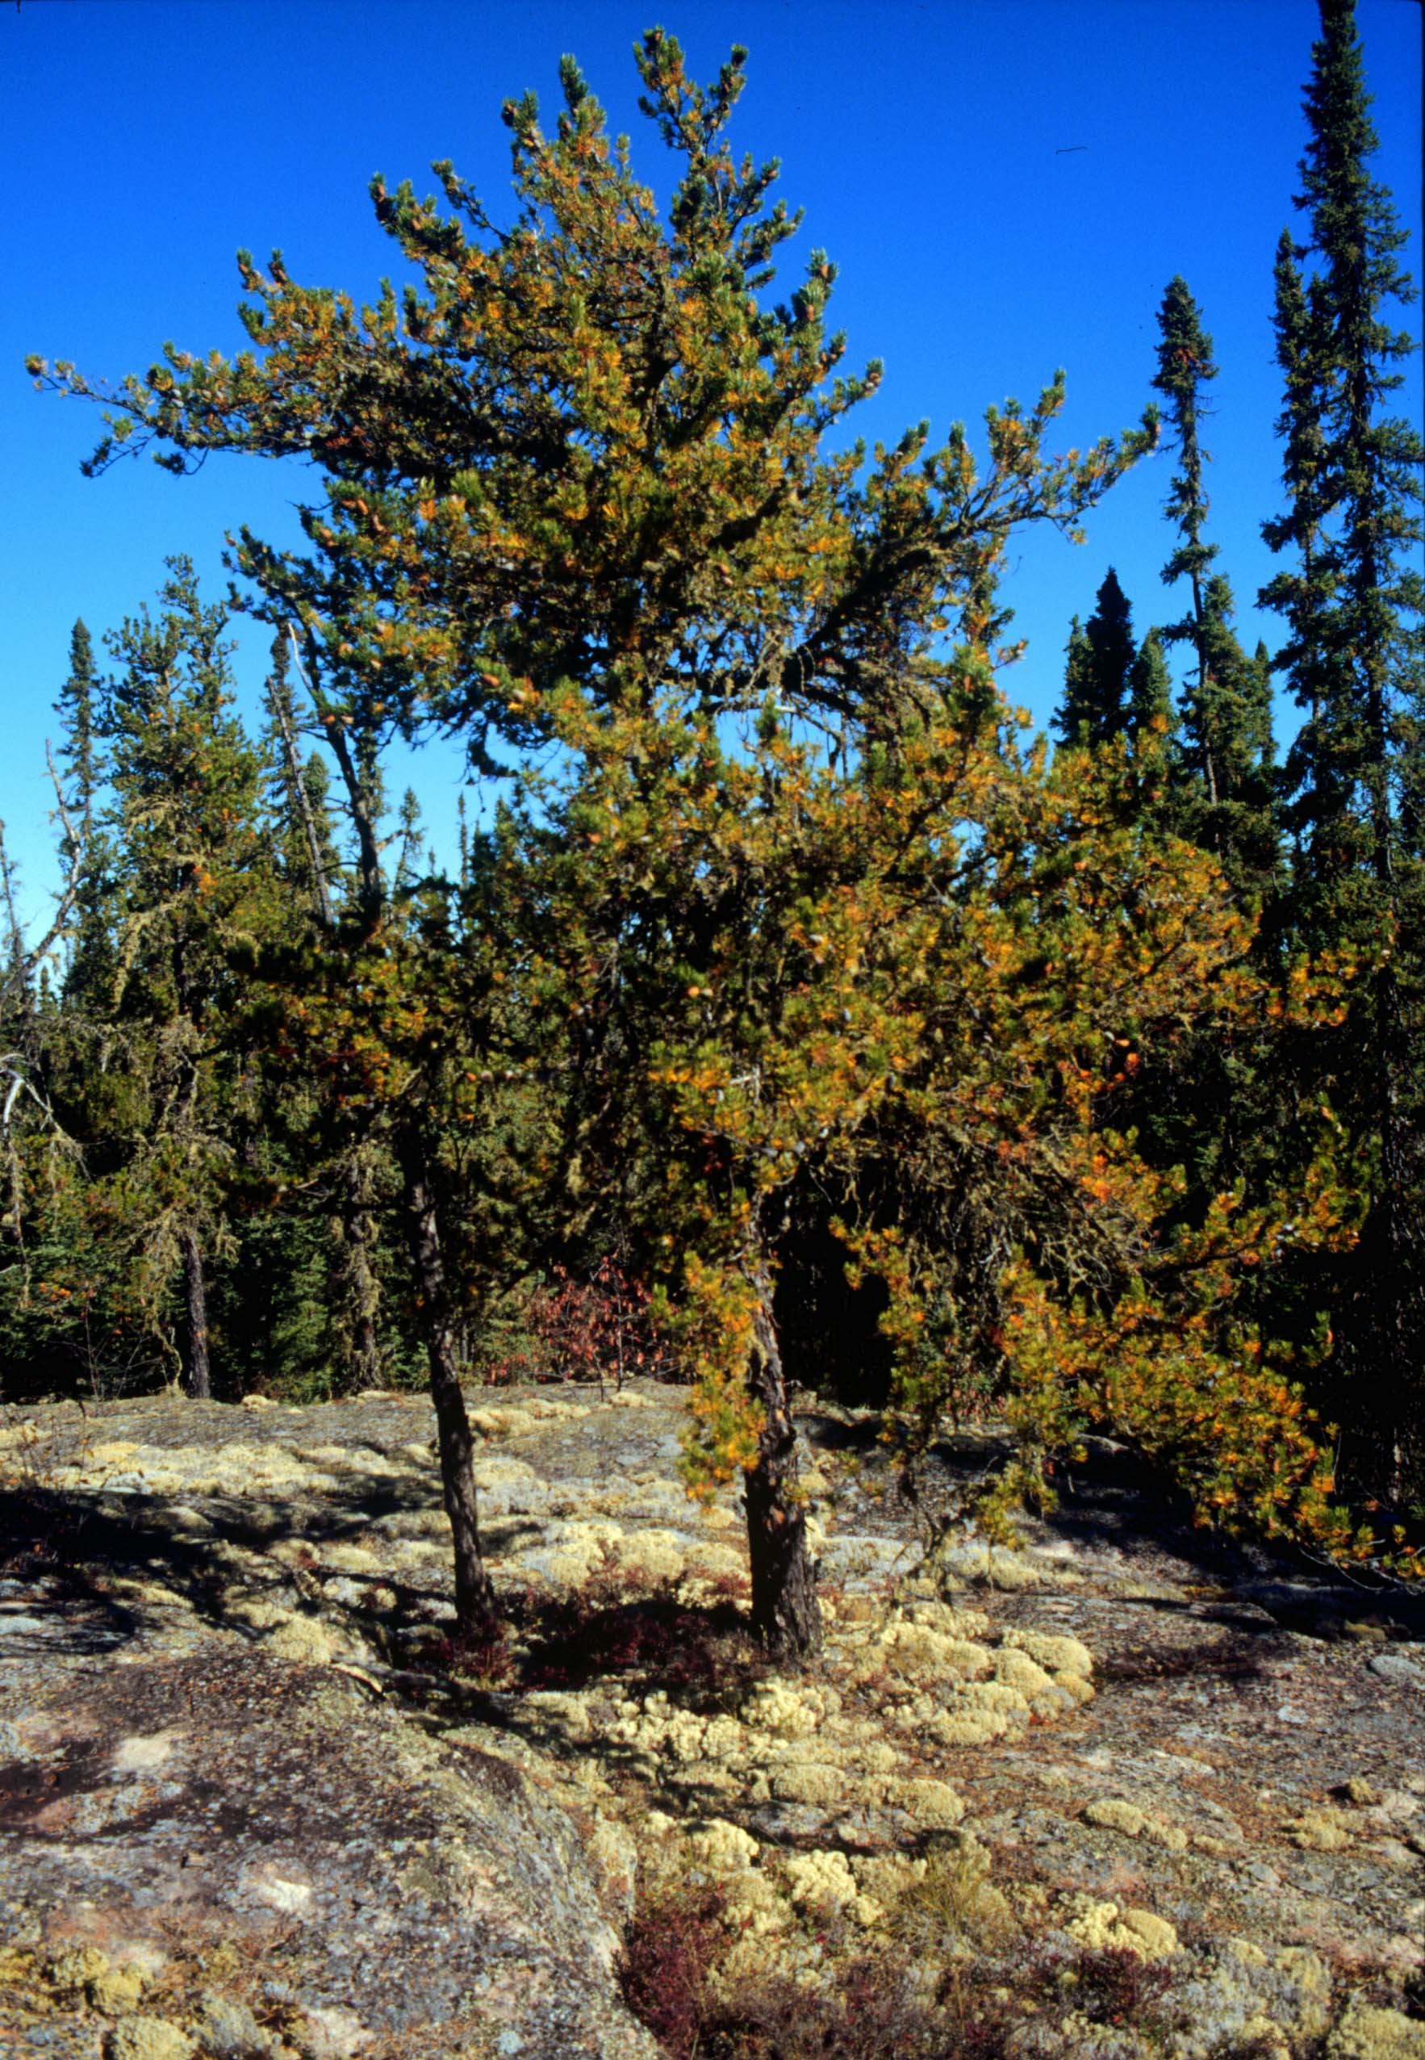




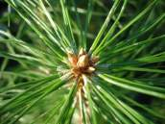

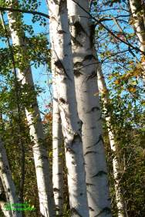
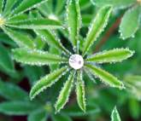

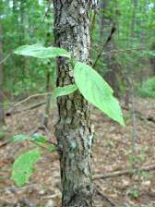

Overview
What is the temperature response of respiration?
What is temperature acclimation of respiration?
How can experiments and observations contribute to modeling efforts?

Slide 6
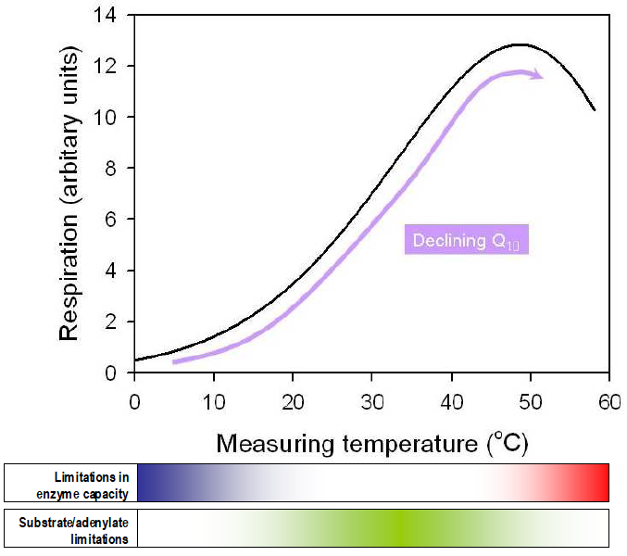
What is the temperature response of respiration?
Atkin & Tjoelker 2003, Trends in Plant Science

Slide 7
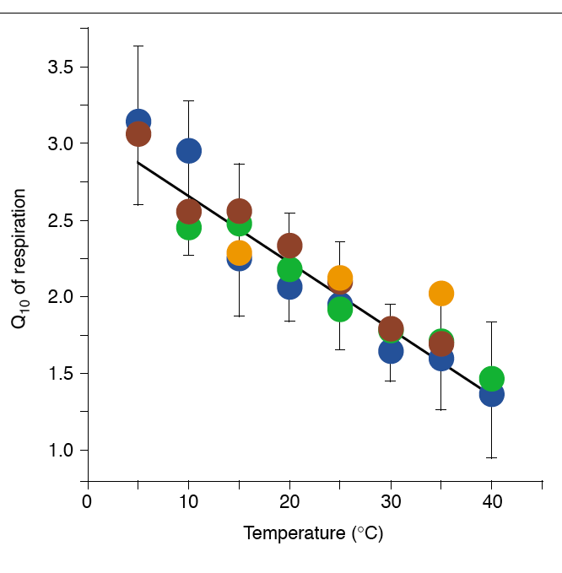
Q₁₀ is dependent upon measurement temperature
Arctic
Boreal
Temperate
Tropical
Global survey
121 species, 23 studies
r² = 0.46, n = 650
Q₁₀ declines linearly with increasing measurement temperature across diverse plant taxa and biomes
Q₁₀ = 3.09 - 0.043T
Tjoelker et al. 2001, Global Change Biology

Slide 8
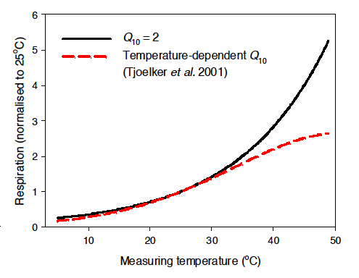
Q₁₀ is dependent upon measurement temperature
Tjoelker et al. 2001, Global Change Biology

Slide 9
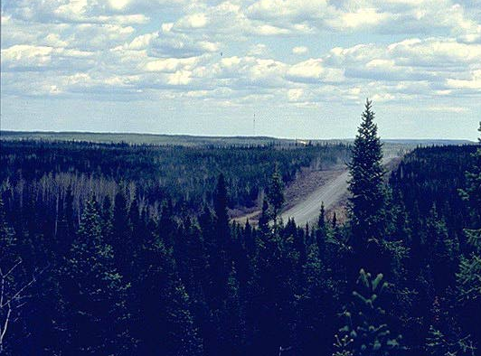
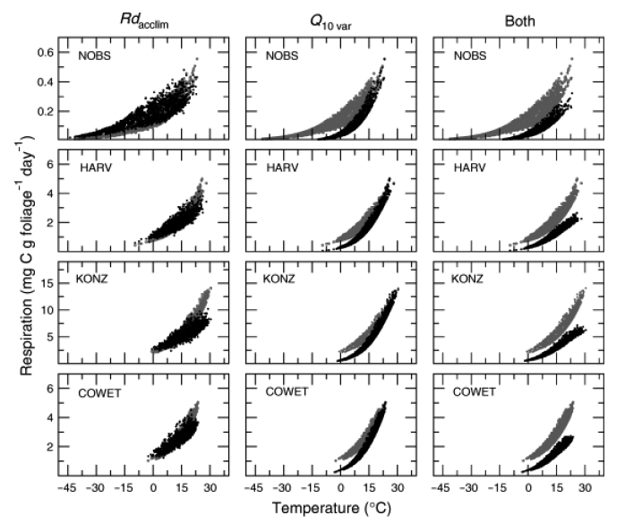
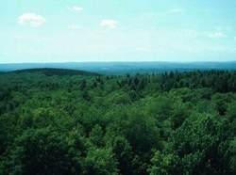
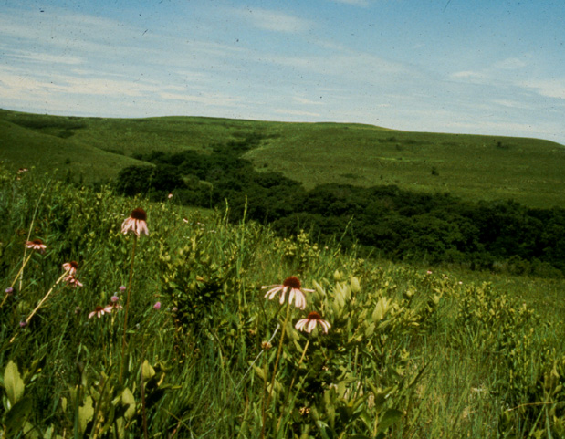
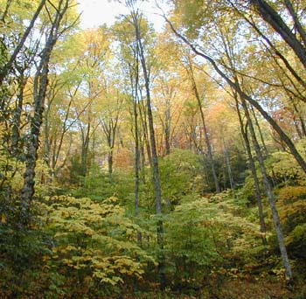
A temperature-sensitive Q₁₀ reduces modeled
respiration
Boreal forest
PnET simulation
Temperate forest
Prairie grassland
Hardwood forest
Temperature-sensitive Q₁₀
Wythers et al. 2005, Global Change Biology

Slide 10
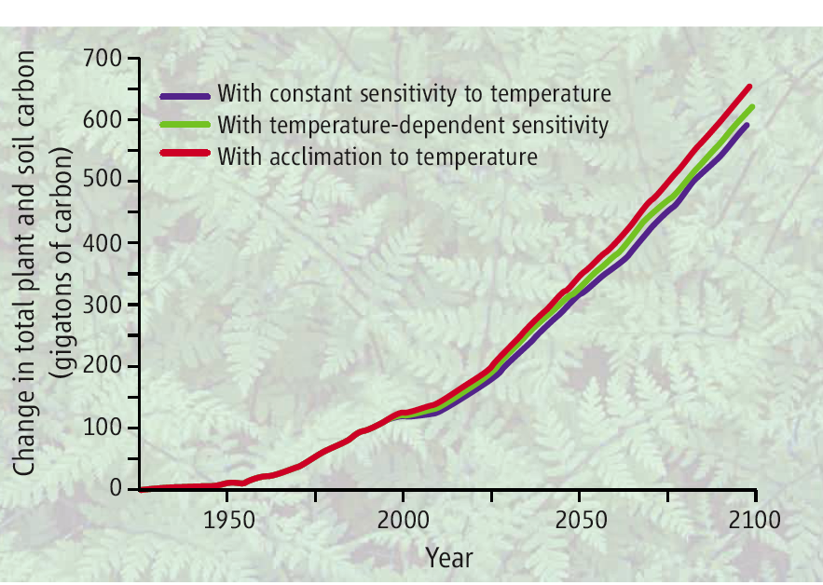
A temperature-dependent Q₁₀ increases global C storage
GTEC 2.0 simulation
King et al. 2006, Science

Slide 11
Summary
The shape of the short-term temperature response function of respiration differs from a simple exponential
A temperature-dependent Q₁₀ alters simulated respiratory C fluxes

Slide 12
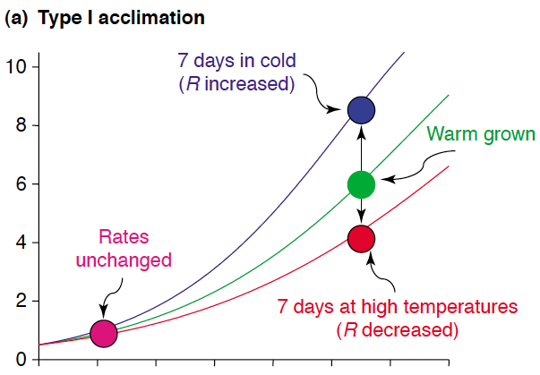
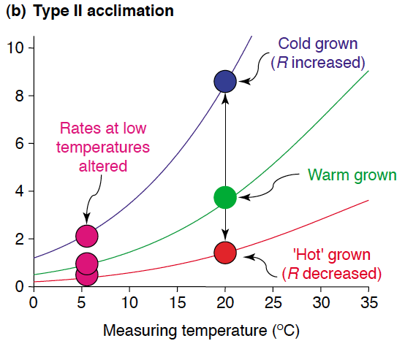

What is temperature acclimation of respiration?
Atkin & Tjoelker 2003, Trends in Plant Science

Slide 13
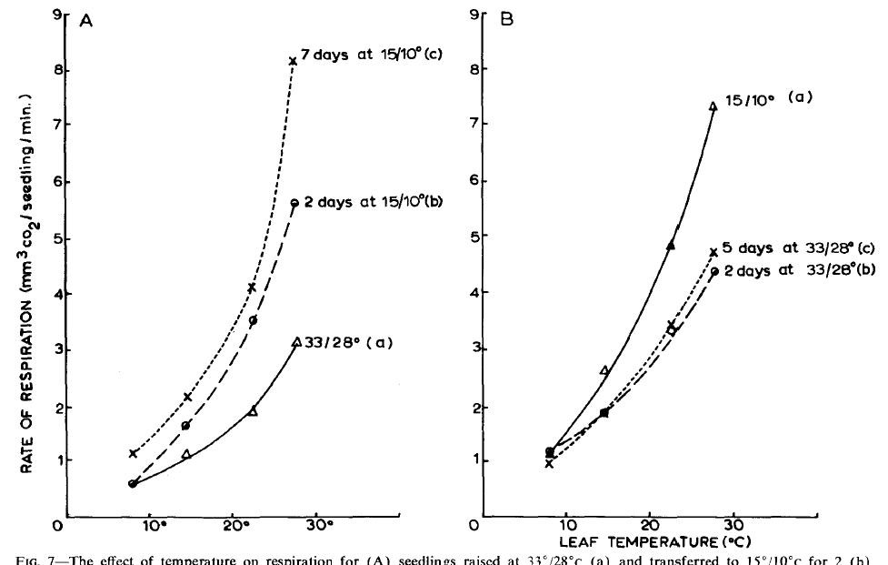
Temperature acclimation is rapid and reversible
Pinus radiata seedling study
Warm transfer
Cold transfer
Rook 1969, New Zealand Journal of Botany

Slide 14
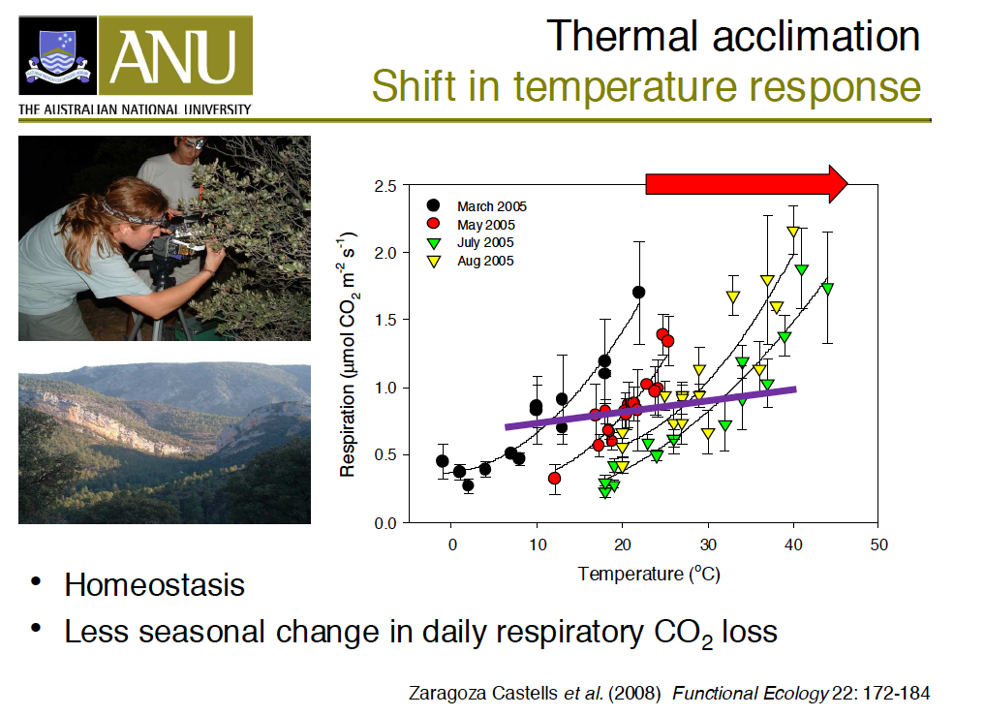
Quercus ilex in Spain

Slide 15
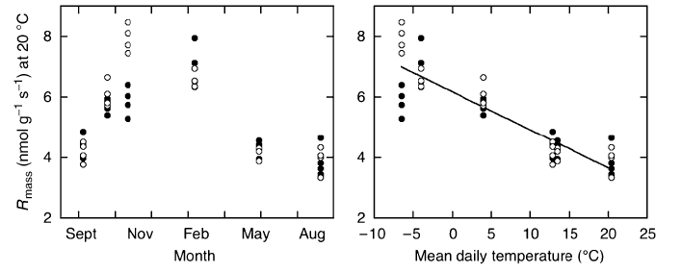
Temperature acclimation in the field
Eight geographically diverse populations of Pinus banksiana grown in northern Minnesota
R_{mass} = 6.18 - 0.125T
r² = 0.80, n = 48
Northern populations
Southern populations
Tjoelker et al. 2008, Global Change Biology

Slide 16
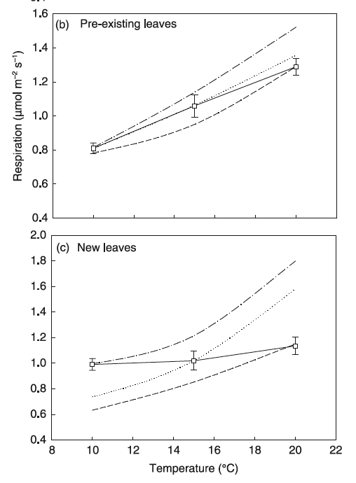
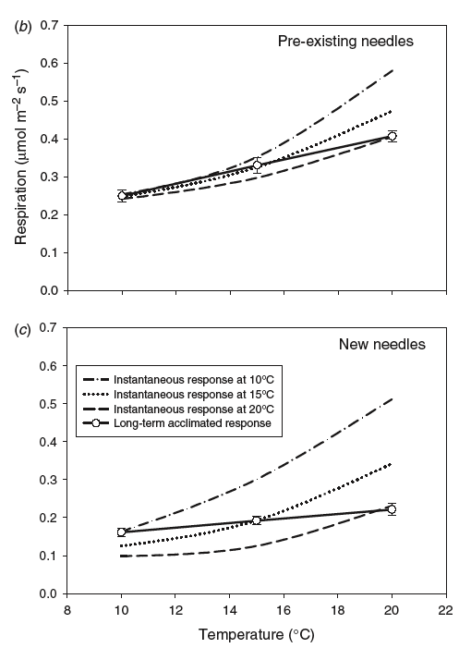
Temperature acclimation: Type I vs Type II
Populus deltoides x nigra
Pinus radiata
Type I
Q₁₀ change
Type II
Intercept change
Homeostasis
Ow et al. 2008, New Phytologist
Ow et al. 2008, Functional Plant Biology

Slide 17
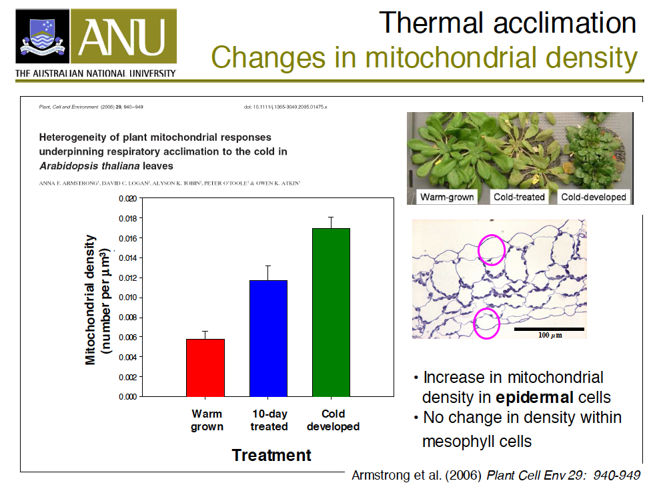

Slide 18
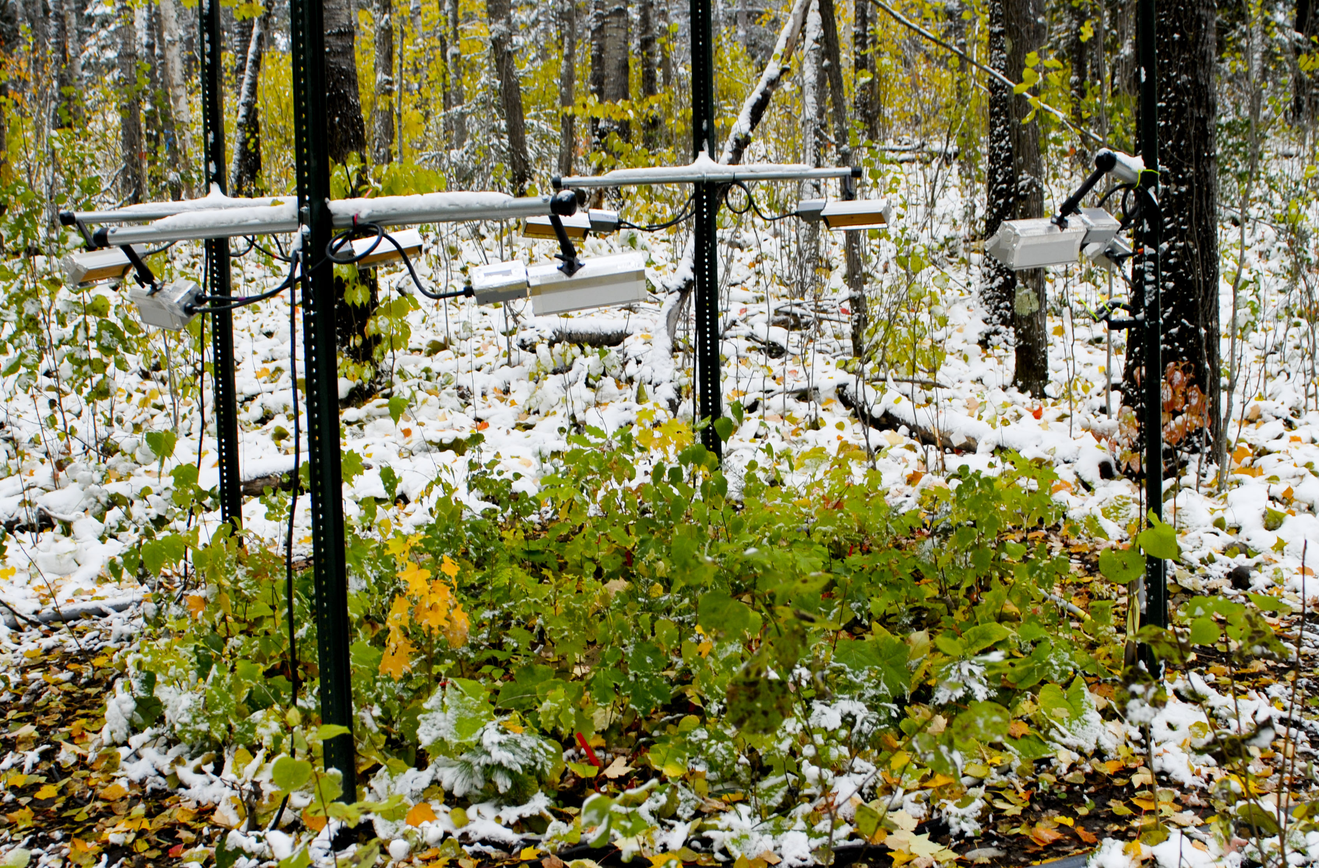
Leaf respiration acclimates under experimental warming in the boreal forest in Minnesota
Trembling aspen
Bur oak
4
ambient treatment
3
ambient treatment
Mean dark respiration (µmol m⁻² s⁻¹)
2
+4 °C treatment
1
+4 °C
treatment
10
20
30
40
10
20
30
40
Leaf temperature (°C)
Courtesy of: Peter B Reich, University of Minnesota

Slide 19
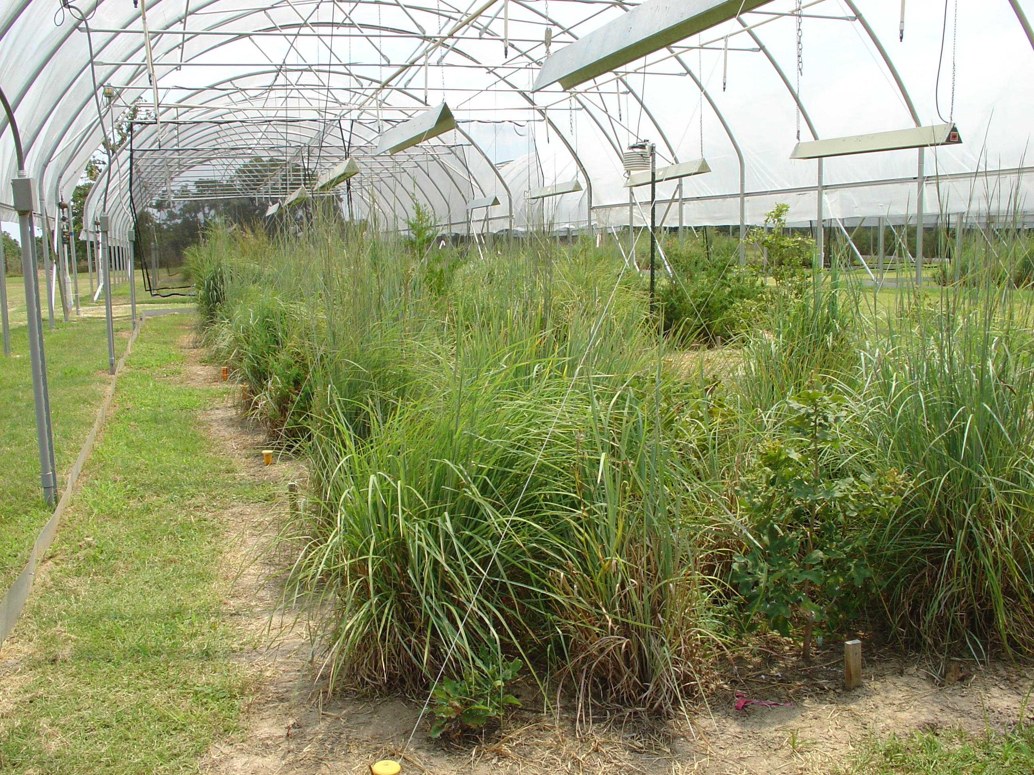
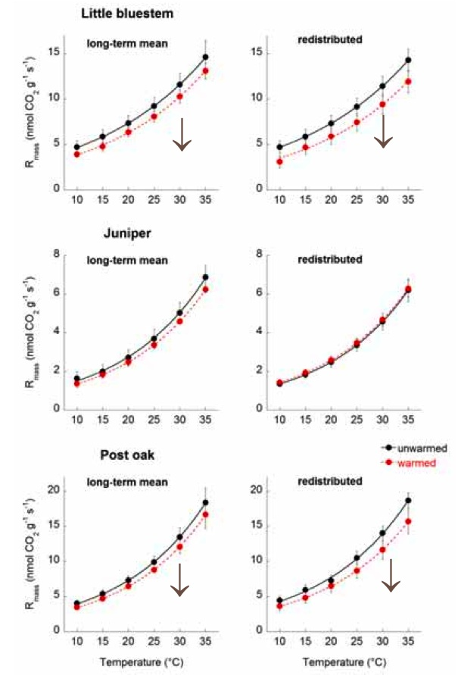
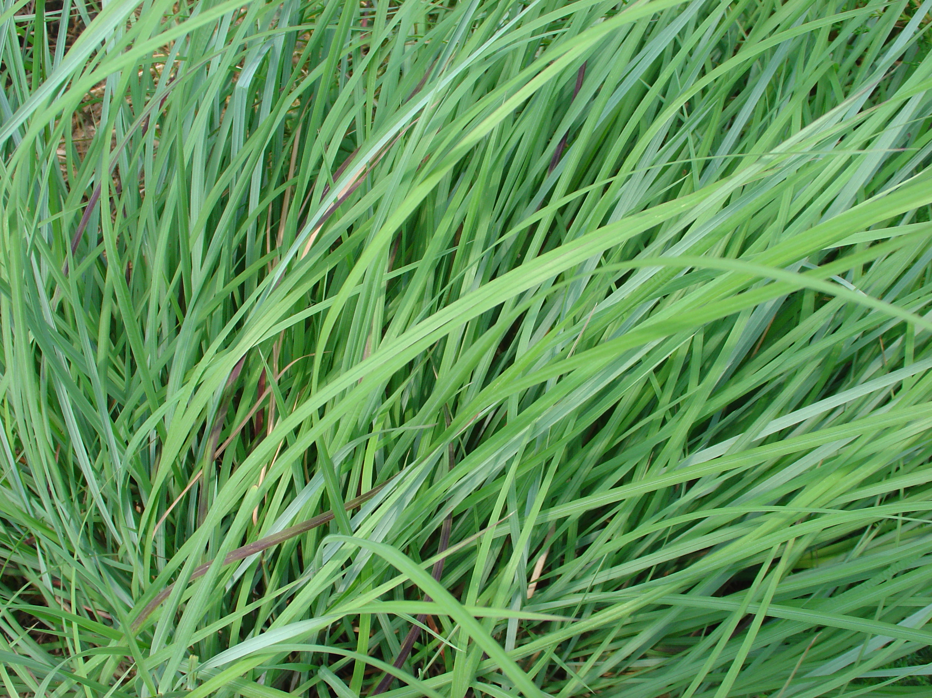
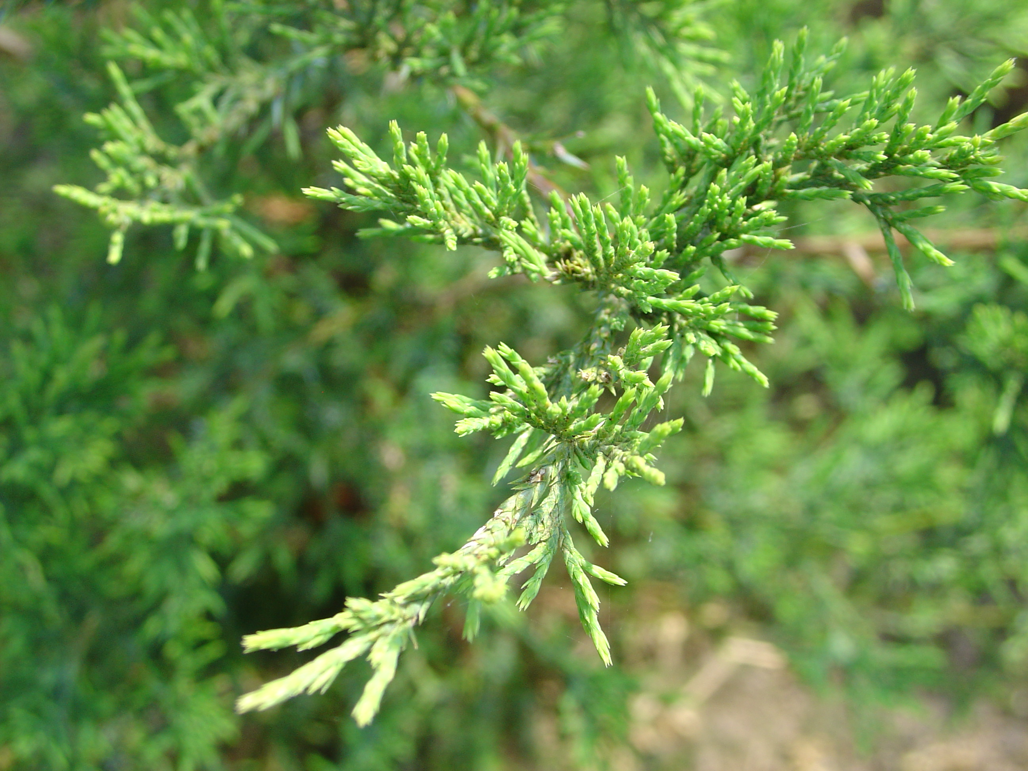
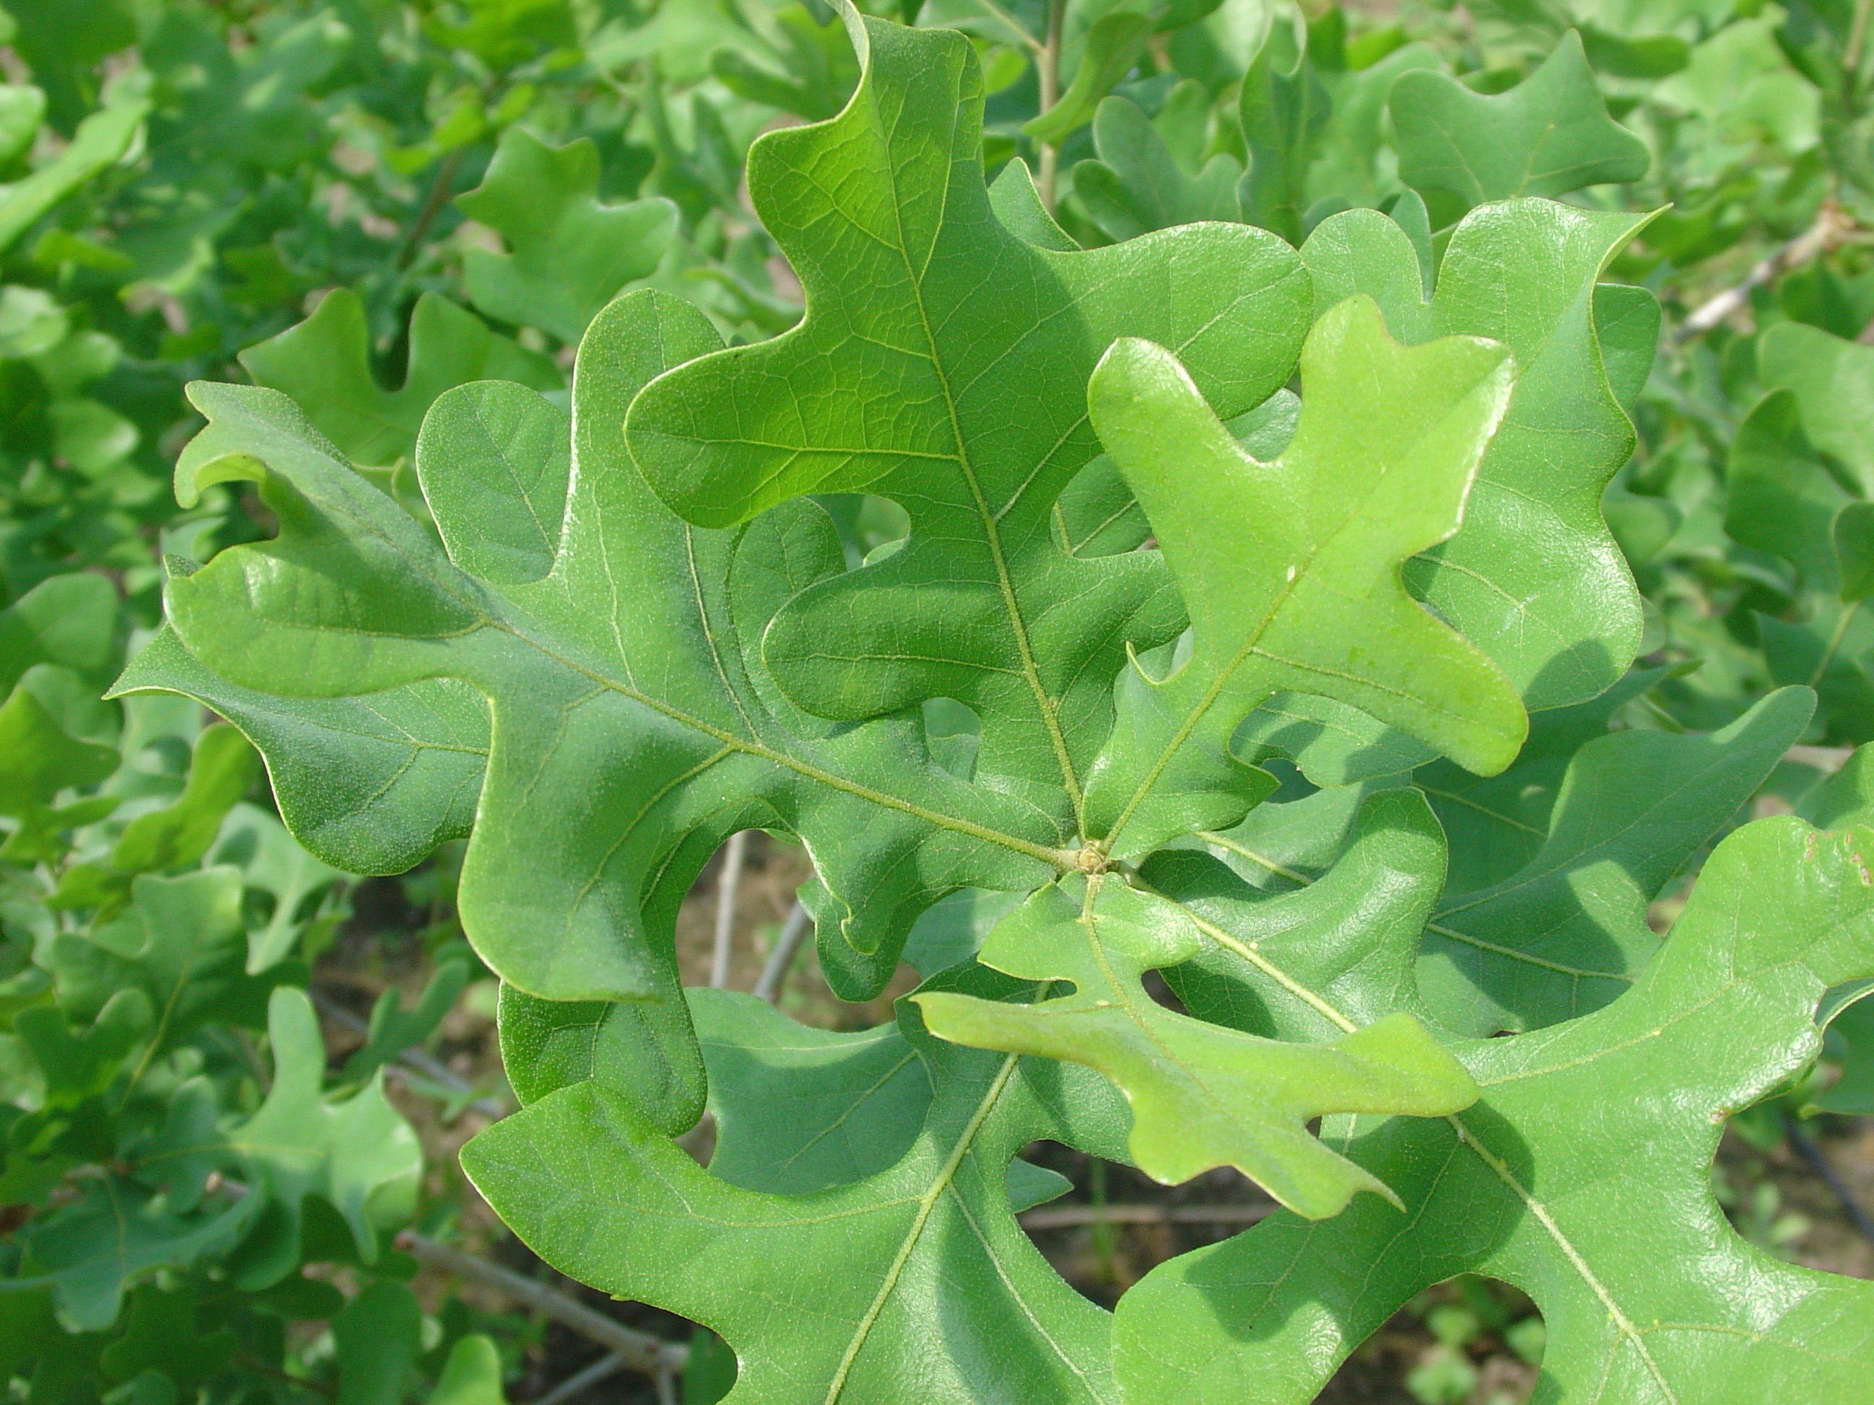


Respiration acclimates under experimental warming in Texas savanna
Schizachyrium scoparium
Texas WaRM experiment (+ 1.5 °C)
Juniperus virginiana
Respiration
(nmol g⁻¹ s⁻¹)
Quercus stellata
Lindgren & Tjoelker, thesis

Slide 20
The degree of acclimation differs among species
Actual increase in respiratory carbon efflux with warming was less than predicted assuming no acclimation
100
80
difference due to acclimation
60
Percent of predicted efflux
40
20
0
red maple
sugar maple
paper birch
bur oak
red oak
aspen
Courtesy of: Peter B Reich, University of Minnesota

Slide 21
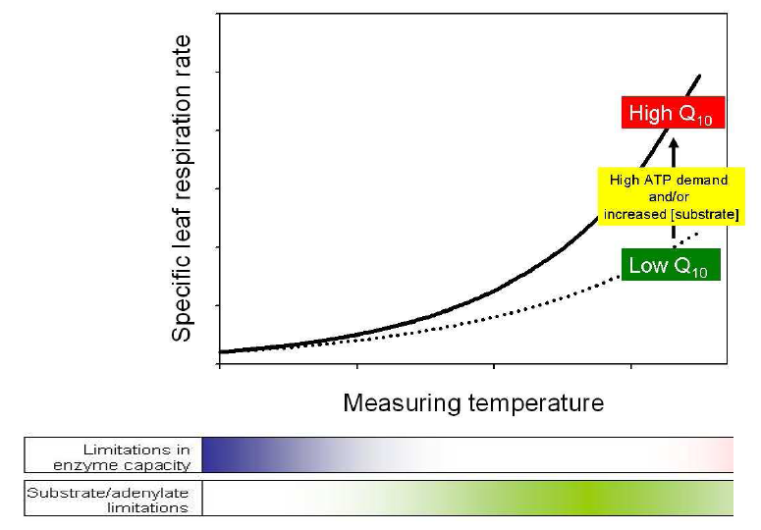
Dynamic variation in Q₁₀ of respiration
Temperature response of plant respiration is highly variable
Regulatory changes likely account for variation in Q₁₀

Slide 22
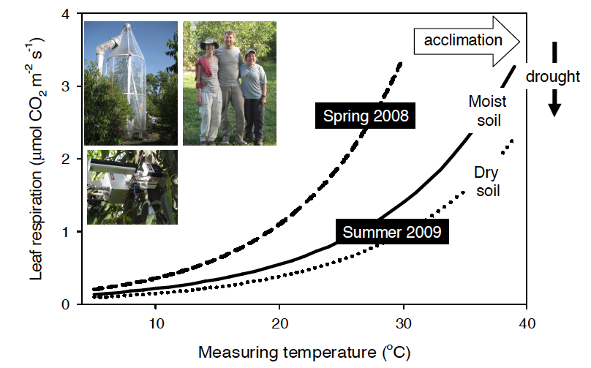
Temperature acclimation is accentuated under drought
Eucalyptus saligna in Australia
Crous et al. 2010, Global Change Biology

Slide 23
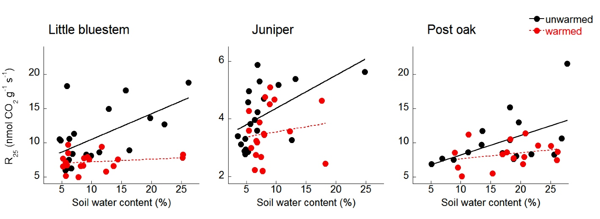
Leaf respiration declines with drought and warming
Texas WaRM experiment, prolonged summer drought
Interacting effects of warming and drought
Consequences for models?
Lindgren & Tjoelker, 2009

Slide 24
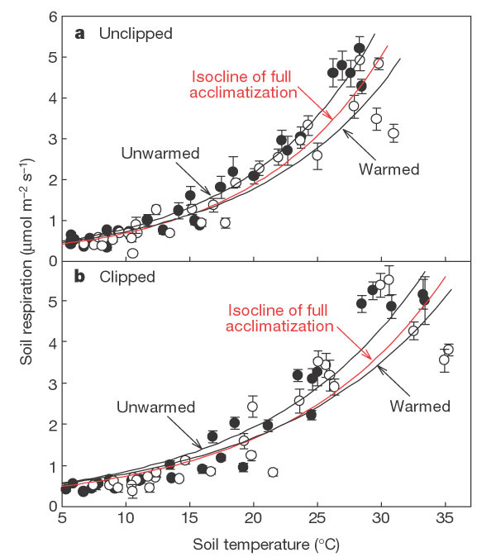
Acclimation of soil respiration to warming
Tall grass prairie warming experiment in Oklahoma
Luo et al. 2001, Nature

Slide 25
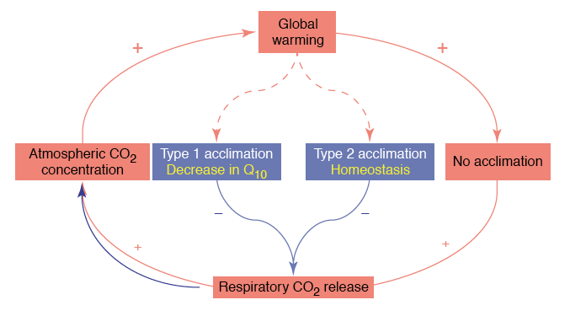
Will climate warming lead to runaway respiration?
Atkin & Tjoelker 2003, Trends in Plant Science

Slide 26
Boreal forest
Temperature acclimation reduces respiration
PnET simulation
Temperate forest
Prairie grassland
Acclimated
Hardwood forest
Temperature (°C)
Wythers et al. 2005, Global Change Biology

Slide 27
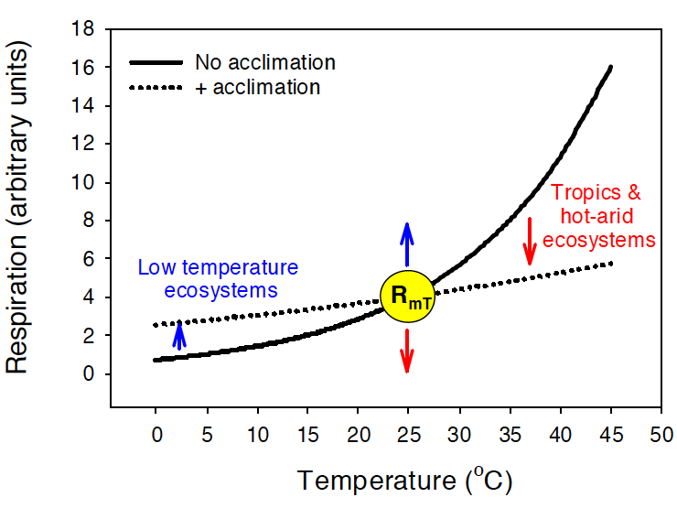
Temperature acclimation of respiration varies globally
Atkin et al. 2008, Global Change Biology

Slide 28
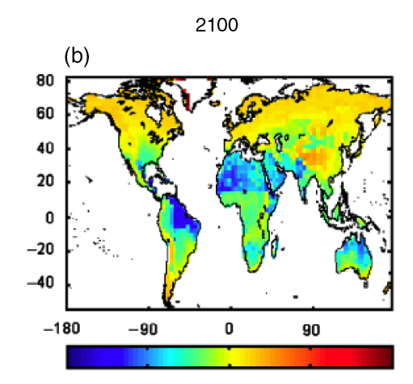

Temperature acclimation of respiration varies globally
Hadley (JULES) simulation
Accounting for acclimation reduces predicted respiration up to 20% in the tropics
Acclimation-dependent change in plant respiration compared to controls (%)
Atkin et al. 2008, Global Change Biology

Slide 29
Temperature acclimation increases global carbon storage
GTEC 2.0 simulation
King et al. 2006, Science

Slide 30
Conclusions and implications
The temperature sensitivity (Q₁₀) of respiration matters.
Short-term temperature response functions differ from long-term temperature responses, owing to temperature acclimation.
Temperature acclimation of respiration is dynamic.
Type 1 acclimation (Q₁₀) underpinned by changes in substrate and/or energy demand.
Type 2 acclimation (shifts in elevation) linked to development.
Temperature acclimation of plants and soils may constrain respiratory carbon fluxes, resulting in a negative feedback on the global carbon cycle.

Slide 31
Overview
What is the temperature response of respiration?
What is temperature acclimation of respiration?
How can experiments and observations contribute to modeling efforts?

Slide 33
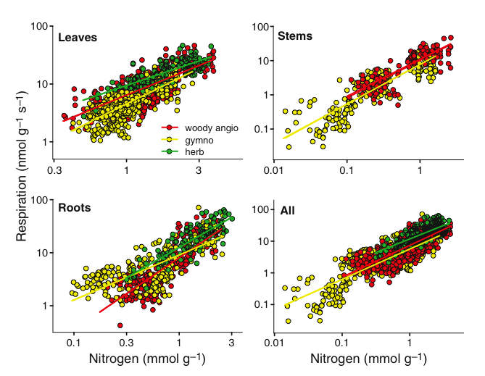
Comparing leaf, stem, and root respiration
287 species worldwide, 2510 measurements
Reich et al. 2008, Ecology Letters

Slide 34
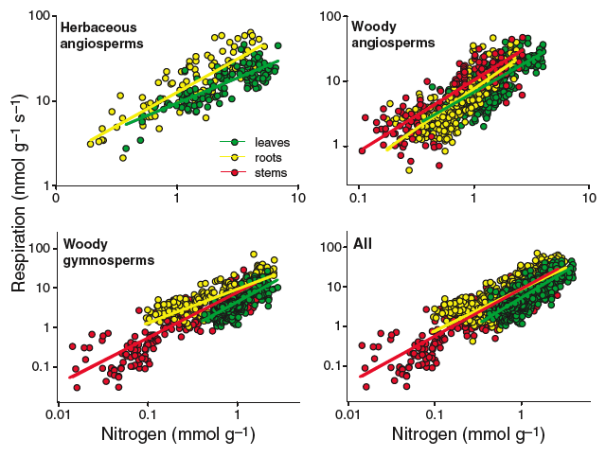
Comparing leaf, stem, and root respiration
287 species worldwide, 2510 measurements
Reich et al. 2008, Ecology Letters

Slide 35
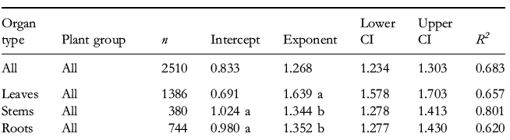
Leaves differ from stems and roots in respiration-N scaling relationships
287 species worldwide, 2510 measurements
Scaling relationships are expressed as the log-log form of the equation: Y = Y₀M^{b}
Reduced major axis intercepts and slopes (exponents) are shown

Slide 36
Field-based evidence of acclimation of root respiration to temperature
Harvard Forest soil warming study
Unwarmed soils
Warmed soils
(ambient + 5°C)
Intercepts differ, P < 0.001
Burton et al. 2008, Journal of Integrative Plant Biology

Slide 37
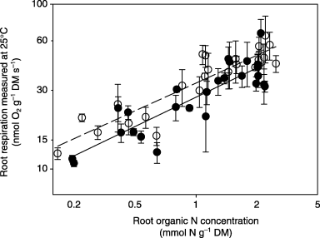
Does temperature acclimation alters R vs. N scaling in roots and leaves?
Five herbaceous species
Controlled environment study
Cold-grown 13/8 °C
Warm-grown 25/20 °C
Atkinson et al. 2006, New Phytologist

Slide 38
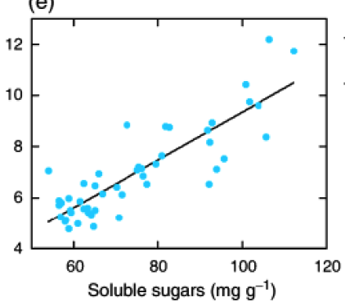
Is variation in respiration per unit N explained by soluble sugar contents?
Leaf respiration
Field study
r² = 0.74, n = 48
R
Nitrogen-based at 20 °C
(µmol mol N⁻¹s⁻¹)
Pinus banksiana
Seasonal variation among eight populations
Evidence for substrate supply and/or adenylate demand limitation
Tjoelker et al. 2008, Global Change Biology

Slide 39
Summary
Respiration of plant parts scale with nitrogen content in an organ-specific manner.
Temperature acclimation alters respiration-nitrogen scaling relationships.
Plant traits such as nitrogen show promise as predictors of respiratory fluxes across large spatial and temporal scales.
Trait-based scaling relationships can inform models, particularly physiology-based process models of biogeochemistry and global change.

Slide 40


Owen Atkin
Australian National University
Peter B Reich,
University of Minnesota
Jacek Oleksyn,
Polish Academy of Sciences
David D. Briske
Astrid Volder
Kourtnee M. Lindgren
Texas A&M University
US National Science Foundation
US Department of Energy, National Institute for Climatic Change Research
Texas A&M University, AgriLife Research
Texas Warming and Rainfall Manipulation Experiment (WaRM)

