Slide 1
Impact of Changes in Atmospheric Composition on Land Carbon Storage: Processes, Metrics and Constraints
Peter Cox
(University of Exeter)
Chris Huntingford, Lina Mercado (CEH),
Stephen Sitch (Leeds Uni.),
Nic Gedney (Met Office)

Slide 2
Turning Noise into Signal:
Using Temporal Variability as a Constraint on Feedbacks
..using model spread
to our advantage…

Slide 3
An Example from Climate Science
IPCC 2007

Slide 4
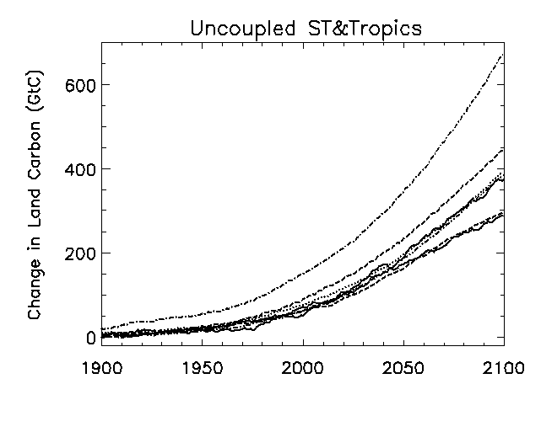
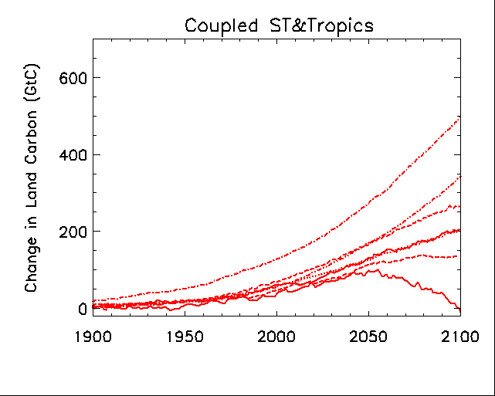
Uncertainty in Future Land
Carbon Storage in Tropics (30ºN-30ºS)
C⁴MIP Models (Friedlingstein et al., 2006)
Models without
climate affects on Carbon Cycle
Models with
climate affects on Carbon Cycle
ΔC_{L} = β. ΔCO₂
ΔC_{L} = β. ΔCO₂ + γ. ΔT_{L}

Slide 5
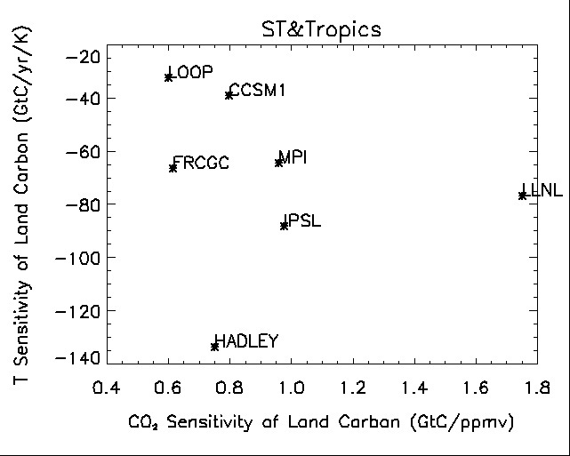
Uncertainty in Future Land
Carbon Storage in Tropics (30ºN-30ºS)
C⁴MIP Models (Friedlingstein et al., 2006)
γ
TROPICS becomes a
Strong CO₂ Sink
Factor of 4 Uncertainty in Climate
Sensitivity of Tropical Land Carbon
TROPICS become a
CO₂ Source
β

Slide 6
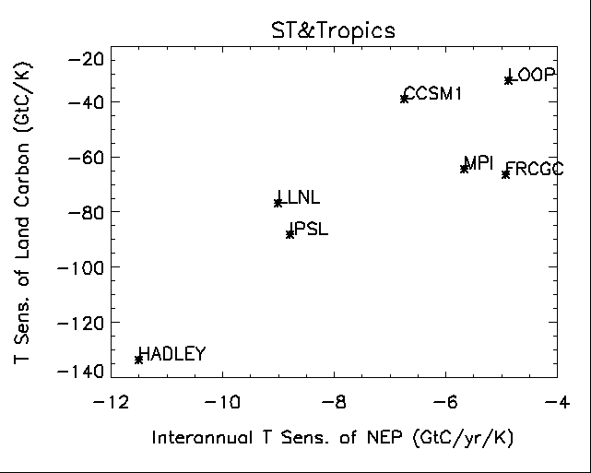
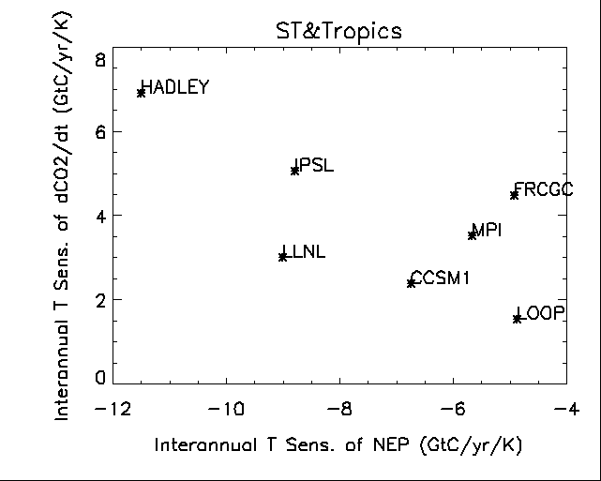
Uncertainty in Future Land
Carbon Storage in Tropics (30ºN-30ºS)
C⁴MIP Models (Friedlingstein et al., 2006)
T sensitivity of land carbon related
to sensitivity of NEP to T variability
Sensitivity of NEP to T variability related
to variability in CO₂ growth-rate

Slide 7
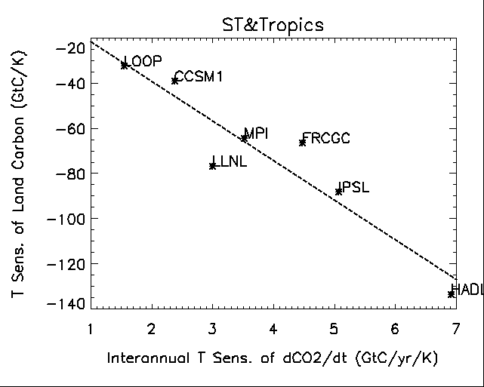
Climate Sensitivity of Land Carbon in Tropics (30ºN-30ºS) related to
Interannual Variability in CO₂ growth-rate
C⁴MIP Models (Friedlingstein et al., 2006)

Slide 8
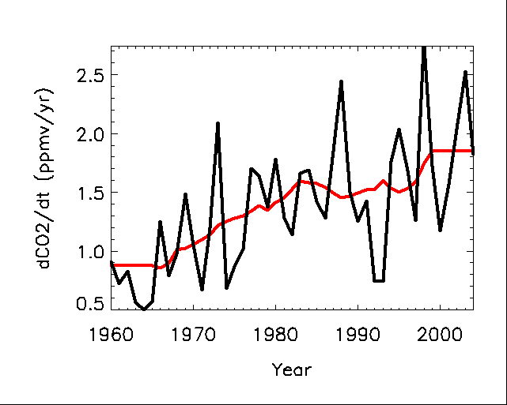
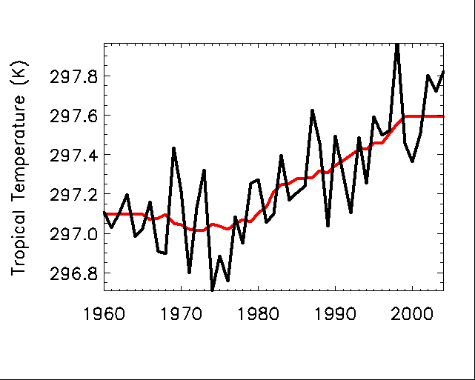
Constraints from Observed
Interannual Variability
CO₂ Growth-rate at Mauna Loa
Mean Temperature 30ºN-30ºS

Slide 9
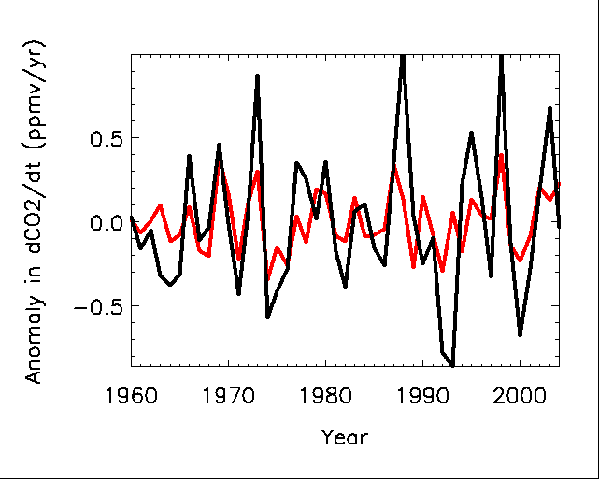
Constraints from Observed
Interannual Variability
CO₂ Growth-rate at Mauna Loa
Mean Temperature 30ºN-30ºS

Slide 10
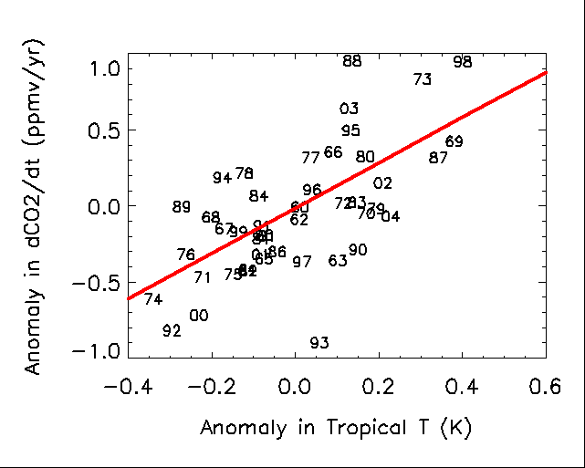
Constraints from Observed
Interannual Variability
dCO₂/dt (GtC/yr) = 3.15+/-0.56 dT (K)

Slide 11
Climate Sensitivity of Land Carbon in Tropics (30ºN-30ºS) related to
Interannual Variability in CO₂ growth-rate
C⁴MIP Models (Friedlingstein et al., 2006)
Observational Constraint on T Sensitivity
of Tropical Land Carbon
Variability from Mauna Loa

Slide 12
Land Carbon Dynamics are affected by much more than Climate and CO₂
…climate change is much more than radiative forcing……..
…comparing the impacts of changes in atmospheric composition on Land Carbon..

Slide 13
Rationale
The impacts of different atmospheric pollutants on climate are typically compared in terms of Radiative Forcing or Global Warming Potential

Slide 14
Direct Climate Forcing by GHGs and Aerosols
CLIMATE
Radiative
Forcing
GHGs & AEROSOLS
Anthropogenic
Emissions

Slide 15
Radiative Forcing of Climate 1750-2005
Ignores differing impacts of pollutants on ecosystem function
IPCC 2007

Slide 16
Rationale
The impacts of different atmospheric pollutants on climate are typically compared in terms of Radiative Forcing or Global Warming Potential
But the Land Carbon Cycle is affected directly by many atmospheric pollutants, as well as indirectly via the impact of these pollutants on climate change.
How do the Physiological Impacts of different pollutants vary ?

Slide 17
Physiological Effects on Ecosystem Services
and Indirect Climate Forcing
CLIMATE
Indirect Radiative
Forcing
Greenhouse
Effect
CO₂
Change in
Land Carbon
Storage
GHGs & AEROSOLS
Physiological
Impacts
LAND
ECOSYSTEMS
Anthropogenic
Emissions
Food
Water
Ecosystem Services

Slide 18
Physiological Effects of
Atmospheric Pollutants
CO₂ Fertilization Effects - increasing CO₂ →
Enhancement of Net Primary Productivity (depends on nutrients)

Slide 19
CO₂ Fertilization of NPP
(FACE Experiments)
Norby et al. 2005
at 550 ppmv
at 376 ppmv

Slide 20
Dynamic Global Vegetation Models agree on NPP increase in 20th Century !
25% Increase
Outstanding issue : how will nutrient availability limit CO₂ fertilization ??

Slide 21
Physiological Effects of
Atmospheric Pollutants
CO₂ Fertilization Effects - increasing CO₂ →
Enhancement of Net Primary Productivity (depends on nutrients)
CO₂ induced Stomatal Closure (leading to higher Runoff?)

Slide 22
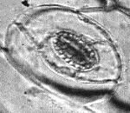
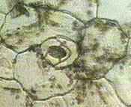
Stomata are pores on plant leaves (typical dimension 10-100 x 10⁻⁶ m), which open and close in response to environmental stimuli, allowing carbon dioxide in (to be fixed during photosynthesis) and water vapour out (forming the transpiration flux).
Stomata : Linking Water and CO₂
Source: Mike Morgan (www.micscape.simplenet.com/mag/arcticles/stomata.html)

Slide 23
Physiological Effects of
Atmospheric Pollutants
CO₂ Fertilization Effects - increasing CO₂ →
Enhancement of Net Primary Productivity (depends on nutrients)
CO₂ induced Stomatal Closure (leading to higher Runoff?)
Increase in Water Use Efficiency

Slide 24
Partitioning of Water on Land
Precipitation
Evaporation
Transpiration
River Runoff
Groundwater Recharge

Slide 25
Attribution of Trend in Global Runoff to Forcing Factors
…CO₂ effect on water use efficiency detected at the global scale...?
Gedney et al., 2006

Slide 26
Physiological Effects of
Atmospheric Pollutants
CO₂ Fertilization Effects - increasing CO₂ →
Enhancement of Net Primary Productivity (depends on nutrients)
CO₂ induced Stomatal Closure (leading to higher Runoff?)
Increase in Water Use Efficiency
Diffuse Radiation Fertilization - increasing aerosols →
Reduces sunlight reaching the surface reducing NPP
Increases ‘diffuse fraction’ of sunlight increasing NPP
Overall plants like it hazy…..

Slide 28
Diffuse Radiation Fertilization
Sunflecks – Light-saturated
Rate of Photosynthesis
Leaves in Diffuse Sunlight
– More Light-Use Efficient
Shaded Leaves – Light-limited
Incident Sunlight

Slide 29
Mercado et al., 2009

Slide 30
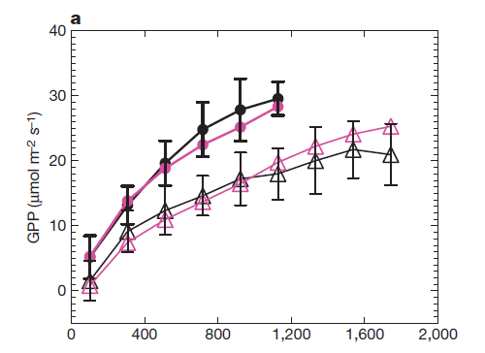
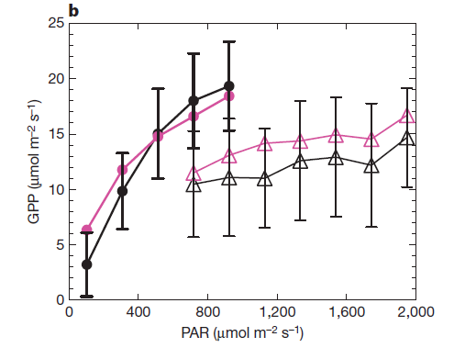
Diffuse vs. Direct Light-Response Curves:
Model & Observations
MODIFIED JULES MODEL, OBSERVATIONS
Broadleaf Tree (Hainich)
Needleleaf Tree (Wetzstein)
Diffuse PAR
Direct PAR

Slide 31
Impact of Diffuse PAR on the
20th Century
Land Carbon Sink
Pinatubo
25% enhancement of
1960-1999 land carbon sink
by variations in diffuse
radiation
Partial offset by reductions
in Total PAR

Slide 32
Physiological Effects of
Atmospheric Pollutants
CO₂ Fertilization Effects - increasing CO₂ →
Enhancement of Net Primary Productivity (depends on nutrients)
CO₂ induced Stomatal Closure (leading to higher Runoff?)
Increase in Water Use Efficiency
Diffuse Radiation Fertilization - increasing aerosols →
Reduces sunlight reaching the surface reducing NPP
Increases ‘diffuse fraction’ of sunlight increasing NPP
Overall plants like it hazy…..
O₃ Damage to plants – increases in ground-level ozone →
Reduced NPP
Reduced Stomatal Conductance (increasing Runoff)
Damage to photosynthetic machinery

Slide 33
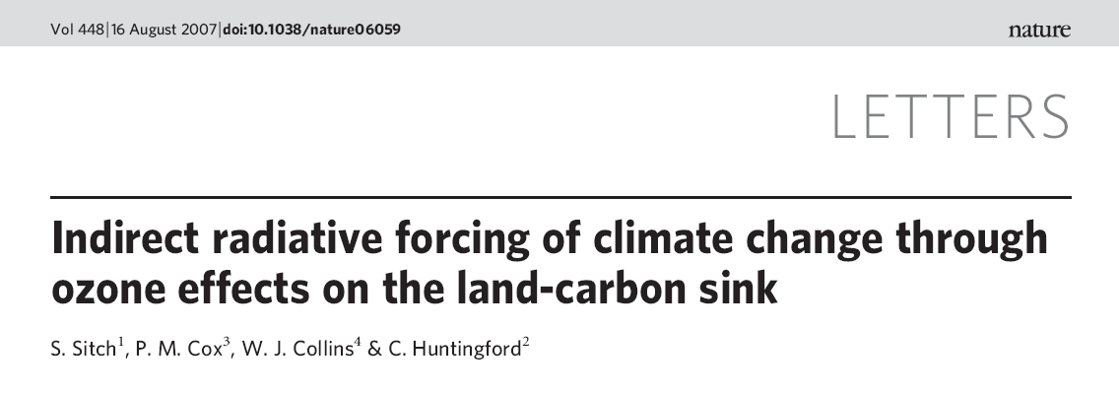
Sitch et al., 2007

Slide 34
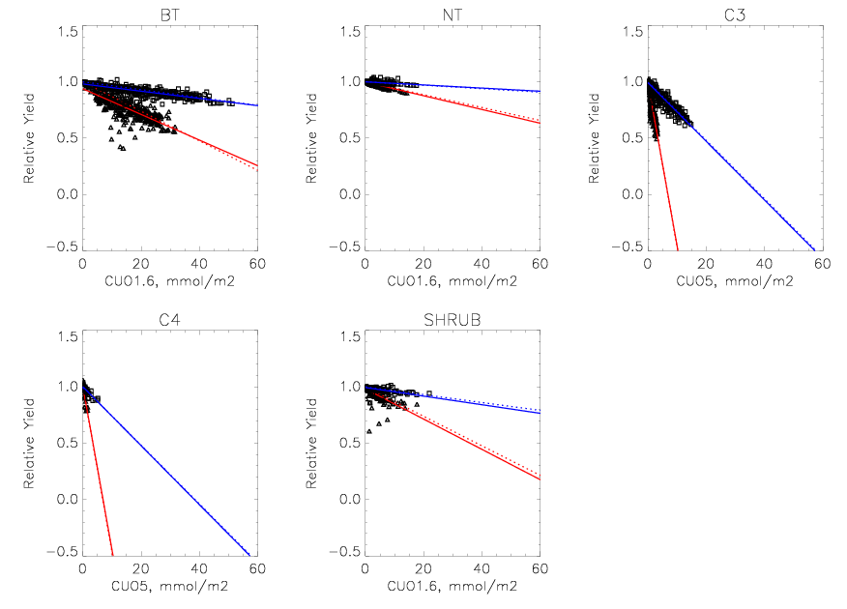
“High” and “Low” Plant Ozone Sensitivities
MOSES
Sensitivity
“High”
“Low”
Observations
(Pleijel et al., 2004; Karlson et al., 2004)

Slide 35
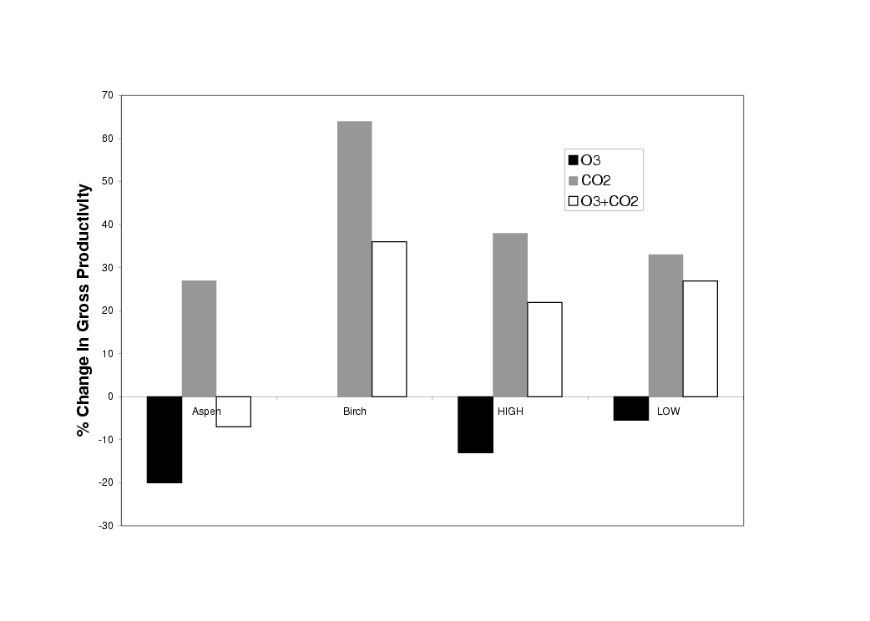
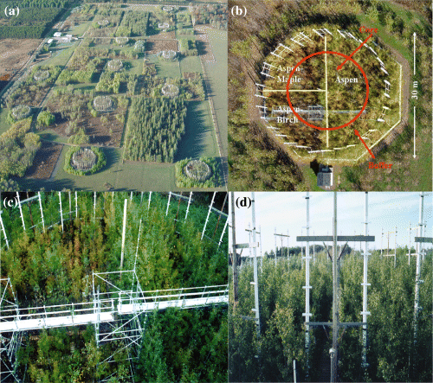
Evaluation Against FACE experimental data
Measurements (Amax)
Model (GPP)
Karnosky et al. 2005, PCE 28, 965-981

Slide 36
How can we compare overall impacts of different Pollutants?
Consider physiological effects of a concentration change of each pollutant equivalent to +1 W m⁻² of direct radiative forcing.
Use IMOGEN/MOSES model to estimate physiological impacts on:
Net Primary Productivity (which is related to crop yield)
River Runoff (related to freshwater availability)
Land carbon storage (implies change in atmospheric CO₂)
Compare to impacts +1 W m⁻² of climate change alone.

Slide 37
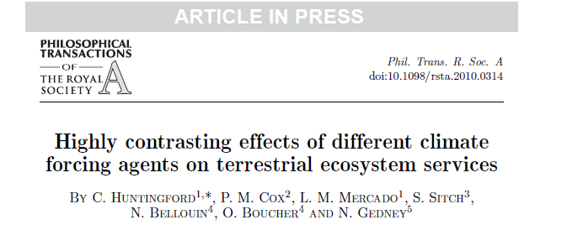

Slide 38
Physiological Effects on Ecosystem Services
GHGs & AEROSOLS
Physiological
Effects
LAND
ECOSYSTEMS
Anthropogenic
Emissions
Food
Water
Ecosystem Services

Slide 39
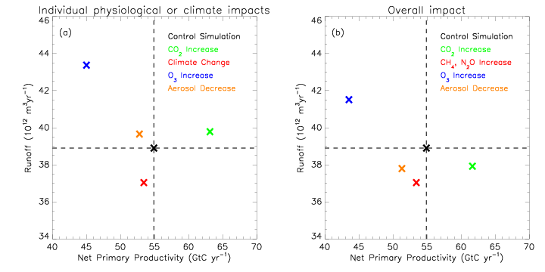
Contrasting Impacts on NPP and Runoff
Can the combination of Carbon and Water Changes
tell us the causes of those changes?

Slide 40
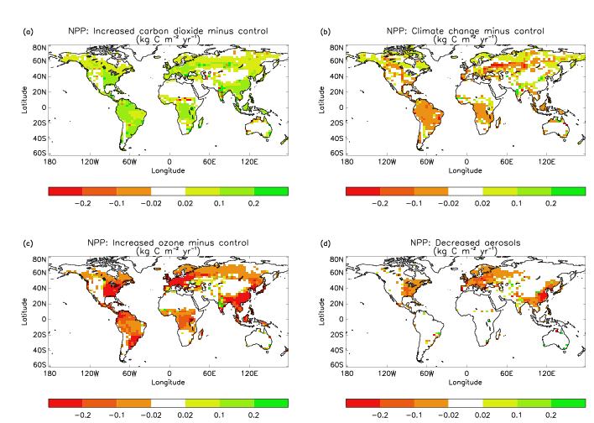
Contrasting Climate & Physiological
Impacts on NPP
CO₂ Physiology Only
Climate Change Only
O₃ Physiology Only
-Aerosol Physiology Only

Slide 41
Indirect Climate Forcing
CLIMATE
Indirect Radiative
Forcing
Greenhouse
Effect
CO₂
Change in
Land Carbon
Storage
GHGs & AEROSOLS
Physiological
Effects
LAND
ECOSYSTEMS
Anthropogenic
Emissions

Slide 42
Impact on Land Carbon Storage of +1 W m⁻²
and Total Effective Radiative Forcing
O₃
Land C
RF
CO₂
AERO
CH₄
CO₂
CH₄
AERO
O₃
Land Carbon Radiative Forcing is extra radiative forcing due to released land carbon
relative to CO₂
(assuming an Airborne Fraction of 0.5)

Slide 43
Conclusions
The Land Carbon Cycle is affected physiologically by many atmospheric pollutants, as well as via the impact of these pollutants on climate change.
The Physiological Impacts of different atmospheric pollutants on land ecosystem services vary radically, and are often larger than the impacts of climate change alone.
Current global models suggest that CO₂ fertilization will increase land carbon storage, whereas climate change alone will tend to reduce it. Reductions in aerosols or increases in ground-level O₃ would have even more negative impacts on land carbon storage.
There are significant uncertainties in the size of each of these effects. These uncertainties matter for Earth System Models and also climate policy.
In some cases the spread in global model results, reveals an across-model relationship between some “observable” (e.g. Interannual variability in CO2) and something we would like to predict (e.g. Climate sensitivity of tropical land carbon).

