Slide 1

Modeling Nutrient Limitation: Ecosystem Consequences of Resource Optimization
Nature should weed out sub-optimal strategies of acquiring resources from the environment
E.B. Rastetter
The Ecosystems Center
Marine Biological Laboratory
Woods Hole, MA 02543
Captiva Island Meeting
March 2011

Slide 2
Strategies for modeling resource acquisition:
Uncoupled:
U₁ = g B f(R₁) f(T)
Liebig Limitation:
U₁ = g B min{f(R₁), f(R₂), f(R₃)...} f(T)
U₂ = q₂ U₁
U₃ = q₃ U₁
.
.
.
Concurrent Limitation:
U₁ = g B {f(R₁) f(R₂) f(R₃)...} f(T)
U₂ = q₂ U₁
U₃ = q₃ U₁
.
.
.

Slide 3
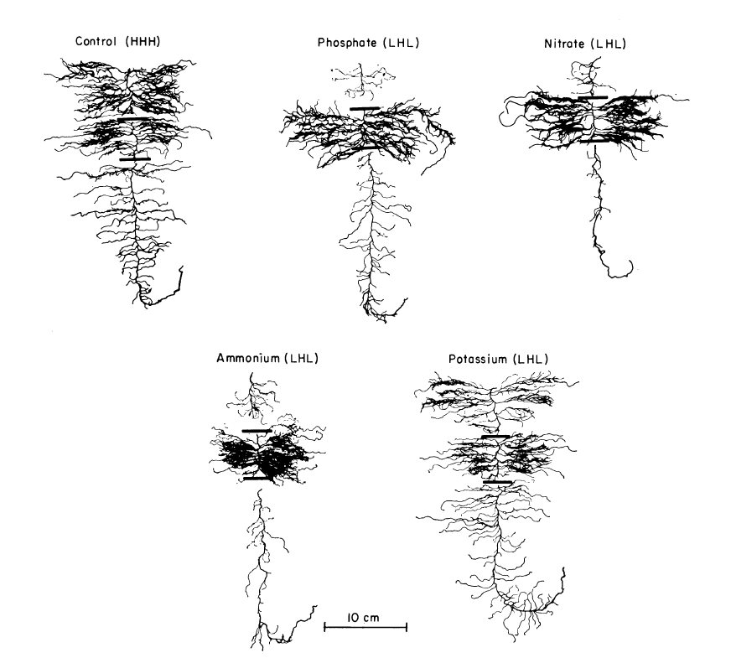
Control (HHH)
PO₄ (LHL)
NO₃ (LHL)
NH₄ (LHL)
K (LHL)
Barley roots
Drew 1975

Slide 4
0 - 4 cm
200
4 - 8 cm
8 - 12 cm
Nutrient limiting in all layers
100
0
200
Nutrient supplied to top and bottom layers
Length of primary lateral roots (% control)
100
0
Nutrient supplied to middle layer
200
100
0
PO₄
NO₃
K
NH₄
Data from Drew 1975

Slide 5
Response of birch seedlings to element limitation
1
0.75
Root:shoot ratio
0.5
0.25
0
0.2
0.4
0.6
0.8
1
Concentration of nutrient in the plant
(fraction of optimum)
Data from Wikström and Ericsson 1995

Slide 6
Nadelhoffer et al. 2002

Slide 7
Response of an arctic
cotton grass to elevated CO₂
data from Tissue & Oechel 1987

Slide 8
Optimized:
U₁ = g₁ B V₁ f(R₁) f(T)
U₂ = g₂ B V₂ f(R₂) f(T)
U₃ = g₃ B V₃ f(R₃) f(T)
.
.
.
Maximize U₁ under the constraints that
V₁ + V₂ + V₂ ... = 1
U₂ = q₂ U₁
U₃ = q₃ U₁
.
.
.

Slide 9
Adaptive (Optimizing):
U_{i} = g_{i} B V_{i} f(R_{i}) f(T)
dV_{i}/dt = a ln{Φ q_{i} U₁/U_{i} } V_{i}
Select Φ so that ∑dV_{i}/dt = 0 (i.e., ∑V_{i} = 1):
Φ = π(U_{i}/(q_{i} U₁))^{Vi}
q₁ ≡ 1

Slide 10
Comparison of responses for
3-resource models:
Uncoupled: U_{1U} = g B f(R₁) f(T)
Liebig: U_{iL} = q_{i} g B min{f(R₁), f(R₂), f(R₃)} f(T)
Concurrent: U_{iC} = q_{i} g B {f(R₁) f(R₂) f(R₃)} f(T)
Optimized: U_{iO} = g_{i} B V_{i} f(R_{i}) f(T)
If f(R₁) doubles:
U_{1U} 2×
U_{iL} ≥ 0×, ≤ 2×
U_{iC} 2×
U_{iO} > 0×, < 2×

Slide 11
Comparison of responses for
3-resource models:
Uncoupled: U_{1U} = g B f(R₁) f(T)
Liebig: U_{iL} = q_{i} g B min{f(R₁), f(R₂), f(R₃)} f(T)
Concurrent: U_{iC} = q_{i} g B {f(R₁) f(R₂) f(R₃)} f(T)
Optimized: U_{iO} = g_{i} B V_{i} f(R_{i}) f(T)
If all three f(R_{i}) double:
U_{1U} 2×
U_{iL} 2×
U_{iC} 8×
U_{iO} 2×

Slide 12
Based on Sollins et al. 1980
HJ Andrews Forest
Plants
B_{C}: 43550
B_{N}: 74
B_{P}: 11
P_{n}: 770
U_{Nfix}: 0
I_{NF}: 0.28
I_{ND}: 0.2
I_{P}: 0.05
U_{N}: 6.5
U_{P}: 1.2
L_{C}: 770
L_{N}: 6.5
L_{P}: 1.2
Inorganic
E_{N}: 2.6
E_{P}:0.26
M_{N}: 26
M_{P}: 2.6
Microbes and soil organic matter
D_{C}: 19960
D_{N}: 420
D_{P}: 42
R_{m}: 515
Q_{N}: 0.014
Q_{P}: 0.025
U_{mN}: 19.98
U_{mP}: 1.387
Q_{OC}: 255
Q_{ON}: 0.47
Q_{OP}: 0.025
Rastetter 2011

Slide 13
Uncoupled:

Slide 14
Liebig:

Slide 15
Concurrent:

Slide 16
Adaptive:
At steady state:

Slide 17
NPP
(g C m⁻² yr⁻¹ )
Net N
mineralization
(g N m⁻² yr⁻¹ )
Net P mineralization
(g P m⁻² yr⁻¹ )
2 x CO₂
Years

Slide 18
NPP
(g C m⁻² yr⁻¹ )
Net N
mineralization
(g N m⁻² yr⁻¹ )
Net P mineralization
(g P m⁻² yr⁻¹ )
2 x CO₂
Years

Slide 19
NPP
(g C m⁻² yr⁻¹ )
Net N
mineralization
(g N m⁻² yr⁻¹ )
Net P mineralization
(g P m⁻² yr⁻¹ )
2 x CO₂
Years

Slide 20
NPP
(g C m⁻² yr⁻¹ )
Net N
mineralization
(g N m⁻² yr⁻¹ )
Net P mineralization
(g P m⁻² yr⁻¹ )
2 x CO₂
Years

Slide 21
NPP
(g C m⁻² yr⁻¹ )
Net N
mineralization
(g N m⁻² yr⁻¹ )
Net P mineralization
(g P m⁻² yr⁻¹ )
2 x CO₂ + 4ºC
Years

Slide 22
6602
NPP
(g C m⁻² yr⁻¹ )
Net N
mineralization
(g N m⁻² yr⁻¹ )
Net P mineralization
(g P m⁻² yr⁻¹ )
2 x CO₂ + 4ºC
Years

Slide 23
NPP
(g C m⁻² yr⁻¹ )
Net N
mineralization
(g N m⁻² yr⁻¹ )
Net P mineralization
(g P m⁻² yr⁻¹ )
2 x CO₂ + 4ºC
Years

Slide 24
6602
NPP
(g C m⁻² yr⁻¹ )
Net N
mineralization
(g N m⁻² yr⁻¹ )
Net P mineralization
(g P m⁻² yr⁻¹ )
2 x CO₂ + 4ºC
Years

Slide 25
Conclusions:
Acclimation toward optimal resource use adds additional dynamics that propagate through and interact with ecosystem resource cycles.
These dynamics reflect adjustments within the biotic components of the ecosystem to maintain a metabolic balance and meet stoichiometric constraints
These dynamics are not represented in either “Liebig’s Law of the minimum” or “Concurrent” models of resource acquisition.
Because of these additional dynamics, initial responses are not likely to reflect long-term responses, making long-term projections from short-term experiments or observations difficult.
The optimization of resource use will tend to synchronize ecosystem resource cycles in the long term unless disturbance resets the system.
These “acclimation” responses act on many time scales and include activation/deactivation of enzyme systems, allocation of resources to individual tissues, replacement of suboptimal species with other species with more “optimal” uptake characteristics, and even natural selection of more “optimal” uptake characteristics.

Slide 26
Conclusions:
Resource optimization in my model is simulated through the reallocation of an abstract quantity I call “effort” (V_{i})
Because the allocation of “effort” represents many processes within the vegetation, it is difficult to quantify except in terms of the observed long-terms dynamics of the ecosystem; this is the model’s biggest weakness.
Currently the allocation of “effort” is tied to a single rate constant. Because of the many processes involved in acclimation, a formulation with several rate constants might be more realistic
Model description in Rastetter EB. 2011. Modeling coupled biogeochemical cycles. Frontiers in Ecology and the Environment 9:68-73.
Executable code, sample data files, and instructions are available at http://dryas.mbl.edu/Research/Models/frontiers/welcome.html

