Slide 1
How do we improve earth system models: Nutrients – an experimental perspective
Bridget Emmett, Chris Evans, Ed Rowe, Filip Oehele (NERC’s Centre for Ecology and Hydrology)
Plus unpublished data and slides from:
Christine Goodale, et al. (N addition synthesis),
Gareth Phoenix et al (UK N addition synthesis ;
Pam Templer and Michelle Mack et al. (NCEAS 15N experiment synthesis)
Lina Mercado et al. (Jules applications of phosphorus in Amazon)

Slide 2
Co-authors (Unpuplished data)
N addition review:
CL Goodale, RQ Thomas, F Dentener, MB Adams, JS Baron, RD Bowden, DB Dail, BA Emmett, CD Evans, IJ Fernandez, P Gundersen, F Hagedorn, A Kulmatiski, GM Lovett, SG McNulty, AM Melvin, F Moldan, SV Ollinger, P Schleppi, LJ Sheppard, MS Weiss
15N synthesis: Pamela Templer and Michelle Mack Boston University, University of Florida NCEAS Participants: Jana Campton, Terri Chapin, Lynn Christenson, Hannah Crook, Bill Currie, Chris Curtis, Bryan Dail, Carla D’Antonio, Bridgett Emmett, Howie Epstein, Christy Goodale, Per Gundersen, Sarah Hobbie, Keri Holland, David Hooper, Inger Kappel-Schimdt, Knute Nadelhoffer, Craig Osenberg, Steve Perakis, Patrick Schleppi, Josh Schimel, Martin Sommerkorn, Sébastien Lamontagne, Don Zak
UK N effects on vegetation composition (experimental): G. Phoenix; B A Emmett, L Sheppard, S Caporn, S Power, C Field, A. Sowerby, J Wildig
UK N effects on vegetation composition (Survey) ; Emmett, B.A^{b}, Rowe, E.C.^{b}, Stevens, C.J.ª, Gowing, D.J.ª, Henrys, P.A.^{c}, Maskell, L.C.^{c} & Smart, S.M
Phosphorus into JULES for the Amzon rainforest: Lina Mercado Tomas Domingues, Beto Quesada, Liana Anderson, Nikolaos Fyllas, Phil Harris, Nic Gedney and Jon Lloyd

Slide 3
WHY: Do we need greater representation of nutrients in earth system models?
BECAUSE: Experiments (surveys) tell us we need to…

Slide 4


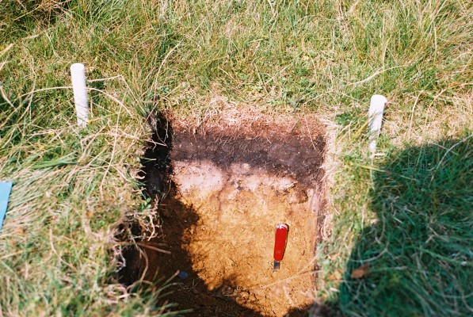
The world according to ecosystem experimental scientists
Land-atmosphere modelling community
Management
Climate
dynamic vegetation module
Hydrological module
Ecological niche models
+ Nutrient module
Acidification/soil chemistry models

Slide 5
The world according to ecosystem experimental scientists
management
Climate
dynamic vegetation module
Hydrological module
Ecological niche models
+ Nutrient module
Air quality community
Acidification/soil chemistry models

Slide 6
The world according to ecosystem experimental scientists
management
Climate
dynamic vegetation module
Hydrological module
Ecological niche models
+ Nutrient module
Contaminant community
Acidification/soil chemistry models

Slide 7
The world according to ecosystem experimental scientists
management
Climate
Biodiversiy and agri-community
dynamic vegetation module
Hydrological module
Ecological niche models
+ Nutrient module
Acidification/soil chemistry models

Slide 8
Which nutrients do we need to include?
Nitrogen
  Most accept this is needed – but just plant production? What about impact on soil C turnover?
Phosphorus
  Primary limiting factor in some areas and co-limitation of plant production is common. Peak phosphorus issues could be important in the future?
Sulpur / acidity
  The forgotten nutrient (sulphur deficiency now being reported) AND growing evidence of controls of soil C turnover

Slide 9
What about controls on soil C turnover and losses
Have we focussed too much on plant production and forgotten about nutrient controls on soil carbon turnover?
Are leaching losses in the models? DOC (dissolved organic carbon is the main net loss of carbon in peatland systems). An increasing amout of nitrogen is leached from the system with N deposition
Sulphur and acidification has not gone away….and going in opposite directions in different parts of the world

Slide 10
… slides redacted, at least temporarily…

Slide 11
So…. What are modelling needs for nutrients to capture major effects that experimentalists see?
Plant production: Variable responses to nitrogen (+; - and no change); need to include phosphorus
Leaching losses: Need to include leaching losses of C and N and check against large amount of data available (probably best data available)
Variable decomposition: Requires two linked soil carbon pools – labile and recalcitrant which respond to labile C inputs and N status
Changing ecology: Effects through species / functional type change on litter quality and ‘filtering’ effect

