Slide 1
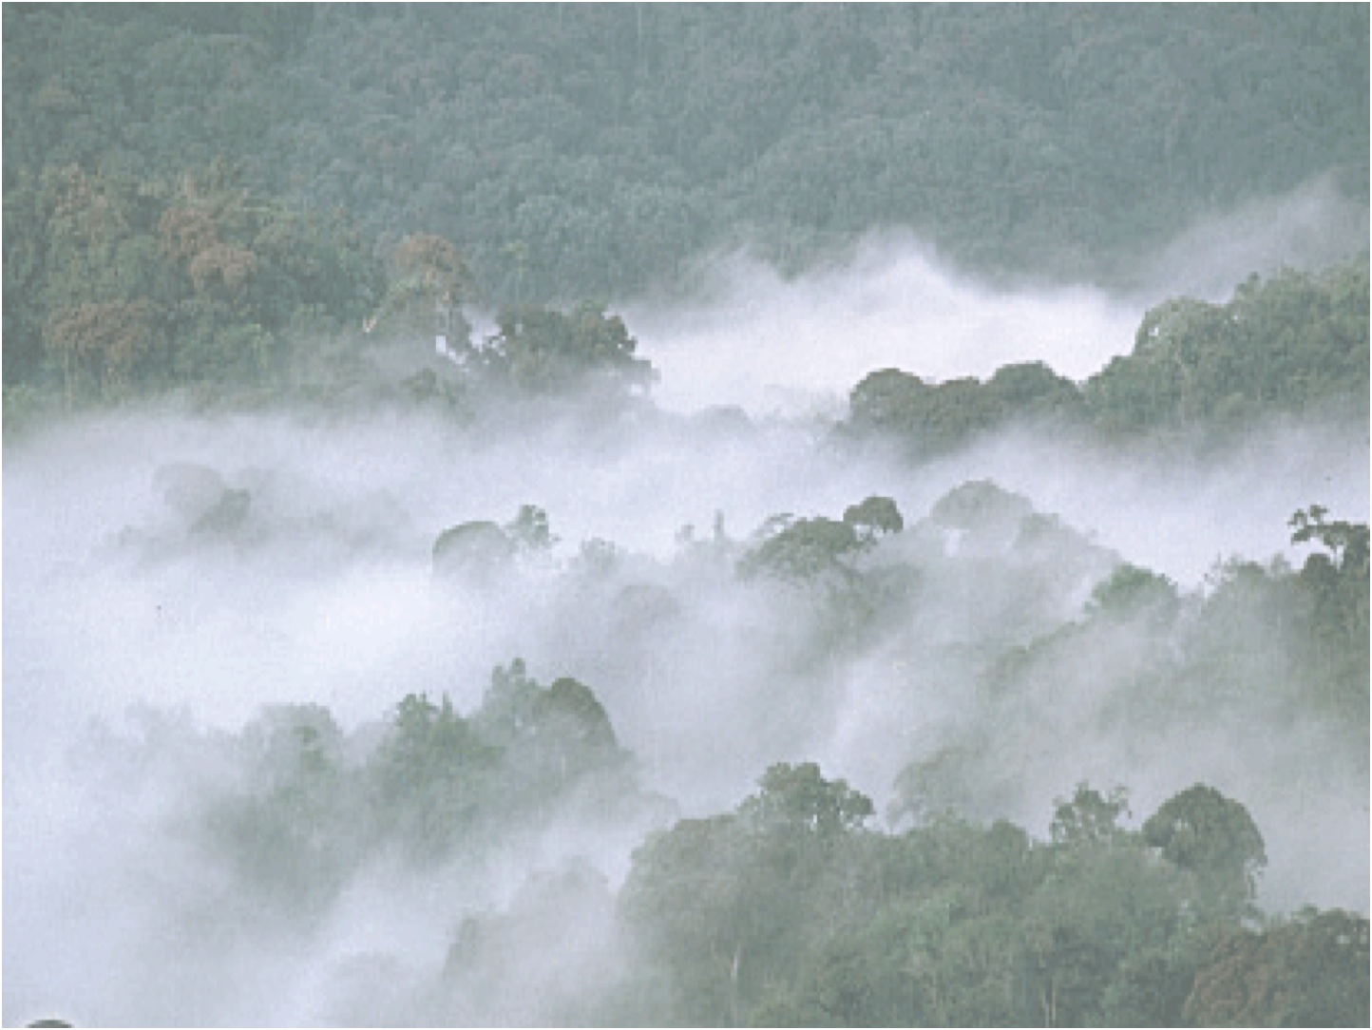


Nutrient Limitation in Terrestrial Ecosystems: Observational Insights
(With a focus on tropical forests)
Cory Cleveland
Department of Ecosystem &
Conservation Sciences
University of Montana
Cory.Cleveland@umontana.edu

Slide 2
To what extent is terrestrial C uptake constrained by nutrient availability?

