Slide 1
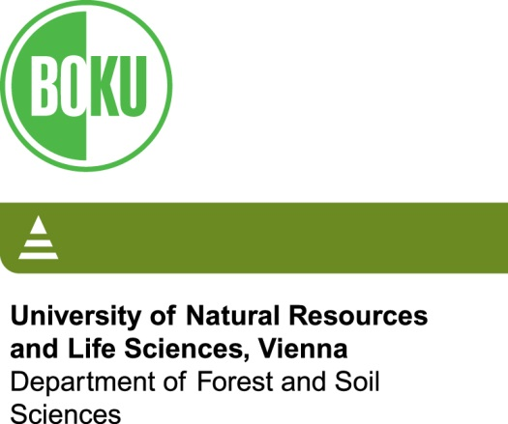

Soil warming experiments: bringing the climate to the soil or the soil to the climate?
Michael Zimmermann
BOKU University, Vienna, Austria

Slide 2
Content
In situ warming vs translocations
Translocation methods
Translocation types
Review of altitudinal translocation studies
Summary of results

Slide 3
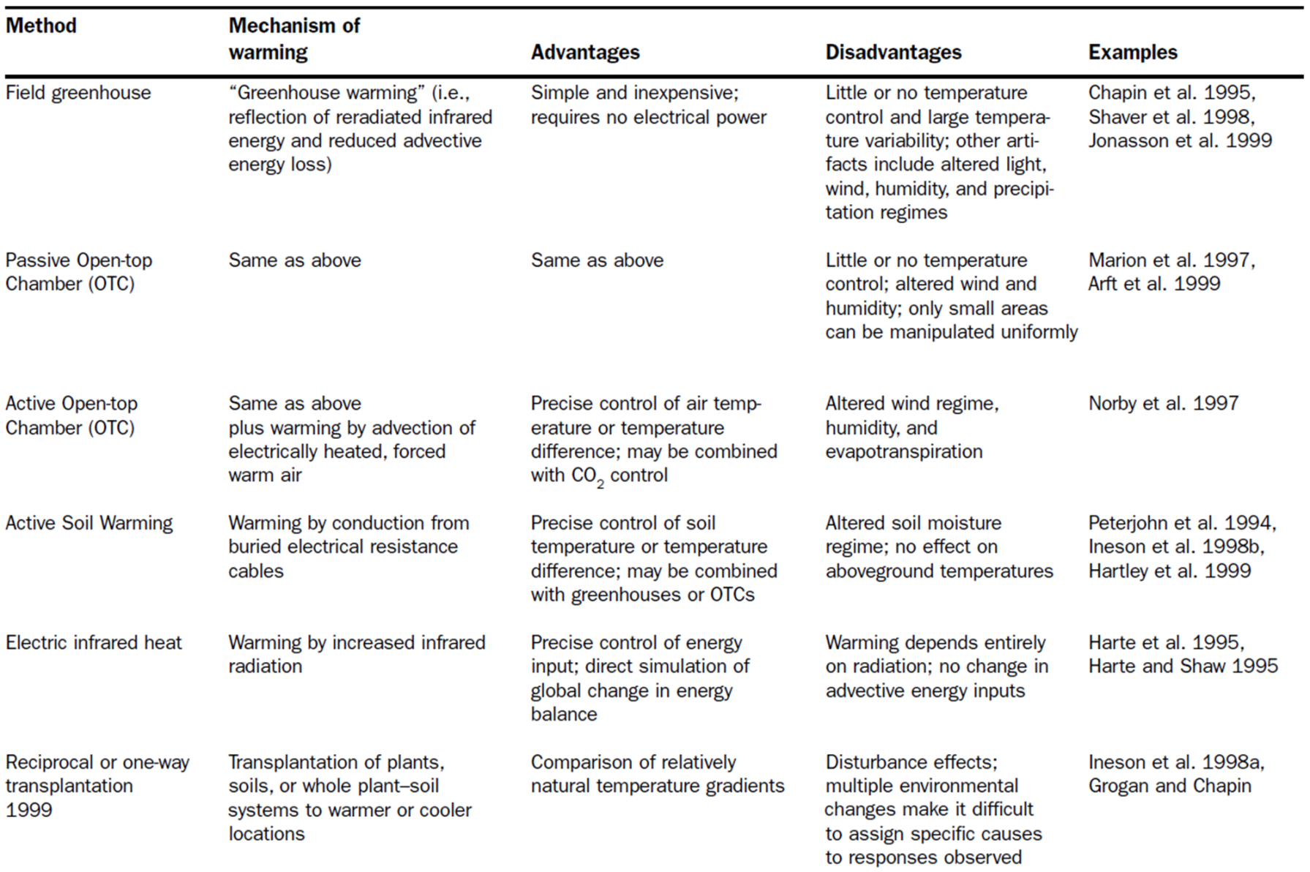
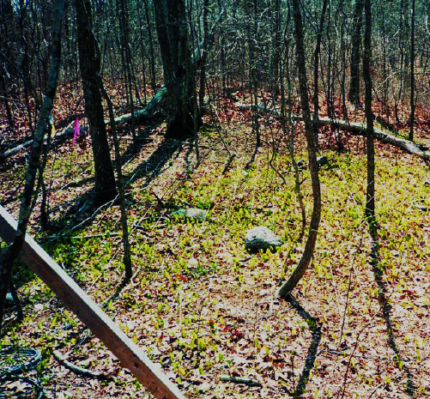
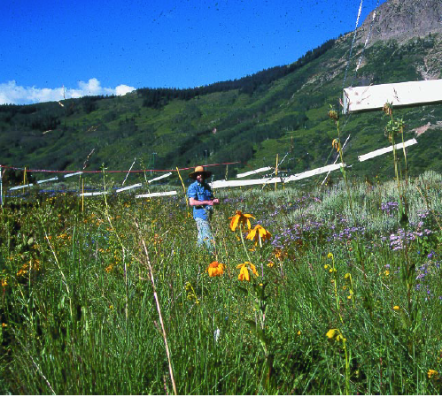
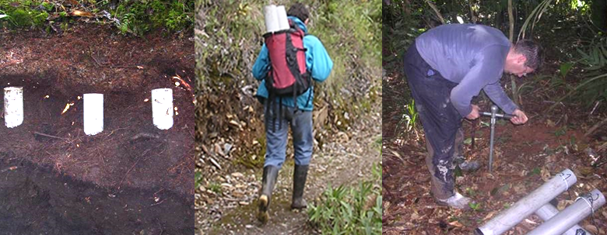
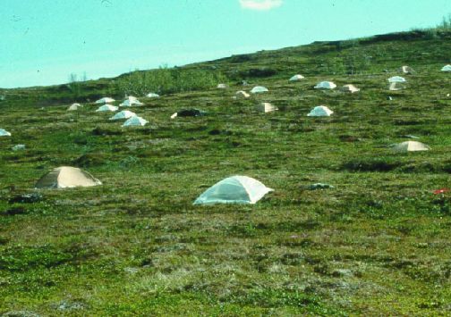
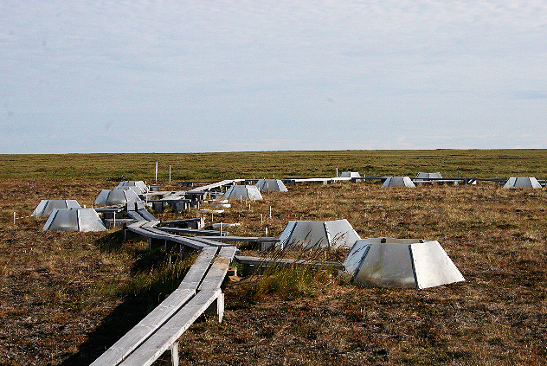
Warming experiments methods: review by Shaver et al., 2000
Shaver G.R et al., 2000, Global Warming and Terrestrial Ecosystems: A Conceptual Framework for Analysis. BioScience, 50, 871-882

Slide 4
Translocation experiments vs in situ warming experiments
Advantages:
No power supply need
Low maintenance / applicable at remote sites
Warming and cooling possible
Rain input easily adjustable
Soil processes only
Disadvantages:
Soil processes only
Small samples
Influences of deceasing roots
Disturbed physical soil properties

Slide 5
Translocation experiments: most common approaches:
Intact soil
Sieved soil
What?
no
plants
with
plants
Tubes
Blocks
Mesh bags
With mesh bottom
On suction plate
Pot with outlet
Bulldozer
How?
On resin bags
With side holes
PVC sleeve
Metal cage with mesh

Slide 6
Translocation experiments: type of translocation
1. Along land-use / ecotone gradients
Bottomley et al. (2006): Reciprocal soil transfer between forest and meadow
Clein & Schimmel (1994): Soil transplant between alder and poplar site
Eschen et al. (2009): Soil transplant between grasslands and ex-arable restoration sites
Germino et al. (2006): Soil translocaion with seedlings across alpine tree line
Gregg et al. (2003): Soil transplant between urban and rural sites
Hietalahti et al. (2005): Soil transloaction from woodland to pasture sites
Kitzberger et al. (2005): Soil translocation from burned to un-burned sites
Lazarro et al. (2011): Reciprocal soil exchange between calcareous and siliceous glacier forefields
Mack & D'Antonio (2003): Soil translocation among unburned woodland, woodland invaded by grasses, and burned woodland replaced by grasses
Novack et al. (2010): Reciprocal peat transplant
Sjögersten & Wookey (2005): Translocated soil cores across a birch forest–tundra ecotone
Verville et al. (1998): Reciprocal soil transplant between wet-meadow and tussock tundra
Waldrop & Firestone (2006): Reciprocal soil transplant from under oak canopy to adjacent grassland
Yelenik et al. (2011): Switched soil between isolates shrubs and grasslands

Slide 7
Translocation experiments: type of translocation
2. Along latitudinal gradients
Berg et al. (1997): Reciprocal soil translocation across North and Central Europe
Bottner et al. (2000); Couteaux et al. (2001): Translocated labelled soil material southwards in Europe
Rey et al. (2007): Translocated soil monoliths to warmer sites within Spain
Shibata et al. (2011): Transplantation of forest surface soils along climate gradient on Japanese archipelago
Sjögersten & Wookey (2005): Translocated soils across Fennoscandinavia
Vanhala et al. (2001): Transferred organic surface soils from northern to southern Finland

Slide 8
Translocation experiments: type of translocation
3. Along altitudinal gradients
Djukic et al., 2013, Soil microbial communities and their feedbacks to simulated climate change: comparisons among terrestrial montane ecosystems. EGU meeting 2013, Vienna, Austria, Poster

Slide 9
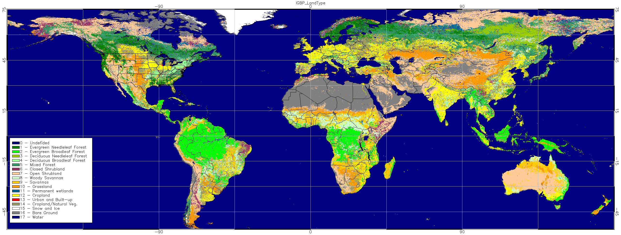
Translocation experiments: altitudinal translocation sites
Sierra Nevada, USA
San Francisco Mountains, USA
Cascade Mountains, USA
Cumbria, UK
Arizona, USA
Rattlesnake Mountain,
USA
Swiss Alps
Smoky Mountains, USA
Appalachians, USA
Austrian Alps
Andes, Peru
Tropical North Queensland, Australia
Notes:
12 sites, 10 in temperate to semi-arid zones, 2 in tropics

Slide 10
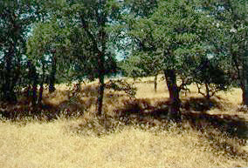
Translocation experiments:
Linking microbial community composition and soil processes in a California annual grassland and mixed-conifer forest.
Balser TC & Firestone MK, 2005, Biogeochemistry, 73, 395-415
Location: Sierra Nevada, USA
Sites: 2 sites, blue oak grassland savanna, mixed conifer forest
Altitudinal range: 470 – 1240 m asl
Climatic range: MAT 17.8 – 8.9 °C; MAP 310 – 950 mm
Method: reciprocal; intact soil cores in tubes of 10 × 5 cm; 2 × 150 cores
Duration: 2 years
Scope: Impact of climate change on microbial
communities
Analysis: PLFA, CO₂, N₂O, NH₄⁺, NO₃⁻
Notes:
All analysis done in lab

Slide 11
Translocation experiments:
Linking microbial community composition and soil processes in a California annual grassland and mixed-conifer forest.
Balser TC & Firestone MK, 2005, Biogeochemistry, 73, 395-415
Main findings:
Field soil temperature had the strongest relationship with CO₂ production and soil NH₄⁺ concentration.
Microbial community characteristics correlated with N₂O production, nitrification potential, gross N-mineralization, and soil NO₃⁻ concentration independent of environmental controllers.
Microbial biomass and community composition remained constant over two years with just a small shift in fungal abundance in grassland soils.
Notes:
We found no significant relationship between microbial biomass, or lipid diversity, and soil process rates. We also found that the first principal component was a good summary variable to represent the microbial community, and could be related to soil processes. Our data indicated that microbial community characteristics may mediate or constrain soil process rates independent of environmental changes. More specifically, we found a relationship between specific components of the microbial community and those soil processes that are more tightly linked to microbial phylogeny. In addition, we found that microbial community composition may not equilibrate to an environmental change as readily or as rapidly as we have often assumed. If microbial communities evolve or shift slowly in response to environmental change, and particularly if their response potentially constrains soil process rates, then it may be advantageous to include parameters quantifying microbial community responses in our conceptual and mechanistic models of ecosystem functioning.

Slide 12
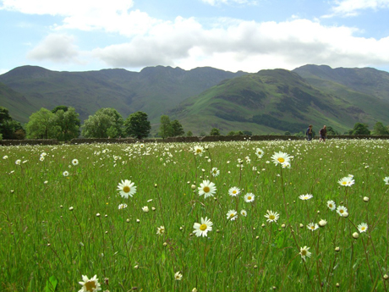
Translocation experiments:
Effects of climate change on soil fauna; responses of Enchytraeids, Diptera larvae and Tardigrades in a transplant
experiment.
Briones MJI et al., 1997, Applied Soil Ecology, 6, 117-134
Location: Northern Pennies, Cumbria, UK
Sites: 2 sites, pastured grasslands
Altitudinal range: 480 - 845 m asl
Climatic range: MAT 6.3 – 3.5 °C; MAP 1270 – 1605 mm
Method: high-to-low; intact soil cores in tubes of 15 × 28 cm; 2 × 60 cores
Duration: 6 weeks
Scope: Impact of climate conditions on soil
invertebrates
Analysis: Extraction of invertebrates
Notes:
Enchytraeids = Earhworms
Diptera = Flies

Slide 13
Translocation experiments:
Effects of climate change on soil fauna; responses of Enchytraeids, Diptera larvae and Tardigrades in a transplant
experiment.
Briones MJI et al., 1997, Applied Soil Ecology, 6, 117-134
Main findings:
Different species of enchytraeids responded differently; e.g. numbers of Cognettia sphagnetorum were correlated positively with temperature, whereas their vertical distribution was determined by moisture.
Vertical migration to avoid adverse climatic conditions might be an unsuitable strategy due to food exhaustion, as organic matter is concentrated in top 10 cm.
Notes:
Results from the canonical correspondence analysis showed that the 'temperature-moisture' gradient determined species composition at Moor House. Therefore, we can infer that climate change would result in new species associations in the soils investigated and increasing temperatures would result in increasing numbers of the more tolerant species (A. eiseni); migrations to other microhabitats or layers (Cognettia); dormancy and resistant states (tardigrades); or extinction (Cernosvitoviella, Diptera).
Vertical migration seems to be a successful strategy for avoiding adverse climatic conditions, but appendages and certain body shapes prevent penetration into deeper soil layers; in addition, readily-available organic matter is concentrated in the upper top 10 cm of the current soil, limiting the extent to which downward faunal movements can occur. Thus, if new climatic conditions persist then migration to the deeper layers may become an unsuitable strategy due to food exhaustion. In the short-term survival can also be ensured by entering dormancy states, but many species do not have this alternative strategy.
Many soil processes are affected by the activities of soil fauna, and any alterations in numbers, species composition, and distribution through the soil profile may have important implications for nutrient cycling, with particular impacts on organic matter turnover (Briones et al., submitted). Also, increasing temperatures result in changes in plant productivity which, in turn, may have important effects on the soil community. We conclude that assumptions that the soil fauna may respond little to predicted temperature changes (Whitford, 1992) are not substantiated by the current work.

Slide 14
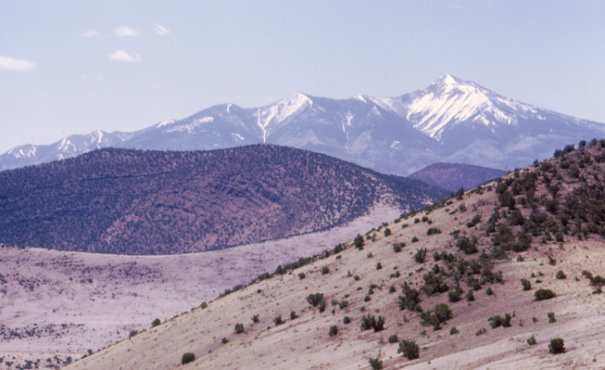
Translocation experiments:
Environmental Factors Controlling Soil Respiration in Three Semiarid Ecosystems.
Conant R et al., 2000, Soil Science Society of America Journal, 64, 383-390
Location: San Francisco Mountains, Arizona, USA
Sites: 3 sites, desert shrub, pinyon-juniper woodland, pine forest
Altitudinal range: 1987 - 2295m asl
Climatic range: MAT 8.5 – 5.5 °C; MAP 320 – 530 mm
Method: reciprocal, sieved soils (1.5 cm) as mesocosms in plastic pots, 60 in total
Duration: 18 months
Scope: Impact of climate conditions and soil C
pools on heterotrophic respiration rates
Analysis: CO₂, soil C pools

Slide 15
Translocation experiments:
Environmental Factors Controlling Soil Respiration in Three Semiarid Ecosystems.
Conant R et al., 2000, Soil Science Society of America Journal, 64, 383-390
Main findings:
Soil respiration rates were highest at the wettest (coldest) site.
Temperature was negatively correlated to soil respiration, with exceptions at the coolest times.
Respiration rates were strongest influenced by total soil C.
In this semi-arid ecosystem, soil respiration was controlled by the soil C pool and soil moisture.
Notes:
Results from the canonical correspondence analysis showed that the 'temperature-moisture' gradient determined species composition at Moor House. Therefore, we can infer that climate change would result in new species associations in the soils investigated and increasing temperatures would result in increasing numbers of the more tolerant species (A. eiseni); migrations to other microhabitats or layers (Cognettia); dormancy and resistant states (tardigrades); or extinction (Cernosvitoviella, Diptera).
Vertical migration seems to be a successful strategy for avoiding adverse climatic conditions, but appendages and certain body shapes prevent penetration into deeper soil layers; in addition, readily-available organic matter is concentrated in the upper top 10 cm of the current soil, limiting the extent to which downward faunal movements can occur. Thus, if new climatic conditions persist then migration to the deeper layers may become an unsuitable strategy due to food exhaustion. In the short-term survival can also be ensured by entering dormancy states, but many species do not have this alternative strategy.
Many soil processes are affected by the activities of soil fauna, and any alterations in numbers, species composition, and distribution through the soil profile may have important implications for nutrient cycling, with particular impacts on organic matter turnover (Briones et al., submitted). Also, increasing temperatures result in changes in plant productivity which, in turn, may have important effects on the soil community. We conclude that assumptions that the soil fauna may respond little to predicted temperature changes (Whitford, 1992) are not substantiated by the current work.

Slide 16
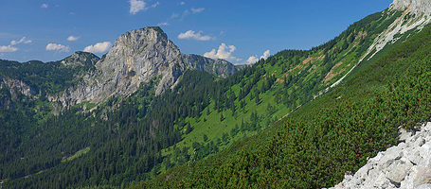
Translocation experiments:
In situ carbon turnover dynamics and the role of soil
microorganisms therein: a climate warming study in an Alpine ecosystem
Djukic I et al., 2013, FEMS Microbiology Ecology, 83, 112-124
Location: Hochschwab in the Northern Limestone Alps of Austria
Sites: 3 sites, beech forest, spruce forest, alpine grassland
Altitudinal range: 900 – 1900 m asl
Climatic range: MAT 6.2 – 2.1 °C; MAP 1178 – 1715 mm
Method: high-to-low; intact open soil cores of 15 × 10 cm; added maize litter; 48 cores at top for translocation, 3 × 24 as controls
Duration: 2 years
Scope: Role of soil microorganisms in the
C turnover under changed climatic conditions
Analysis: PLFAs, δ¹³C
Notes:
48 soil cores wer translocated downwards, and at each site 24 cores as controls taken and installed

Slide 17
Translocation experiments:
In situ carbon turnover dynamics and the role of soil
microorganisms therein: a climate warming study in an Alpine ecosystem
Djukic I et al., 2013, FEMS Microbiology Ecology, 83, 112-124
Main findings:
Prevailing environmental site conditions influenced microbial community composition more than substrate quantity and quality.
Adaptation of the microbial community to new climatic and site conditions as well as to substrate quality and quantity.
Microbial community composition and function significantly affected substrate decomposition rates only in the later stage of decomposition.
Notes:
In summary, our study shows that different climatic conditions along the studied elevation gradient and related differences in vegetation composition, physicochemical soil properties and abundance and structure of soil microorganism groups exert an influence on litter decomposition at different points in time and to different extents. Decomposition of litter carbon accelerates when temperatures rise; however, decomposition processes do not necessarily follow a linear pathway with regard to increasing temperature but may also be determined by exceeding of threshold values such as water availability during the winter months. Our study also demonstrates that changing environmental conditions entails a very fast adaptation of the soil microbial communities.

Slide 18
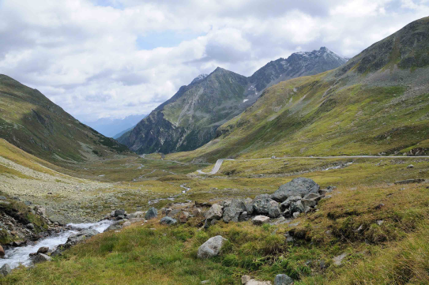
Translocation experiments:
Experimental determination of climate-change effects on above-ground and below-ground organic matter in alpine grasslands by translocation of cores
Egli M et al., 2004, Journal of Plant Nutrition & Soil Science, 167, 457-470
Location: Vereina Valley, Swiss Alps
Sites: 2 sites, both in alpine grassland
Altitudinal range: 1895 - 2525 m asl
Climatic range: MAT 1.1 – -2.2 °C; MAP ~1800 mm
Method: high-to-low; intact soil cores of 7 × 50 cm in mesh bags; 12 cores from top for translocation, 2 × 16 cores as controls
Duration: 2 years
Scope: Effect of increased temperatures on
phytomass and organic matter in cool alpine areas
Analysis: Total SOC, phytomass, soil chemistry

Slide 19
Translocation experiments:
Experimental determination of climate-change effects on above-ground and below-ground organic matter in alpine grasslands by translocation of cores
Egli M et al., 2004, Journal of Plant Nutrition & Soil Science, 167, 457-470
Main findings:
Distinct decrease in above-ground plant biomass (-45%) after two years caused by warming (+1.5°C, “die-back effect”).
Below-ground phytomass decreased significantly (up to 50%) in the top 5 cm, probably caused by reduced photosynthesis and hence C flow to below-ground.
Rapid climate change exceeded the ability of the grassland to adapt.
Notes:
Therefore, it cannot be fully excluded that the experimental design influenced the results. Translocation of soil cores from a very cool to a warmer site led to a distinct decrease in above-ground phytomass (about –45%) over the experimental period of two years. Below-ground phytomass significantly decreased (up to –50%) in the topsoil (0–5 cm) after artificial warming. Possible mechanisms are that roots reduced photosynthesis and hence C flow below-ground, a reduction of soil moisture that would have led to root death (not a very probable cause, however) or an abrupt change in the radiation duration and flux which affected root growth (also not very probable). Fast climate change exceeded the ability of the above-ground and below-ground phytomass to adapt quickly. Whether the decrease in phytomass was a short-term or a long-term response to climate warming remains uncertain. Based on a gradient study (climosequence at the same locality), we hypothesize that the decreased plant productivity might be a short-term effect.

Slide 20
Translocation experiments:
Experimental determination of climate-change effects on above-ground and below-ground organic matter in alpine grasslands by translocation of cores
Egli M et al., 2004, Journal of Plant Nutrition & Soil Science, 167, 457-470
Soil microbial communities in (sub)alpine grasslands indicate a moderate shift towards new environmental conditions 11 years after soil translocation
Budge K et al., 2011, Soil Biology & Biochemistry, 43, 1148-1154
Resampled cores from Egli et al. after 11 years
Scope: Investigate differences in soil microbial communities across an altitudinal gradient and the long-term effects of high–to-low elevation translocated soil cores
Analysis: PLFAs, total microbial biomass

Slide 21
Translocation experiments:
Soil microbial communities in (sub)alpine grasslands indicate a moderate shift towards new environmental conditions 11 years after soil translocation
Budge K et al., 2011, Soil Biology & Biochemistry, 43, 1148-1154
Main findings:
Significant differences in microbial communities between sites.
Translocation induced a shift in total microbial biomass (TMB) and proportional distribution of structural groups in the translocated cores towards the lower elevation community, probably driven by a combined temperature-vegetation effect.
Soil C remained similar to the site of origin also after 11 years.
Notes:
Subalpine and alpine environments are characterised by extreme climatic conditions and are likely to be especially sensitive to changing environmental conditions such as global warming. The microbial community in soils across a (sub)alpine grassland elevation gradient could be a good indicator of present-day climate influence and future induced changes. Our principal findings are the following:
- Simulated climate warming through soil translocation induced a shift of the total microbial biomass towards that of lower elevations, with a slight reduction at 0e10 cm soil depth and a significant increase at 10e20 cm soil depth.
- PLFA analyses confirmed that significant differences in microbial communities exist between the sites. The proportions of all structural groups at lower soil depth and some structural groups in the upper depth indicate a trend from the high elevation site towards the lower elevation site which may be driven by combined temperatureevegetation effects.
- Across our three (sub)alpine grassland sites, EM fungi proportions increased with elevation while AM fungi decreased.
- High soil carbon concentrations and low microbial content at one of our sites indicated factors other than air temperature and carbon availability were more influential for microbial activity and decomposition.

Slide 22
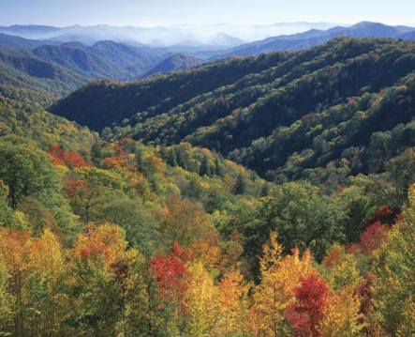
Translocation experiments:
Changes in Carbon following Forest Soil Transplants
along an Altitudinal Gradient
Garten CT, 2008, Communications in Soil Science and Plant Analysis, 39, 2883 - 2893
Location: Great Smoky Mountains National Park, Tennesse, USA
Sites: 4 sites at 2 elevations, 3 in broad-leaf deciduous forests, 1 in needle-leaf evergreen (spruce and fir) forest
Altitudinal range: 530 – 1570 m asl
Climatic range: MAT 12.8 – 7.9 °C; MAP 1613 – 2206 mm
Method: reciprocal; sieved soils of top 20 cm in mesh bags of 12.5 × 25 cm; 2 × 14 bags
Duration: 5 years
Scope: Impact of warming on C concentrations in
soils of different N-pools
Analysis: Total SOC and N, Particulate Organic Matter

Slide 23
Translocation experiments:
Changes in Carbon following Forest Soil Transplants
along an Altitudinal Gradient
Garten CT, 2008, Communications in Soil Science and Plant Analysis, 39, 2883 - 2893
Main findings:
C-concentrations in whole soils, particulate organic matter, and mineral-associated organic matter declined significantly after down-slope translocation (+4.8°C).
Cooling of soils (up-slope translocation) produced no detectable changes in C-concentrations.
Warming of higher quality soil organic matter (lower C/N ratio) resulted in greater soil C loss.
Notes:
The results of this small case study indicate that a future warmer and drier climate could cause losses of forest soil C at high elevations in the Great Smoky Mountains National Park and that these losses are not necessarily limited to more labile soil C pools (like POM C). By comparison, reciprocal transplants of low-elevation forest soils to high elevations produced no detectable change in C concentrations. Numerous studies indicate that the decomposition rate of soil organic matter will accelerate with increasing temperature (Kirschbaum 1995; Trumbore, Chadwick, and Amundson 1996; Yang et al. 2002; Knorr et al. 2005), although the relationship has been challenged (Liski et al. 1999; Giardina and Ryan 2000). Decomposition rates, normalized for soil C concentrations, appear to decline with increasing elevation in forests represented by this case study (Garten 2006). Moreover, relatively rapid, short-term losses of labile soil C are one observed outcome of soil warming experiments (Melillo et al. 2002).

Slide 24
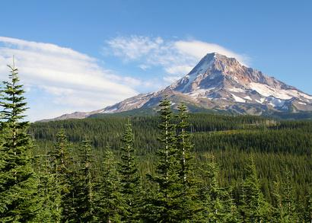
Translocation experiments:
Transferring soils from high- to low-elevation forests increases nitrogen cycling rates: climate change implications.
Hart SC & Perry DA, 1999, Global Change Biology, 5, 23-32
Location: Central Oregon Cascade Mountains, USA
Sites: 2 sites, mixed Douglas-fir, mixed Pacific silver fir
Altitudinal range: 490 – 1310 m asl
Climatic range: MAT 8.3 – 5.9 °C; MAP 1880 – 1890 mm
Method: reciprocal; intact soil cores over ion exchange resin bags in tubes of 5 × 15 cm; 2 × 16 cores
Duration: 9 months
Scope: Impact of warming on soil N
transformation in absence of plant uptake
Analysis: Microbial biomass, NH₄⁺, NO₃⁻,
lab incubations

Slide 25
Translocation experiments:
Transferring soils from high- to low-elevation forests increases nitrogen cycling rates: climate change implications.
Hart SC & Perry DA, 1999, Global Change Biology, 5, 23-32
Main findings:
Annual net N mineralization and nitrification more than doubled in soil transferred down-slope due to temperature (+3.9°C).
Leaching of inorganic N from the surface soil (in the absence of plant uptake) also increased.
The reciprocal treatment (up-slope translocation) resulted in reductions in annual rates of net N mineralization (-70%), nitrification (-80%), and inorganic N leaching (-65%).
High elevation forests have larger C and N soil pools becuase low temperatures limit mineralization rates.
Notes:
Our results support the hypothesis that high-elevation, old-growth forest soils in the central Cascades have higher C and N storage than their low­ elevation analogues primarily because low temperatures limit net C and N mineralization rates at higher elevations. Hence, increases in surface temperatures associated with global warming will likely increase net rates of C and N mineralization from these high-elevation forest soils. However, it is unclear if the additional amounts of mineralized soil C and N will contribute to increases in global warming (from increased emissions of C02 or N20) and eutrophication of downslope aquatic ecosystems (from increased inputs of N to N-limited streams), or if concomitant increases in net primary production will sequester all or part of the released C and N. Experimental evidence from arctic tundra ecosystems suggests that net primary productivity is less temperature-limited than soil microbial activity (Shaver et al. 1992), implying that at least some of the global warming-released soil C and N will have an impact on athmospheric and aquatic systems.

Slide 26
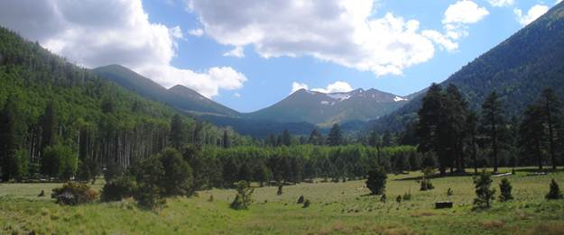
Translocation experiments:
Potential impacts of climate change on nitrogen transformations and greenhouse gas fluxes in forests: a soil transfer study.
Hart SC, 2006, Global Change Biology, 12, 1032-1046
Location: Agassiz Peak, Arizona, USA
Sites: 2 mature forest sites, mixed spruce fir trees, ponderosa pine
Altitudinal range: 2200 – 2930 m asl
Climatic range: MAT 6.1 – 3.4 °C; MAP 641 – 869 mm
Method: reciprocal; intact soil cores over ion exchange resin bags in tubes of 10 × 15 cm; 2 × 16 cores
Duration: 13 months
Scope: Impact of global warming on greenhouse gases and
N transformation
Analysis: CO₂, CH₄, N₂O, microbial communities,
N in leachate
Notes:
Total bacteria biomass was determined by counting numbers and diameters of all bacteria in soil suspensions stained with fluorescein isothiocyanate (FITC) and filtered onto Nuclepore black-stained filters (Babiuk & Paul, 1970). Active bacterial biomass was determined by counting fluorescein diacetate (FDA)-stained bacteria in agar-film soil suspensions (Lodge & Ingham, 1991). Total fungal biomass was determined by measuring the length and diameters of all hyphae, whereas active fungal biomass was determined by measuring the length and diameter of FDA stained hyphae in agar-film soil suspensions using a combination of epi-fluorescence and phase contrast microscopy

Slide 27
Translocation experiments:
Potential impacts of climate change on nitrogen transformations and greenhouse gas fluxes in forests: a soil transfer study.
Hart SC, 2006, Global Change Biology, 12, 1032-1046
Main findings:
Down-slope translocation (+2.7°C) increased annual net CO₂ fluxes (190%), net CH₄ consumption (190%) and N₂O fluxes (290%).
CO₂ and CH₄ were correlated with temperature, whereas CO₂
and N₂O also correlated with soil moisture.
Total soil microbial biomass decreased in warmed cores, but active bacteria increased.
Net N mineralization and nitrification increased over 80% in down-slope translocated soil cores.
Notes:
In my study, soil cores were isolated from the effects of plant roots for extended periods of time, and this isolation may have impacted the soil pools and processes that I measured. I evaluated the effect of soil coring (disturbance that included root severing) on soil microclimate (temperature and water content) and net trace-gas fluxes at both sites. Overall, I found very few impacts of soil coring on these variables suggesting that, at least in these soils, short-term (13 months or less) containment does not lead to substantial changes in these soil processes. The relative responses of forest soils to experimental warming induced by soil transfer along an altitudinal gradient were generally higher than those found in other warming studies using different heating methods.
In a recent synthesis of global warming studies that had experimentally increased soil temperature by 0.3–6.0 1C for 2–9 years, Rustad et al. (2001) found that the mean relative increase in net N mineralization following warming was 46% across 12 sites. The relative increases in net N mineralization that I observed with warming using the soil transfer approach in forest soils of the SW and PNW (Hart & Perry, 1999) were substantially higher than this mean value; however, the magnitude of response in these soil transfer studies was still within the range of responses found in their synthesis. In the SW, the relative increase in soil net CO2 flux that I observed by transferring high-elevation soil cores to a lower elevation site was considerably higher than the mean increase found in these other studies (20%), and this change was outside the range of increases observed among the 16 studies evaluated (Rustad et al., 2001).

Slide 28
Translocation experiments:
Effects of climate change on nitrogen dynamics in
upland soils. 1. A transplant approach.
Ineson P et al., 1998, Global Change Biology, 4, 413-152
Location: Northern Pennies, Cumbria, UK (same as Briones et al.)
Sites: 4 sites, pastured grasslands
Altitudinal range: 171 - 845 m asl
Climatic range: MAT 6.3 – 3.5 °C; MAP 1270 – 1605 mm
Method: high-to-low; intact soil cores incl. vegetation in tubes of 15 × 28 cm over lysimeters from 3 soil types; 3 × 30 cores
Duration: 2 years
Scope: Impact of climate change on N leaching
Analysis: NH₄⁺ and NO₃⁻ in leachate

Slide 29
Translocation experiments:
Effects of climate change on nitrogen dynamics in
upland soils. 1. A transplant approach.
Ineson P et al., 1998, Global Change Biology, 4, 413-152
Main findings:
Decreases in leachate nitrate concentrations were observed for all three soil types transplanted downwards (+4.6°C).
Temperature was the main controlling factor responsible for the observed reductions, as warming increased growth and N uptake by the vegetation.

Slide 30
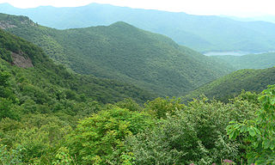
Translocation experiments:
Regulation of nitrogen mineralization and nitrification in Southern Appalachian ecosystems: Separating the relative importance of biotic vs. abiotic controls.
Knoepp JD & Vose JM, 2007, Pedobiologia, 2007, 51, 89-97
Location: Southern Appalachian, North Carolina, USA
Sites: 5 sites, mixed oak pine, cove hardwoods, mixed oaks (2x), northern hardwoods
Altitudinal range: 788 – 1389 m asl
Climatic range: Δ T 2.9°C; Δ soil moisture content 25%
Method: reciprocal; intact soil cores in tubes of 4.3 × 15 cm; 5 × 5 cores × 2 seasons
Duration: 2 × 4 weeks, compared with 5 year data
Scope: Effect of biotic vs abotic factors in soil
N transformations
Analysis: NH₄⁺ and NO₃⁻ of cores in lab

Slide 31
Translocation experiments:
Regulation of nitrogen mineralization and nitrification in Southern Appalachian ecosystems: Separating the relative importance of biotic vs. abiotic controls.
Knoepp JD & Vose JM, 2007, Pedobiologia, 2007, 51, 89-97
Main findings:
N mineralization and nitrification rates were significantly increased only when soils from the highest site were transplanted to warmer sites (+2.9°C, 4 weeks), or from the driest site to wetter sites.
Biotic (total N and C:N) and climatic factors (moisture and temperature) regulated N mineralization.
Environmental controls were significant only at the extreme sites; i.e. at the wettest and warmest sites, and soils with highest and lowest C and N contents.
Notes:
N mineralization and nitrification rates in soils from the northern hardwood (NH) site were significantly increased when soils were transplanted to warmer sites. N mineralization rates also increased in transplanted soil from the dry mixed-oak/pine site to a wetter site. Multiple regression analysis of N mineralization from all five sites found that biotic (total soil N and C:N ratios) and climatic factors (moisture and temperature) regulate N mineralization. Regression analyses of individual sites showed that N mineralization rates responded to variation in temperature and moisture at only the high elevation northern hardwood site and moisture alone on the dry warm mixed-oak/ pine site. N mineralization was unrelated to temperature or moisture at any of the other sites. Results indicate that soil properties plus climatic conditions affect soil N transformations along the environmental gradient at Coweeta. Environmental controls were significant only at the extreme sites; i.e., at the wettest and warmest sites and soils with highest and lowest C and N contents. The high degree of temperature sensitivity for the northern hardwood soils indicates potentially large responses to climatic change at these sites.

Slide 32
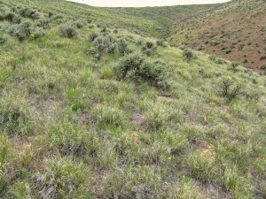
Translocation experiments:
A reciprocal transplant experiment within a climatic gradient
in a semiarid shrub-steppe ecosystem: effects on bunchgrass growth and reproduction, soil carbon, and soil nitrogen.
Link S et al., 2003, Global Change Biology, 9, 1097-1105
Location: Rattlesnake Mountains, Washington, USA
Sites: 2 sites, native shrub-steppe
Altitudinal range: 310 – 844 m asl
Climatic range: MM_{max} 28.5 – 23.5 °C; MAP 224 – 272 mm
Method: reciprocal; intact soil cores with grass (Poa secunda) in tubes of 30 × 30 cm; 2 × 16 cores
Duration: 4.5 years
Scope: Impact of climate change on
P. secunda and soils
Analysis: Plants, soil C / N, POM C / N

Slide 33
Translocation experiments:
A reciprocal transplant experiment within a climatic gradient
in a semiarid shrub-steppe ecosystem: effects on bunchgrass growth and reproduction, soil carbon, and soil nitrogen.
Link S et al., 2003, Global Change Biology, 9, 1097-1105
Main findings:
Down-slope translocation (+5.0°C) had not effect on plant production, but up-slope translocation reduced production.
Warming and drying reduced total soil carbon by 32% and total soil nitrogen by 40%, whereas up-slope translocation (cooler and wetter) had no effect on total soil C or N.
Of the C and N that was lost over time, 64% of both came from the particulate organic matter fraction (POM, > 53 µm).
Notes:
Our results suggest that the consequences of a cooler, wetter climate are severe for the lower elevation plants and likely to result in the loss of current populations. The upper elevation plants are more likely to be successful in a warmer, drier climate. Temperature is likely a strong factor explaining reduced production in our experiment. If P. secunda behaves as other Poa species (Woodward, 1979; Korner & Woodward, 1987), then populations adapted to warm temperatures will be less successful in a cooler climate. There was no reproductive effort in plants exposed to the cooler, wetter climate. The P. secunda populations may differ genetically. An investigation into the genetic basis for photosynthetic adaptations to altitude may show differences between P. secunda populations that can account for the effects of the cooler, wetter climate found in this study.
Soil C and N losses are a serious consequence of climate change. In this study, climate change resulted in a very rapid decrease in soil C and N compared to tillage, which can reduce SOM levels over long periods. The reduction in soil organic matter can affect the soil chemical, physical, and biological properties that contribute to ecosystem function and stability. The significant loss of C and N from the POM fraction of soil along with decreasing C/N ratios and increasing mineral SOM fractions can affect nutrient distribution patterns. Such changes may cause a shift in plant and microbial diversity leading to a functional change in the ecosystem.

Slide 34
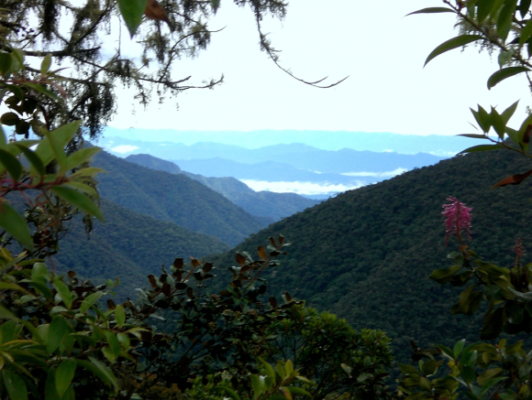
Translocation experiments:
Climate dependence of heterotrophic soil respiration from
a soil-translocation experiment along a 3000 m tropical
forest altitudinal gradient.
Zimmermann M et al., 2009, European Journal of Soil Sciences, 60, 895-906
Location: Andes, Peru
Sites: 4 sites, montane cloud forests, cloud forests ,highland rain forest, lowland rain forest
Altitudinal range: 200 – 3030 m asl
Climatic range: MAT 26.4 – 12.5 °C; MAP 2730 – 1710 mm
Method: reciprocal; intact soil cores of 10 × 50 cm; 4 × 12 cores; tubes with caps to manipulate moisture
Duration: 2 years
Scope: Influence of warming on soil respiration
and C compounds
Analysis: CO₂, soil C and N, soil fractions

Slide 35
Translocation experiments:
Climate dependence of heterotrophic soil respiration from
a soil-translocation experiment along a 3000 m tropical
forest altitudinal gradient.
Zimmermann M et al., 2009, European Journal of Soil Sciences, 60, 895-906
Main findings:
Soil organic C-stocks along gradient increased linearly with altitude, but total soil respiration rate R_{s} did not vary significantly with elevation.
After 1 year, calculated Q₁₀ values of heterotrophic soil respiration R_{sh} where highest for high altitude soils.

Slide 36
Translocation experiments:
Temporal variation and climate dependence of soil respiration
and its components along a 3000 m altitudinal tropical forest gradient.
Zimmermann M et al., 2010, Global Biogeochemical Cycles, 24, GB4012
Main findings:
The temperature sensitivity of R_{sh} increased with time for all soils, i.e. with the loss of the most labile C pools.
The contribution of R_{sh} to R_{s} was not correlated with elevation (or temperature or moisture) and ranged from 25% to 60%.
The diurnal range in R_{s} increased with altitude; this variation was mainly root and litter derived, whereas R_{sh} varied only slightly over full 24 h periods

Slide 37
Translocation experiments:
Can composition and physical protection of soil organic matter explain soil respiration temperature sensitivity?
Zimmermann M et al., 2012, Biogeochemistry, 107, 423-436
Main findings:
Temperature sensitivity of heterotrophic respiration did not correlate with the available amount of SOM or its chemical structure.
Relative distribution of C into particulate organic matter (POM) fractions correlated with Q₁₀ values.
Physical protection of soil C more important than chemical recalcitrance.

Slide 38
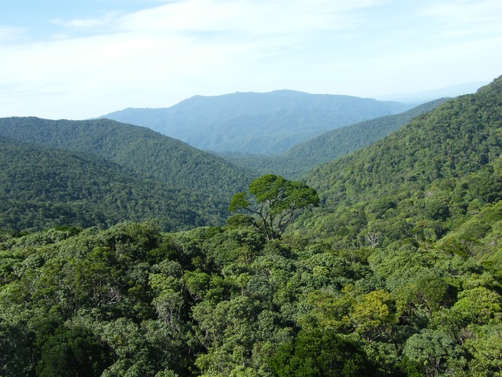
Translocation experiments:
Impact of temperature and moisture on heterotrophic soil respiration along a moist tropical forest gradient in Australia
Zimmermann M & Bird M, in preparation
Location: Tropical Far North Queensland, Australia
Sites: 3 sites, moist tropical rainforests
Altitudinal range: 100 – 1540 m asl
Climatic range: MAT 23.4 – 14.2 °C; MAP 1770 – 8100 mm
Method: reciprocal; intact soil cores of 10 × 30 cm; 3 × 15 cores
Duration: 2 years
Scope: Impact of SOM quality and climatic
conditions on soil respiration
Analysis: CO₂, soil C and N, soil fractions

Slide 39
Translocation experiments:
Impact of temperature and moisture on heterotrophic soil respiration along a moist tropical forest gradient in Australia
Zimmermann M & Bird M, in preparation
Main findings:
Temperature had the higher impact on respiration rates than moisture.
Soils cores from the highest elevation revealed the largest temperature sensitivity which decreased with decreasing elevation (or soil C-stocks).

Slide 40
Translocation experiments: summary of results
Scope of studies:
  Soil carbon dynamics (8)
  Nitrogen transformation (7)
  Microbial community dynamcis (5)
  Plant biomass (2)
  Invertebrates (1)
  → Some studies with multiple scopes

Slide 41
Translocation experiments: summary of results
Soil carbon dynamics:
Warming reduced C-concentrations significantly in absence of plants.
Moisture and temperature controlled decomposition of C after translocation, but temperature had larger impact than moisture, except in arid ecosystems.
Substrate quality changed over time, whereas particulate organic matter was most sensitive to warming.

Slide 42
Translocation experiments: summary of results
Soil nitrogen transformation:
Warming increased net N mineralization and nitrification and reduced total N significantly.
Moisture and temperature regulated N mineralization together.
Environmental controls were more pronounced at extreme sites; i.e. hot and moist sites, and soils with high and low C and N contents.

Slide 43
Translocation experiments: summary of results
Soil microbial communitiy dynamcis:
Small increase in relative abundance of fungi.
Shift of microbial communities and microbial biomass towards new site conditions only after several years.

Slide 44
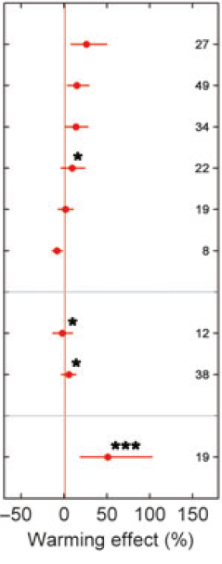
Results of warming experiments: review by Dieleman et al., 2012
Data from 150 manipulation experiments from 42 sites
Total Biomass
Aboveground biomass
Root biomass
Fine root biomass
Microbial biomass
Soil C
Number of studies
Heterotrophic respiration
Soil respiration
Mineral N
Dieleman et al., 2012, Simple additive effects are rare: a quantitative review of plant biomass and soil process responses to combined manipulations of CO₂ and temperature. Global Change Biology, 18, 2681-2693
Notes:
Warming typically stimulates nutrient availability via enhanced net N mineralization rates. Second, in contrast to elevated [CO2] experiments, higher temperatures enhance aboveground biomass, but do not stimulate (fine) root biomass (Fig. 1b). This apparent difference in the impact on biomass distribution patterns may be partly due to the increased N availability in warming experiments (Fig. 1b), as higher nutrient availability reduces the need to develop an elaborate belowground nutrient acquisition system (Melillo et al., 2011). A third striking difference is the lack of stimulation of soil respiration in the warming experiments (Fig. 1b). Whereas elevated [CO2] typically increases soil respiration, soil respiration does not show a consistent long-term response to warming (Fig. 1b). Although soil respiration generally increases when temperature rises on a short time scale (±5 years), several mechanisms can prevent a persistent positive warming effect on microbial and soil respiration. Particularly important in this regard are depletion of labile soil organic matter pools following extended stimulation of microbial decomposition during earlier phases in the warming experiments, warming-induced water limitation of microbial activity (Suseela et al., 2012), and thermal acclimatization of root and/or microbial respiration.
Elevated [CO2] and warming thus elicit very different ecosystem responses, but in situ these two global change factors are changing concurrently. Therefore, combined [CO2] enrichment and warming experiments are crucial to test whether ecosystem processes in a warmer, [CO2]-enriched world will mirror those observed in warming, those in elevated [CO2], or whether their responses will be additive, antagonistic or even synergistic.

Slide 45
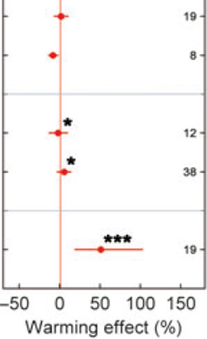
To sum up: warming vs translocation experiments
in situ warming translocation
Microbial biomass
Adaptation after years
Soil C
Significant negative impact after 1-2 years
(caused by depletion of most labile C?)
Heterotrophic
respiration
Significant positive impact after 1-2 years
(priming by deceased roots?)
Mineral N
Significant positive impact after 1-2 years
Notes:
Most data from translocations just from 1-2 years, much too short…

Slide 46
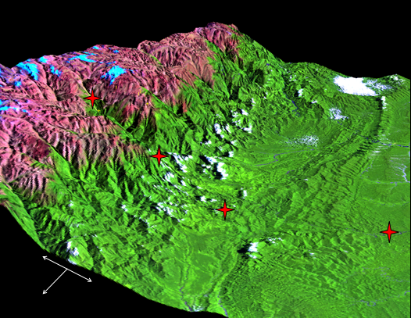
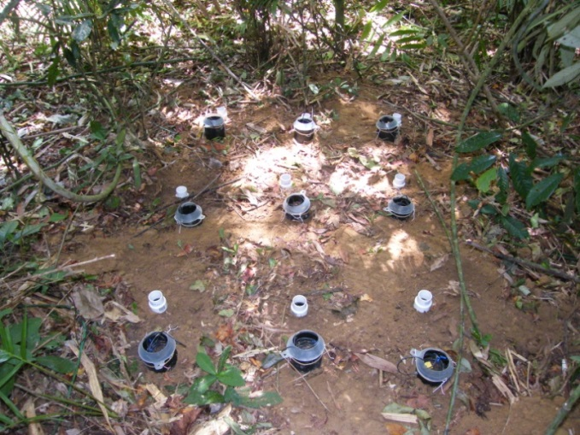
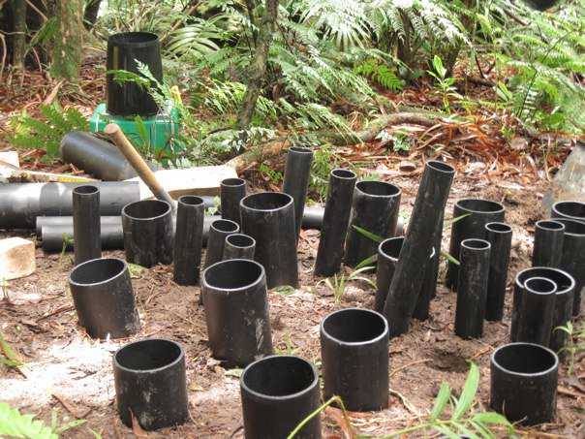
Thank you very much
3030 m
1500 m
200 m
1000 m
West
East
Soil translocation Andes
South

