Slide 1
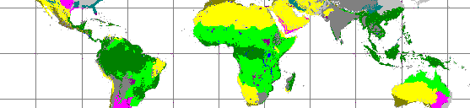
Tropical plant trait evolution and the consequences for savanna-forest transitions
William A. Hoffmann
North Carolina State University
Collaborators
Augusto Franco
M. Haridasan
Erika Geiger
Sybil Gotsch
Lucas Silva
Davi Rossatto
Notes:
This is not the title that I claimed I would speak about. That talk never evolved. However, as you will see, the results from our work provides a framework that lends itself quite well to global dynamic vegetation modeling, though to my knowledge, only Simon’s encorporates anything similar to this.

Slide 2
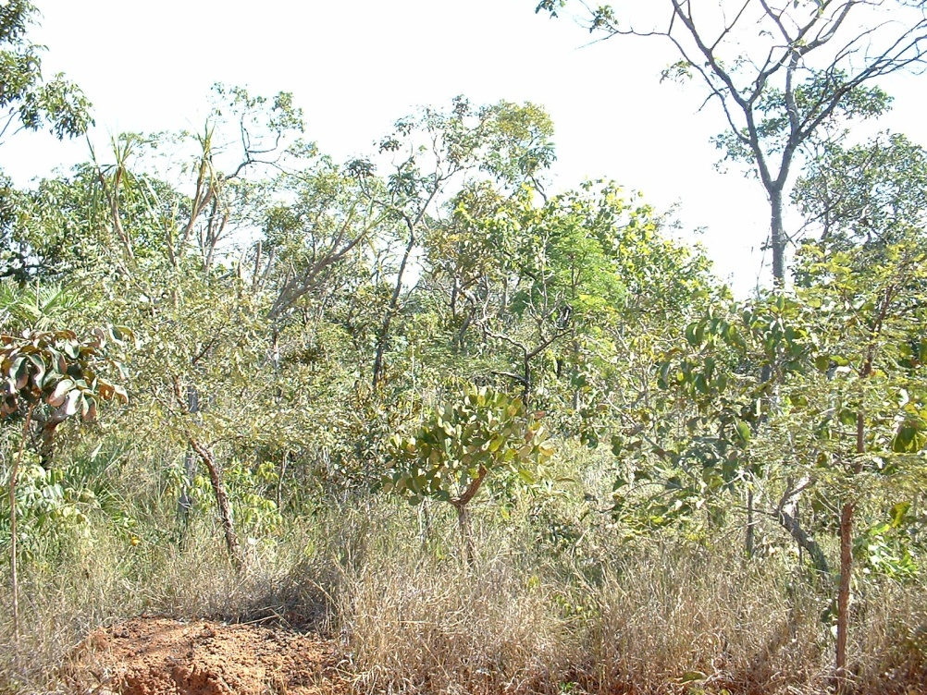
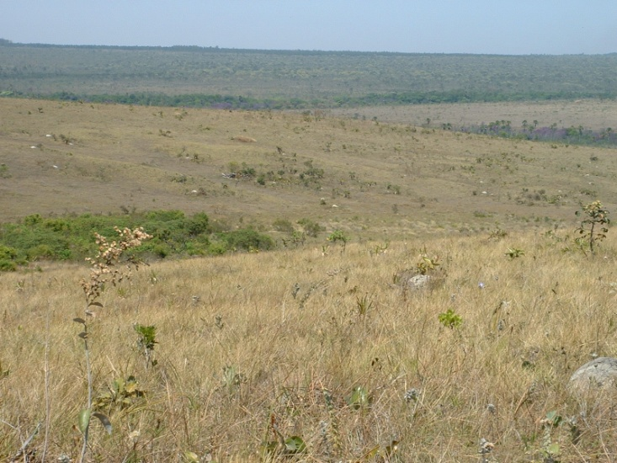
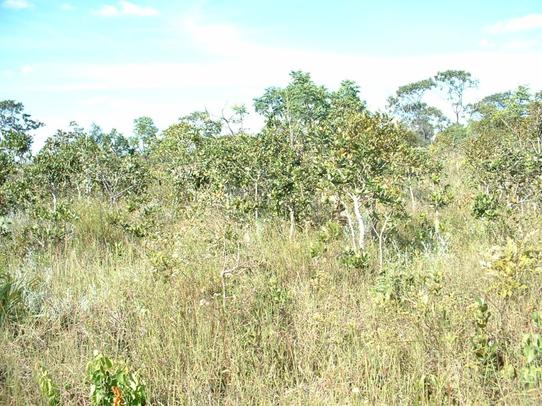
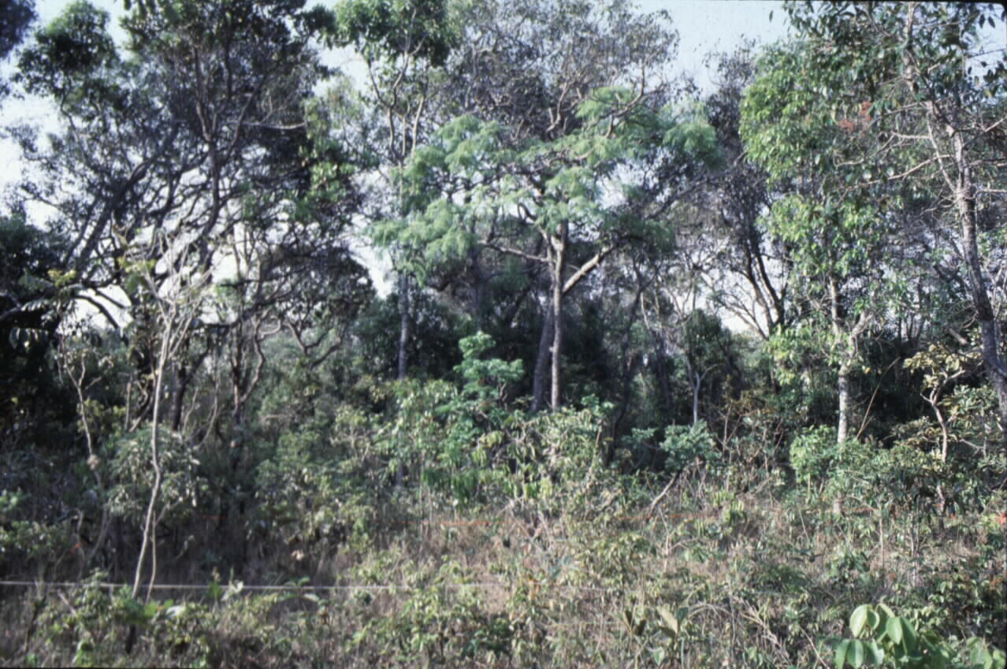
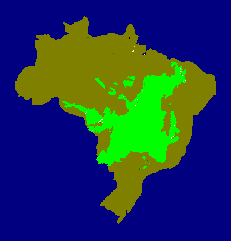
The Cerrado
Notes:
I want to begin by introducing my study system. I will be talking about work we have been undertaking in the cerrado region of Brazil. This is an area that is predominantly savanna vegetation, but with a number of forest types.
Mostly savanna
Dry season, most of area receives over 1200 mm yr
Nutrient limited
No herbivores
This variantion in tree cover begs the age-old question in savannas:

Slide 3
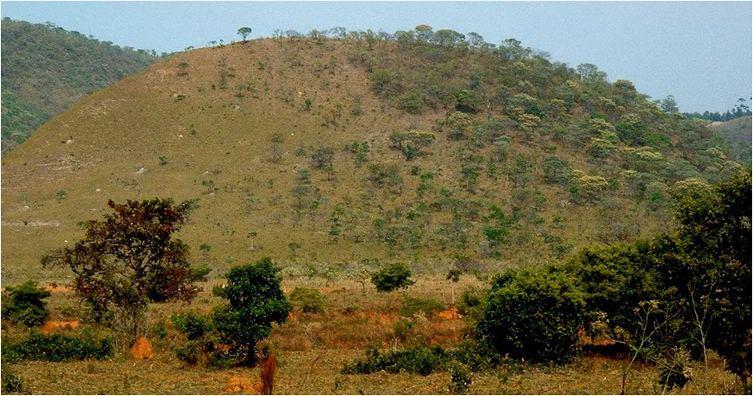
What determines tree cover in savannas?
Notes:
Here, as in every other savanna system of the world. The eternal question in tropical savannas is “What governs tree cover in savanna.”

Slide 4
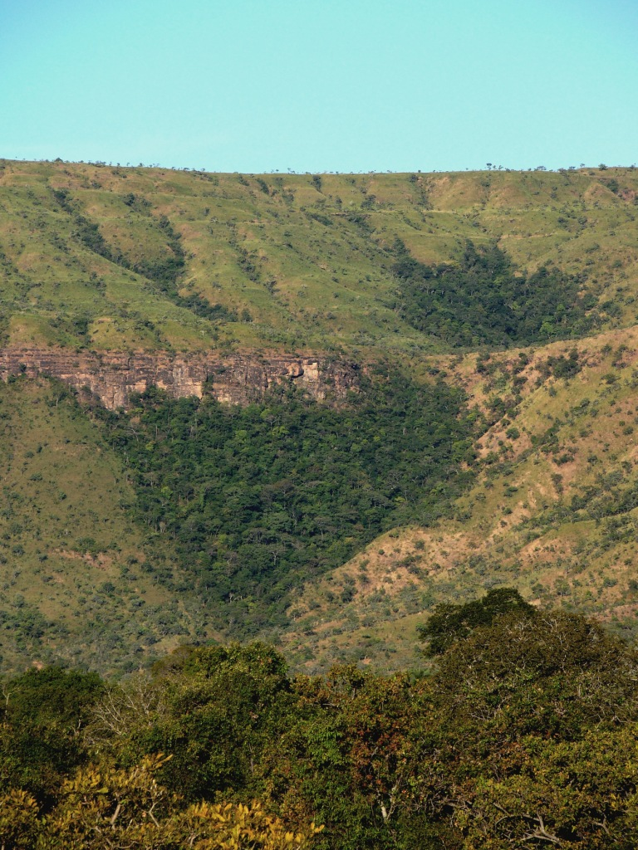
What determines the distribution of forest and savanna?
Notes:
A special case of this problem, which requires special attention , is “what determines the distribution of savanna versus forest?”
This is a particularly important question. There are huge areas of the tropics where the climate
There are several reasons why this is such a special question. First, grasses are absent in forest.

Slide 5
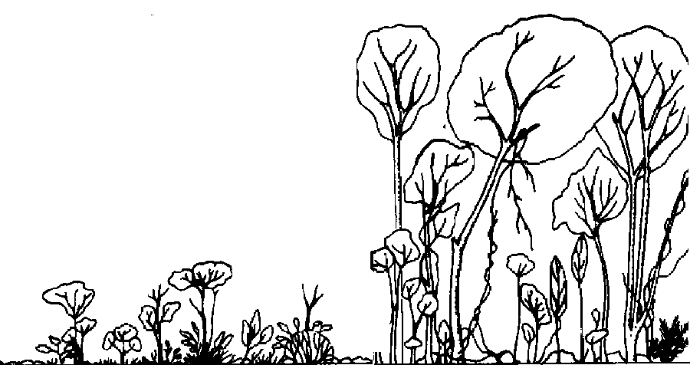
Sparse tree cover
Dense grass
Dense tree cover
no grass
Cool, moist microclimate
Infrequent, mild fire
Hot, dry, windy microclimate
Frequent fire
Notes:
There is support for a number of positive feedbacks which can help explain the existance of alternate stable states and sharp vegetation boundaries. When you have positive feedbacks, it clouds the question of whether the environment determines vegetation or whether vegetation determines the environment. The truth is that both are true. Nevertheless, when we examine environmental gradients across the boundary we usually have some beleifs about whether a particular variable is being more strongly driven by vegetaion or is driving the vegetation.
Postive feedbacks
Alternate stable states – fire
Becomes difficult to attempt to identify causality - meaningless

Slide 6
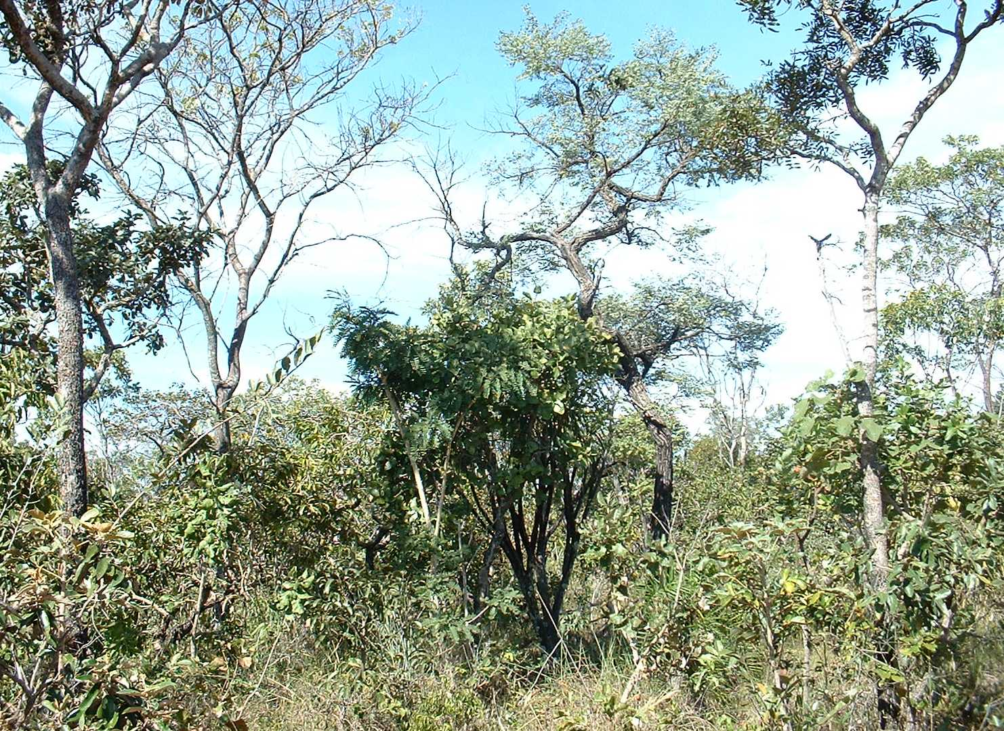
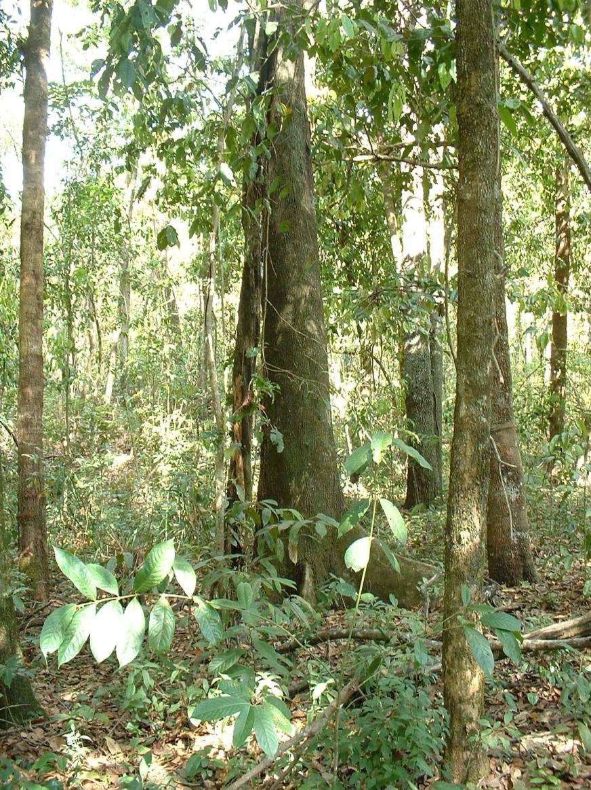
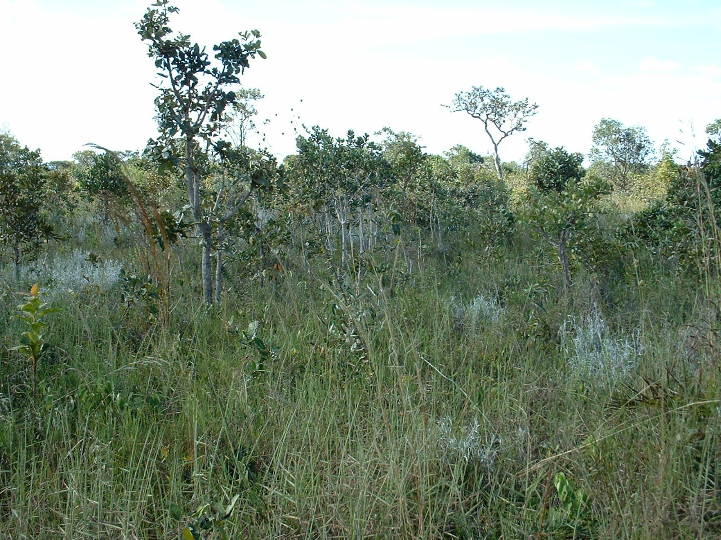
Notes:
And there is a third way in which the transition between savanna and forest differs from grasients of tree density within savanna…
If there is a complete switch in species composition, it begs the question if a site is forest because it has forest species or whether a site has forest species because it is a forest.
The question of what determines the distribution of savanna and forest cannot be extracted from the question of what determines the distribution of forest species and savanna species.
Not only is the vegetation-fire issue a difficult one to tease apart. Vegetation – species composition. And we suddenly are forced to consider their roles as well as how the species arose.
Now this was not always this way.

Slide 7
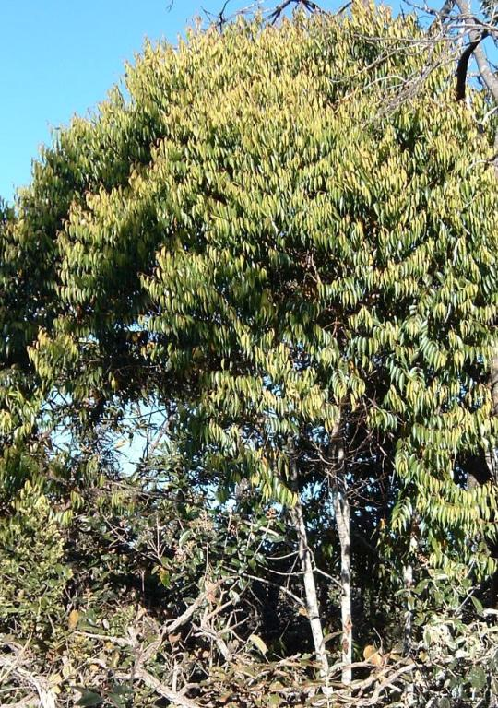
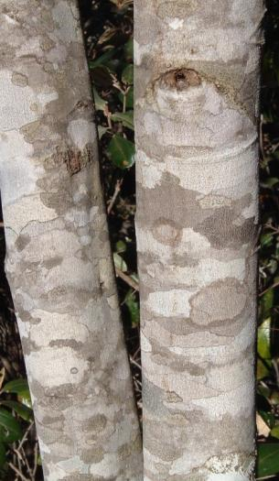
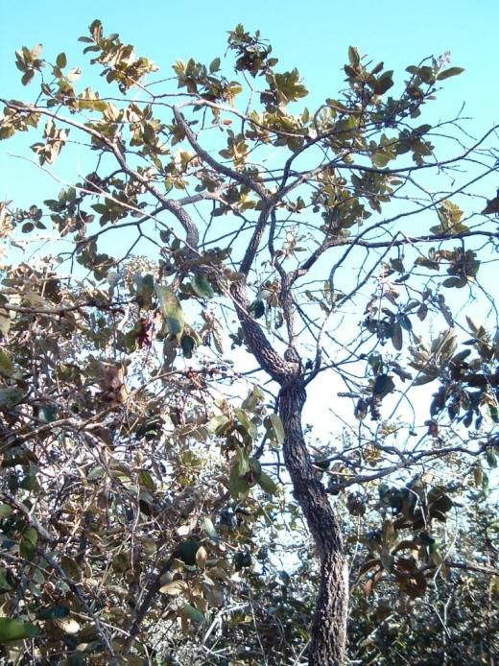
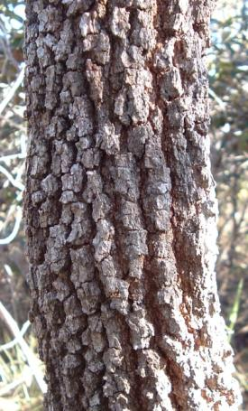
Miconia pohliana
(Savanna species)
Miconia cuspidata
(Forest species)

Slide 8
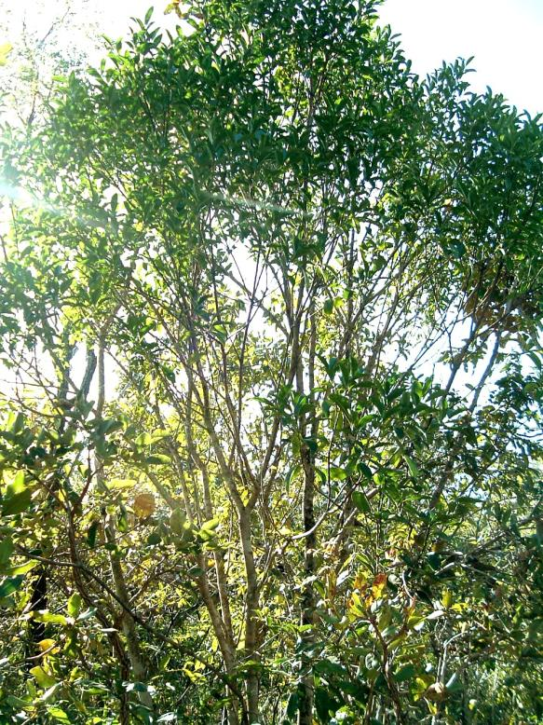
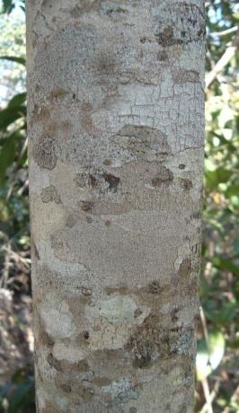
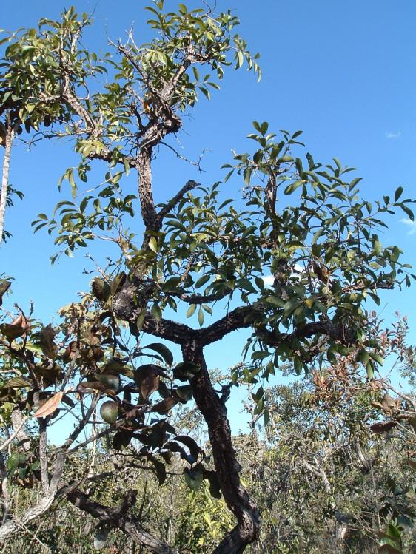
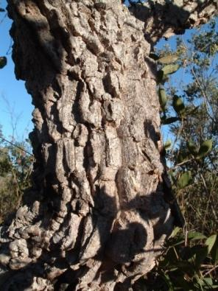
Symplocos
rhamnifolia
(Savanna species)
Symplocos mosenii
(Forest species)

Slide 9
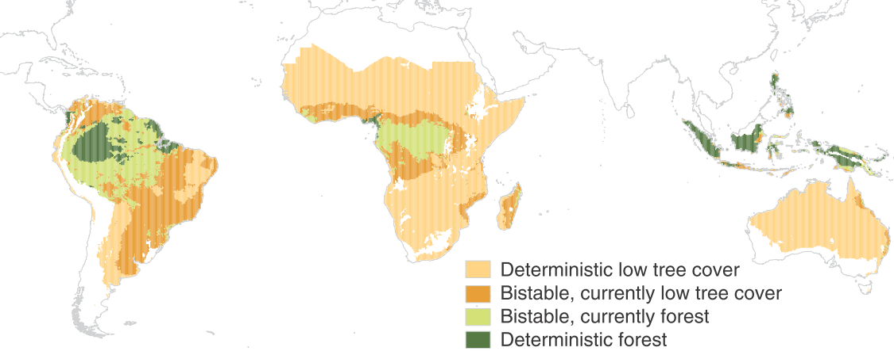
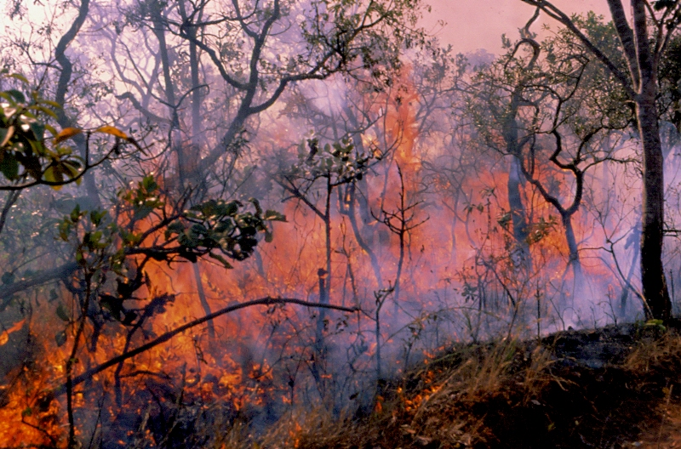
Large areas of the tropics have climates in which either savanna or forest vegetation in possible
Staver et al (2011)
Notes:
Large areas of the tropics are prone to shifts in vegetation. So the question of

Slide 10
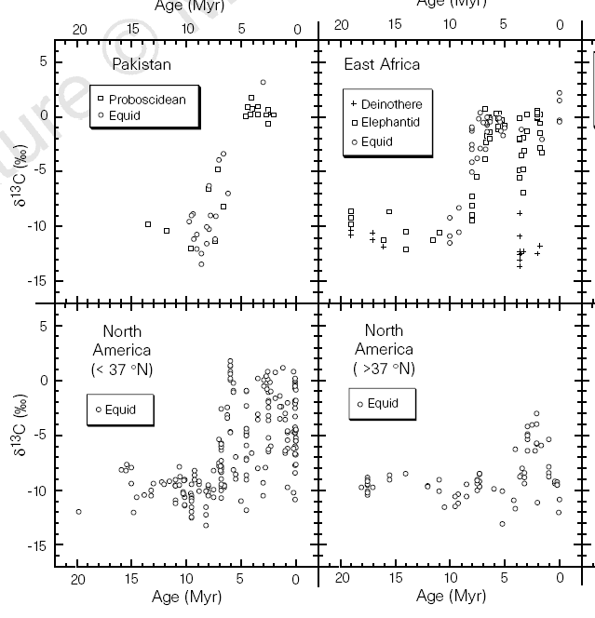
C₄ grasses became abundant only in the past 8 million years
Cerling et al 1997 Nature 389:153-158
Notes:
Now if you recognize that either savanna or forest is possible in these areas, it is easy to fall into the the trap of beleiving that humans are responsible for these savannas.
This graph shows changes in carbon isotopes in the enable of large mammals in four regions across the globe. What it shows is that their diets changed from C3 to C4.

Slide 11
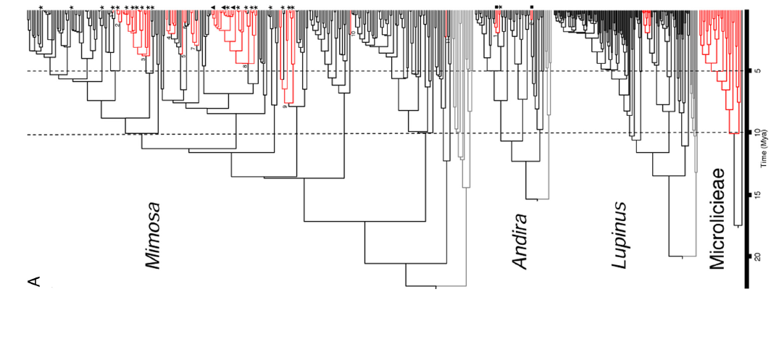
Simon et al 2009
Savanna trees and shrubs began to arise from forest ancestors approximately 10 million years ago.
Notes:
In the Brazilian savannas, this is supported by recent phylogenetic work…

Slide 12
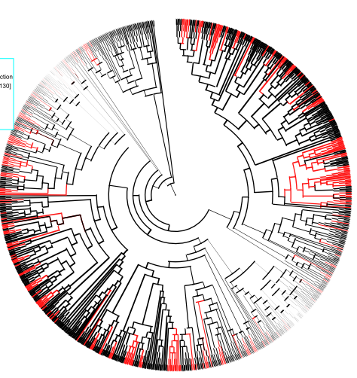
There have been at least 115 independent origins of savanna trees or shrubs
Black = forest taxa
Red = savanna taxa
Hoffmann (unpublished)
Notes:
I should mention that these generalizations are not based on just a few species

Slide 13
Main questions
What selective pressures have shaped the evolution of tree species in savanna?
What are the consequences of savanna tree adaptations for ecosystem properties and vegetation dynamics?
Notes:
And given that these evolutionary changes will influence how plants interact with their environment, they have the potential to influence ecosystem properties and vegetation dynamics.
The selective pressures provide great insight into the dominant factors that limit tree success.
The second question is relevant for understanding how vegetation is likely to shift in response to climate change, etc.

Slide 14
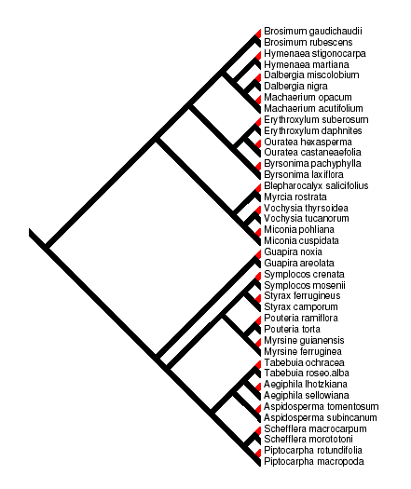
The multiple, independent origins of savanna lineages is ideal for comparative studies
Black = forest taxa
Red = savanna taxa

Slide 15
Savanna and forest species differ substantially in traits that have large implications for ecosystem structure and dynamics
Note that this is a comparison of forest and savanna species.

Slide 16
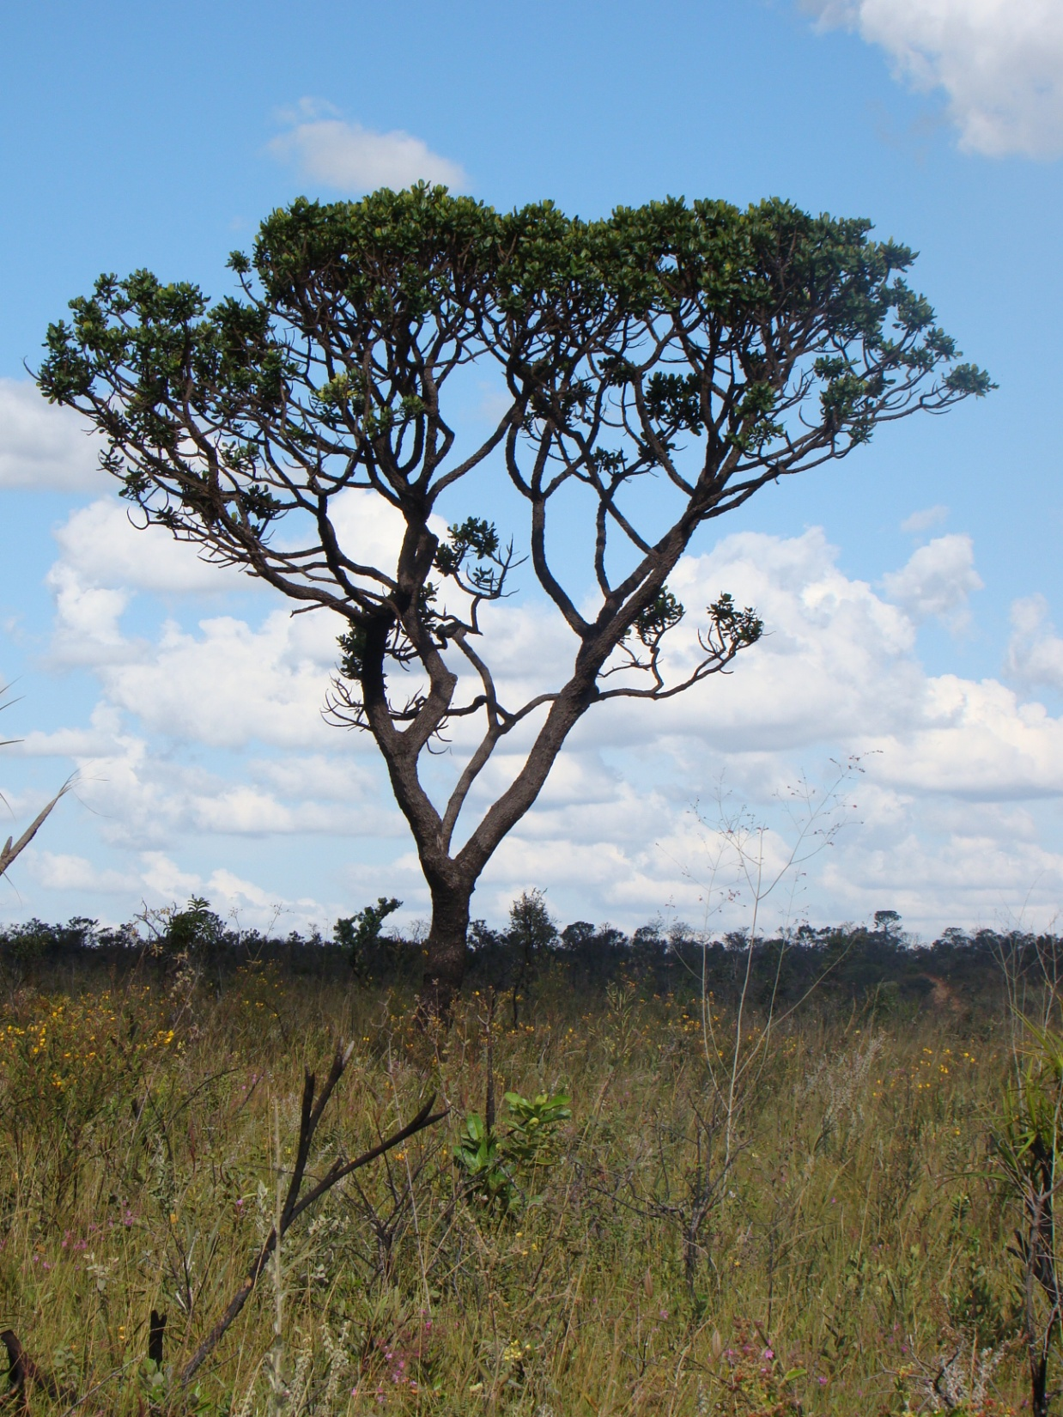
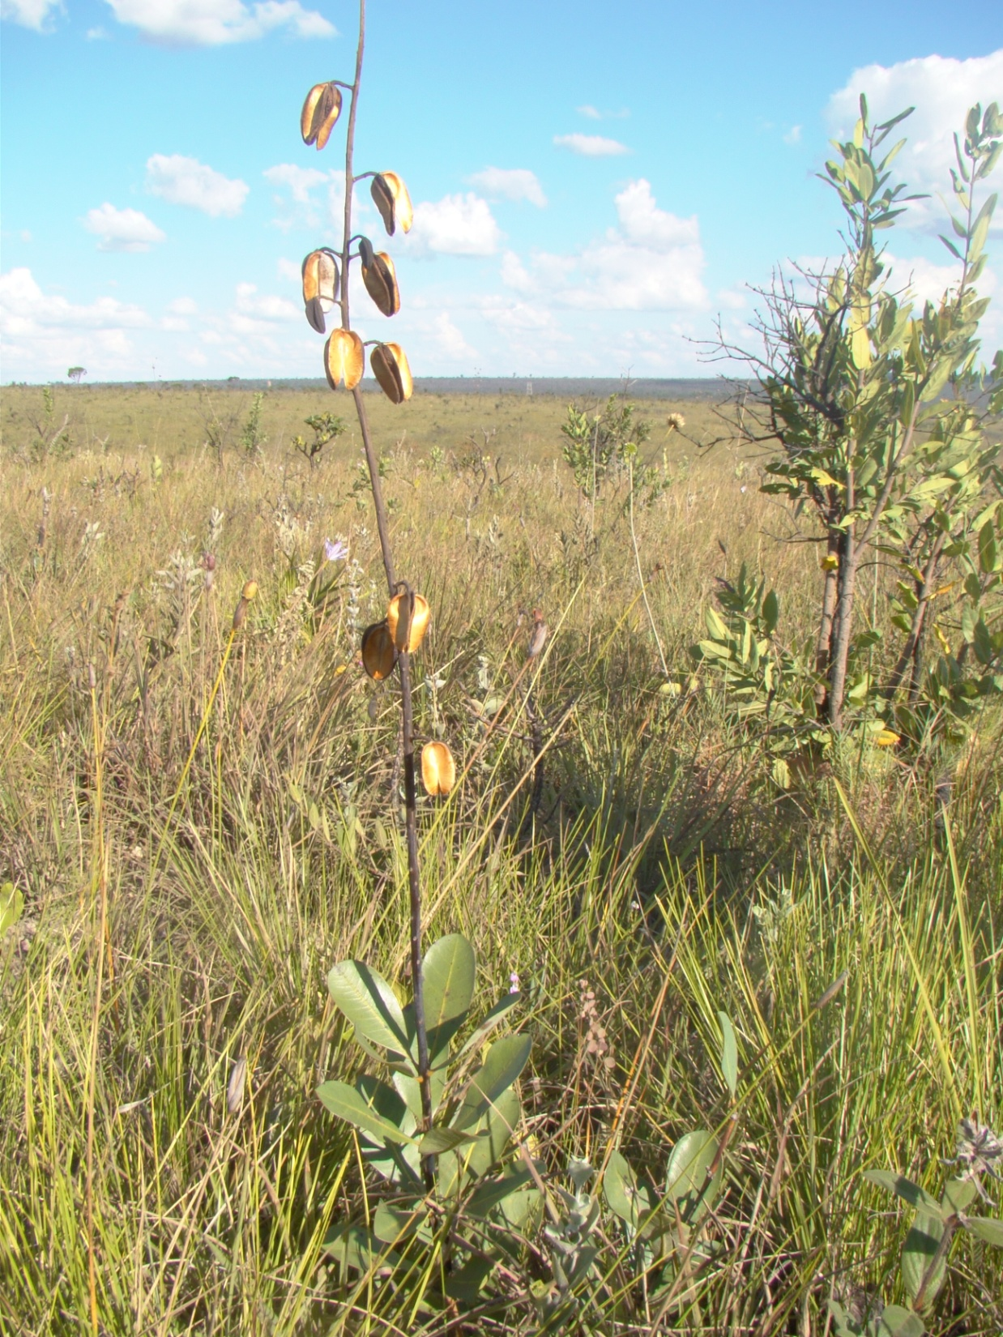
53% of the evolutionary transitions from forest to savanna were associated with a shift to a smaller growth form.

Slide 17
Question 2:
What are the consequences of these adaptations for ecosystem properties and vegetation dynamics?
Notes:
The selective pressures provide great insight into the dominant factors that limit tree success.
The second question is relevant for understanding how vegetation is likely to shift in response to climate change, etc.

Slide 18
Savanna and forest species survive fire equally well
Notes:
Some of the more surprising results we have had is that there was no difference in tree whole-plant mortality in response to fire

Slide 19
The fire trap (Bell 1984)
Long time
without fire
Fire
Notes:
Where fire is common, the concept of the fire trap is relevant
Escaping the fire trap within a given period without fire will depend on rate of tree growth and size at which fire resistance is attained.
Reaching theshold size is critical because it will determine whether a tree reaches a size where it can reproduce sexually and to contribute substantially to tree cover.
Grow fast
Reach fire resistance at a smaller size

Slide 20
The fire trap (Bell 1984)
Long time
without fire
Short time
without fire
Fire
Notes:
Where fire is common, the concept of the fire trap is relevant
Escaping the fire trap within a given period without fire will depend on rate of tree growth and size at which fire resistance is attained.
Reaching theshold size is critical because it will determine whether a tree reaches a size where it can reproduce sexually and to contribute substantially to tree cover.
Grow fast
Reach fire resistance at a smaller size

Slide 21
The fire trap (Bell 1984)
Long time
without fire
Short time
without fire
Fire
Fire
Notes:
Where fire is common, the concept of the fire trap is relevant
Escaping the fire trap within a given period without fire will depend on rate of tree growth and size at which fire resistance is attained.
Reaching theshold size is critical because it will determine whether a tree reaches a size where it can reproduce sexually and to contribute substantially to tree cover.
Grow fast
Reach fire resistance at a smaller size

Slide 22
The fire trap (Bell 1984)
Long time
without fire
Short time
without fire
Fire
Notes:
Where fire is common, the concept of the fire trap is relevant
Escaping the fire trap within a given period without fire will depend on rate of tree growth and size at which fire resistance is attained.
Reaching theshold size is critical because it will determine whether a tree reaches a size where it can reproduce sexually and to contribute substantially to tree cover.
Grow fast
Reach fire resistance at a smaller size

Slide 23
The fire trap (Bell 1984)
Long time
without fire
Short time
without fire
Fire
Fire
Notes:
Where fire is common, the concept of the fire trap is relevant
Escaping the fire trap within a given period without fire will depend on rate of tree growth and size at which fire resistance is attained.
Reaching theshold size is critical because it will determine whether a tree reaches a size where it can reproduce sexually and to contribute substantially to tree cover.
Grow fast
Reach fire resistance at a smaller size

Slide 24
An analogous threshold exists for ecosystems
Notes:
For a stand to escape the fire trap within a given amount of time without fire will depend on rate of canopy closure, which will depend on establishment processes, rate of tree growth, and canopy density as well.
Again, growth will be very important
But alo will be the ability to cast shade
Obviously, establishment processes are very important, but I won’t talk about this

Slide 25
An analogous threshold exists for ecosystems
Short time
without fire
Notes:
For a stand to escape the fire trap within a given amount of time without fire will depend on rate of canopy closure, which will depend on establishment processes, rate of tree growth, and canopy density as well.
Again, growth will be very important
But alo will be the ability to cast shade
Obviously, establishment processes are very important, but I won’t talk about this

Slide 26
An analogous threshold exists for ecosystems
Short time
without fire
Fire
Notes:
For a stand to escape the fire trap within a given amount of time without fire will depend on rate of canopy closure, which will depend on establishment processes, rate of tree growth, and canopy density as well.
Again, growth will be very important
But alo will be the ability to cast shade
Obviously, establishment processes are very important, but I won’t talk about this

Slide 27
An analogous threshold exists for ecosystems
Long time
without fire
Short time
without fire
Fire
Notes:
For a stand to escape the fire trap within a given amount of time without fire will depend on rate of canopy closure, which will depend on establishment processes, rate of tree growth, and canopy density as well.
Again, growth will be very important
But alo will be the ability to cast shade
Obviously, establishment processes are very important, but I won’t talk about this

Slide 28
An analogous threshold exists for ecosystems
Long time
without fire
Short time
without fire
Fire
Fire
Notes:
For a stand to escape the fire trap within a given amount of time without fire will depend on rate of canopy closure, which will depend on establishment processes, rate of tree growth, and canopy density as well.
Again, growth will be very important
But alo will be the ability to cast shade
Obviously, establishment processes are very important, but I won’t talk about this

Slide 29
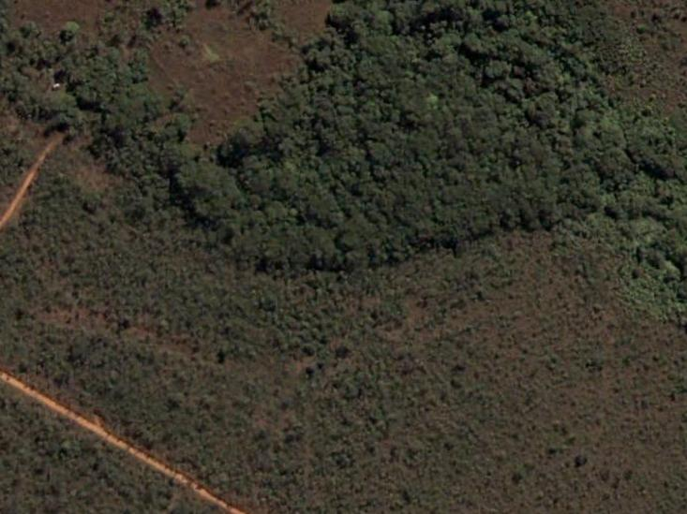

Resource manipulation experiment
10m x 70m plots
CONTROL
NUTRIENTS
WATER
WATER + NUTRIENTS

Slide 30
Tree growth is more strongly limited by nutrients than by water

Slide 31
High-resource sites permit more rapid canopy closure
High resource site
Low resource site

Slide 32
At what point is each thresholds reached?
How big must a tree be to avoid topkill?
How dense must the canopy be to substantially reduce flammability?
Notes:
Once we recognize the existence of the thresholds, it becomes important to understand the point that defines the transition from one phase to another.

Slide 33
Hoffmann et al (2012) Ecology Letters

Slide 34
Hoffmann et al (2012) Ecology Letters

Slide 35
A growing stem becomes fire resistant when its bark thickness exceeds 6 mm
5.9 mm
Hoffmann et al (2012) Ecology Letters

Slide 36
A growing stem becomes fire resistant when its bark thickness exceeds 6 mm
5.9 mm
9.1 mm
Hoffmann et al (2012) Ecology Letters

Slide 37
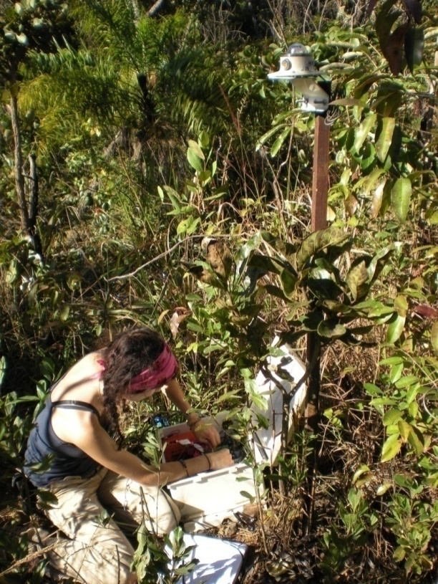
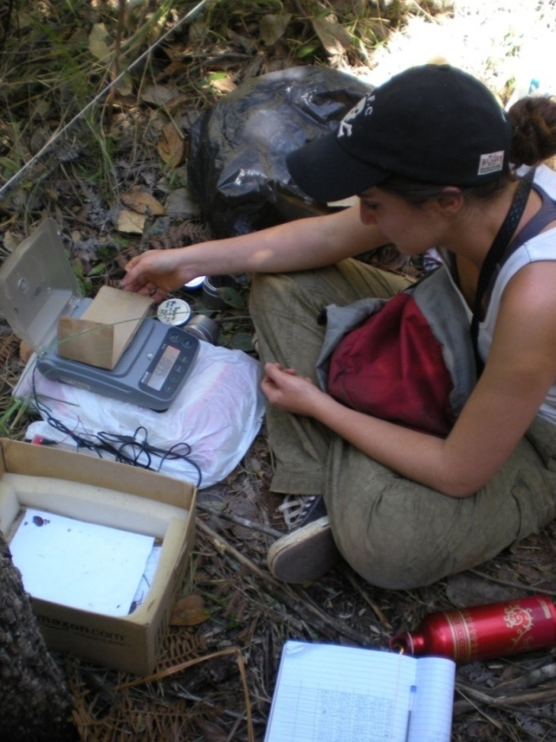
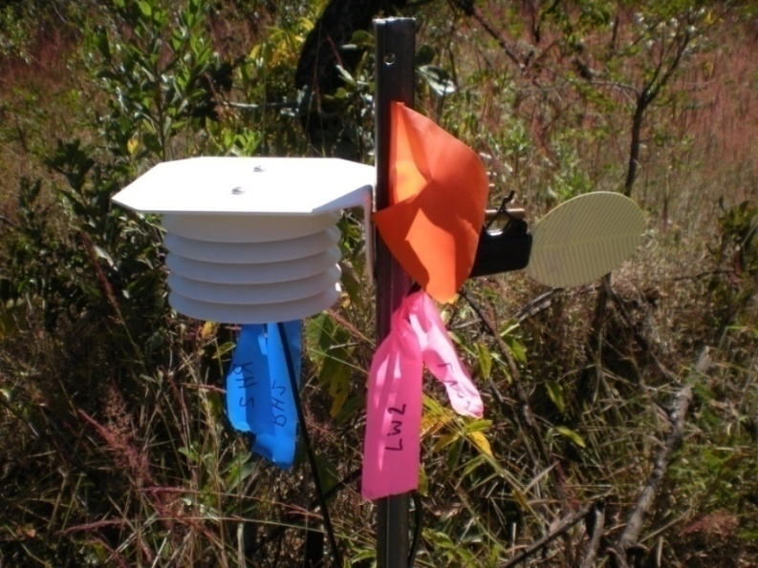
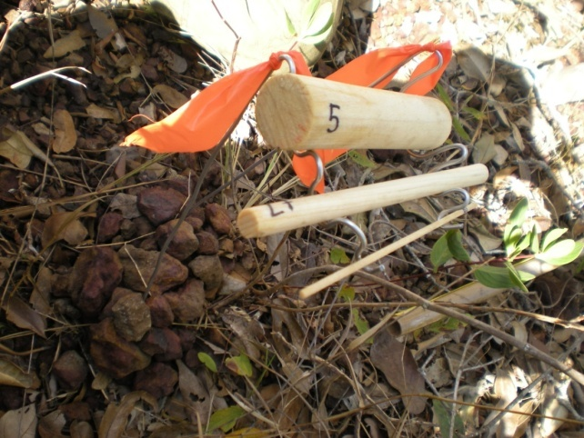
-30
-10
10
30
Distance (m)
Microclimate
Wind speed
Relative humidity
Temperature
Fuels
Mass
Moisture
Bulk density
BehavePlus 5
(fire behavior model)
Hoffmann et al (2012) Austral Ecology
Notes:
So we monitored microclimate and characterized fuels at 8 savanna-forest boundaries. We did this at 4 points along each transect. Microclimate was logged for 1 week before moving the set of instruments to the next site.

Slide 38
Notes:
When we cross the savanna-forest boundary, we find rather sharp gradients in vegetation structure, as well as edaphic and physical environments. As a matter of definition, I define the savanna-forest boundary as the point where savanna grasses are no longer encountered. For these boundaries, this is an amazingly simple rule to follow. If we look at critical meteorological variables that influence fire. We see that understory midday wind speed and midday air temperatures are greater in the savanna, while midday relative humidity and fuel moisture are greater in the forest. at 1 meter height

Slide 39
Fire simulations with BehavePlus
Notes:
When we cross the savanna-forest boundary, we find rather sharp gradients in vegetation structure, as well as edaphic and physical environments. As a matter of definition, I define the savanna-forest boundary as the point where savanna grasses are no longer encountered. For these boundaries, this is an amazingly simple rule to follow. If we look at critical meteorological variables that influence fire. We see that understory midday wind speed and midday air temperatures are greater in the savanna, while midday relative humidity and fuel moisture are greater in the forest. at 1 meter height

Slide 40
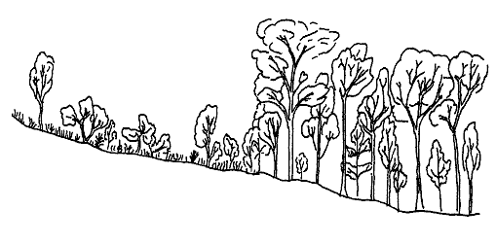
Notes:
-Fuel packing ratio was considerably higher in forest
-volume of the fuel bed occupied by fuel
-grasses stand upright, biomass occupies large volume even when they senesce.
- In forest the fuels occupy a thin, relatively compact litter layer,

Slide 41
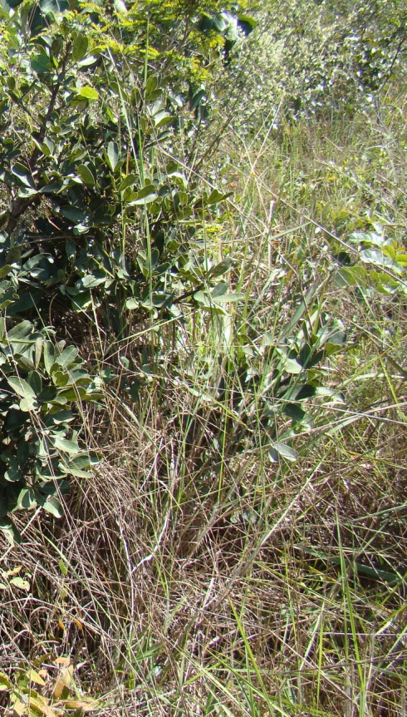
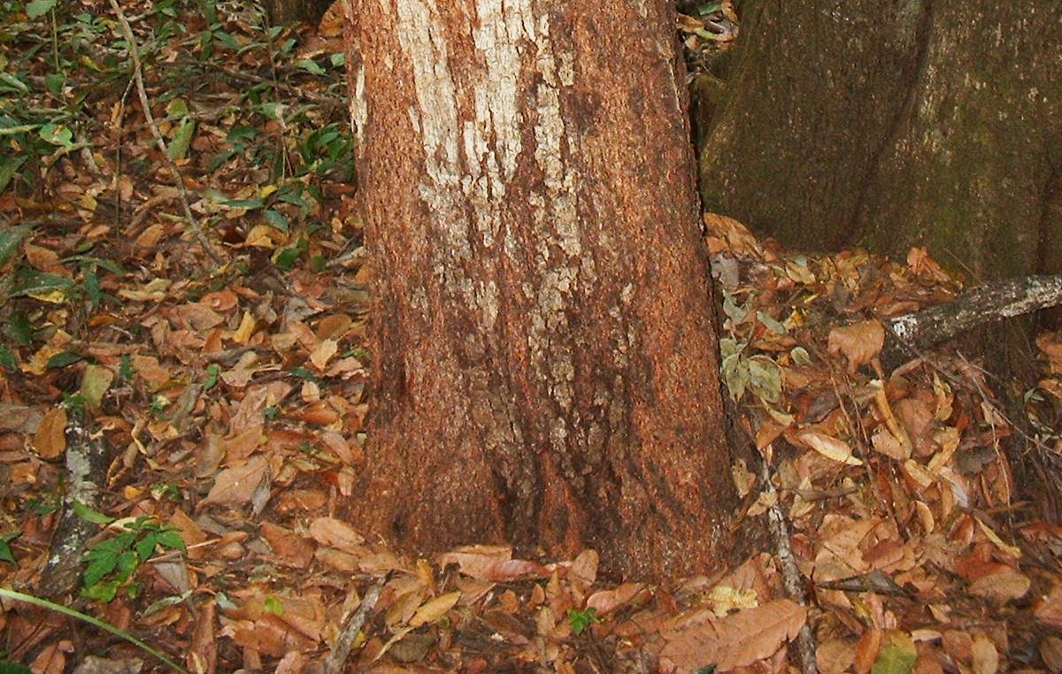
Flammability of savanna is determined primarily by the presence of grass
Notes:
What this work allowed us to show is that the higher flammability of savanna is largely caused by the presence of grasses, and largely due to the low bulk density of
The fuelbed. And finally, you do not need much biomass to have a substantial effect on flammability. So in short, the point at which grasses are lost is a useful indicator of the ecosystem having reached the fire suppression threshold.

Slide 42
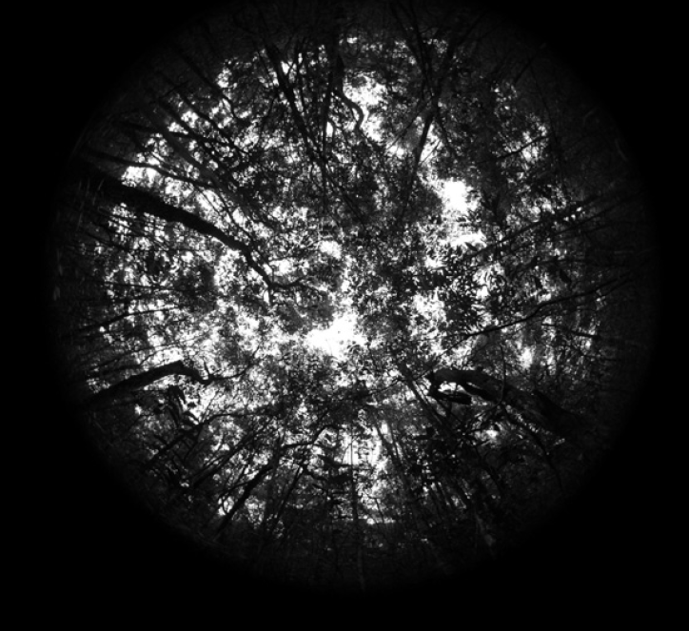
The canopy density at which grasses are excluded is a critical transition between savanna and forest.

Slide 43
Thus we have two critical thresholds
A tree reaches a fire-resistance threshold when it accumulates a bark thickness of about 6 mm.
The ecosystem reaches a fire-suppression threshold when it attains a leaf area index of about 3.
Notes:
Now that we have these, we can explore how factors such as resource availability or species traits influence tree dynamics.

Slide 44
As savanna trees grow, they accumulate bark thickness more quickly than forest species

Slide 45
As savanna trees grow, they accumulate bark thickness more quickly than forest species
Threshold bark
thickness

Slide 46
As savanna trees grow, they accumulate bark thickness more quickly than forest species
Threshold bark
thickness
4.7 cm
10.2 cm

Slide 47
Recall that forest species grow more quickly than savanna species when growing in the same environment

Slide 48
 | Savanna species | Forest species
Fire interval required to ensure <50% topkill | 8 years | 14 years
Expected total time under stochastic fire regime
5-year mean return interval | 25 years | 108 years
2-year mean return interval | 510 years | 32800 years
Notes:
Yes, this is based on many assumptions, but nevertheless, it shows that there are very strong nonlinearities. Consequently, a roughly 2-fold difference in rate of bark accumulation, can have order-of-magnitude effects on the probability of becoming forest.

Slide 49
Under a typical fire regime a forest tree has little chance of reaching maturity in savanna
But, there is safety in numbers
Notes:
For example, many of the trees in forest would be quickly topkilled if they were growing in the

Slide 50
Sparse tree cover
Dense grass
Dense tree cover
no grass
Cool, moist microclimate
Infrequent, mild fire
Hot, dry microclimate
Frequent fire

Slide 51
Forest species have greater leaf area than savanna species when growing in the same environment

Slide 52
Forest species permit more rapid canopy closure
Site occupied
by forest species
Site occupied by
savanna species
Notes:
So using a really crude synthesis, we have that a site occupied by forest species might become dense enough to exclude 6 years vs 19 years

Slide 53
Forest species permit more rapid canopy closure
Site occupied
by forest species
Threshold
canopy density
Site occupied by
savanna species
Notes:
So using a really crude synthesis, we have that a site occupied by forest species might become dense enough to exclude 6 years vs 19 years

Slide 54
Forest species permit more rapid canopy closure
Site occupied
by forest species
Threshold
canopy density
Site occupied by
savanna species
Notes:
So using a really crude synthesis, we have that a site occupied by forest species might become dense enough to exclude 6 years vs 19 years

Slide 55
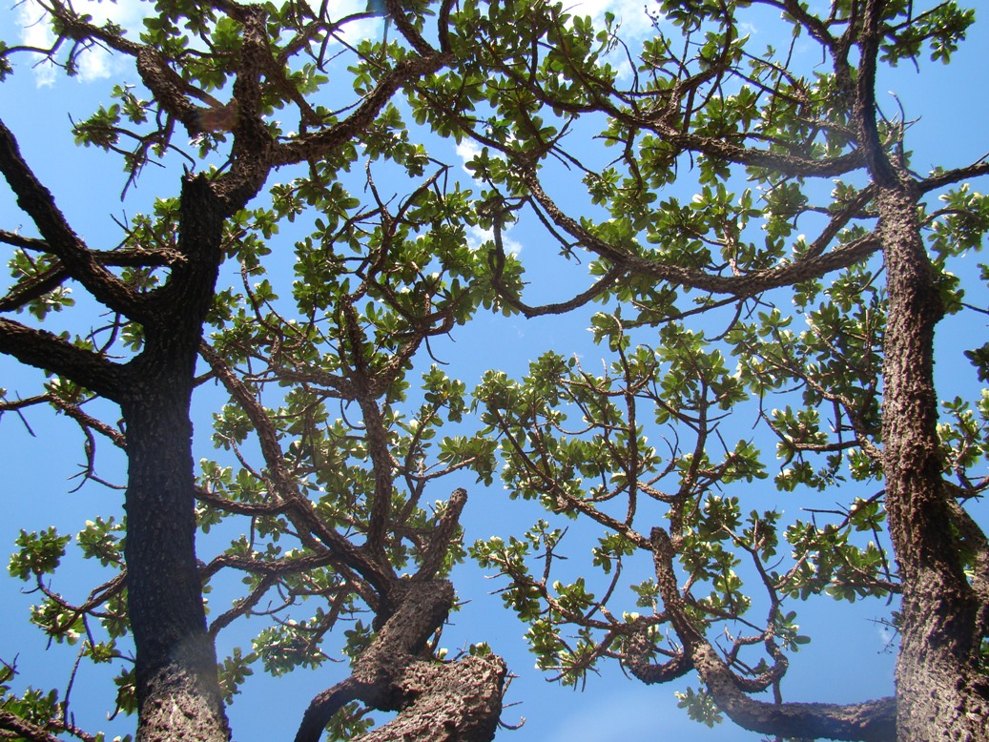
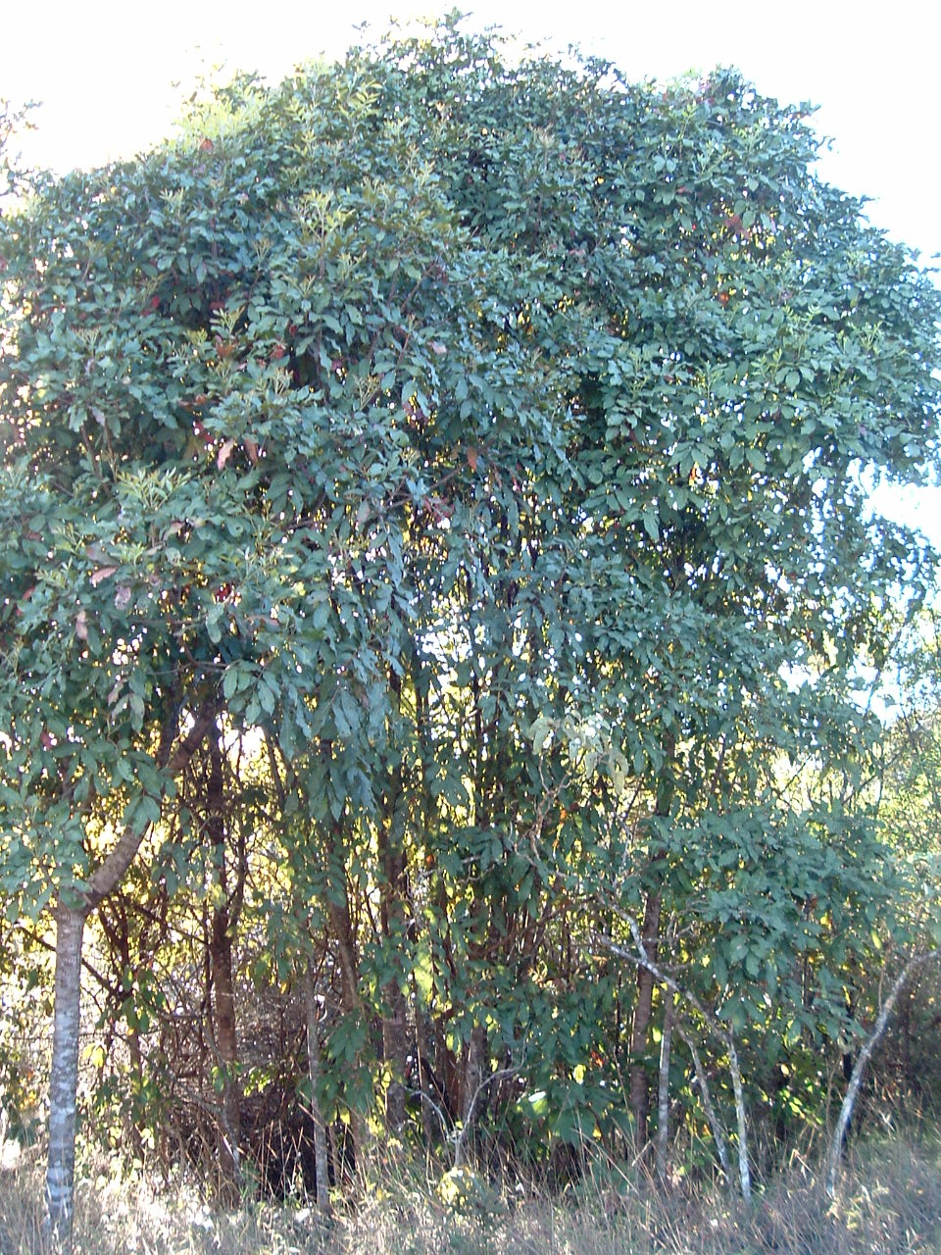
Notes:
These calculations are based on the assumption that savanna and forest trees differ only in the rate at which trees

Slide 56
Notes:
-Fuel packing ratio was considerably higher in forest
-volume of the fuel bed occupied by fuel
-grasses stand upright, biomass occupies large volume even when they senesce.
- In forest the fuels occupy a thin, relatively compact litter layer,

Slide 57
Conclusions
Many indepedent origins of savanna trees
Fire has exerted strong selection on traits
Nutrients, not water, limits tree growth in these mesic savannas.
Two critical thresholds govern savanna-forest dynamics:
  (1) bark thickness at which a stem becomes fire resistant.
  (2) canopy density at which grasses are excluded
Reaching a forest state requires forest species, but these are particularly constrained by the high frequency of fire

Slide 58
Vegetation models should
Represent fire and its feedbacks with vegetation
Represent topkill and reprouting
Represent of savanna and forest tree functional types OR tradeoffs involving bark, carbohydrate storage, shade tolerance, canopy density.
Not assume that tree cover in mesic savannas are water limited.
Robustly simulate savannas over large areas in response to water deficits, multiple nutrient deficiencies, seasonal flooding, and physical soil constraints.

