Slide 1
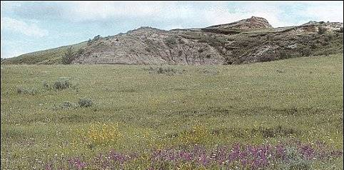
Ecosystem Response of Great Plains Grasslands to Climate Variability
Bill Parton
Myron Gutmann
Melanie Hartman
Emily Merchant
Susan Lutz

Slide 2
Outline
Great Plains location, climate, and land use history
SGS (Shortgrass Steppe) NEE data and biomass production 2001-2003
DayCent Model
Ecosystem greenhouse gas fluxes on dryland and pasture systems
Greenhouse gas responses to rainfall variability
Spatial patterns and integrated GP response
Conclusions

Slide 3
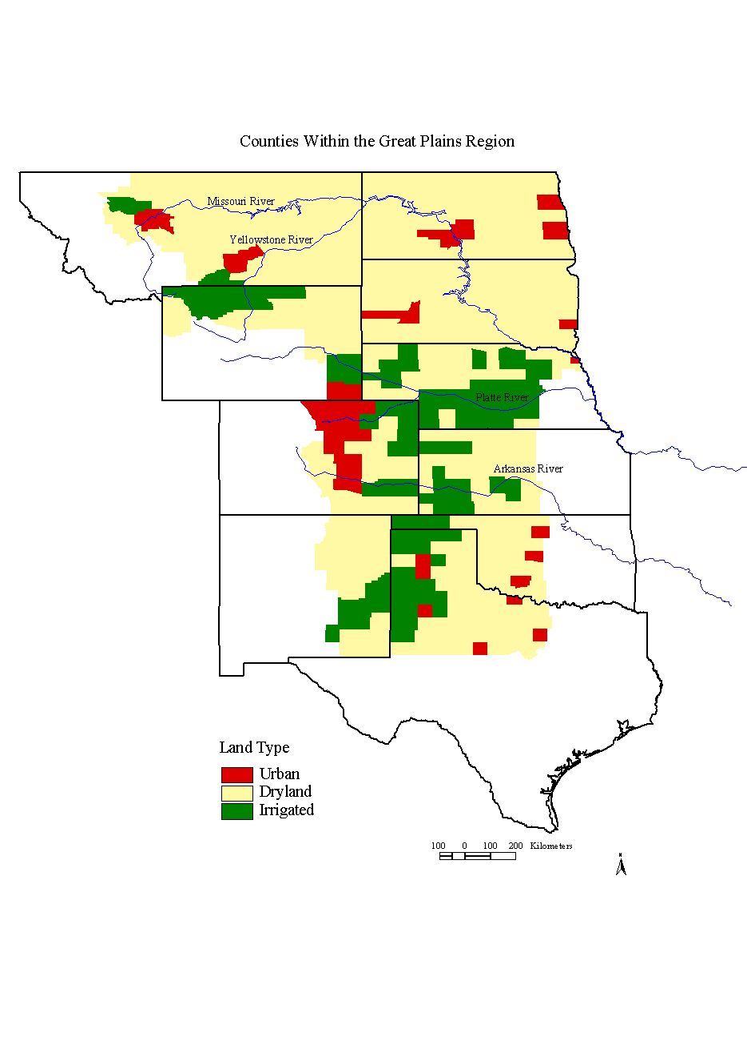

Slide 6
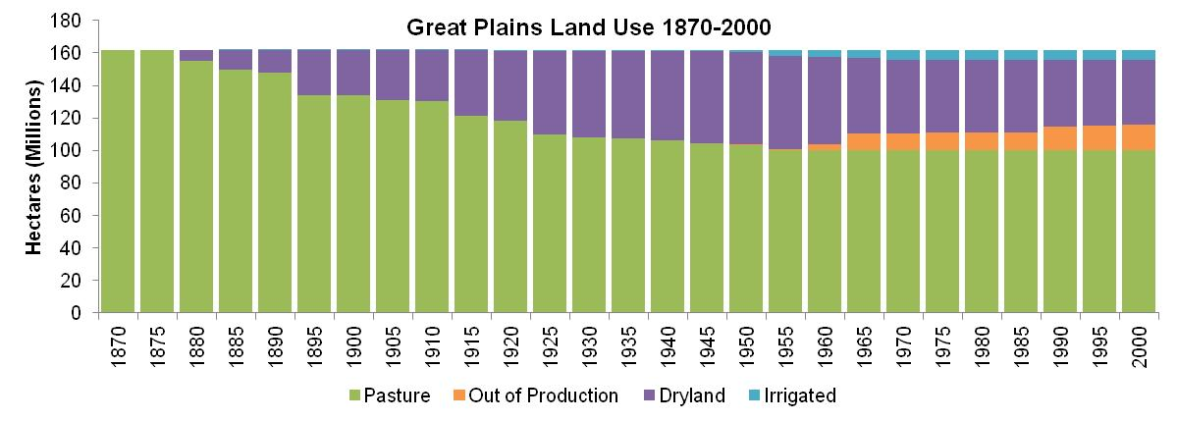

Slide 7
Observed NEE for the Shortgrass Steppe (SGS)

Slide 8
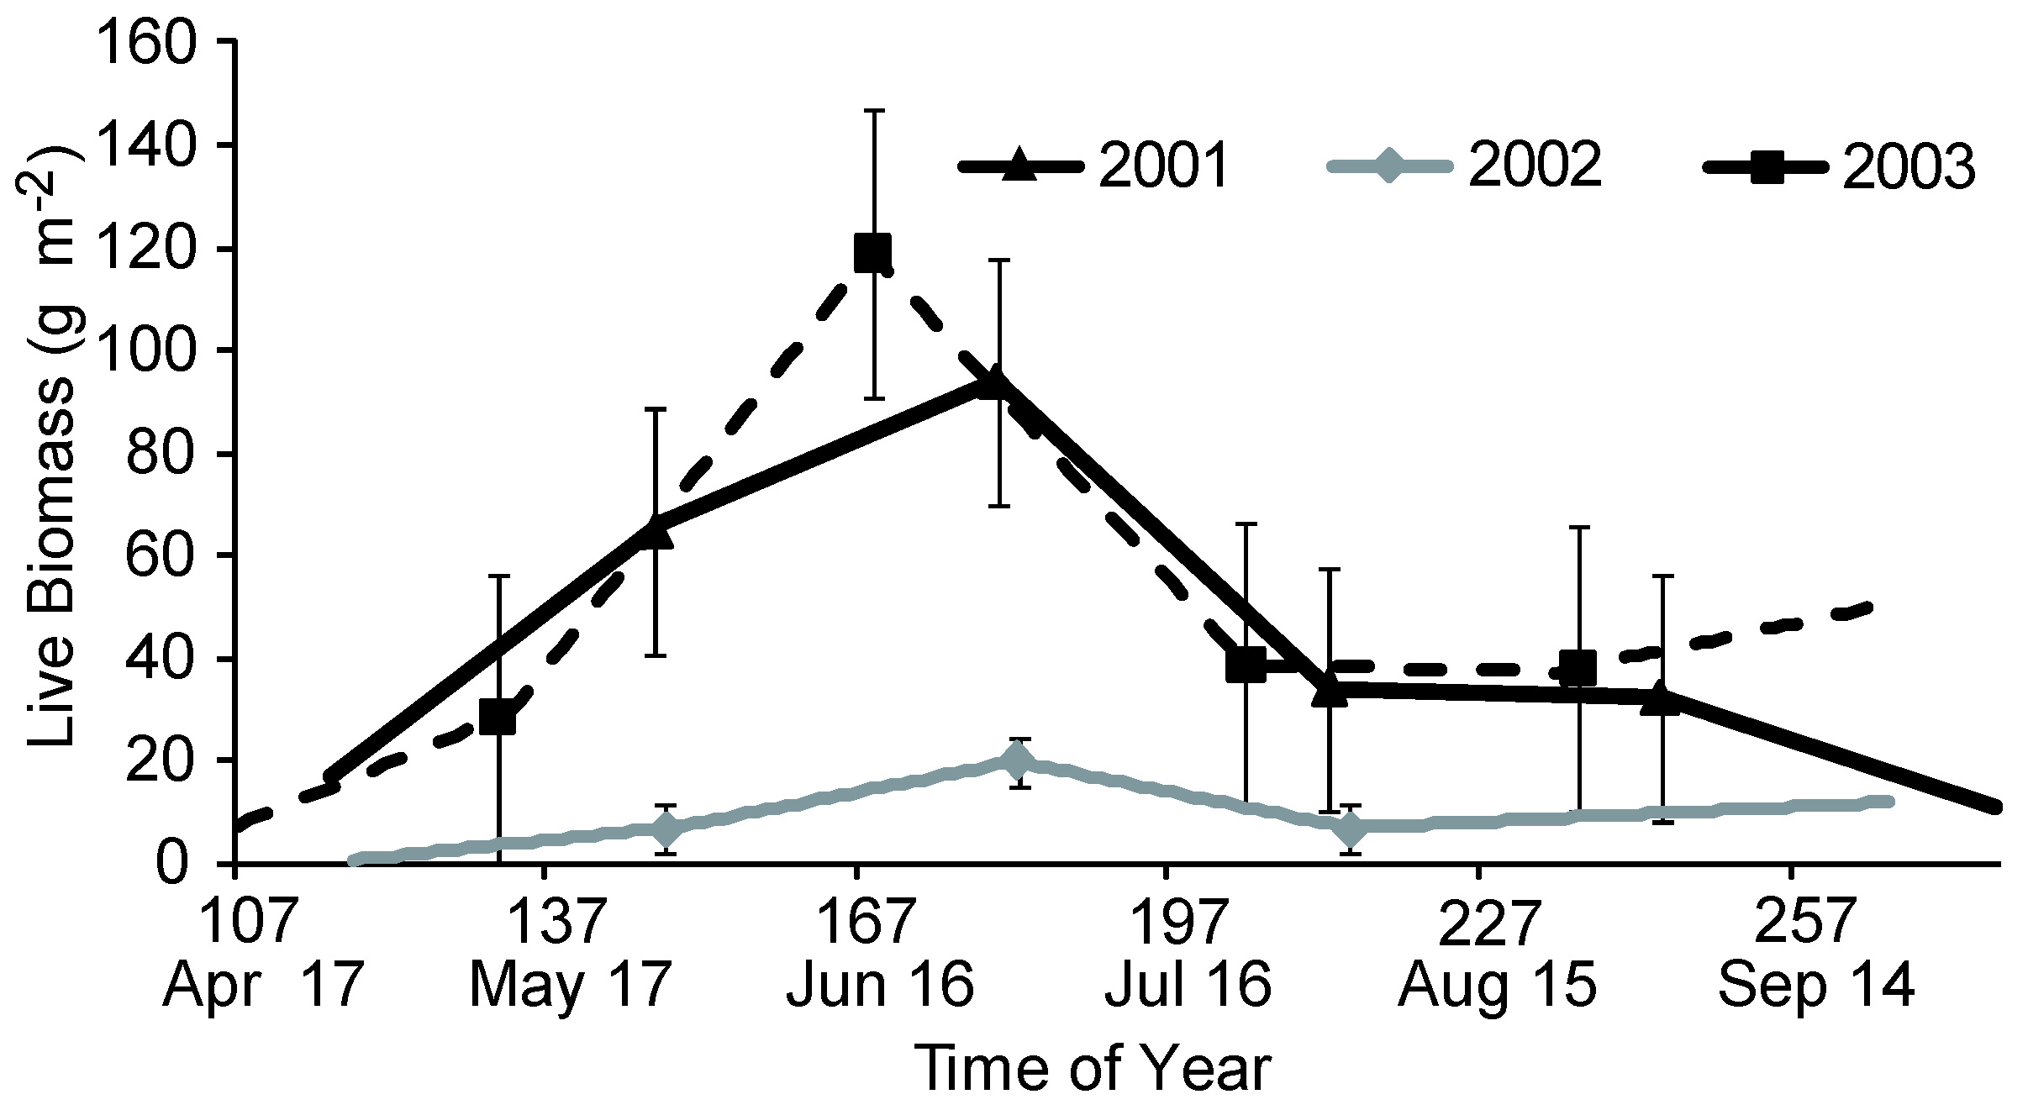

Slide 9
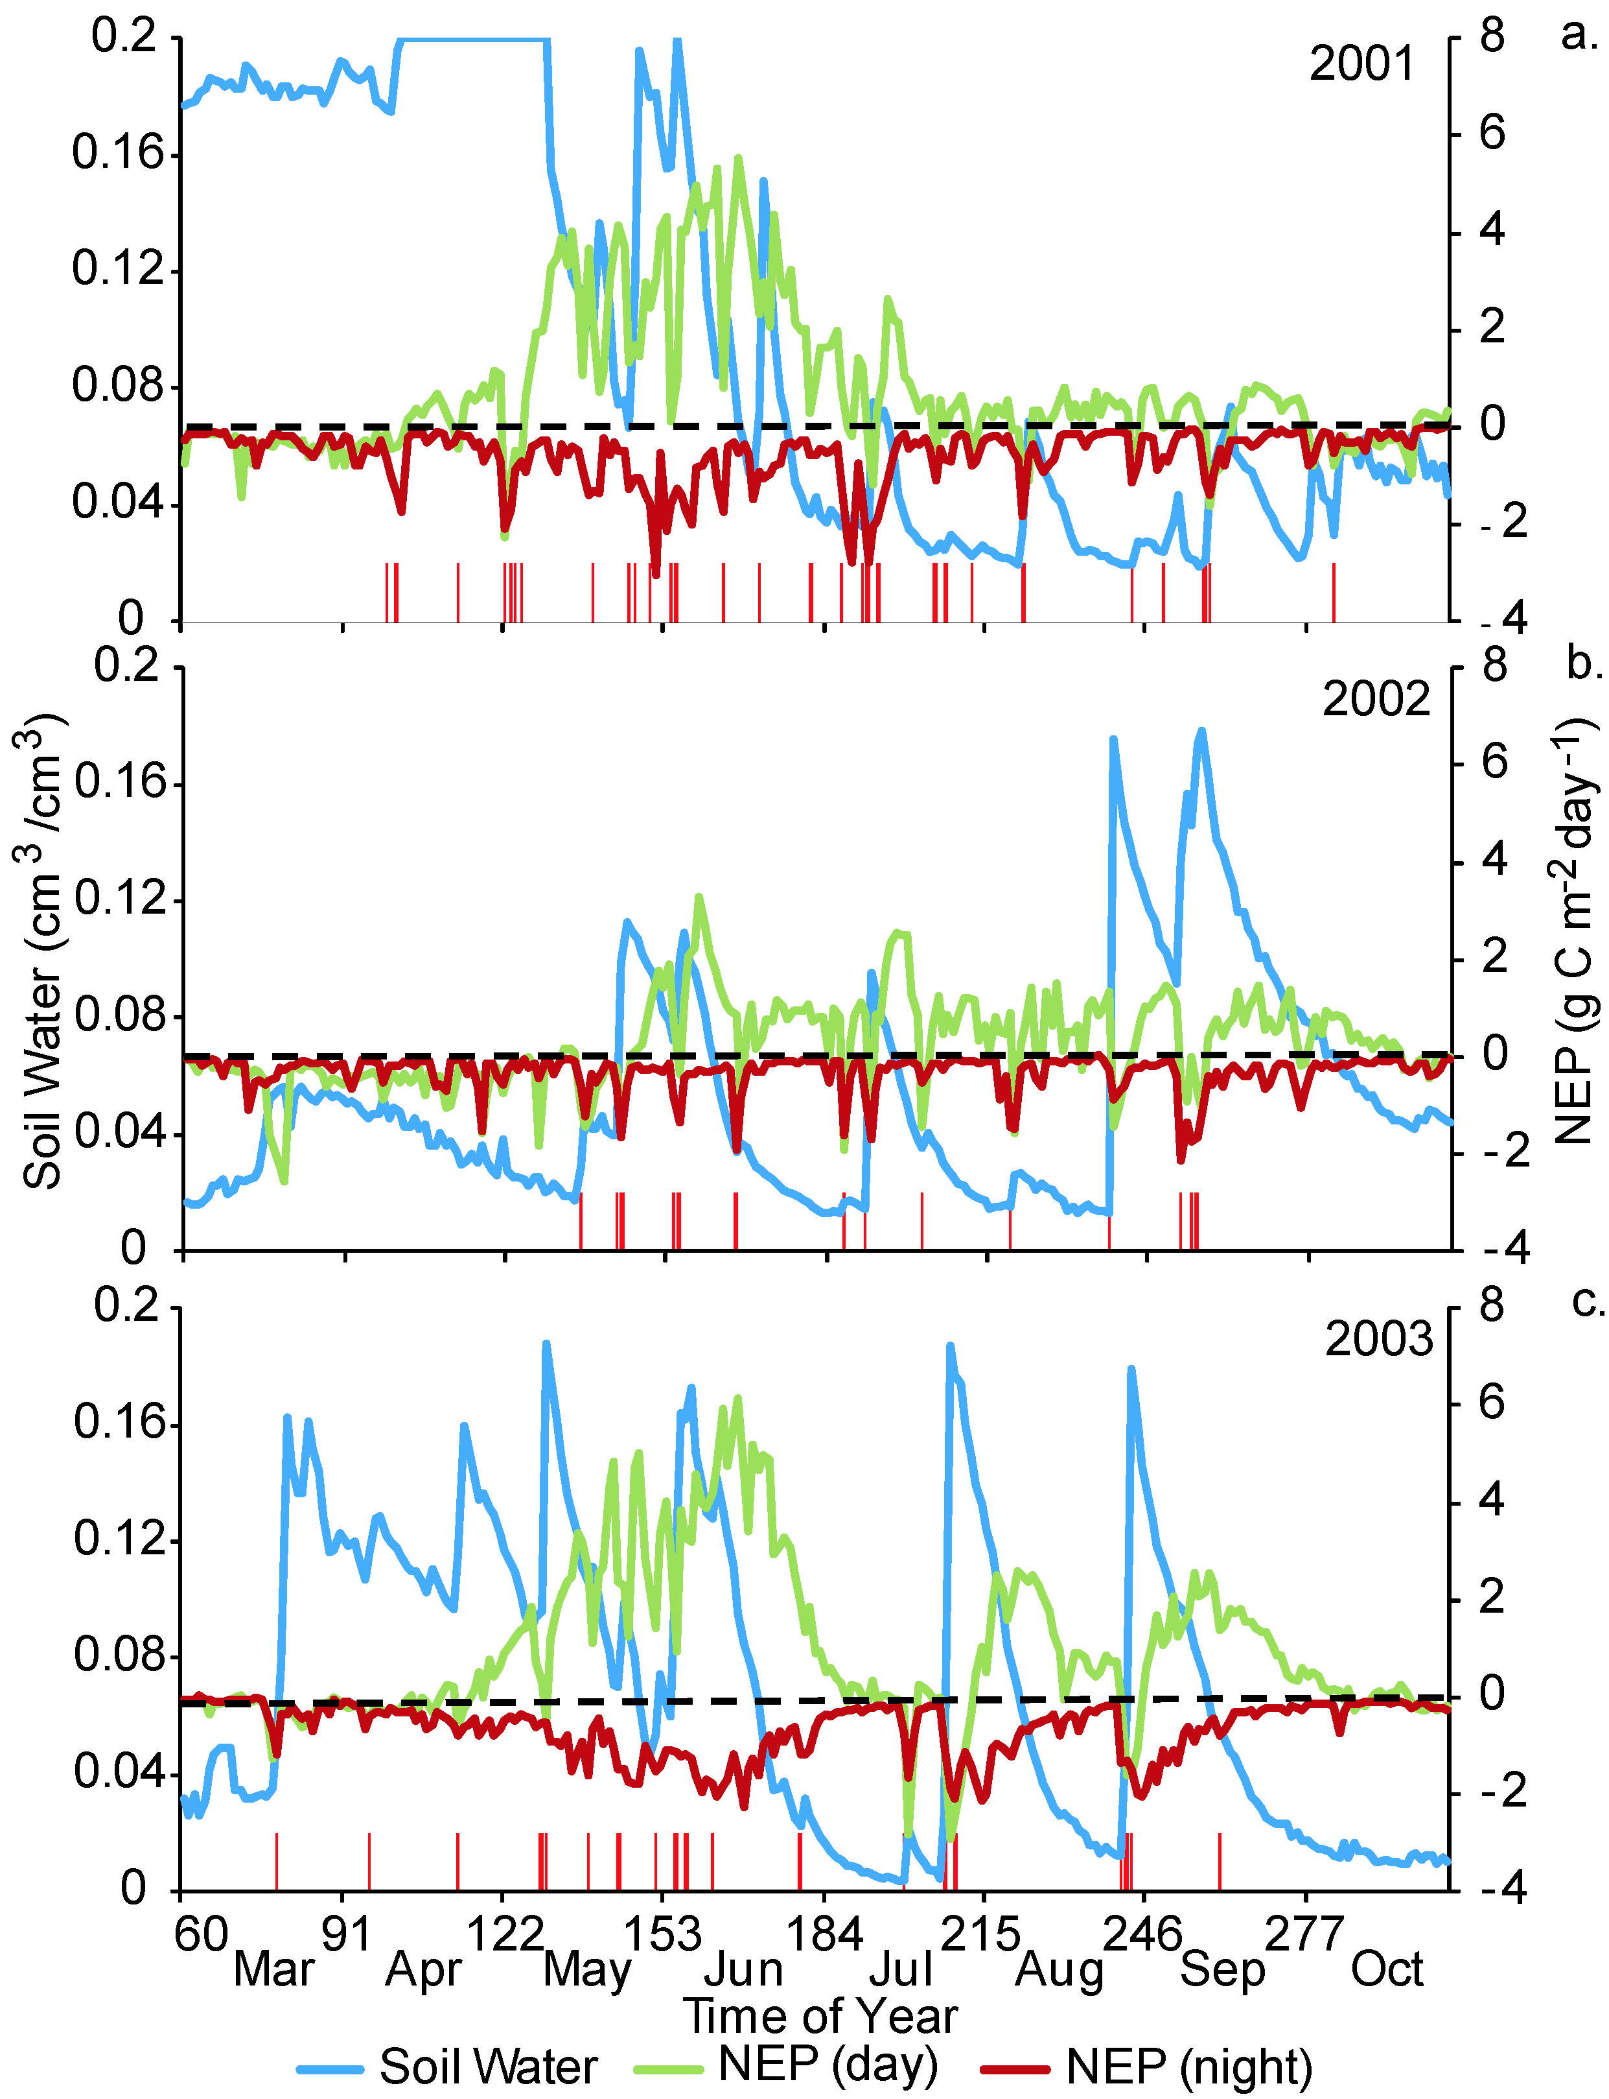

Slide 10
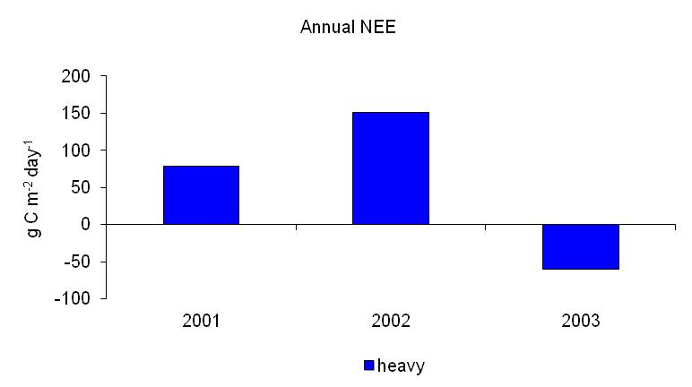

Slide 11
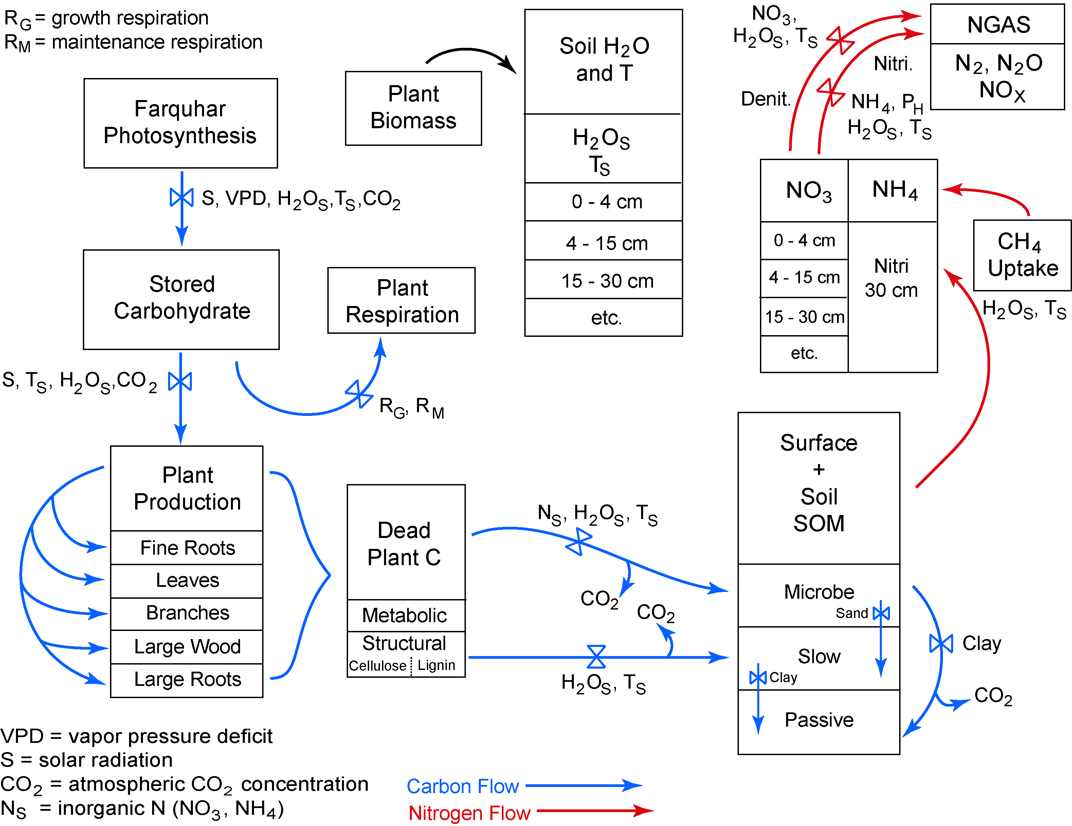

Slide 12
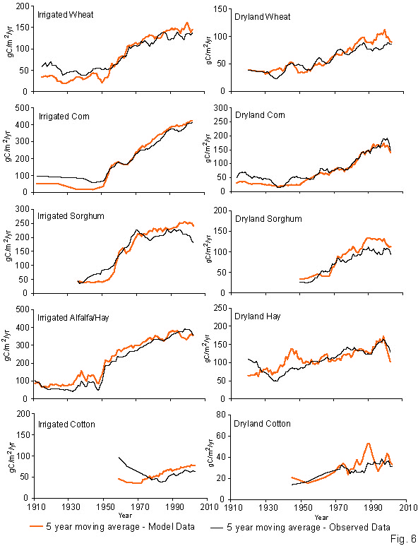

Slide 13
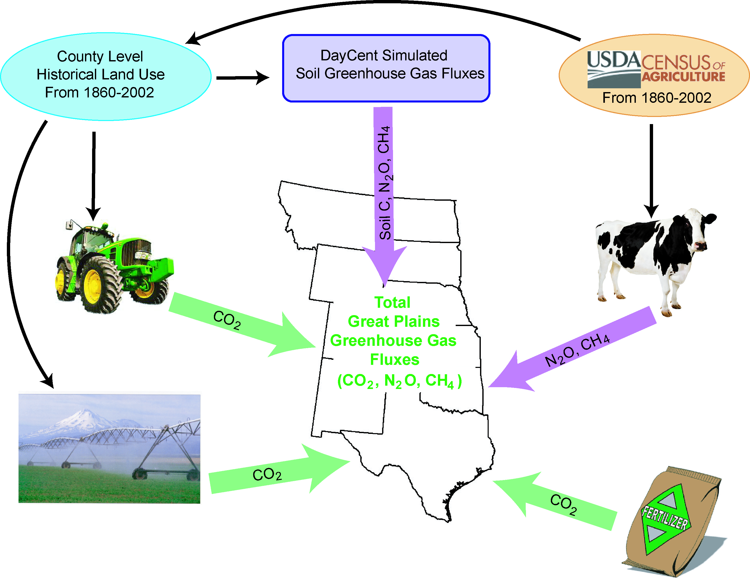

Slide 14
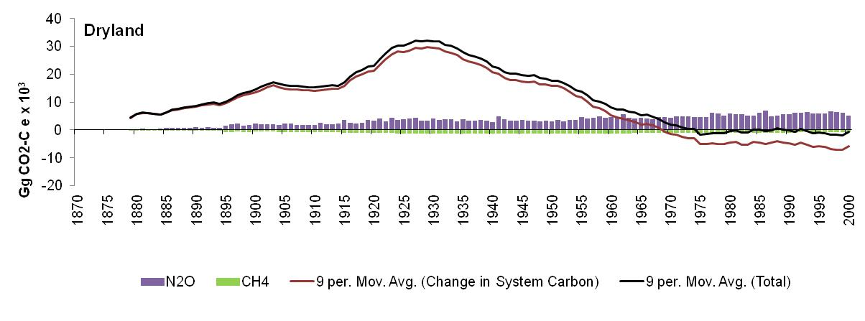

Slide 15
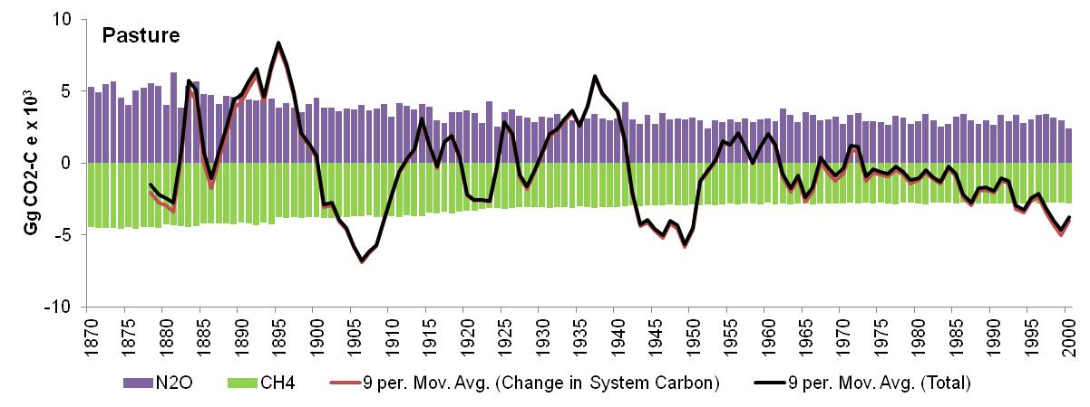

Slide 16
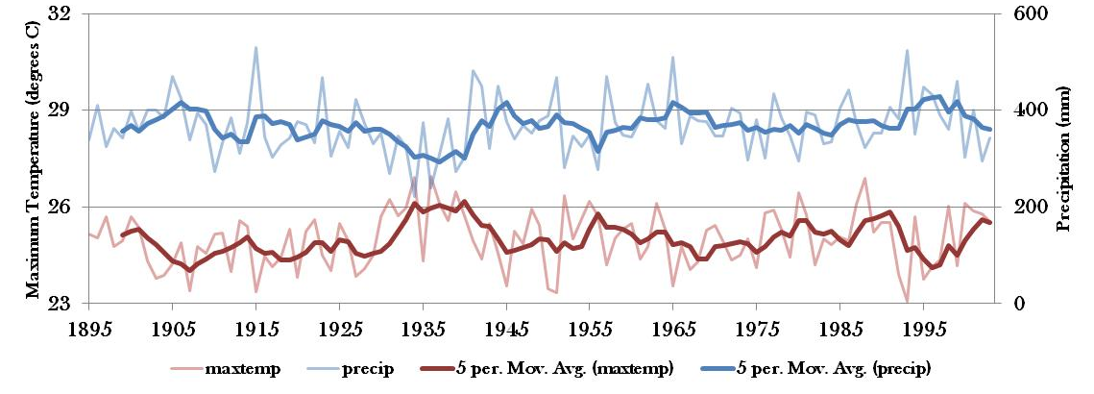
Growing Season Precipitation and Maximum Temperature
r = .61

Slide 17
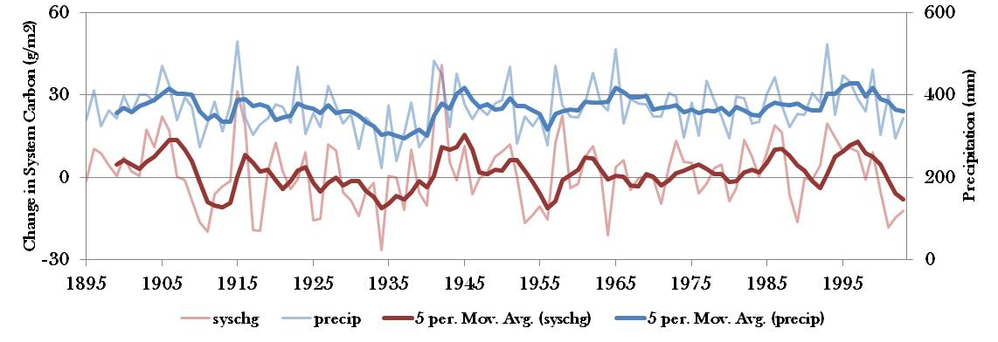
Growing Season Precipitation and System Carbon
r = .62

Slide 18
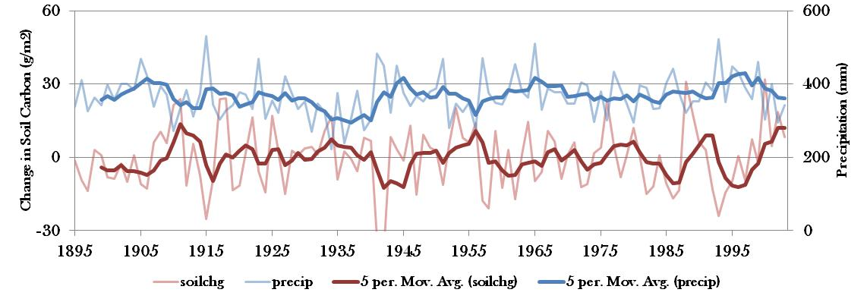
Growing Season Precipitation and
Soil Carbon
r = .61

Slide 19
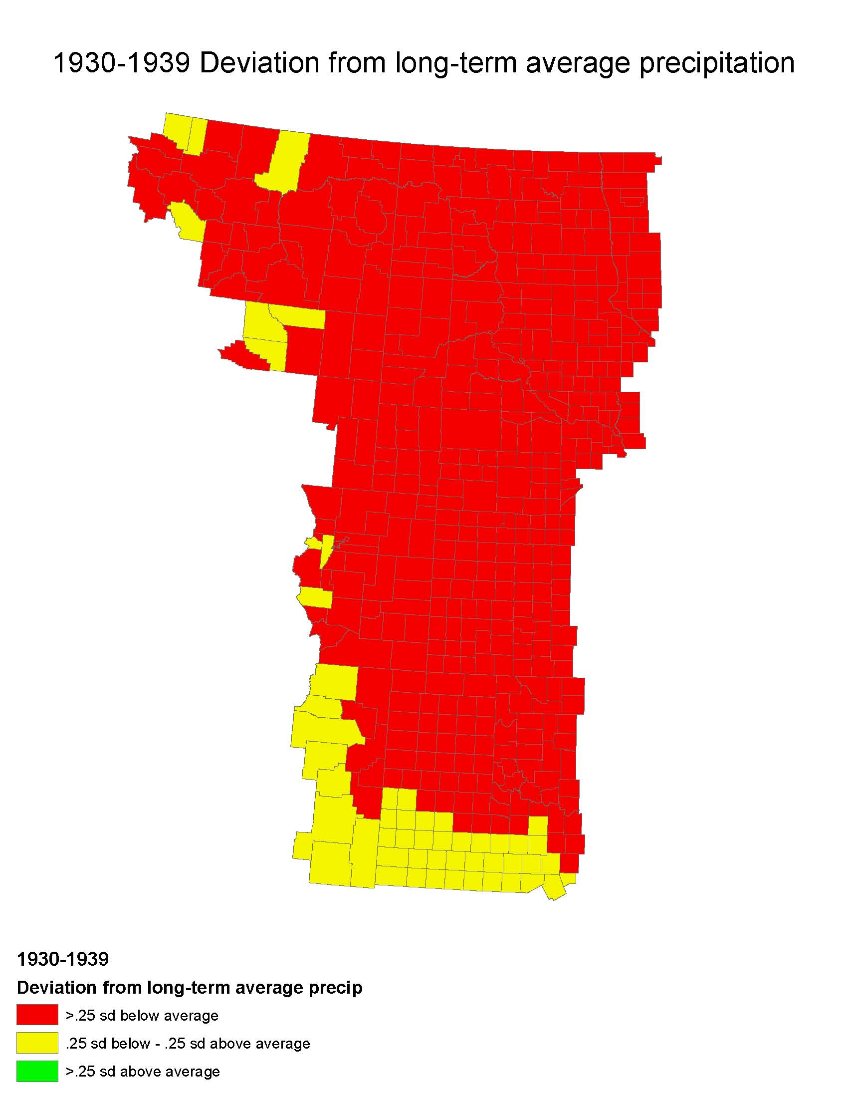

Slide 20
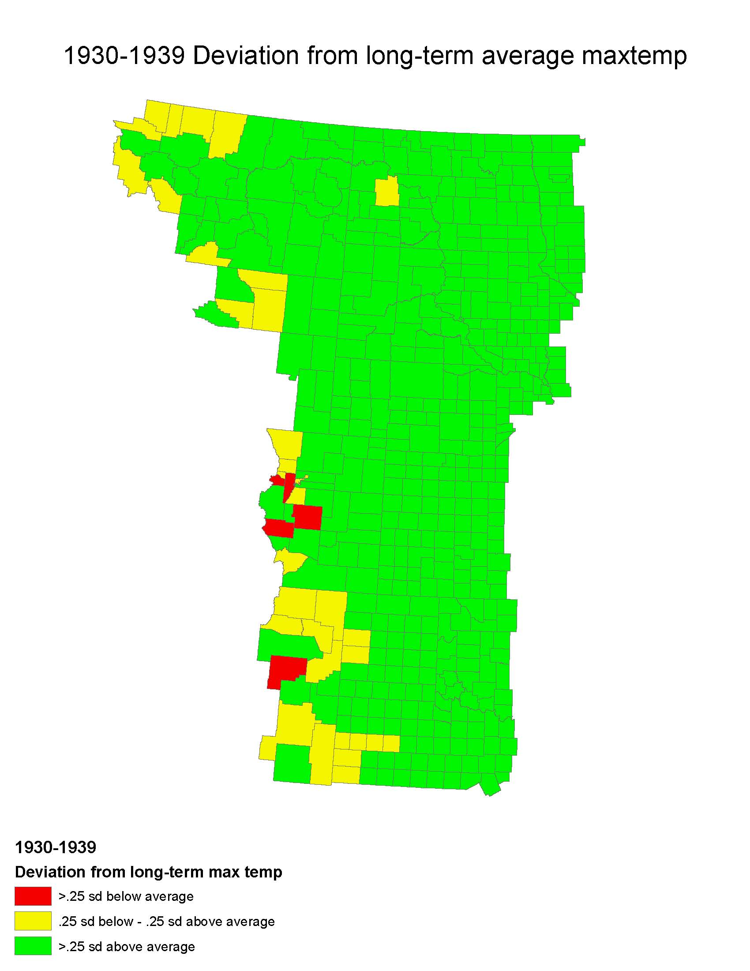

Slide 21
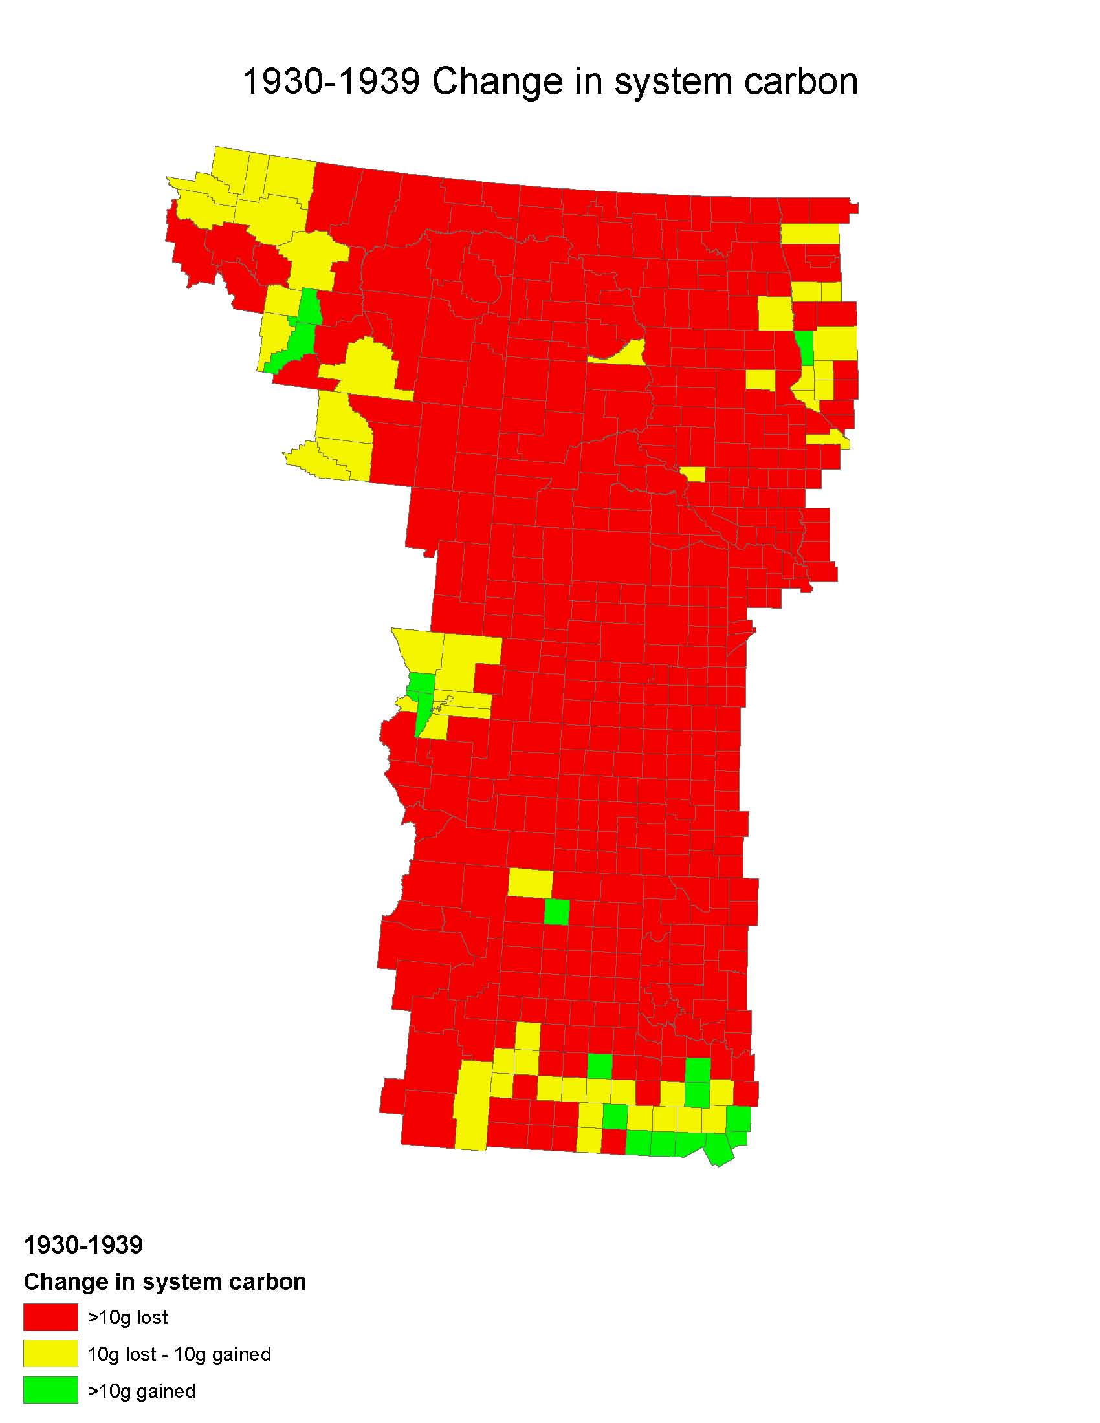

Slide 22
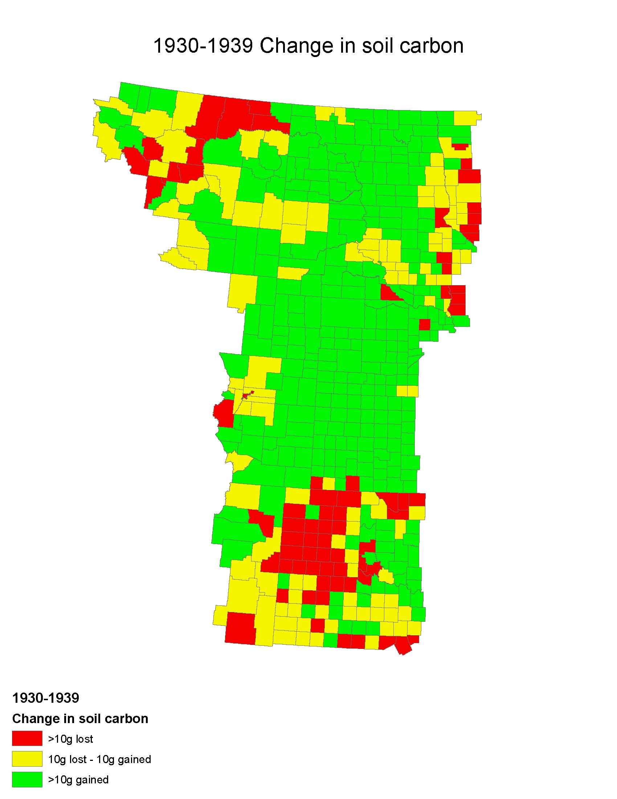

Slide 23
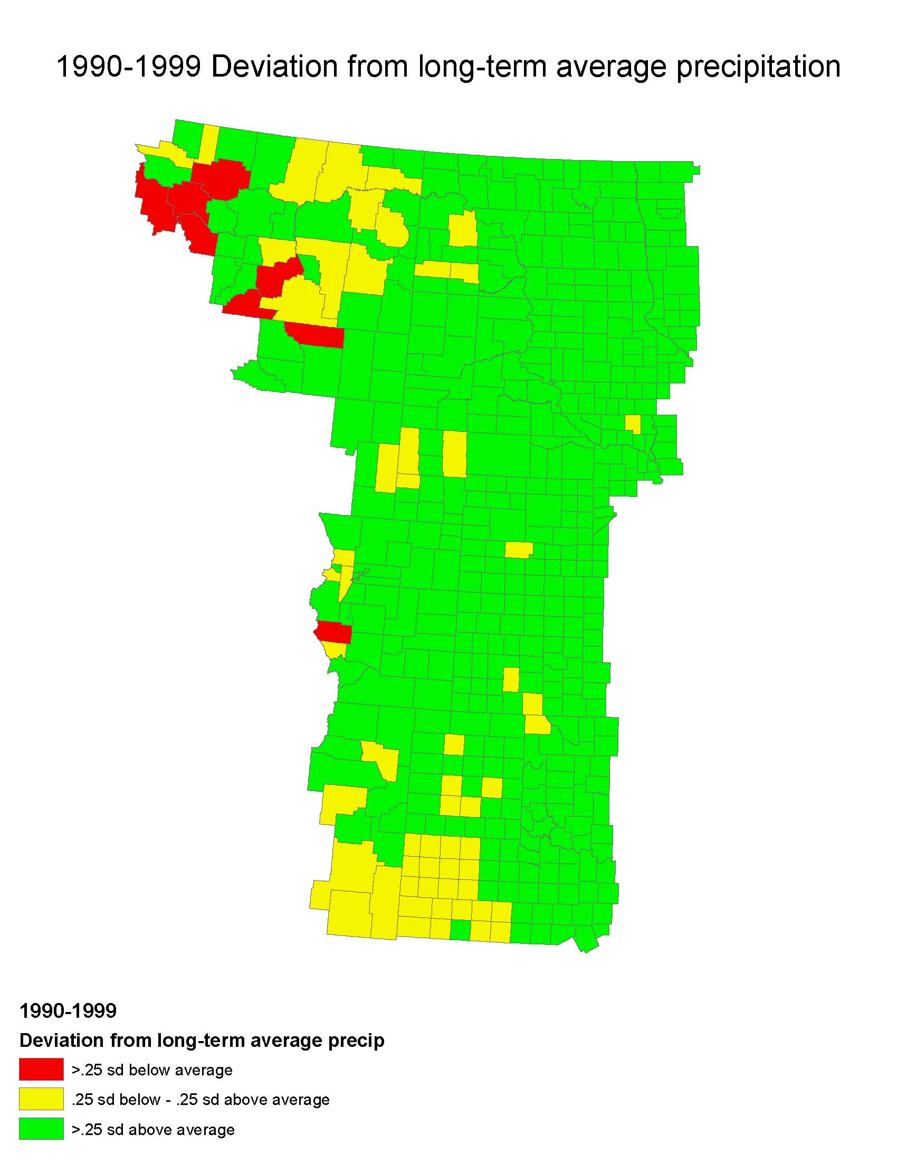

Slide 24
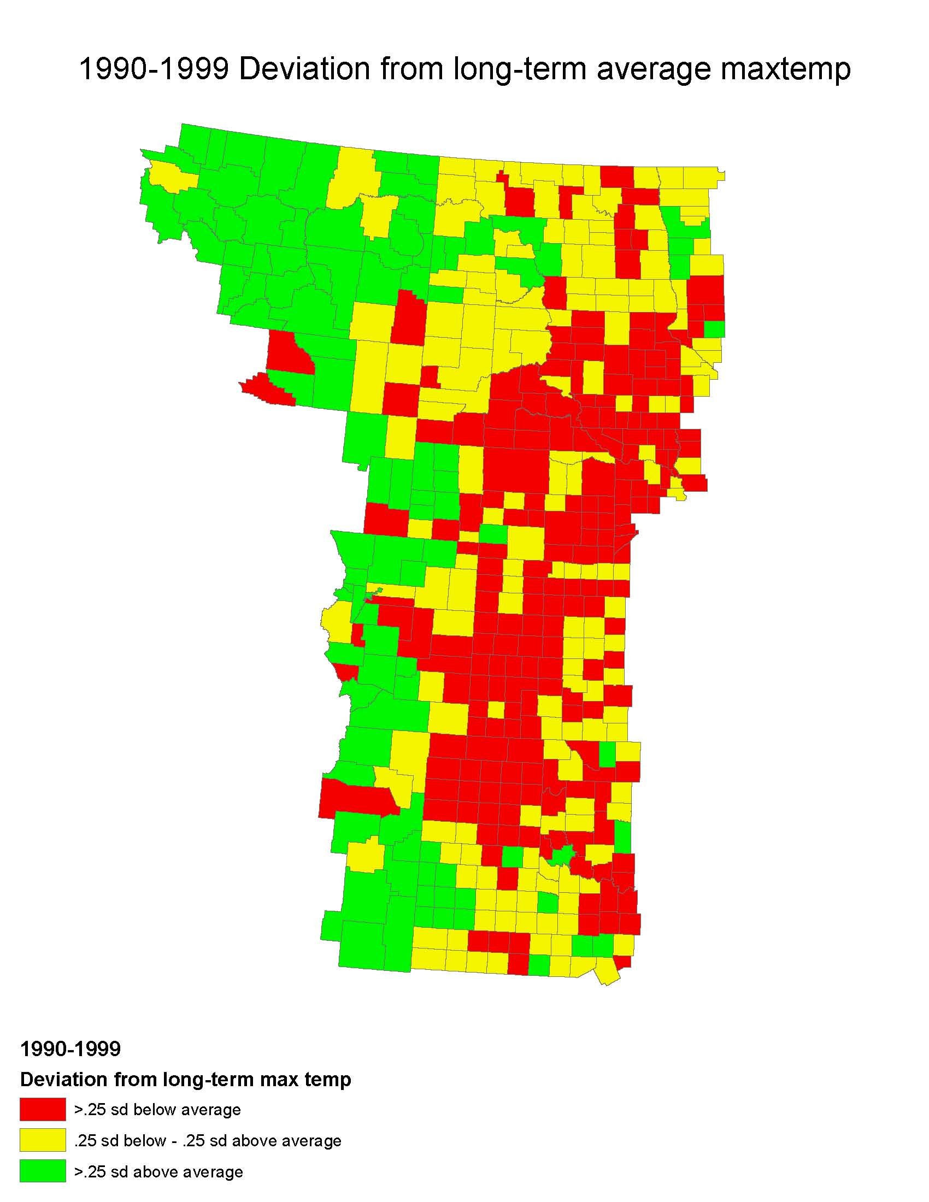

Slide 25
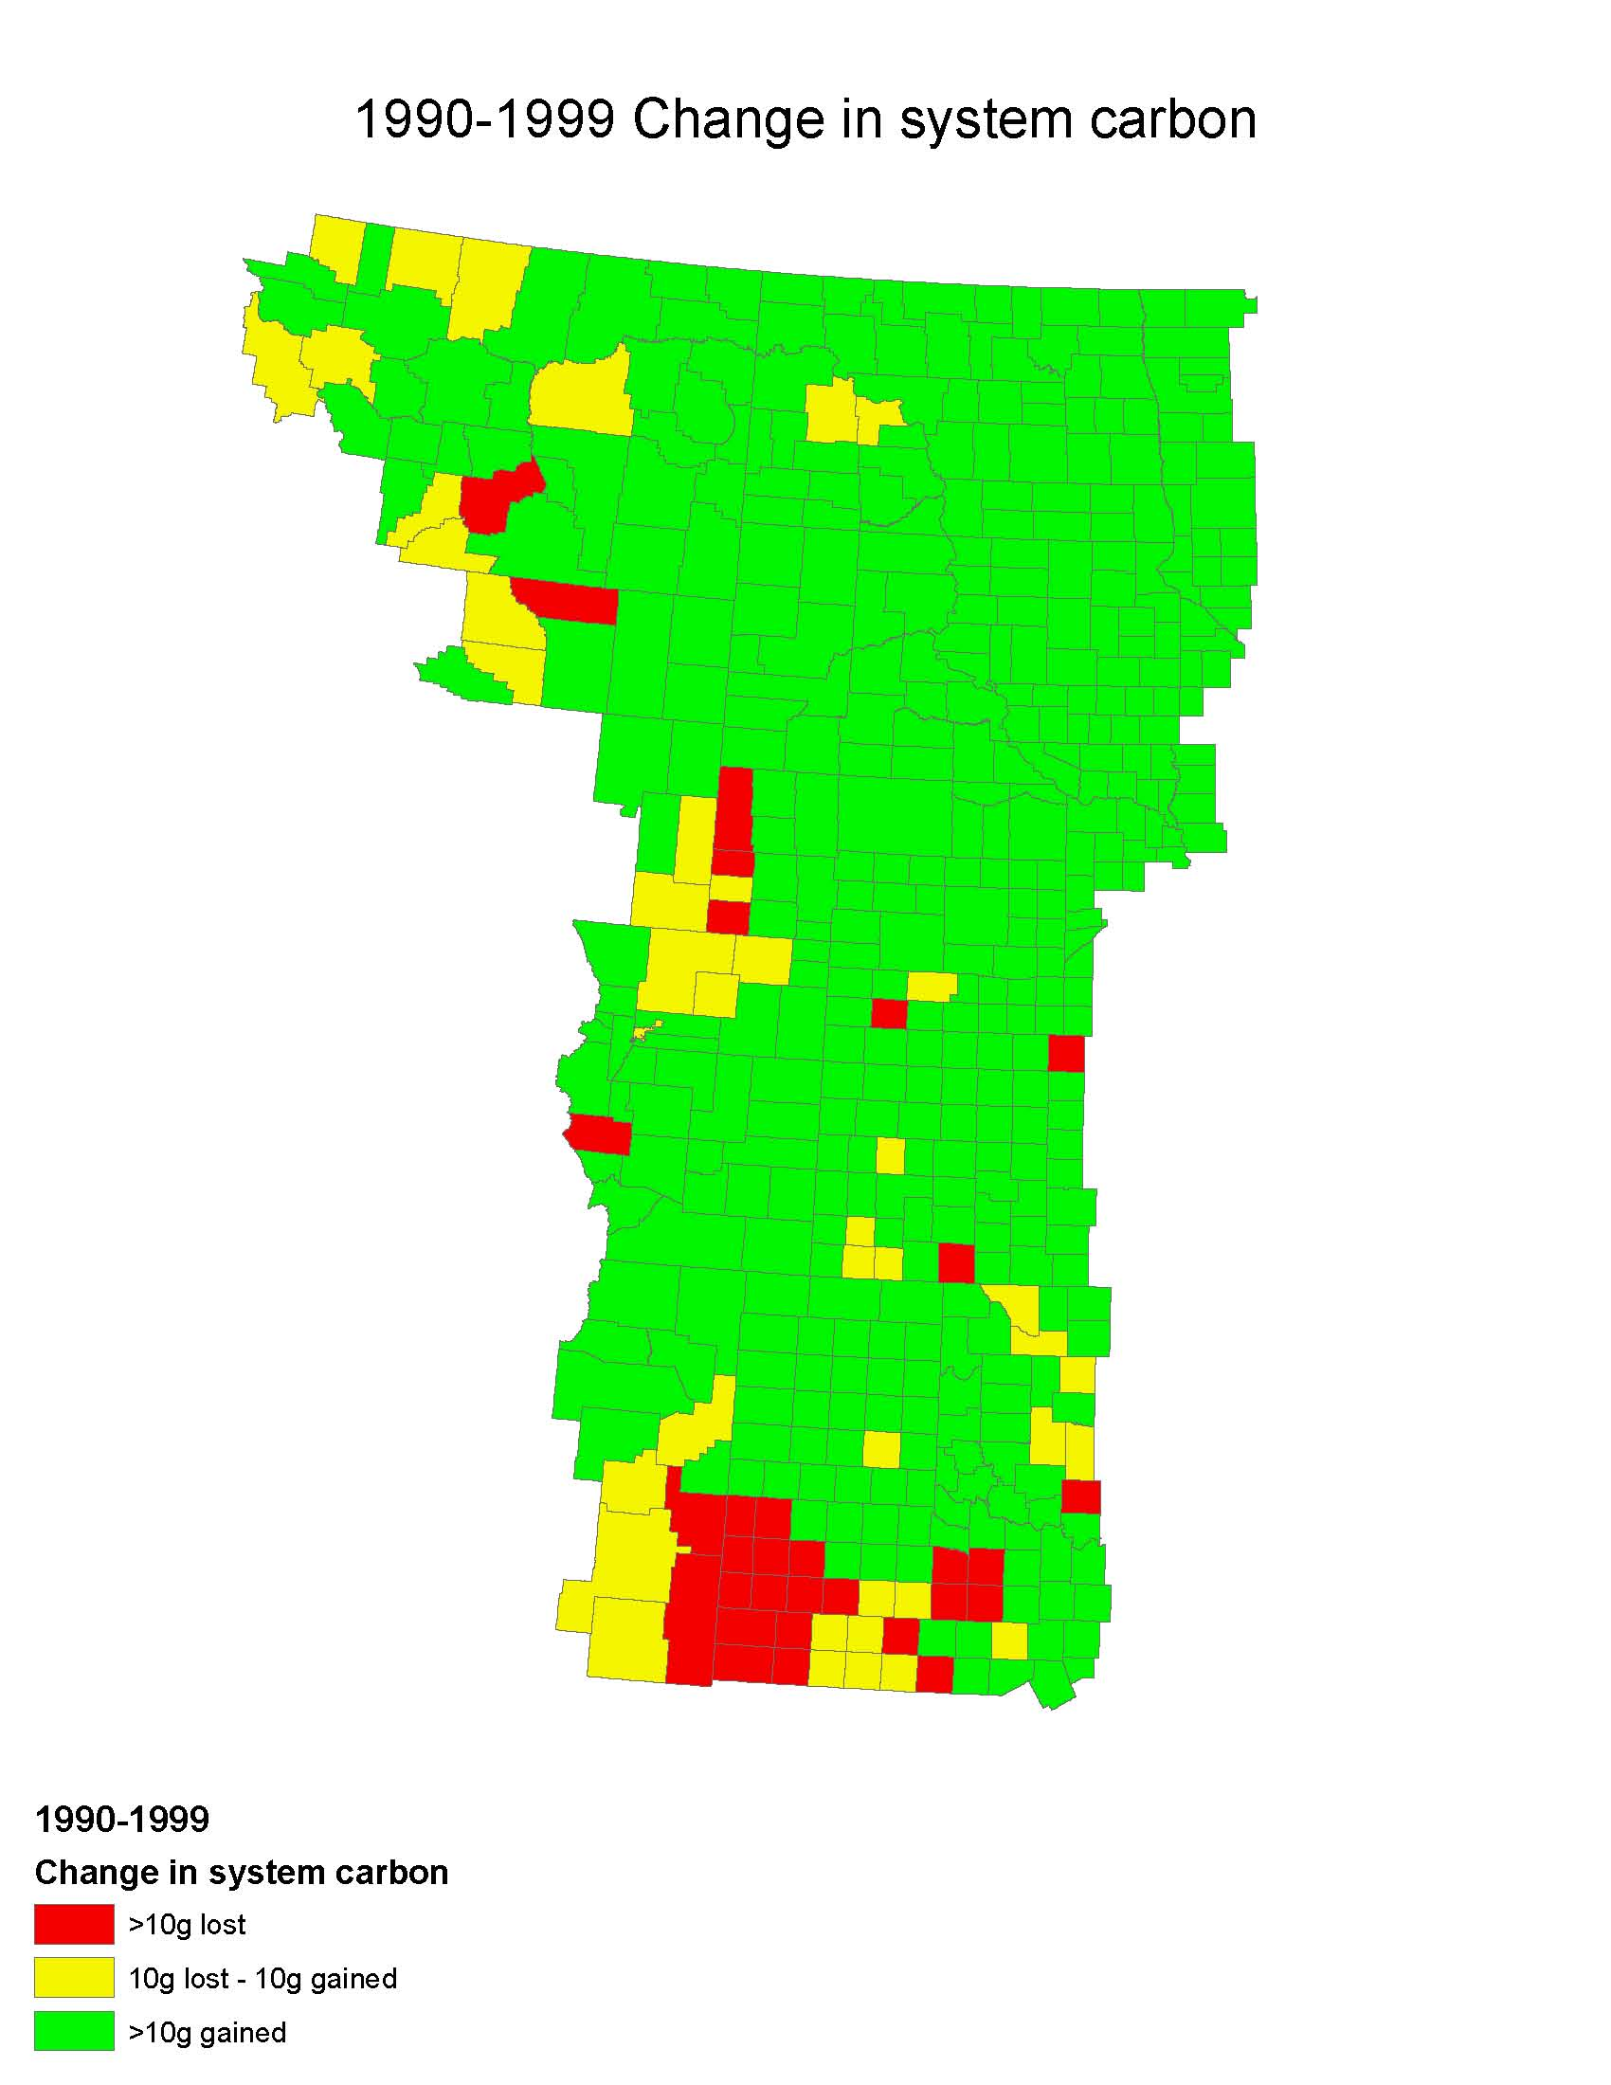

Slide 26
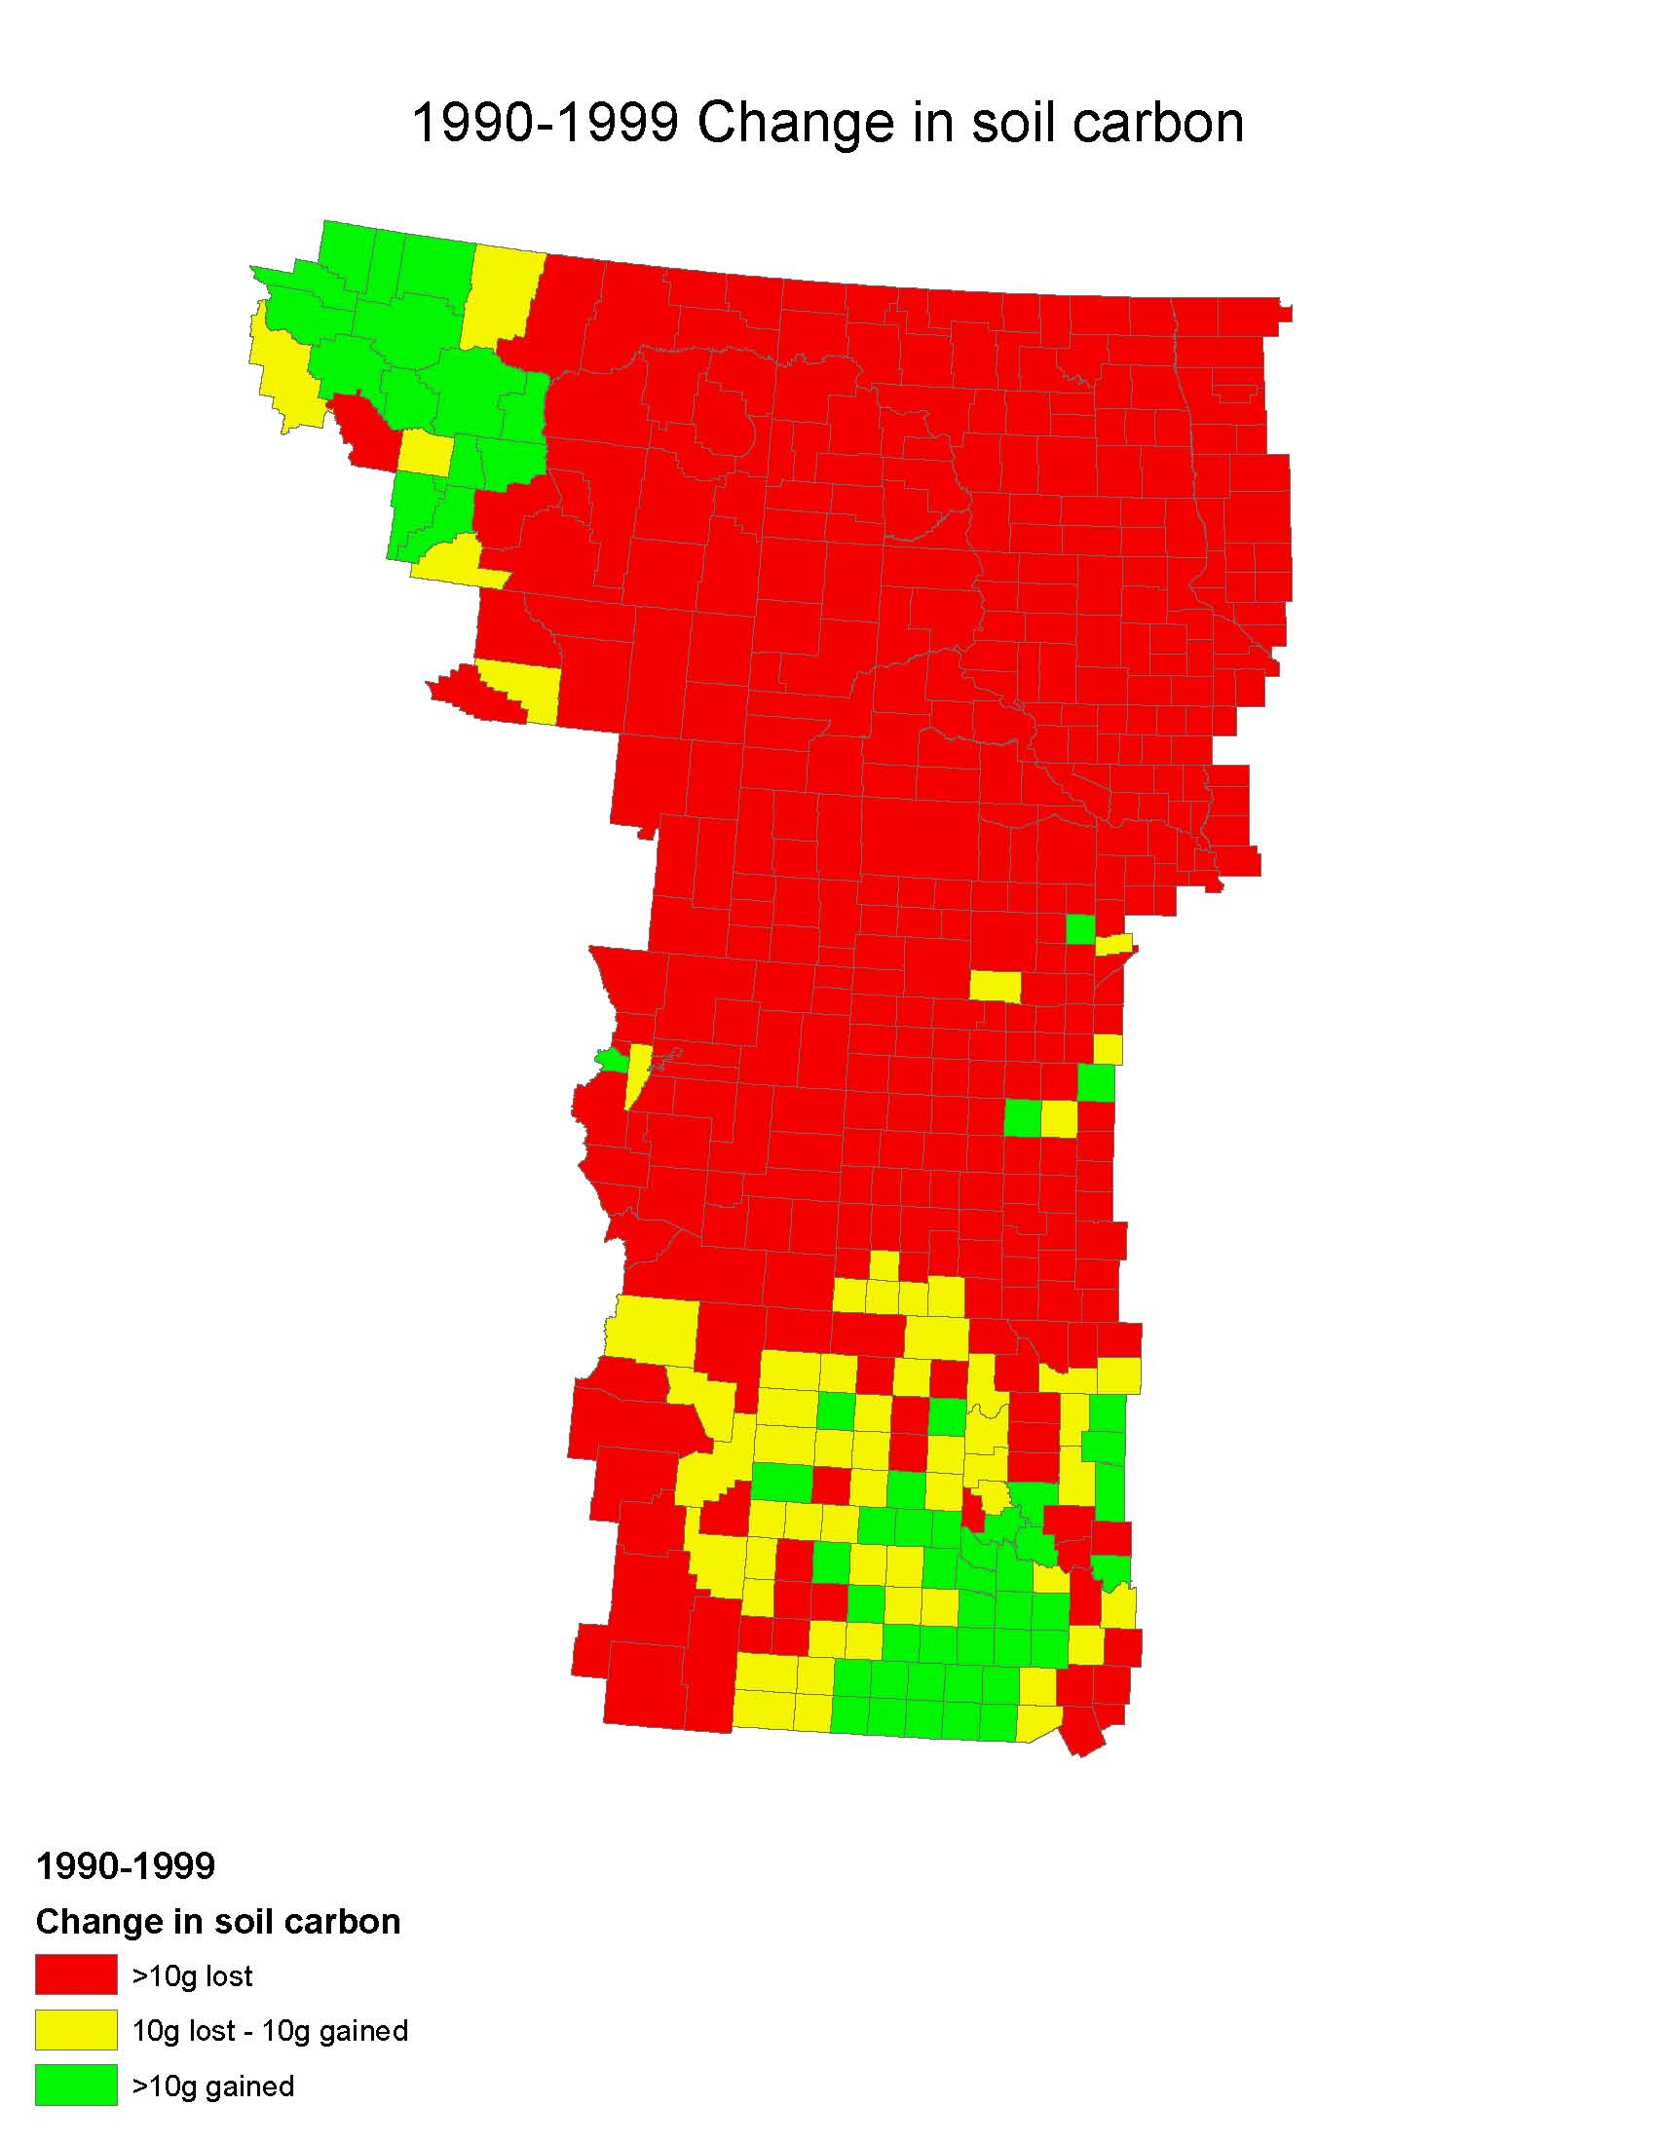

Slide 27
Growing Season | Correlations
Precipitation to Max Air Temperature | r = -0.61
Precipitation to System Carbon | r = 0.62
Precipitation to Soil Carbon | r = -0.61

Slide 28
Conclusions
Surprising autocorrelation of climate pattern in the Great Plains
Negative correlation of growing season precipitation to air temperature
System carbon is positively correlated to precipitation
Soil carbon is negatively correlated to precipitation
Ecosystem NEE is most sensitive to changes in precipitation as a result of change in live biomass
Soil N₂O and CH₄ fluxes are less responsive to climate variability compared to system carbon

