Slide 1
“Dynamics of stoichiometrical and
metabolomical traits under climate change”
Jordi Sardans, Albert Rivas-Ubach, Albert Gargallo-Garriga, Ifigenia Urbina,
Jofre Carnicer, Marc Estiarte, Iolanda Filella, Joan Llusià, Romà Ogaya, Josep Peñuelas

Slide 2
Stoichiometry-metabolomic studies
Useful traits to detct and study plant responses to environmental change
Climate change
Plant
Metabolism and stoichiometry shifts
Sensitivity enough to detect the
dynamics of plant responses
Potential improvement of global
climate and balance models
Mechanisms and functions involved
in the organism response
Clues to global ecosystem impacts
mainly by the effects on trophic webs

Slide 3
Long-time field studies
My first studies of Biogeochemistry in the Global Ecology Unit
Climanani Garraf Site
Prades site

Slide 4
Drought impacts N and P concentrations and contents in Mediterraenan ecosystems
1. Decreases in soil enzyme and root-enzyme activity
Four general results
observed in all studies
2. Decreases of N and P stocks in aboveground biomass
3. Increases in total soil N and P stocks but decreses of
plant-available stocks
4. Changes in plant N:P stoichiometry
After four years of drought
(Mediterranean forest)
Control
Runoff exclussion
Sardans & Peñuelas (2007)
Functional Ecology
Runoff exclussion plus
partial rainfall exclussion
Erica multiflora
Data from Sardans & Peñuelas (2005)
Soil Biology and Biochemistry
Sardans et al. (2008)
Global Change Biology
Sardans and Peñuelas (2007)
Functional Ecology

Slide 5
Changes in N/P ratio is not a minor question
C/N/P ratio related to several ecosystems process
In freshwater ecosystems
RNA
(P-rich)
Growth
rate
Growth Rate Hypothesis (GR)
Elser et al. (1996)
N/P
In terrestrial ecosystems
No conclussive results of GR at this moment
Related to species diversity
Relatedto species style of life
Related to soil trophic web structure

Slide 6
But K-stocks were also afected by drought
Plant biomass
In soil
Sardans and Peñuelas (2007)
Functional Ecology
Sardans et al. (2008)
Plant and Soil

Slide 7
Drought changes whole foliar elemental composition
Soil stocks and biomass concentrations of other several elements
(Mo, S or Ca) had been changed by drought
Sardans et a. (2008) Biogeochemistry, Sardans et al. (2008) J. Geophys. Res.
PC2 (19%)
PC2 (19%)
Peñuelas et al. (2008)
Pol J Ecol

Slide 8
Climate change impact in terrestrial ecosystems stoichiometry: how can we advance?
Experimental, observationals and review
studies (reviews and meta-analysis)
How can improve stoichiometry studies
to be a useful trait to detect dynamics
shifts in terrestrial plant vegetation
Sardans et al. (2012a) Biogeochemistry
Sardans et al. (2012b) Pers Plant Ecol Evol Syst
Sardans and Peñuelas (2012) Plant Physiology
Capture our attention
in current studies limitations
What dowe need?
1.Most studies have been focused on N and P (N/P ratio)
1.More elements such as K, but also Mg, S or
Ca among others should be considered
2. Stoichiometric studies of terrestrial plants have been
mailny focused on foliar tissues, specially in trees
2. Plants also allocate nutrients to other tissues.
We need when possible, take into account whole
plant stoichiometry
3. N/P stoichiometry of higher plants not only depends
of the allocation to growth, several other functions can
be important sinks for nutrients
3. To gain a global knowledgment of the functional
causes underlie stoichiometric shifts in plant
responses to climate change

Slide 9
We propose to solve these constrains and advance in the frame
of climate change impacts on terrestrial plant communities
Plant functional response
Make the next reasonig
Wholel plant
stoichiometrical change
Changes in gene
expresion
1
2
Climate change
Changes in metabolism
and molecular structure
Impacts on biotic relationships
(competition, herbivorism….)
Change in element use
1. Ecometabolomic studies
Soil resources
2. Include other elements such as K.
Study the elemental composition
and its shifts as a whole

Slide 10
We began to use metabolomics analyses in our studies
2
We developed a method to conduct metabolomic analyses with field sampling
Rivas-Ubach et al. (2013)
Methods in Ecology and Evolution

Slide 11
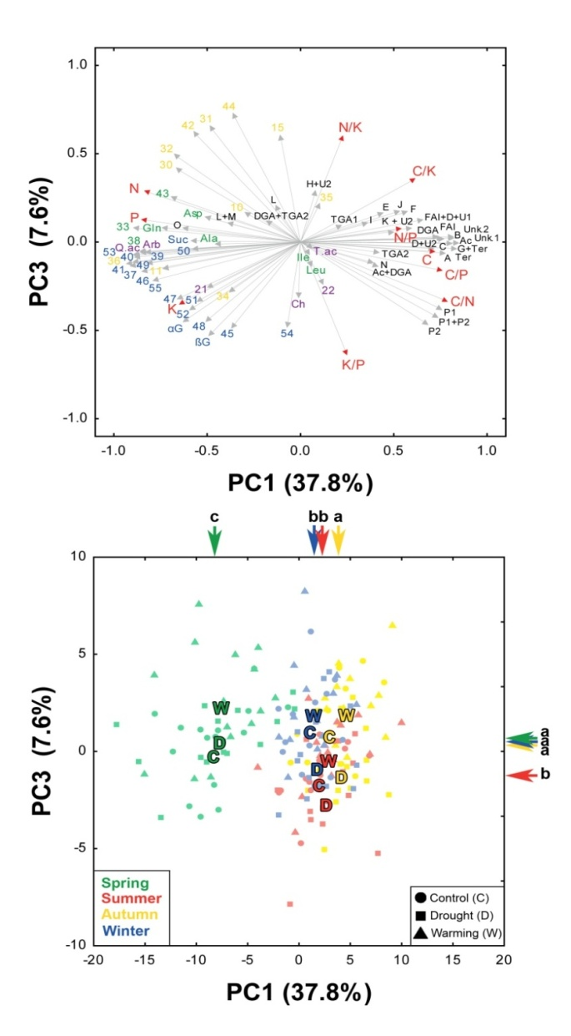
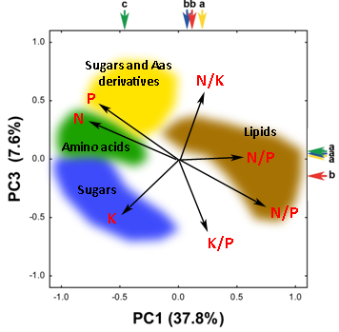

Plants under different climate conditions shift their metabolism. The corresponding
metabolomic analysis informs on the molecular causes underlying the shifts in elemental composition
and stoichiometrical ratios
Stoichiometry
+
Metabolomics
Elemental Stoichiometry
S
Spring Season
N/P
Sugars
Amino acids
Metabolome
Rivas-Ubach et al. (2012) PNAS

Slide 12
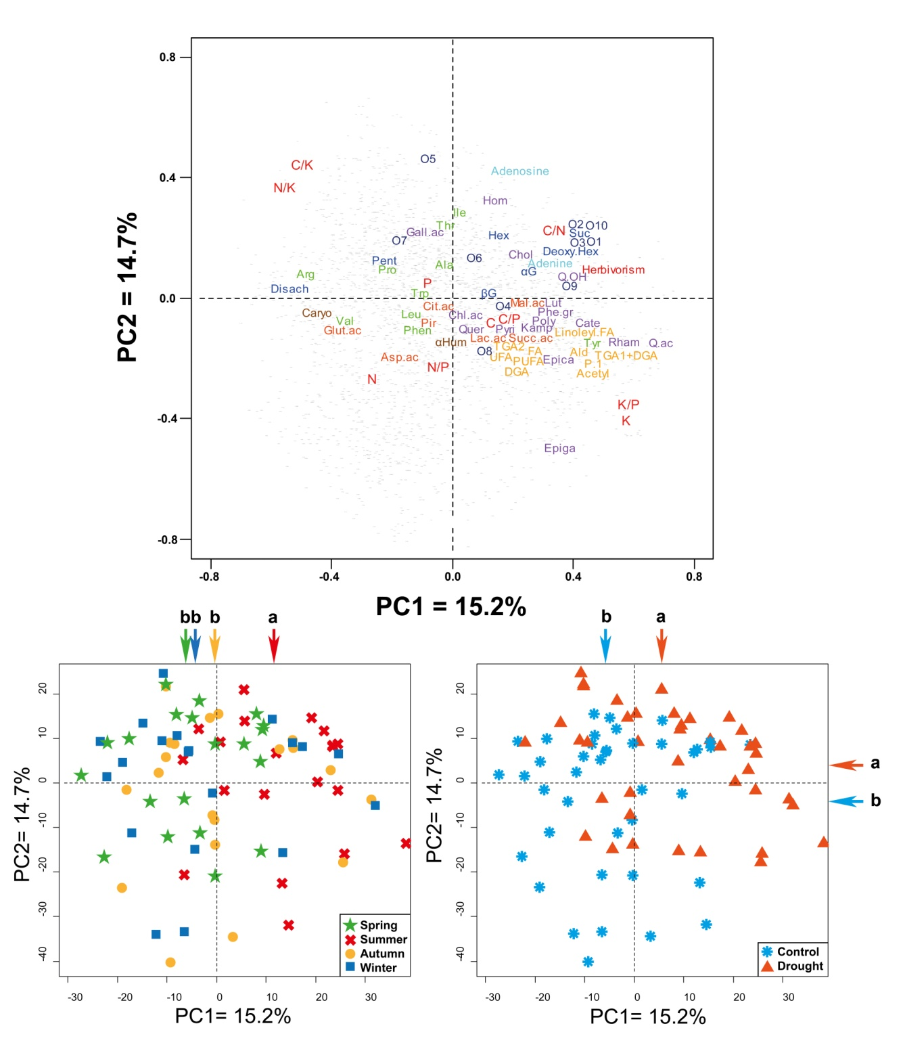
Preliminary Results
Metabolomic profiling
of Quercus ilex.
Seasonal PCA
Drought:
Polyphenolics (antioxidants)
Potassium

Slide 13
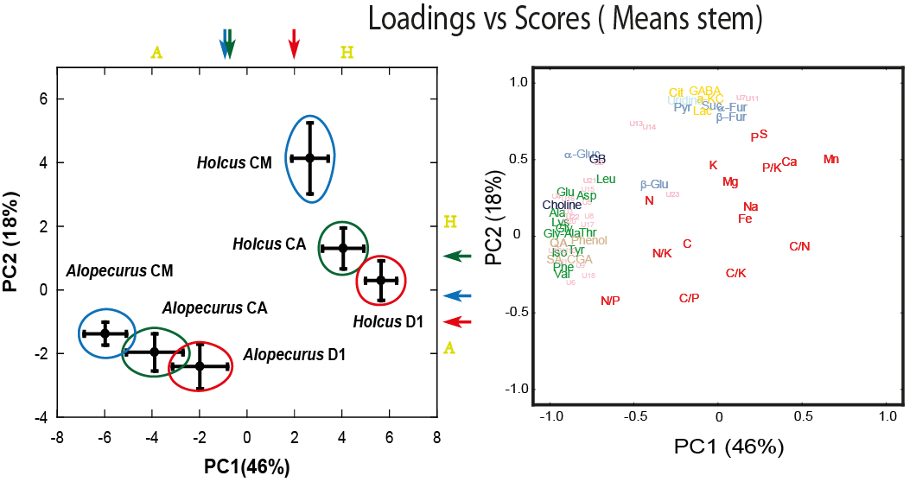
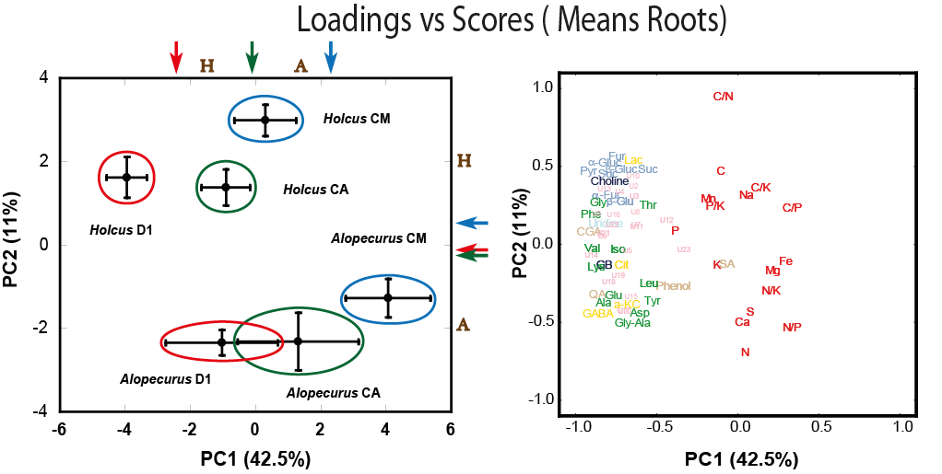
Oposite responses of roots and leaves

Slide 14
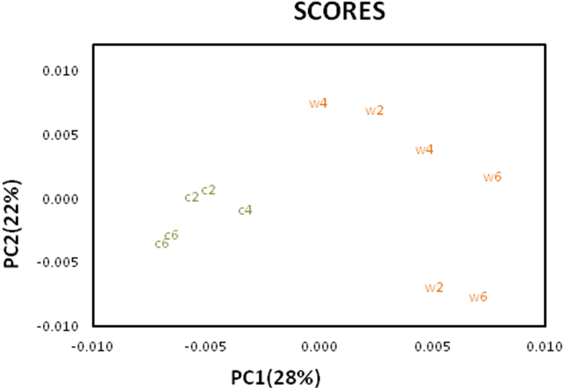
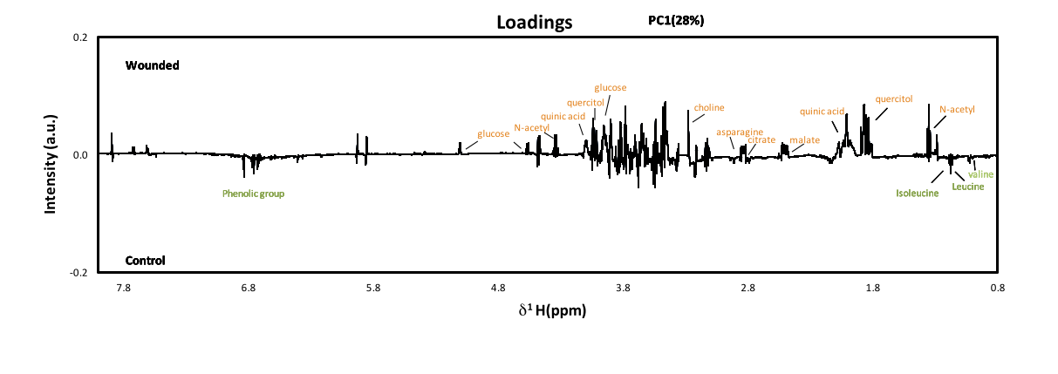
Ecometabolomics : a tool for several ecological estudies
Great sensitivity to detect plant responses
When the plant is wounded the metabolome changes
No-wounded
Wounded
Sardans et al. (2013)
Plant Biology

Slide 15

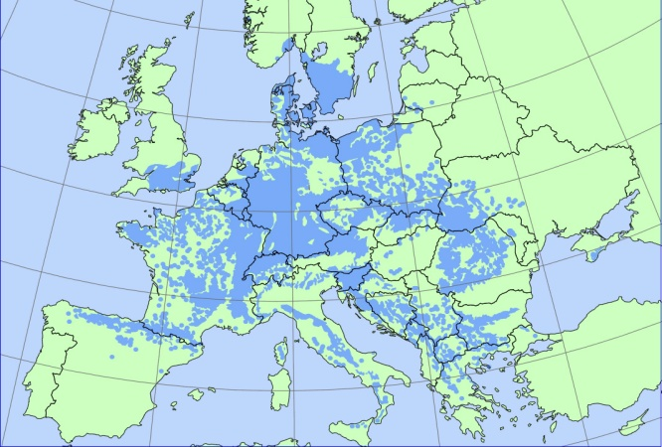
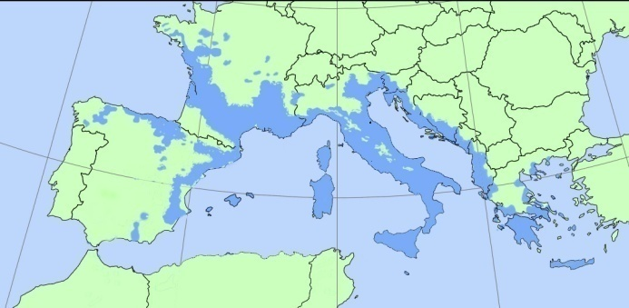
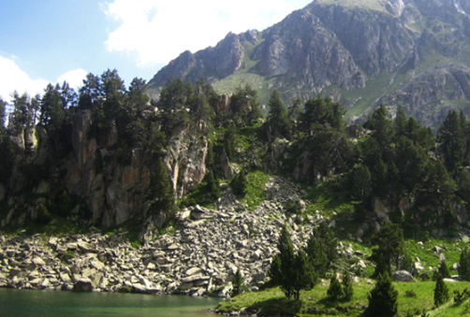
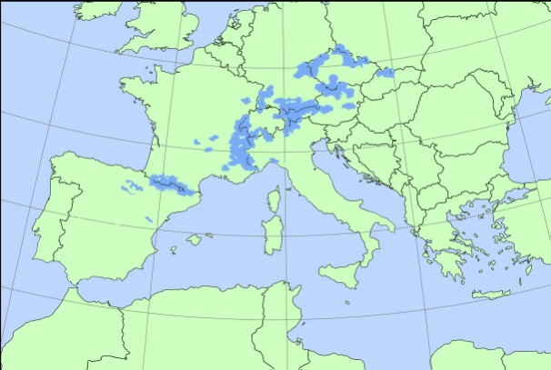
Current ecometabolomic-stoichiometric studies
Climate change effects on the populations of the south border of the distribution
Area of important European forest species
Fagus sylvatica
Quercus ilex
Pinus uncinata

Slide 16

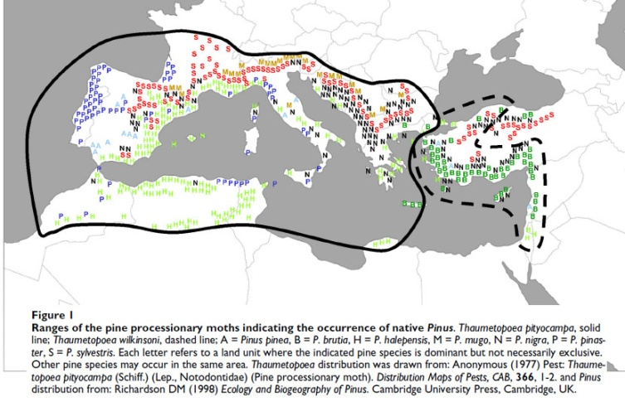
Stoichiometry and Metabolism on plant-herbivore relationship
Pine processionary moths
Thaumetopoea pityocampa

Slide 17
Until this moment the results show that metabolomics can be an useful tool:
1. To give a global view of plant functions involved in plant responses
2.To explain the causes of plant elemental compostion and stoichiometrical shifts under drought
3. To improve the kowledge of the metabolic pathways up– and down-regulated under drought .
4.Is sensitive enough to detect plant molecular and elemental shifts under different environmental conditions through time
5.To know plant responses to herbivore attack

Slide 18
Second: Whole plant elemental composition
2
The role of potassium
Data from Catalan National Forestal Inventory
K content is related with MAP
Sardans et al. (2012)
Functional Ecology
Species adapted to dry climate have higher capacity to allocate
more K to foliar biomass during summer

Slide 19
Have we neglegted the K limiting role in terrestrial ecosystems?
Review of published data
75% of field studies have observed
that K limits growth of terrestrial
plants in field conditions
Sardans et al. (2012)
Global Change Biology (in preparation)

Slide 20
Climate change effects on global plant elemental composition
Different elements plays different functional and structural functions
C (structure,..)
N (growth, light capture, metabolism functioning,..)
P (growth, energy transfer,…)
K (water economy, internal transport,…)
Mg (light capture,…)
Consequence of the optimum
adaptation to maximize species fitness
in determined abiotic and biotic
circumstances, i. e. consequence of
long-term genetic adaptation (Genotype)
“Biogeochemical niche”
, but also of short-term capacity to respond
under certain limits to life-time
environmental competition shifts
(Phenotype flexibility)
Each species, as a singular evolutionary product,
should have an optimum elemental composition
as consequence of optimum function
Peñuelas et al. (2010) Global Change Biology

Slide 21
“Biogeochemical niche” in action
Native and alien species
in Hawai
Different forest types in Catalonia
Peñuelas et al. (2010)
Global Change Biology
Mediterranean species

Slide 22
Until this moment the results show that the use
of more elements that N and P
Give a more global view of the use of resources
Improve the sensitivity in the use of plant elemental
composition shift to detect responses to
environmental change

Slide 23
Changing from local to global scale
N eutrophication threatens to shift the global stoichiometry
Peñuelas et al. (2012)
Global Change Biology

Slide 24
Human induced chsnges on N/P ratios are already altering ecosystems
function and biodiversity by the impacts on N/P ratio is already occuring
Number of “Web of Science” studies reporting effects of
changes in N:P ratios and its effects on ecosystems
species composition and function
Peñuelas et al. (2013)
Natre Communications Submitted.

Slide 25
Global P-cycle is being altered by human activity
Peñuelas et al. (2013)
Nature Communicatios(Submitted)

Slide 26
Global climate and C-balance models related to global change
should include the changes in nutrients balances and stoichiometry
Our first attempt...Projections under different scenarios of the P demands to fixing C emitted by human activities. The models used were TAXIS, HadCM3, IPSL-CM2 , IPSL-CM4-LOOP, CSM, MPI, LLNL,
FRCGC, UMD, UVIC, CLIMBER, BERNCC
Phosphorus and N/P ratio could be gaining role in global capacity to C fixation and
consequently in the global climatic control
Peñuelas et al. (2013)
Nature Geoscience (submitted)

Slide 27
A new tool to study plant responses to climate change
Ecometabolomics-stoichiometric studies
Whole elemental composition shifts
Whole metabolome shifts
Sensitive traits to detect dynamic plant responses
Improvement of the knowledge of the functional mechanisms
underliying plant responses (growth, storage, defense, antistress….)
Clues on further consequences throughout trophic web
Useful information to improve global elemental budgets (C, N, P,..) and
climatic models

Slide 28
Thank you by your attention and…………by no sleepping (if is the case)

