Slide 1
Accurate scaling requires mechanistic understanding: using experimental manipulations and tractable models as a testing ground for improving global land models
Caroline Farrior, Princeton University
CLIMMANI/INTERFACE Conference, Czech Republic
5 June 2013

Slide 2
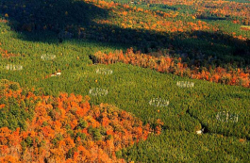
CO₂ fertilization experiments:
Leaf level effects consistent
Duke FACE
Ainsworth and Long (2005) meta-analysis of 15 years of FACE experiments
Light saturated CO₂ uptake
(photosynthetic efficiency)
Instantaneous transpiration efficiency
(leaf-level water-use efficiency)
Notes:
But first, I want to start out with some motivation from the forest FACE experiments, where CO2 was pumped onto plots for several years.
From plot to plot results can vary and be difficult to understand, but one things seems consistent – leaf level responses.

Slide 3
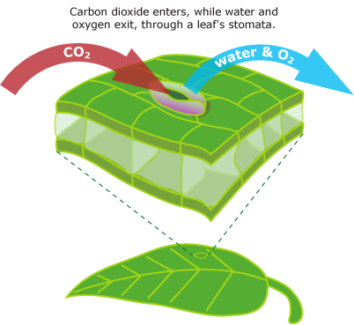
Stand level predictions from leaf level responses.
Leaf level response:
CO₂ → Increased leaf-level water use efficiency (WUE)
Increased WUE only increases productivity if plants are water limited.
Stand-level prediction:
Places or years with greater water stress should have stronger responses to enhanced CO₂.
http://evolution.berkeley.edu/evolibrary/article/mcelwain_02

Slide 4
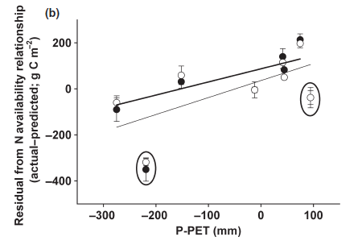
Extrapolation of leaf level effects does not explain FACE (Free Air CO₂ Enrichment) results
Duke FACE, McCarthy et al. 2010
CO₂ effect
CO₂ effect
Enhanced CO₂
Ambient CO₂
Enhanced CO₂
Ambient CO₂
Water availability
Water availability
Similar results in other FACE experiments (Norby et al. 2011 (review))

Slide 5
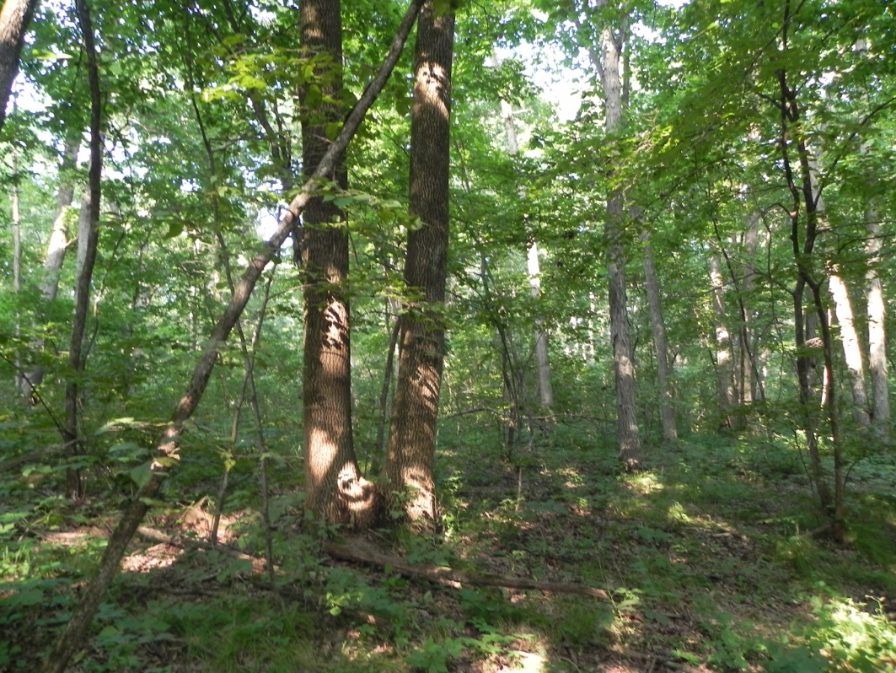
What are we missing?
Notes:
So what are we missing when we try to scale from the leaf level to the stand level?

Slide 6
Changes in allocation patterns have large effects on carbon storage
Residence time
~1 year
Leaves (L)
Woody biomass (W)
~100 years
Individual allocation patterns
Fine roots (R)
~ 2 years
Notes:
Well one thing we are missing is allocation patterns:
Plants may do different things with a boost in productivity from the leaves.
There are three basic pools they may allocate the carbon to:
Leaves – the engines of photosynthesis , woody biomass – for height growth , and fine-roots – to capture water and nutrients.
If they allocate it to leaves or fine roots the carbon will only stay in the plant for a year or two before being dropped, decomposed and returned to the atmosphere.
However if they allocate it to woody biomass it will stay in the tree until it dies, about a hundred years.
So you can see these allocation patterns have a large influence on stand structure and carbon storage.

Slide 7
Simplified plant physiology
Individual trees
Z, W, S all grow allometrically with diameter.
Diameter growth rate = f(resource availability, l, r )
Leaves
Woody biomass
Fine roots
Notes:
Plant is made out of leaves, fine-roots, structural biomass.
Plants differ only in their allocation to these three pools
These size of these components are connected allometrically, such that growth rate is independent of diameter, and dependent on resource availability and l and r only.
l and r are investments in leaf and fine-root biomass per unit crown area

Slide 8
Simplified plant physiology
Water-saturated plant
Light
CO₂
Leaves
N
Water
Nitrogen uptake
Carbon assimilation
Woody biomass
Water-limited plant
Fine roots
Water
Nitrogen
Water uptake

Slide 9
Simplified plant physiology:
carbon conservation
Tissue respiration,
maintenance and
growth
Investment in reproduction
Water-saturated plant
Carbon assimilation
Nitrogen uptake
Water-limited plant
Water uptake

Slide 10
Competition for water and nitrogen.
Uptake depends on community root density
Sparsely rooted plants
Densely rooted plants
Nitrogen
Water
Notes:
Here we look at competition for nitrogen and water. When either is limiting, plants are pretty good at taking up belowground resources, here we assume they take it all up. Such that whether you have a monoculture of sparsely roots plants or a monoculture of densely rooted plants, both take up the same amount of N and water, build the same number of leaves and have the same amount of water-limited carbon assimilation.
But because of conservation of carbon, the densely rooted plants have less to invest in woody biomass.

Slide 11
Competition for light: forest dynamics model
The perfect plasticity approximation
Individuals are good at foraging horizontally for light
Canopy individuals in full sun
Understory individuals in the shade
This simplicity allows analytical predictions
Purves et al. 2007, Strigul et al. 2008

Slide 12
Environmental conditions
Light level constant.
Nitrogen mineralization rate constant.
Rainfall variable.
Water saturation level
Rainfall
Day of the growing season
Rainfall while water limited
Time in water saturation
Note: This abstraction is analogous to a model with stochastic rainfall (Farrior, Rodriguez-Iturbe, Pacala in prep).

Slide 13
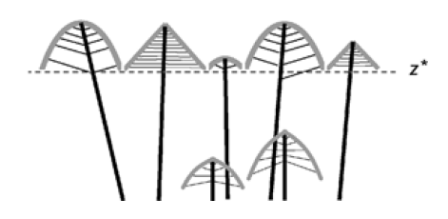
Scaling from individuals to stand
Individual properties
Growth rates = f(allocation, resource availability)
Mortality
Fecundity
PPA
Population dynamics
Stand level properties
Height of canopy closure (Z*)
Expected lifetime reproductive success (LRS, fitness)

Slide 14
Predicting the dominant allocation strategy:
Evolutionarily Stable Strategy (ESS)
ESS – a strategy that when in monoculture prevents invasion by all other strategies
Expected lifetime reproductive success (LRS)
of invader in monoculture of the resident
1
Allocation strategy
(e.g.: allocation to fine roots)
Allocation strategy
(e.g.: allocation to fine roots)
Resident strategy
Successful invaders
Competitive dominant/
Evolutionarily stable strategy (ESS)

Slide 15
Nitrogen-limited plants
Competitive (ESS) allocation strategies
N
Dybzinski et al.
AmNat 2011

Slide 16
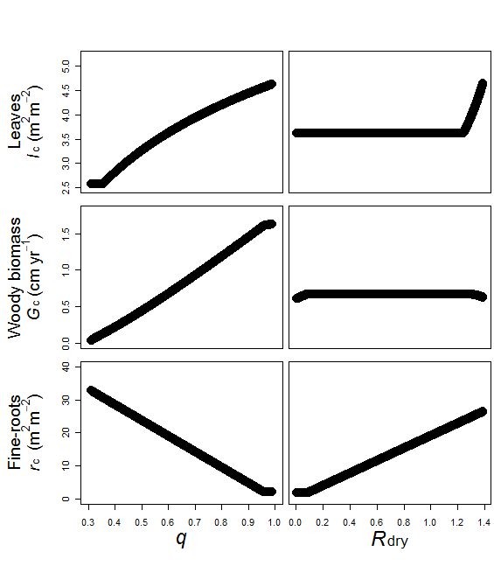
Water-limited plants
Competitive (ESS) allocation strategies
W
Farrior et al.
AmNat 2013
Time in water saturation
Water available during water limitation

Slide 17
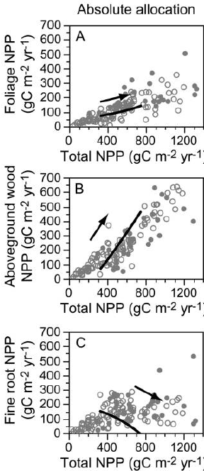
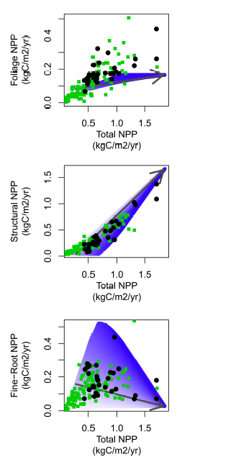
Comparisons to data – Fluxnet sites across the globe
Nitrogen limitation
Water limitation
Dybzinski et al. 2011
Farrior et al. 2013

Slide 18
Application to CO₂ fertilization

Slide 19
ESS allocation example: N-limited plant
N
Competitive, nitrogen-limited plants invest in fine roots at a level that cancels the productivity of the least productive leaf.
Competitive dominant (ESS)
More roots
Less roots
Missing productive leaves
Root cost
(gC/year)
Leaf productivity
(gC/year)
Holds leaves more costly than they are worth
Notes:
But first, we need to look at the ESS a little more closely.
Now, we’ll walk through the ESS strategy for a nitrogen-limited plant.
Here I have the cartoon of a tree up above, and to explain why the ESS is an ESS, we’ll compare the carbon benefit of leaves with their costs in roots down below.
The more leaves you have the less benefits of the last leaf because of self-shading in the plant.
But, for a nitrogen-limited plant, each of these leaf layers costs the same amount of nitrogen to build, and have the same fine-root costs.
This picture is a picture of an ESS, because if a plant had more roots, than the ESS in its environment, it would take up more nitrogen and build more leaves, but you see that last leaf would be making less carbon than it cost in fine-roots.
Alternatively if a plant has less leaves, invading the ESS, it would be missing out on several carbon leaves.
Now the carbon they have to grow and reproduce is represented by this stem here, and you can see that the ESS has the highest fitness in its own environment.

Slide 20
Enhanced [CO₂] perturbs the environment, changing the competitive landscape and the ESS
Plant response
ESS
New ESS
LRS of invader in monoculture of the resident.
+CO₂
Invading strategy
Resident strategy

Slide 21
Plant level responses to enhanced [CO₂]:
N-limited plants
N
Immediate Plant Response
ESS
New ESS
+CO₂
(photosynthetic efficiency)
CO2 fertilization in nitrogen-limited plants promotes growth of fine-root and woody biomass.
Root cost
(gC/year)
Leaf benefit
(gC/year)
Dybzinski et al. In Prep

Slide 22
Plant level responses to enhanced [CO₂]:
Water-limited plants
New ESS
W
Immediate Plant Response
ESS
New ESS
+CO₂
(leaf-level water use efficiency)
CO₂ fertilization in water-limited plants promotes growth of fine-roots biomass without increases in tree growth.
Root cost
(gC/year)
Leaf benefit
(gC/year)
Farrior et al. 2013
If plants are water limited, when CO₂ is added, if there is a productivity response, it is due to the increase in water use efficiency.
With this increase, competitive plants increase fine-root biomass but there is no increase in biomass allocated to wood (yellow – brown area).
Notes:
I don’t have time to fully explain the water-limited ESS, but this is what it looks like.
Because leaf water useage is proportional to their photosynthesis during water-limitation, root costs per leaf are proportional to those leave’s water-limited photosynthesis.

Slide 23
Enhanced CO₂ for water and nitrogen limited plants lead to opposite effects on carbon sinks.

Slide 24
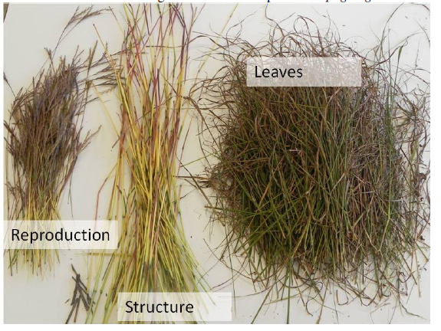
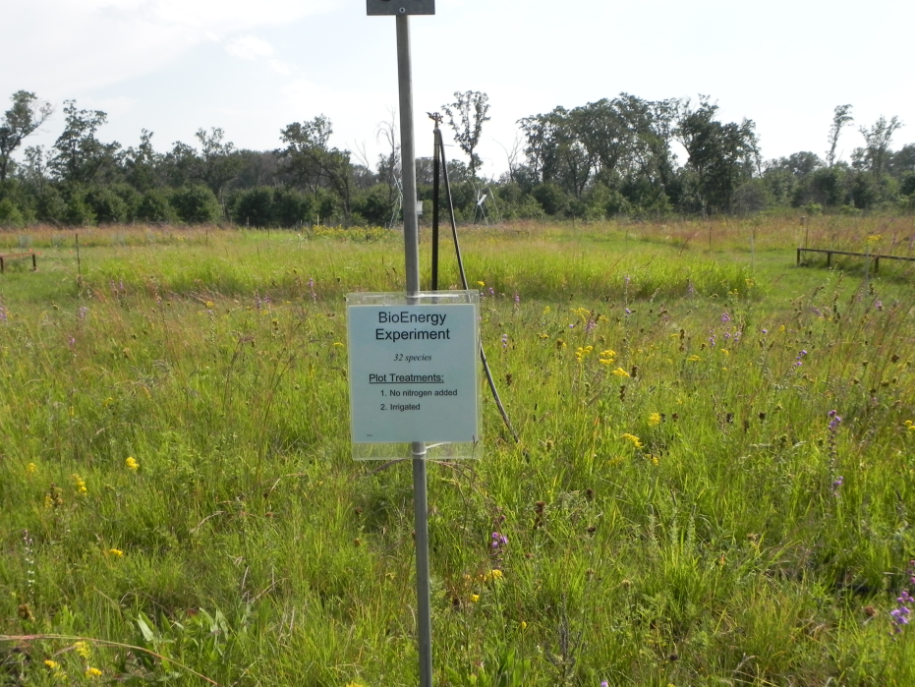
Resource addition experiment
36, 32 species plots planted in 1994 (Cedar Creek, Dave Tilman)
4 years of factorial additions
Nitrogen (ambient, +7g/m²/yr +14g/m²/yr)
Water (ambient, ~double)
Fine roots
Farrior et al. In Press Ecology
Coarse roots

Slide 25
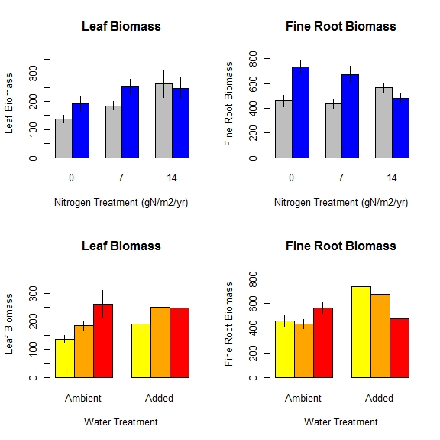
Simple experiment yields some confusing results
Leaves increase with N
Roots increase with water addition but only at low N
Roots decrease with N addition but only at high water
*
*
* Significant effect of the water treatment
Farrior et al. In Press Ecology

Slide 26
Grassland model of competition for light, water, and nitrogen
Individual plant
Allocation to reproduction,
Measure of fitness
CO₂
Water
Water
Nitrogen
Farrior et al. In Press Ecology
Notes:
Modify the model a little bit for prairie plants, but for today just need to know the difference is instead of allocation to stem, allocation to fecundity

Slide 27
Effect of nitrogen addition on biomass allocation
N
Nitrogen ESS
Plant Response
New ESS
+N
Root cost
(gC/year)
Leaf productivity
(gC/year)
Root investment decreases with nitrogen addition because marginal returns of nitrogen uptake are negative.
Notes:
Now if we add nitrogen to a system that is only nitrogen limited. The plant immediately gets to build more leaves with the roots that it has. But these leaves are less productive than before and the new ESS will have less roots.

Slide 28
Effect of water addition on allocation
W
Plant Response
Water ESS
New ESS
+water
during water limitation
Root cost
Water-limited
leaf productivity
Root investment increases with water addition because marginal returns of water uptake are constant.

Slide 29
ESS allocation to fine roots: a weighted average
ESS root investment =
time in water limitation
+
time in water saturation
*
water ESS
*
nitrogen ESS
Explicit interaction between water and nitrogen
→ Nitrogen additions should have a greater effect at high water.
→ Effect of water additions should decrease with nitrogen level.
Notes:
Turns out that the ESS for a nitrogen and water limited plant, the ESS root investment is a weighted average of the pure nitrogen ESS and the pure water ESS by the time spent under those limitations.

Slide 30
ESS allocation to fine roots: a weighted average
*
*
Effect of water additions decrease with nitrogen additions because the nitrogen limitation strategy becomes more important with water additions.

Slide 31
Experimental additions of nitrogen and water results consistent with a model where nitrogen-limited and water-limited plants respond in opposing ways to CO₂ fertilization.

Slide 32
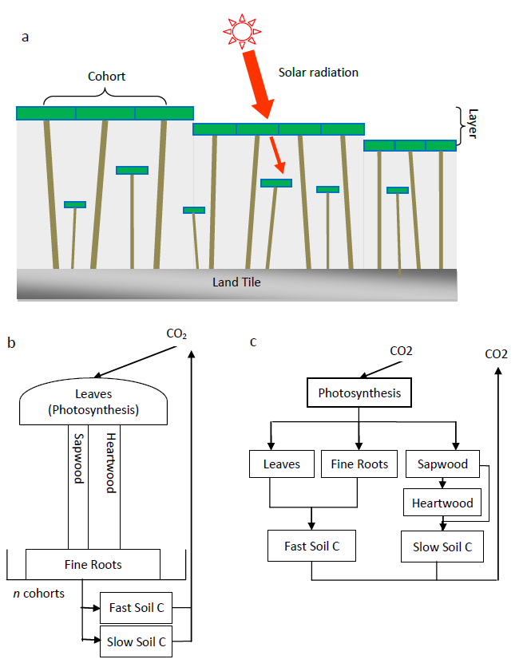
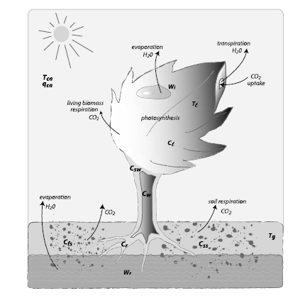
Height-structured competition for light in a global land model
LM3/PPA
LM3V
Shevliakova et al. 2009
Weng et al. In prep

Slide 33
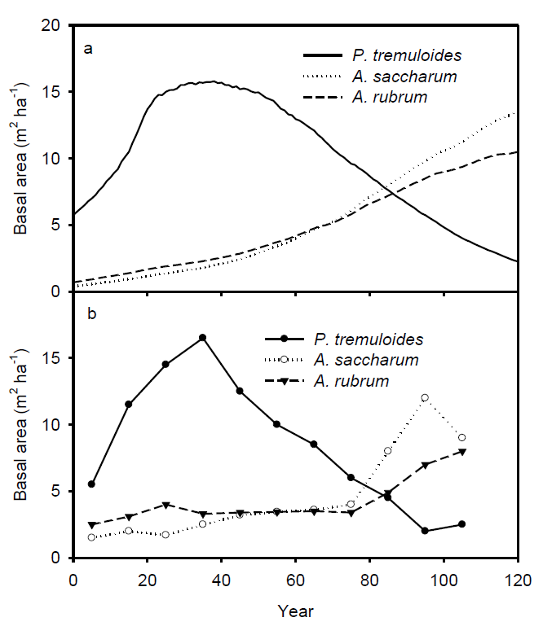
Predicting successional dynamics
Model
Data
Weng et al. In prep

Slide 34
To infinite diversity in a land model
Current directions
Using ESS allocation strategies into forest tiles.
Including realistic rainfall regime (Farrior, Rodriguez-Iturbe, Pacala In Prep)

Slide 35
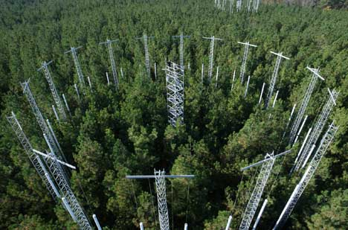
In summary
If possible, tractable models can make it easier to determine and test basic mechanisms and their importance.
Climate crisis demanding of a young science
Must make and improve predictive models
At the same time, important to rebuild/reinvent the basis of these models.
Scaling from small plots to landscapes and regions: what works, and what doesn't?
*
*

Slide 36
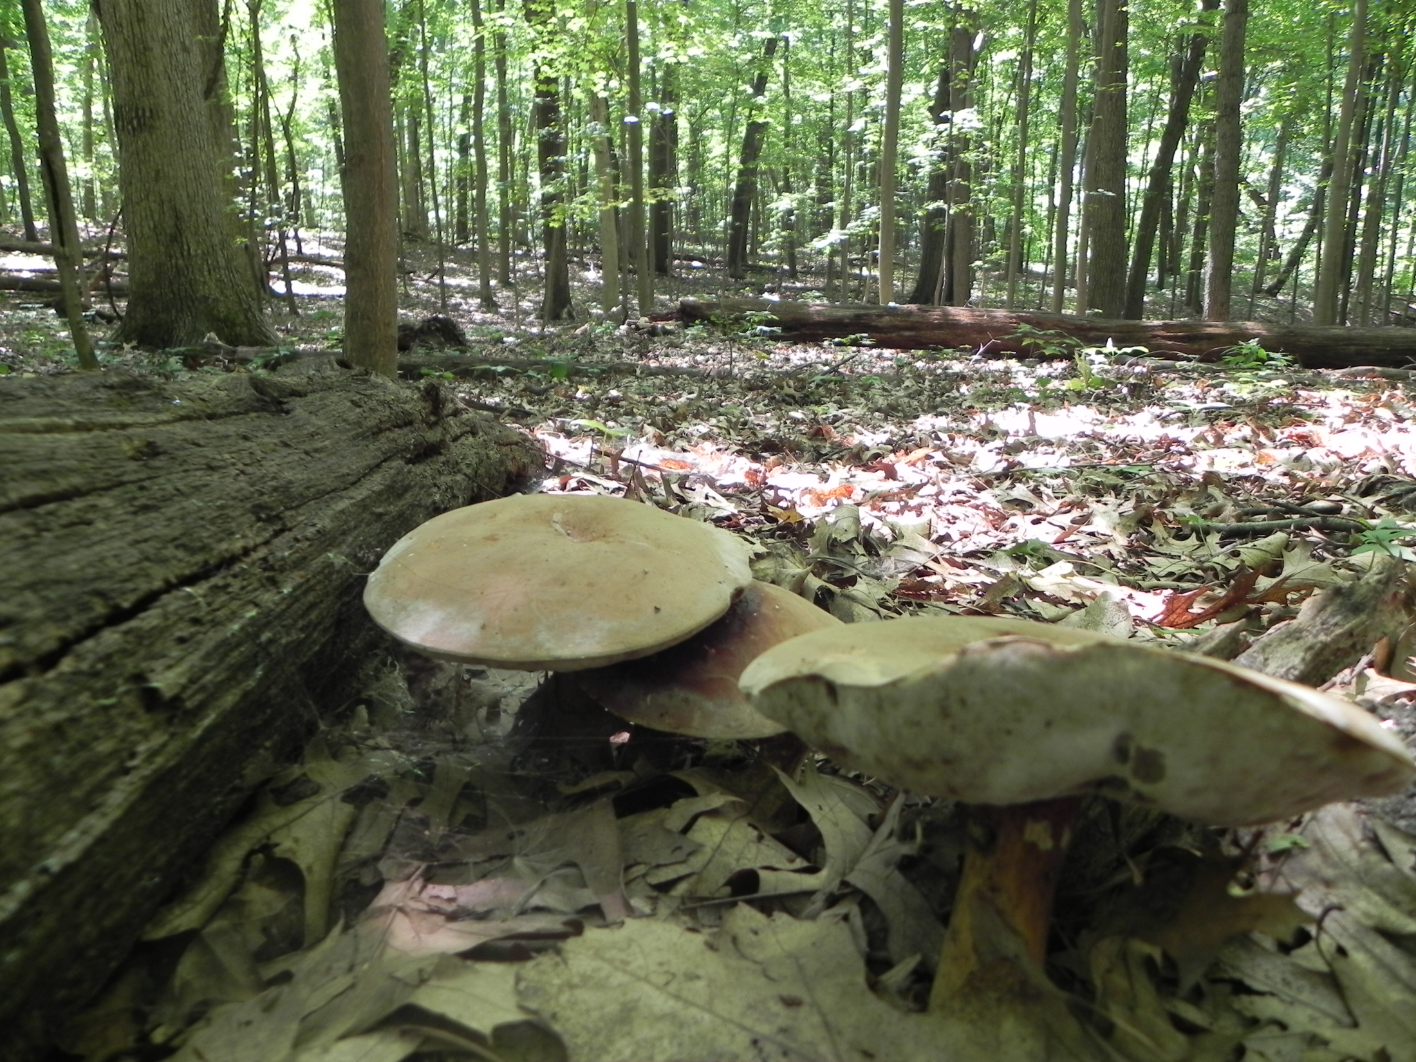
Acknowledgements
Collaborators
Steve Pacala
Ray Dybzinksi
Simon Levin
Dave Tilman
Peter Reich
Ensheng Wang
Elena Shevliakova
Sergey Malyshev
Jeremy Lichstein
Funding Sources
Princeton Carbon Mitigation Initiative
USDA Forest Service
NSF Graduate Fellowship
Legislative-Citizen Commission on Minnesota Resources.

