Slide 1
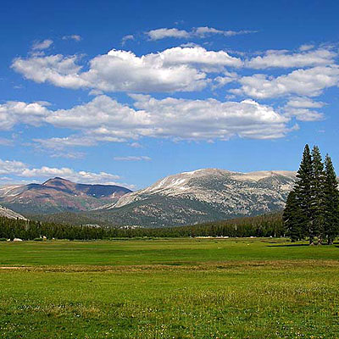


Changes in soil structure in response to extreme drought in the high elevation meadows of Yosemite National Park
Chelsea Arnold
University of California, Merced

Slide 2
Outline
Historical context of high elevation meadow formation and structure of soil
Recent extreme weather in Central Sierra Nevada
Driving question for research
Background on principle of soil consolidation from an ecological perspective
Experimental design of meadow soil consolidation
Results

Slide 3
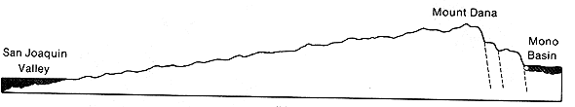
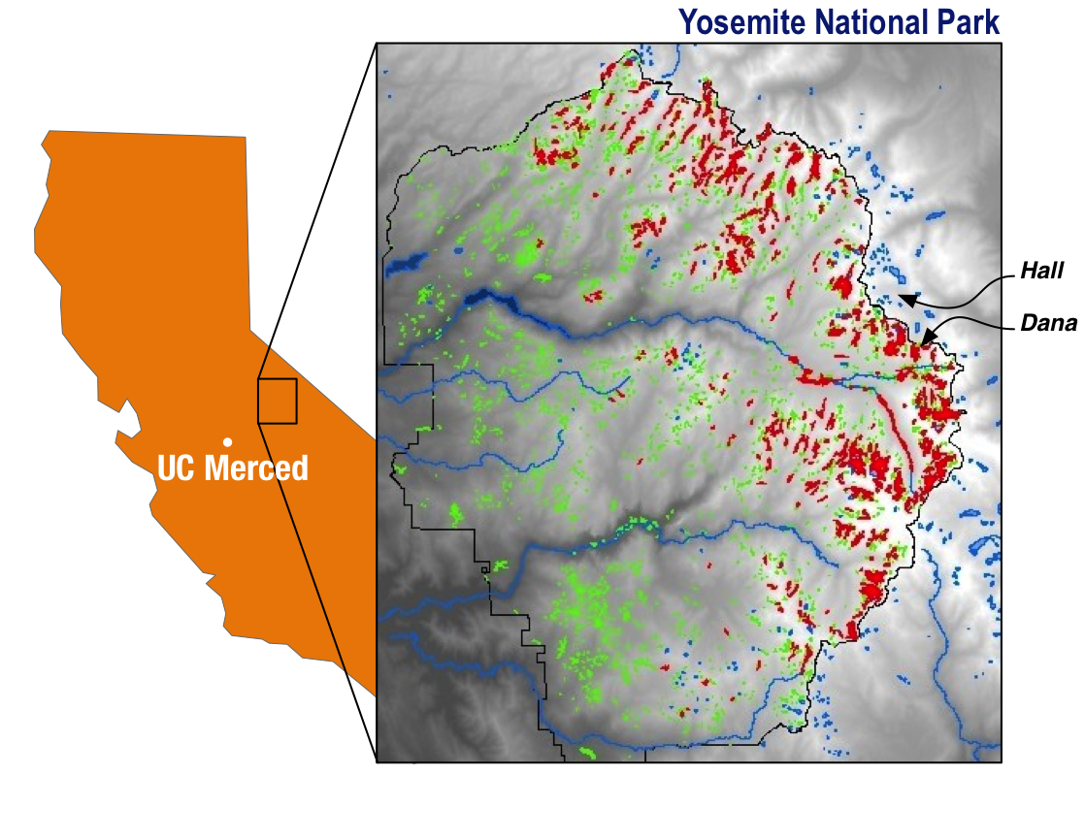
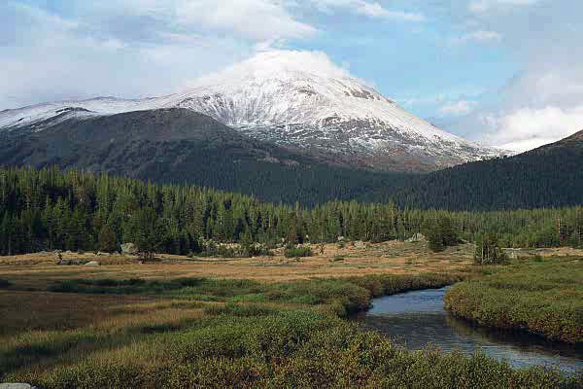

Slide 4
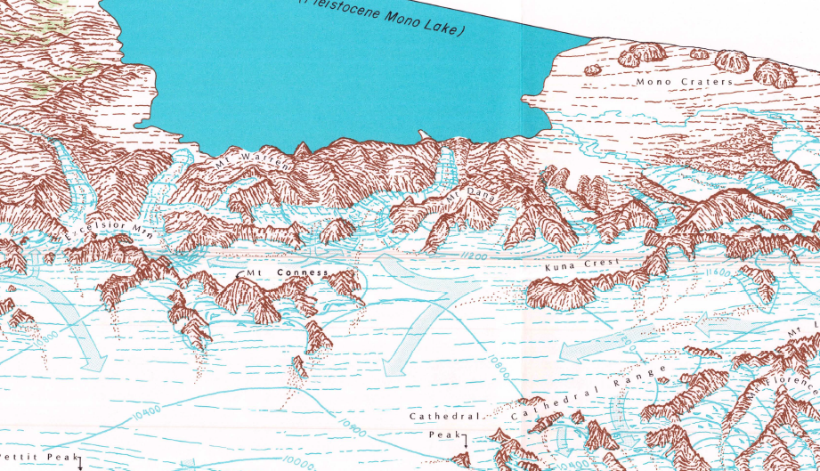
History of glaciation in the Central Sierra Nevada
Tioga – Late Glacial Maximum
( 18,000 cal yr B.P.)
Recess Peak – Late Pleistocene
(14,100 – 13,100 cal yr B.P.)
Matthes – Little Ice Age
( AD 1350 – 1850)
Clark and Gillespie, 1997
Transition to peat occurred ~4500 B.P.
Map of Tioga glaciation in Central Sierra Nevada (USGS)

Slide 5
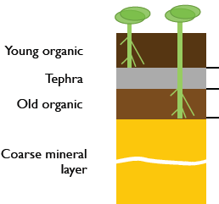
History of extreme climate in the Central Sierra Nevada
Mega Droughts
  1st occurred ~A.D. 892 – AD 1112
  2nd occurred ~AD 1209 – AD 1350
  Increasing wetness between periods of drought from AD 1112 – AD 1209
  Tephra layer 2 at 1175 BP, with organic peat accumulation above
Meadow soil profile
Stine, 1994 and Wood, 1975

Slide 6
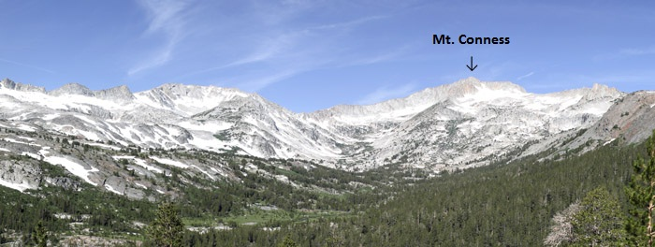
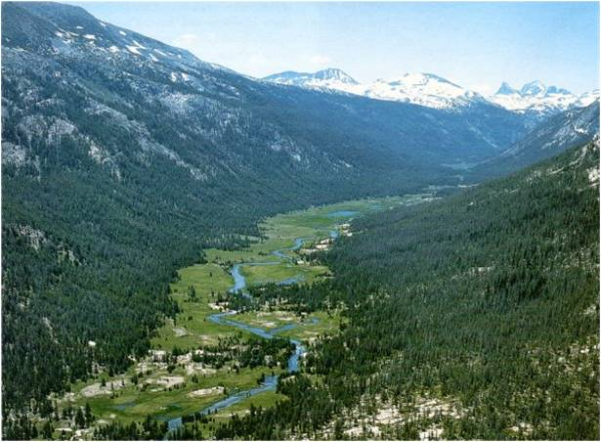
Ecological significance of high elevation meadows in the Sierra Nevada
Ecosystem Services
Filter, store and slowly release water to river systems
Contribution to river baseflow
Flood attenuation
Biodiversity hotspot – breeding habitat
Maintenance of a high water table

Slide 7
Original Problem
Soils that have not been exposed to dryness can shrink irreversibly when desiccated for the first time.
This phenomenon was observed in our lab during routine soil water retention characterization:
  soil samples collected from high-altitude meadows in Yosemite
  Sampling site continuously fed by a spring

Slide 8
Scientific Hypothesis
Desiccation of meadows (even for very short period) can drastically reduce water storage capacity of meadows.
Major cause of desiccation is lowering of water table and/or increased evaporation
  Climate change (extremely dry year)
  Channeling (erosion because of mismanagement)

Slide 9
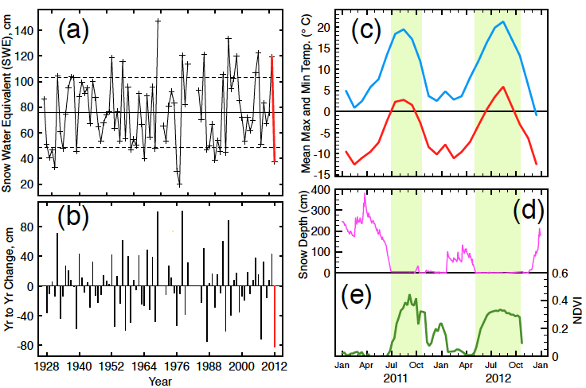
Recent extreme seasonality in the Central Sierra Nevada
Figure a) Historic April 1 snow water equivalent (SWE) for Dana Meadows (1929-2012)
Figure b) April 1 SWE reported as the year to year change

Slide 10

Figure d) Snow depth values for Dana Meadows (2011-2012)
*no early season snow cover over meadows until jan.!
Figure e) Averaged NDVI values for Dana Meadows from MODIS Terra satellite 8 day composites
Number of growing season days (in green) increased 54%from 2011 to 2012
First snow free day was 57 days earlier in 2012

Slide 11
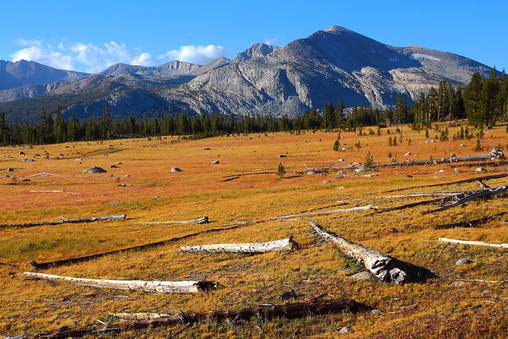
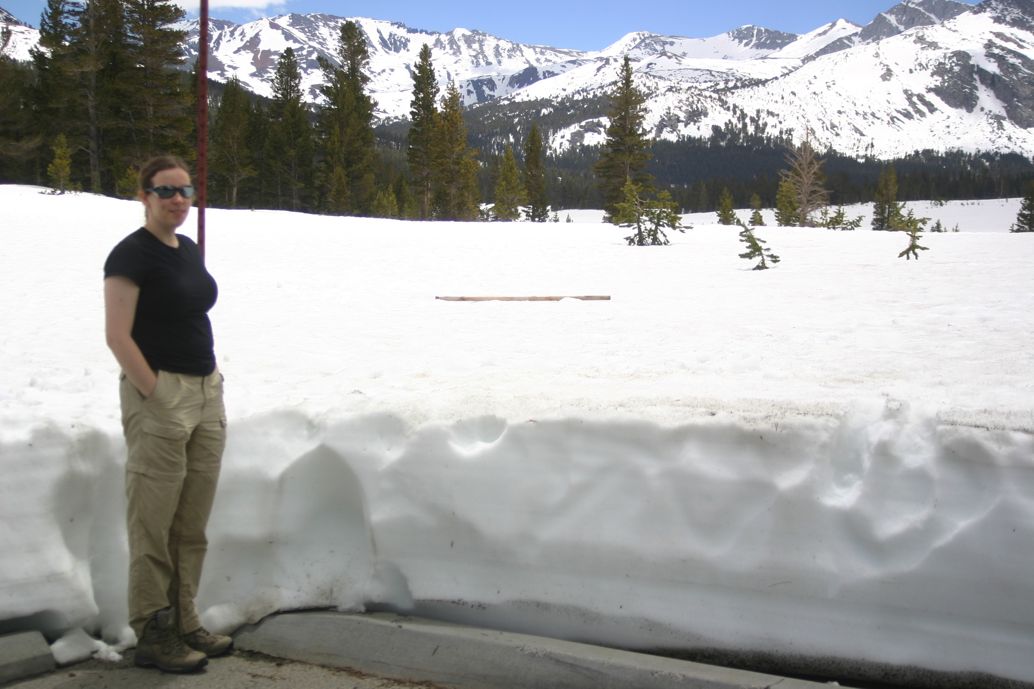
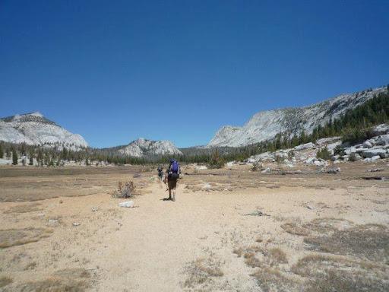
Late summer 2011
Late summer 2012
June 3, 2011

Slide 12
Research question
Can extreme interannual variation in weather induce rapid and irreversible changes in the structure of meadow soil and overall ecosystem functioning?

Slide 13
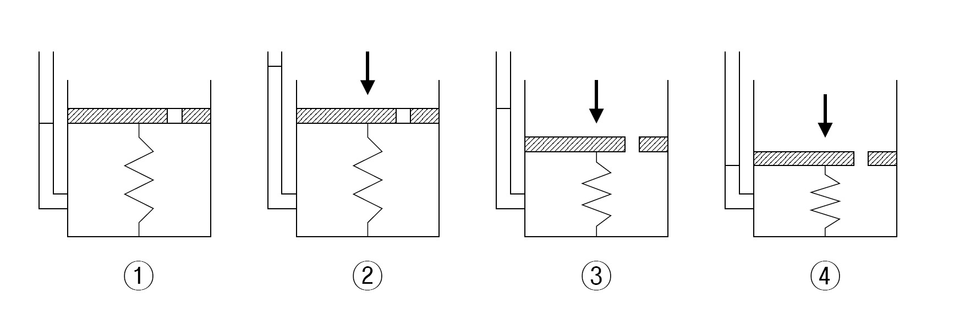
In traditional soil mechanics – load test is utilized to compress soil and induce consolidation by “pressing” water from pores

Slide 14
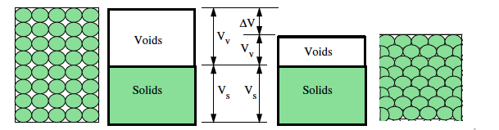
Ecological approach – consolidation by capillary suction
⬇ ⬇ ⬇ ⬇ ⬇
Image modified from C.C. Swan the University of Iowa

Slide 15
Capillary Consolidation
Long-term wetness
Temporary extreme drying
Rewetted state
Permanent rearrangement of soil particles
Porosity loss is not recovered

Slide 16
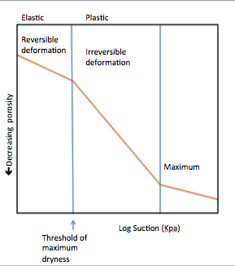
Principle of soil consolidation
The process of soil consolidation is instantaneous and involves irreversible plastic deformation of soil pores

Slide 17
Wet and
High porosity
Dry and
Low porosity

Slide 18
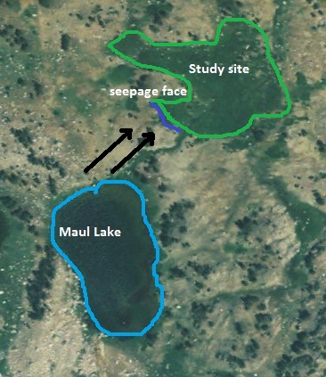
Harvey Monroe Hall Research Natural Area, Inyo National Forest
Aerial view of meadow
Cross sectional view of seepage face

Slide 19
Methods
Intact soil cores were taken in the summers of 2011 and 2012 to three depths (0-5, 10-15, and 20-25 cm)
Sample cores are placed in latex membrane and allowed to saturate in modified triaxial system
System is pressurized to an effective pressure of 5-6 KPa and once equilibrium is reached, sample is drained in steps

Slide 20
Experimental Setup

Slide 21
Compressed air
150 kPa
Measures
porosity loss
Difference = Capillary Pressure
Water Jacket
155 kPa
Pore water
pressure < 150 kPa

Slide 22
Change of Volume
Note: Sample gets increasingly desaturated

Slide 23
Consolidation Curves: 2011

Slide 24
Porosity vs. Stress Curve
Historical maxima = 17 kPa

Slide 25
Tipping Point ?
Initial Vol. = 83 cm³
Final Vol. = 70 cm³
Irreversible porosity loss = 15%

Slide 26
Hydrological Implications
Permanent loss of porosity
  Mostly affects large pores
  Mostly affects drainable porosity
Permanent loss of permeability
  Infiltration and drainage are reduced
  Reduced subsurface feeding of streams
  Increasing proportion of snowmelt runs off on the surface (loss of flood attenuation benefits)

Slide 27
Ecological implications for ecosystem functioning
Increase in decomposition
  1. Drying of soil to expose previously protected labile soil organic matter
  2. Loss of soil organic matter stock
  3. Decrease in water holding capacity
Changes in plant productivity, species diversity and distribution
  through changes in bulk density, plant available water, etc.

Slide 28
Comparison of soil respiration from 2011 and 2012

Slide 29
Conclusion
Take home message
  Extreme drying of meadow soils can result in irreversible loss of porosity and overall water holding capacity.
  Results in a change of state for the meadow soil that can potentially trigger overall degradation of meadow soils and disruption of ecosystem functioning

Slide 30
Acknowledgements
Advisors: Teamrat A. Ghezzehei and Asmeret Asefaw Berhe
Lab and field assistants:
Jesseca Meyer, Jennifer Guerrero, Stephen Ho
James Perry
Funding for this project was provided by the startup funds of Teamrat A. Ghezzehei, the Hellman Family Fund grant and the Mildred E
Mathias grant

