Slide 1
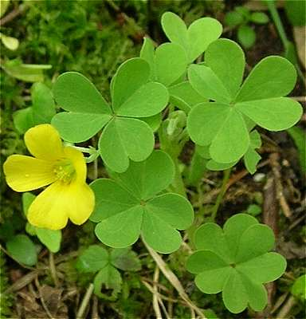
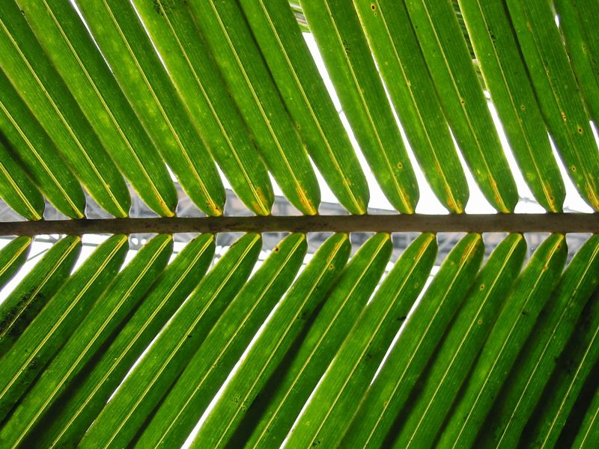
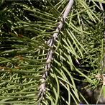

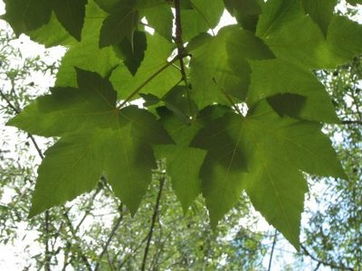

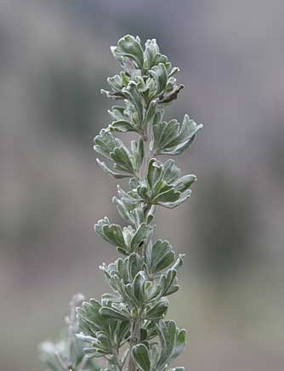
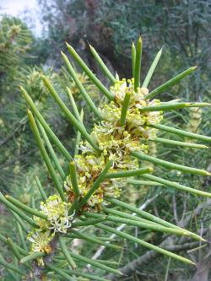
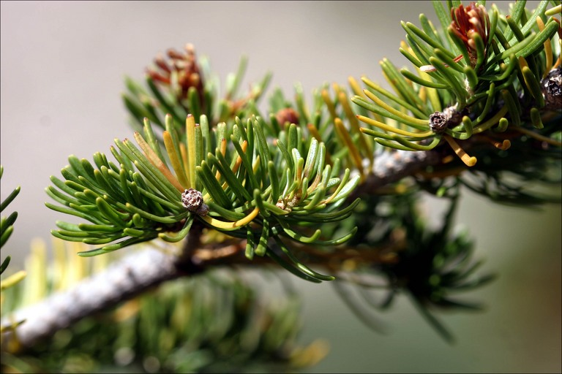



Leaf area- vs. mass-proportionality of leaf traits within canopies and across species: patterns and analytical consequences
Jeanne L. D. Osnas, Jeremy W. Lichstein, Stephen W. Pacala, Peter B. Reich
June 2013

Slide 2
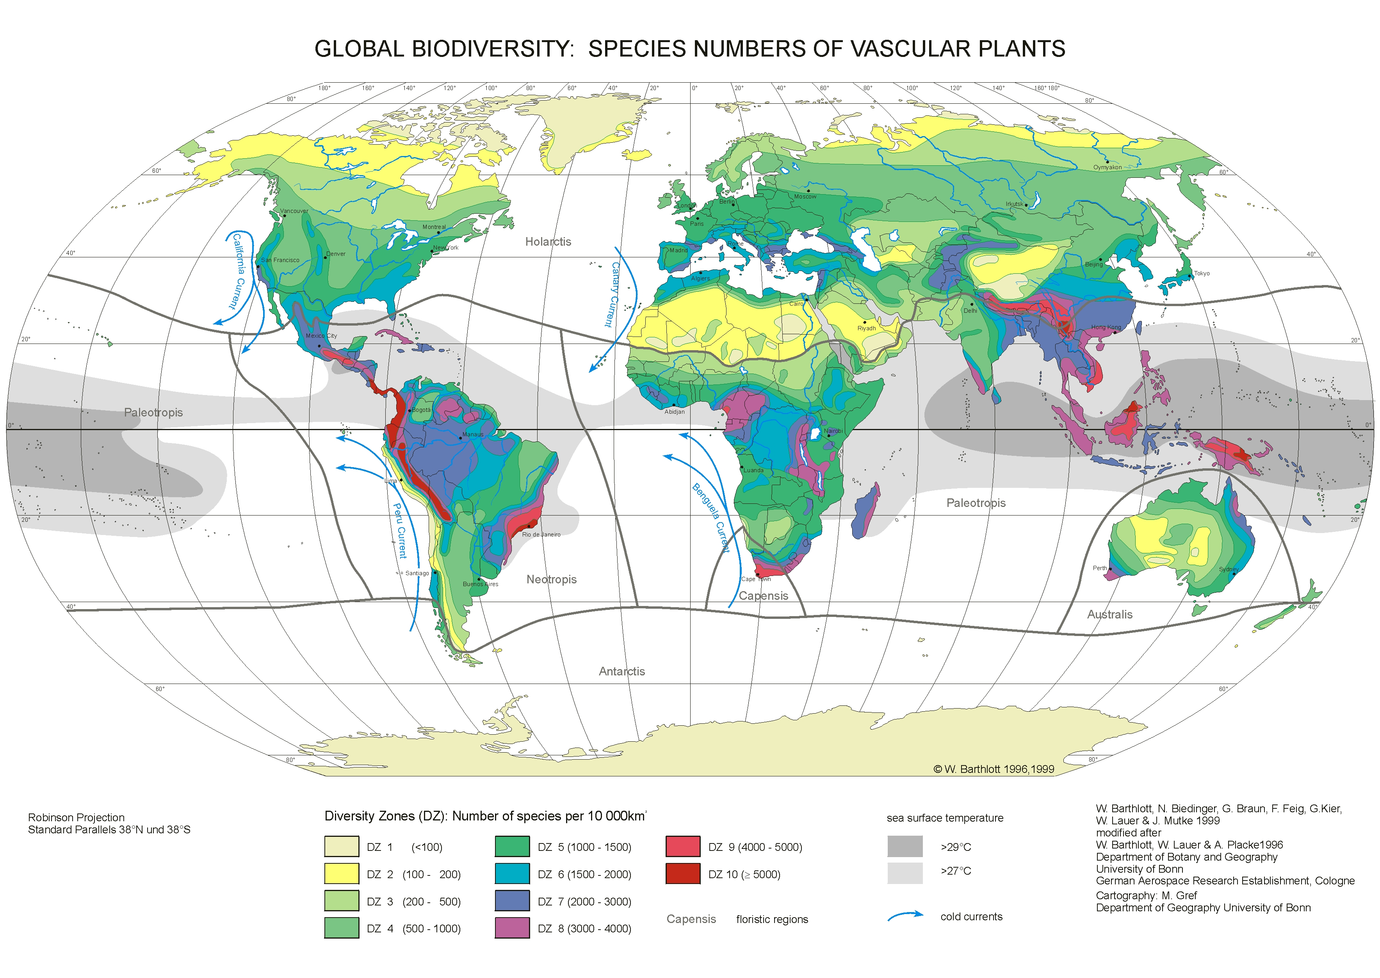
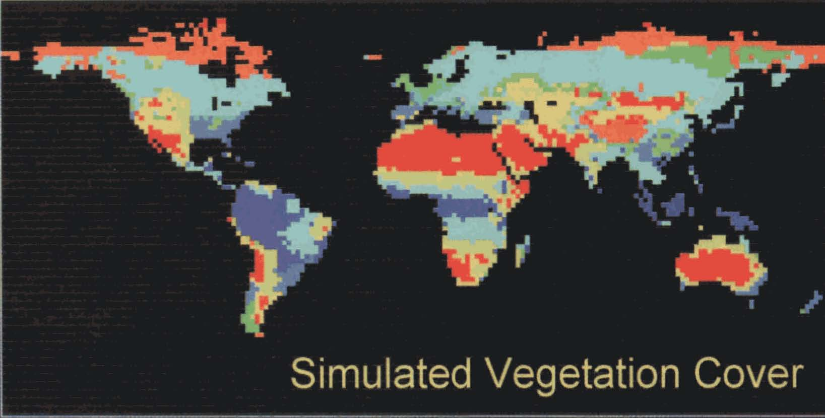
300,000 vascular plant species
global vegetation models: 5-10 plant functional types
Foley et al. 1996
Barthlott et al. 1999

Slide 3
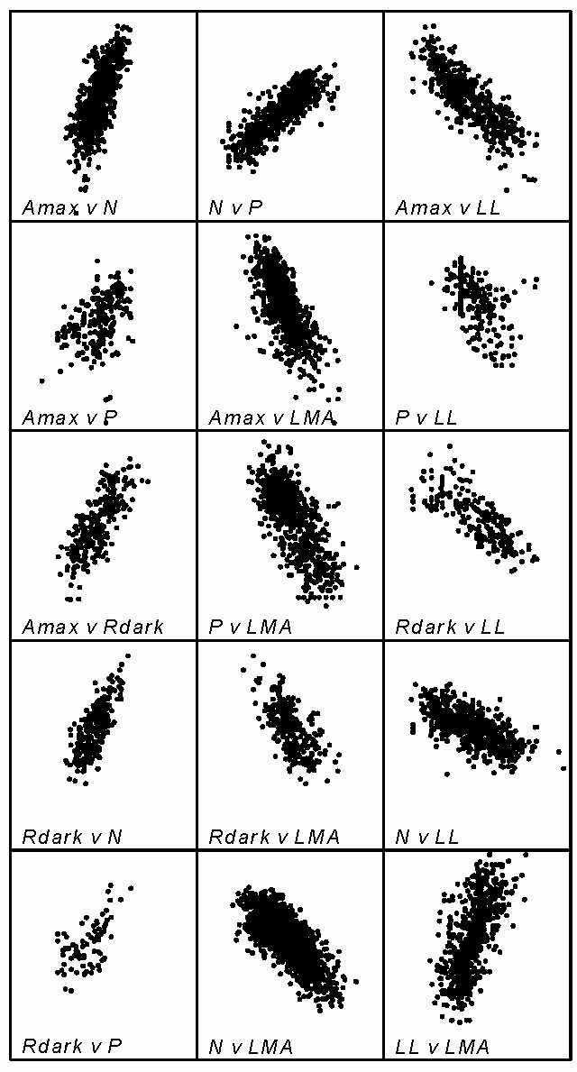
GLOPNET (Wright et al. 2004): 2500+ species
  Gas exchange rates
    Max net photosyn. (Amax)
    Dark respiration (Rdark)
  Nutrient concentrations
    Nitrogen (N)
    Phosphorus (P)
  Leaf lifespan (LL)
  LMA = mass/area
Barthlott et al. 1999

Slide 4
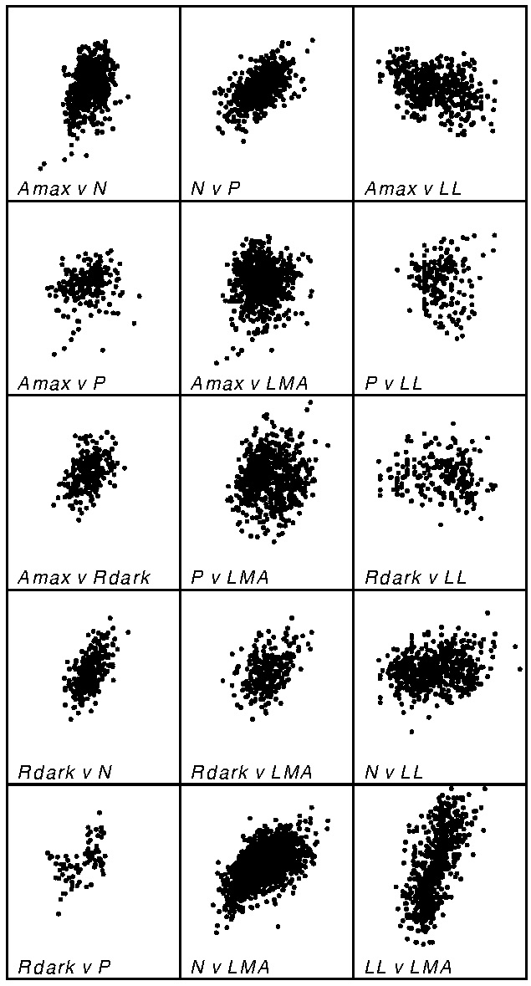
Area-normalized
Mass-normalized
X_{mass} = X_{area}/LMA
X = Amax, Rdark, N, P
GLOPNET

Slide 5
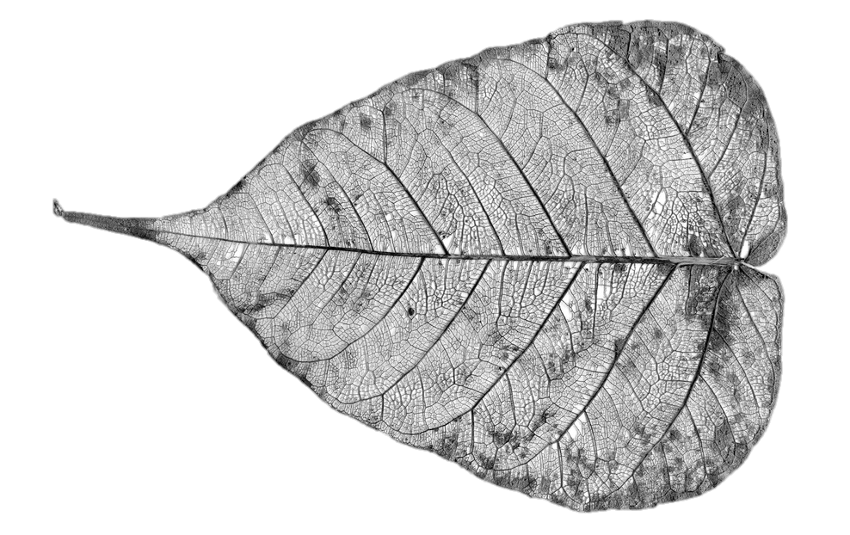
Area-normalized
Mass-normalized
Which to choose?
Structured trait relationships
GLOPNET
normalization
Area- or Mass- proportional?

Slide 6
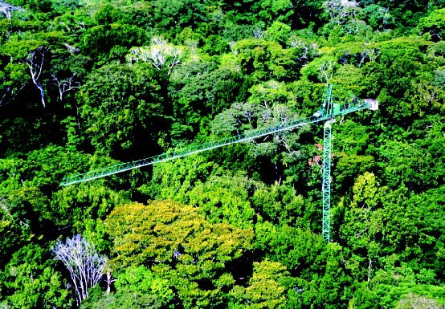
Trait area- and mass-proportionality across species
  Total leaf trait i: X_{ik} = (Mass_{k} μ_{Mi} + Area_{k} μ_{Ai})ε_{ik}
  Mass-normalized: X_{Mik} = (μ_{Mi} + LMA_{k}⁻¹ μ_{Ai})ε_{ik}
  Area-normalized: X_{Aik} = (LMA_{k}μ_{Mi} + μ_{Ai})ε_{ik}
  μ_{Mi}, μ_{Ai} constant across species
  ε_{ik} = random variable (interspecific variation)
Osnas et al. (2013) Science

Slide 7
Quantify trait area- and mass-proportionality across species
  Total leaf trait i: X_{ik} = (Mass_{k} μ_{Mi} + Area_{k} μ_{Ai})ε_{ik}
  Mass-normalized: X_{Mik} = (μ_{Mi} + LMA_{k}⁻¹ μ_{Ai})ε_{ik}
  Area-normalized: X_{Aik} = (LMA_{k}μ_{Mi} + μ_{Ai})ε_{ik}
  μ_{Mi}, μ_{Ai} constant across species
  ε_{ik} = random variable (interspecific variation)
Osnas et al. (2013) Science

Slide 8
Quantify trait area- and mass-proportionality across species
  Total leaf trait i: X_{ik} = (Mass_{k} μ_{Mi} + Area_{k} μ_{Ai})ε_{ik}
  Mass-normalized: X_{Mik} = (μ_{Mi} + LMA_{k}⁻¹ μ_{Ai})ε_{ik}
  Area-normalized: X_{Aik} = (LMA_{k}μ_{Mi} + μ_{Ai})ε_{ik}
  μ_{Mi}, μ_{Ai} constant across species
  ε_{ik} = random variable (interspecific variation)
Osnas et al. (2013) Science

Slide 9
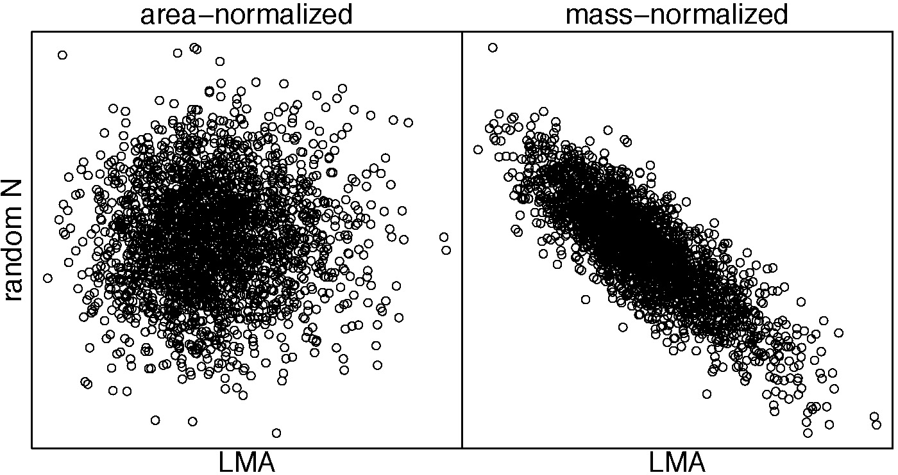
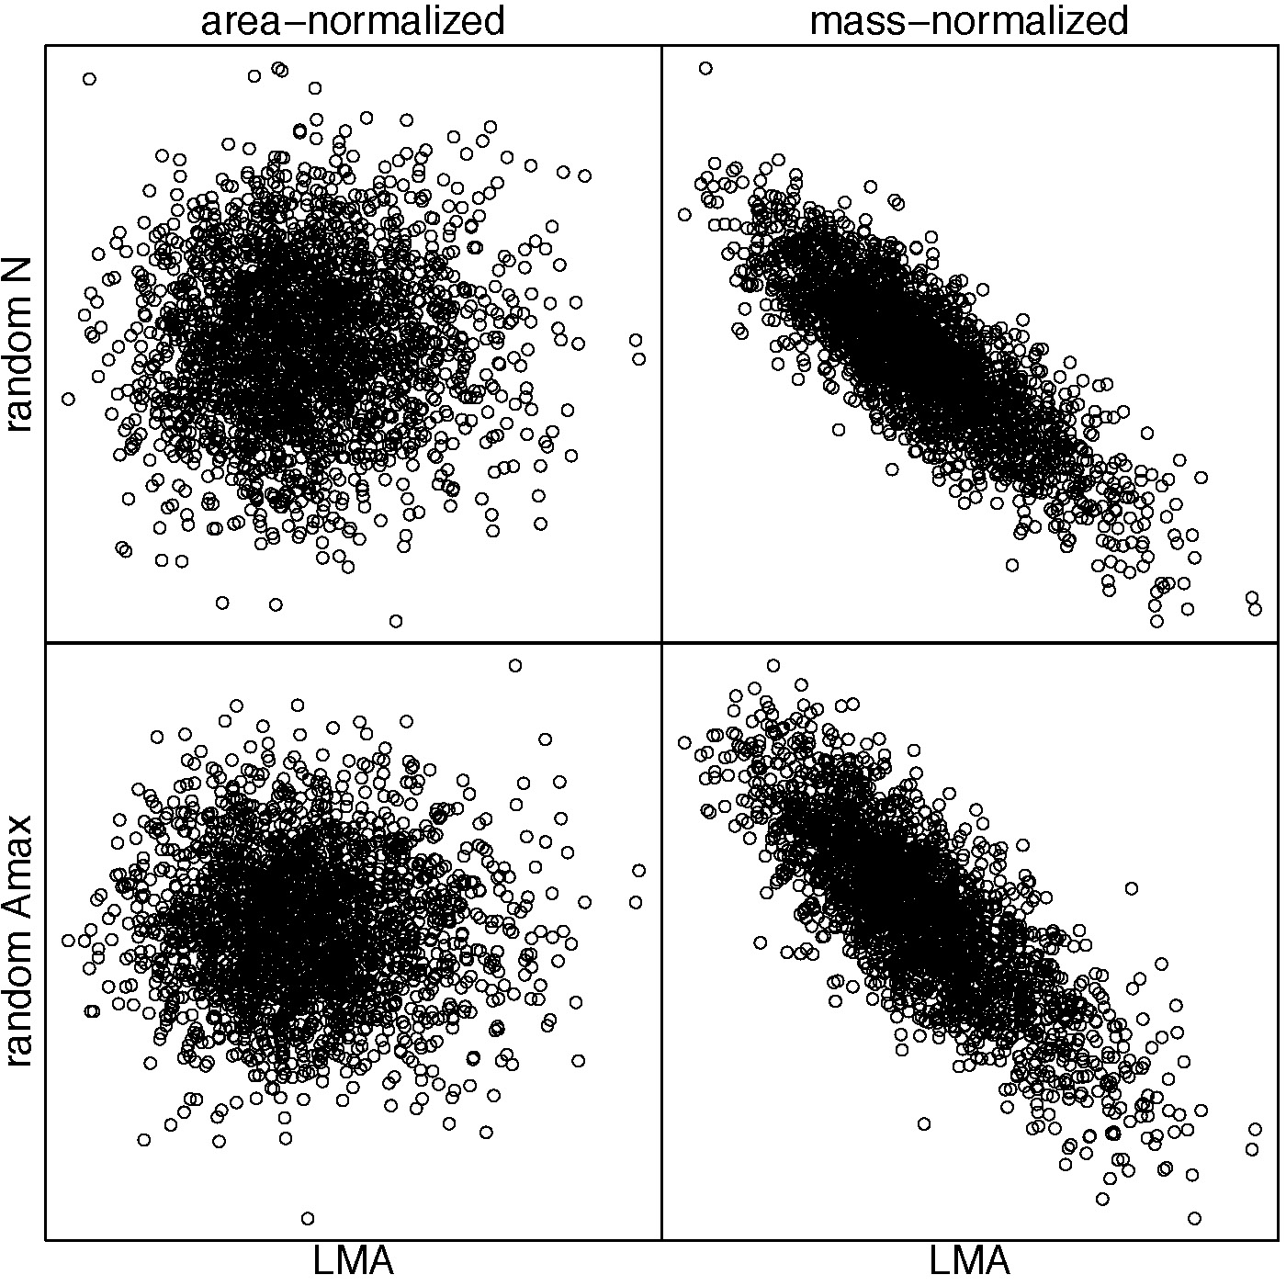
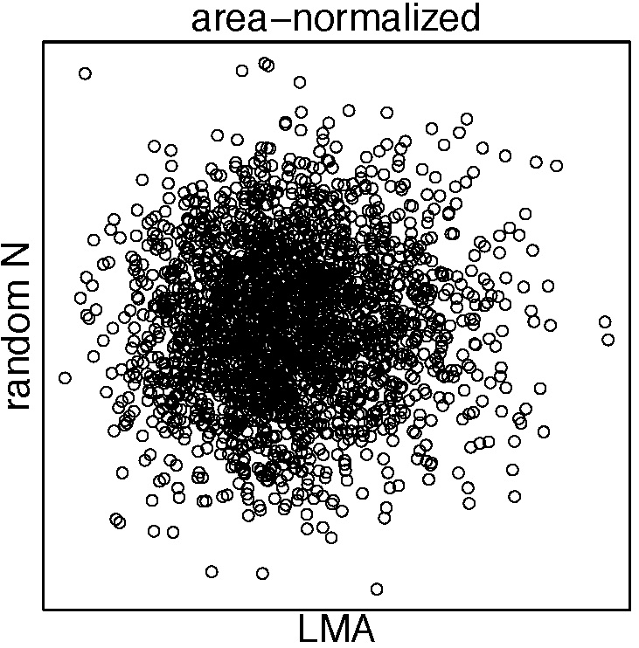
Mass-normalization of area-proportional traits induces strong correlations
Area-normalized
Mass-normalized
Area-normalized
Mass-normalized
Random N
Random N
LMA
LMA
Random N = random draws from lognormal distribution parameterized with GLOPNET N_{area}
GLOPNET LMA
“area-proportional”
Random Amax
Osnas et al. (2013) Science; Lloyd et al. (2013) New Phytologist
LMA
LMA

Slide 10
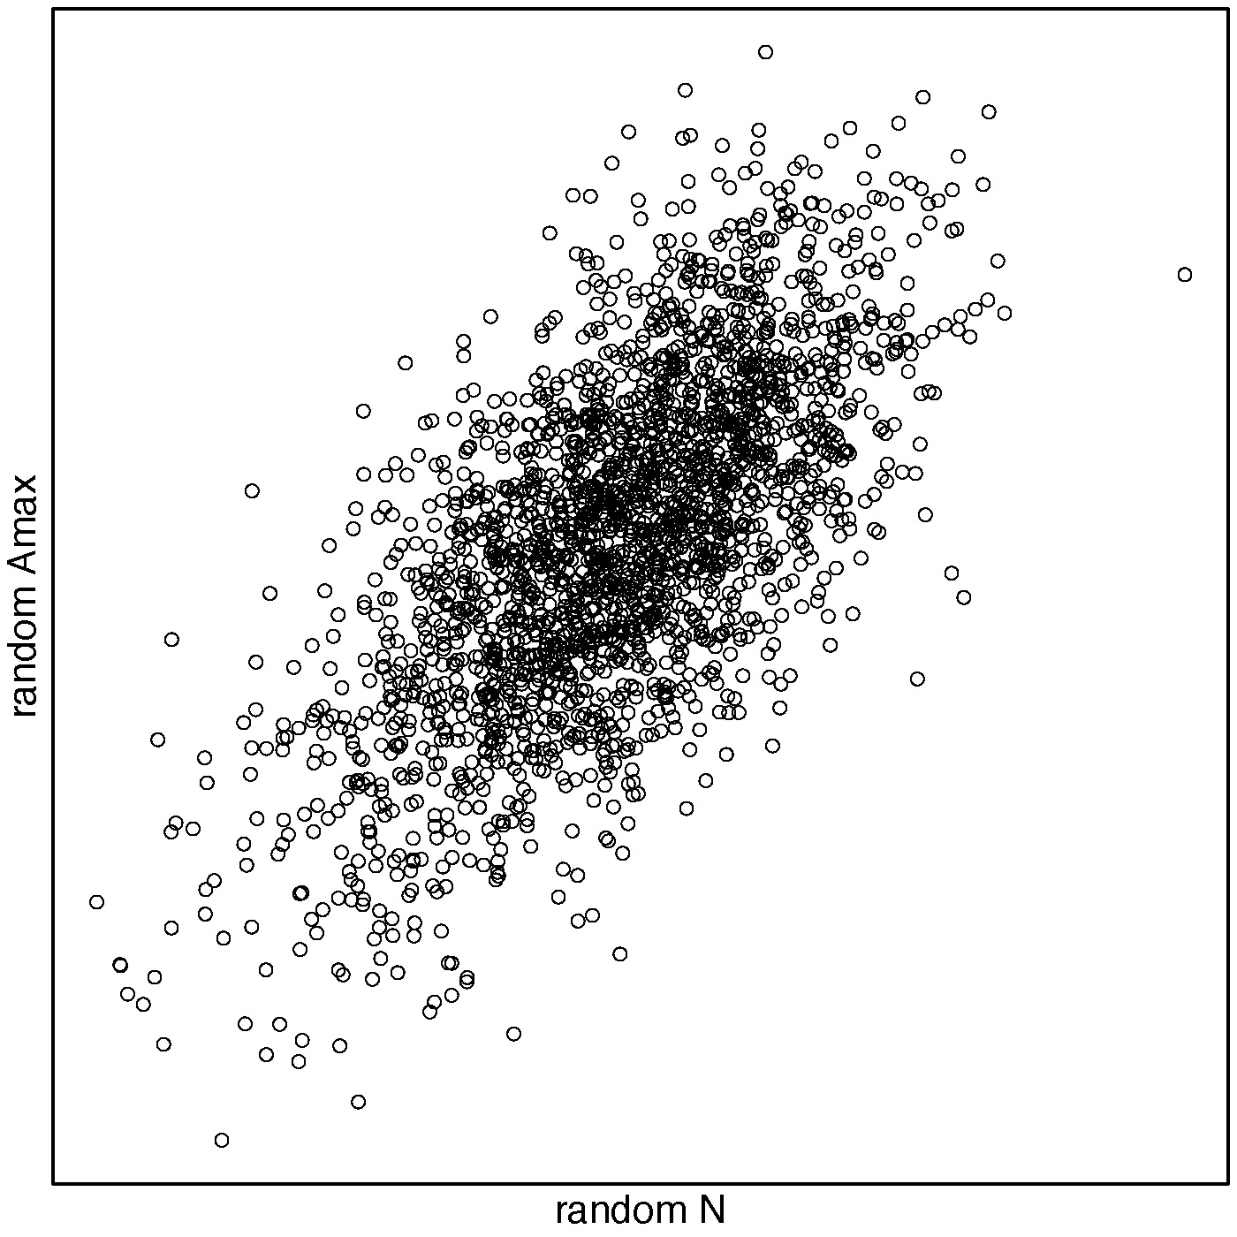
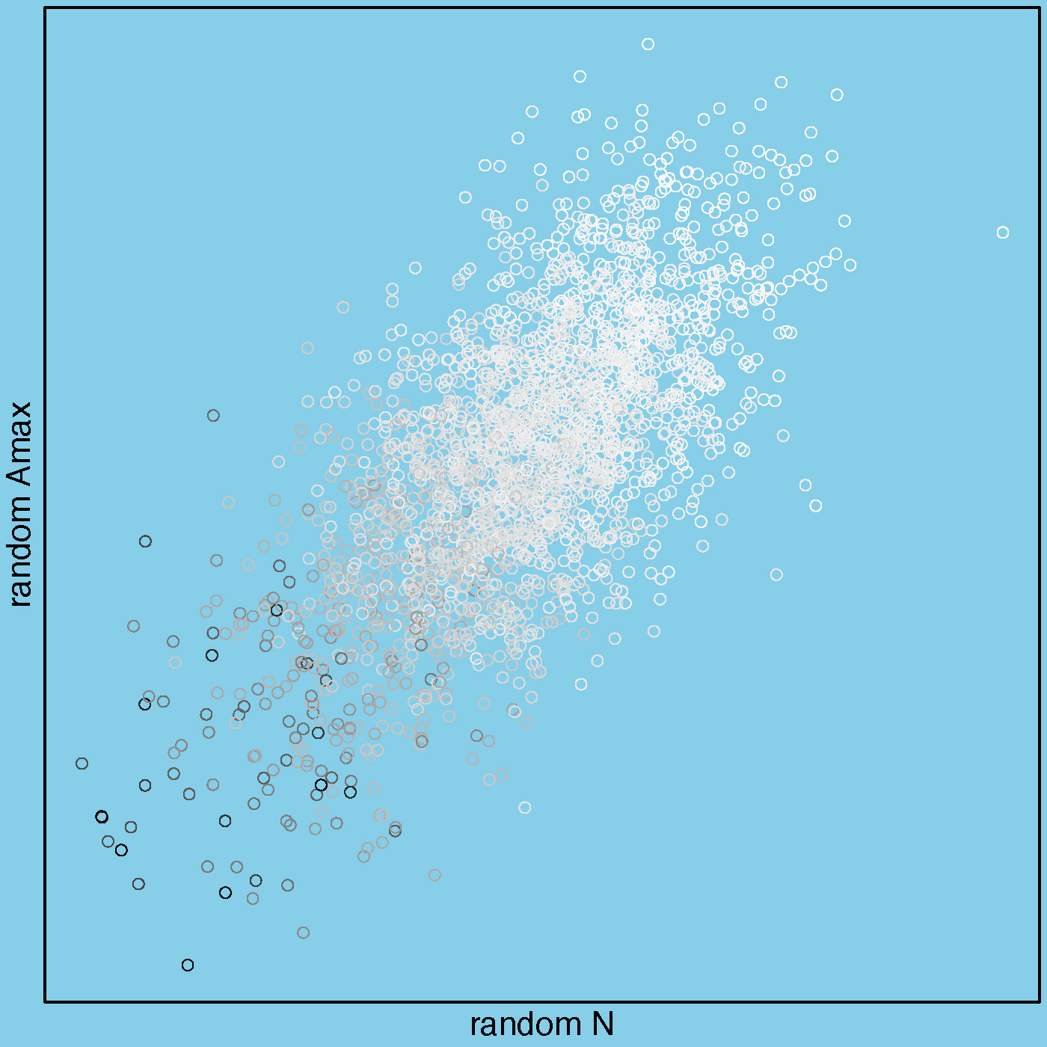
Mass-normalization of area-proportional traits induces strong correlations
Low LMA
Random Amax_{mass}
Osnas et al. (2013) Science; Lloyd et al. (2013) New Phytologist
High LMA
Random N_{mass}

Slide 11
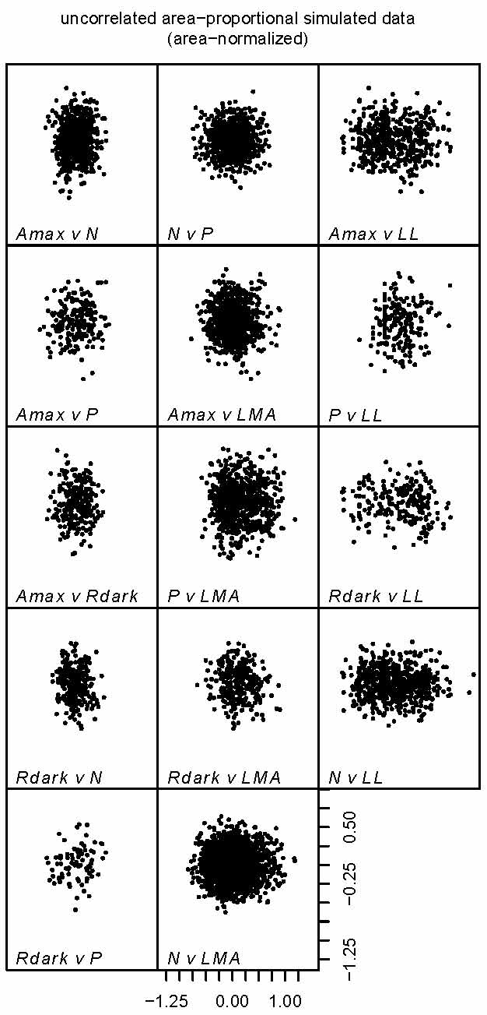
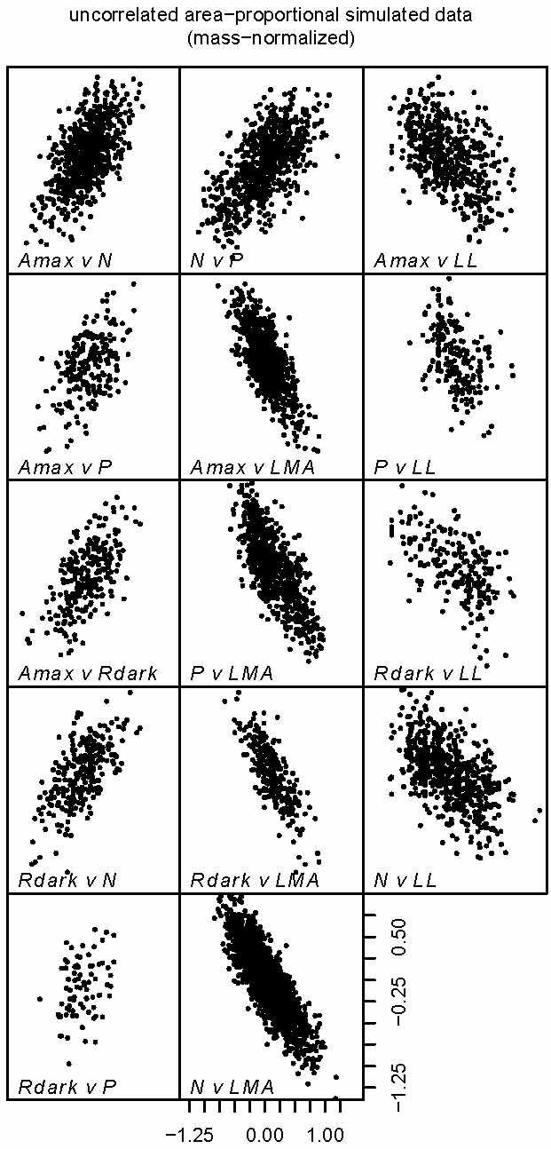
Random area-normalized
Random mass-normalized
GLOPNET mass-normalized
Osnas et al. (2013) Science

Slide 12
How do we know if traits are area-proportional, mass-proportional, or something in between?
Quantify trait mass-proportionality
  Across species in the global flora
Normalization-independent trait relationships
Discuss consequences

Slide 13
Quantify trait area- and mass-proportionality across species
Total leaf:
Area-normalized:
Mass-normalized:
Area-normalized: log(X_{Aik}) = I_{i} + S_{i} log(LMA_{k}) + n_{ik}
Mass-normalized: log(X_{Mik}) = I_{i} + (S_{i} − 1) log(LMA_{k}) + n_{ik}
  C_{i}, S_{i} constant across species
  ε_{ik} = distribution of interspecific variation
S_{i} = mass-proportionality across species
n_{ik} is trait variation conditional on LMA
(normalization-independent)
Osnas et al. (2013) Science

Slide 14
Quantify trait area- and mass-proportionality across species
Total leaf:
Area-normalized:
Mass-normalized:
Area-normalized: log(X_{Aik}) = I_{i} + n_{ik}
Mass-normalized: log(X_{Mik}) = I_{i} − log(LMA_{k}) + n_{ik}
  C_{i}, S_{i} constant across species
  ε_{ik} = distribution of interspecific variation
S_{i} = mass-proportionality across species
Purely area-proportional: S_{i} = 0
Osnas et al. (2013) Science

Slide 15
Quantify trait area- and mass-proportionality across species
Total leaf:
Area-normalized:
Mass-normalized:
Area-normalized: log(X_{Aik}) = I_{i} + log(LMA_{k}) + n_{ik}
Mass-normalized: log(X_{Mik}) = I_{i} + n_{ik}
  C_{i}, S_{i} constant across species
  ε_{ik} = distribution of interspecific variation
S_{i} = mass-proportionality across species
Purely mass-proportional: S_{i} = 1
Osnas et al. (2013) Science

Slide 16
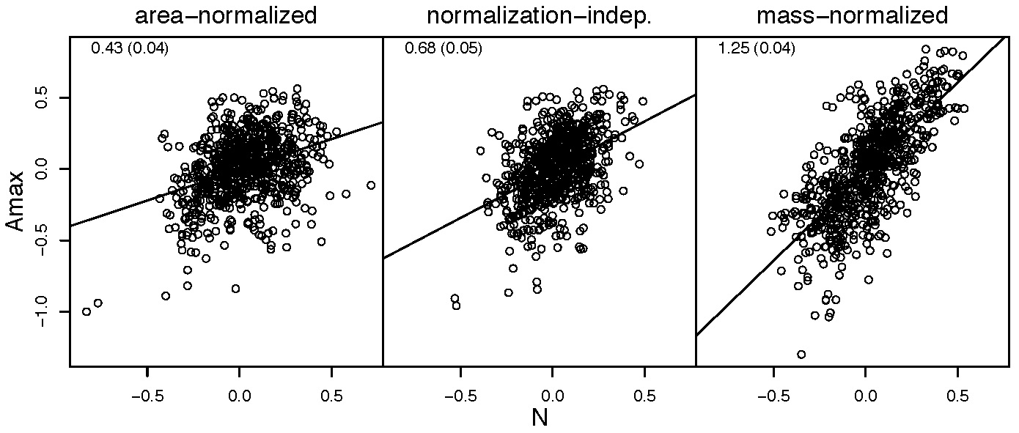
Normalization-independent trait relationships
log(X_{Aik}) = I_{i} + S_{i} log(LMA_{k}) + n_{ik}
i = 1 to 4 (Amax, Rdark, N, and P)
Osnas et al. (2013) Science

Slide 17
Traits are mostly area-proportional across species in the global flora, although N and Rdark have minor but significant mass-proportional components.
Normalization by mass (substantially) or area (somewhat) can create potentially misleading structure in trait relationships
  PC1 of mass-normalized GLOPNET data ≈ LMA
Using trait relationships
  Functional diversity as a species continuum with at least 2 axes:
    PC1 of normalization-independent PCA
    LMA
    Maybe LL, other traits

