Slide 1
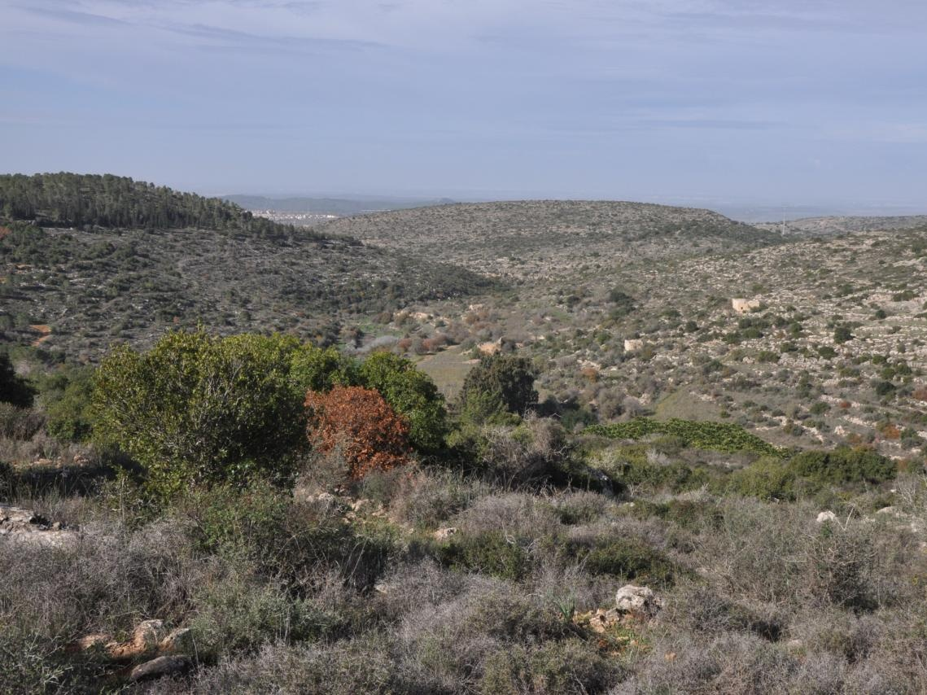
Controls over ecosystem functioning across spatial scales as derived from studies in drylands
José M. Grünzweig
Hebrew University of Jerusalem, Rehovot, Israel
in colloboration with
Marcelo Sternberg, Tel Aviv University, Israel
Katja Tielbörger, University of Tübingen, Germany
ClimMani & INTERFACE Workshop, Scaling climate change experiments across space and time: Challenges of informing large-scale models with small-scale experiments, Mikulov, Czech Republic, June 2013

Slide 2
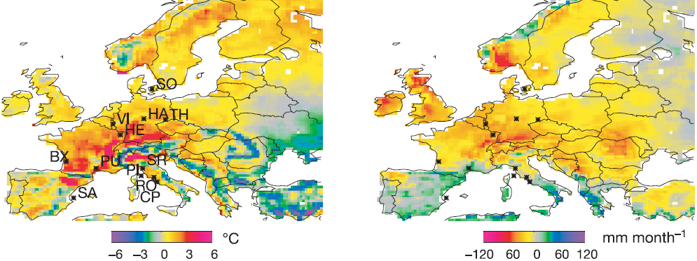
Climate extremes in systems not adapted to those extremes
Climate anomalies, Europe, summer 2003
Ciais et al. 2005 Nature

Slide 3
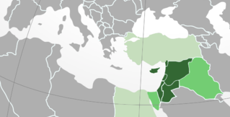
Research in regions adapted to heat and/or drought
Global extent of drylands
Levant (SE Mediterranean)

Slide 4
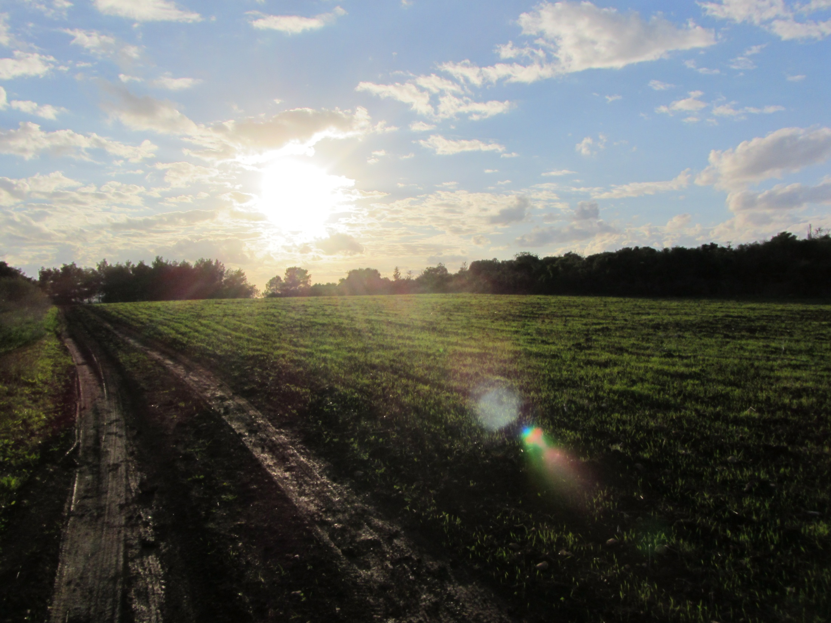
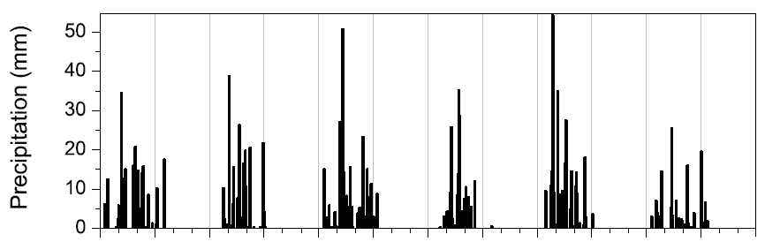

The physical properties of the Levant (SE Mediterranean)
Climate

Slide 5
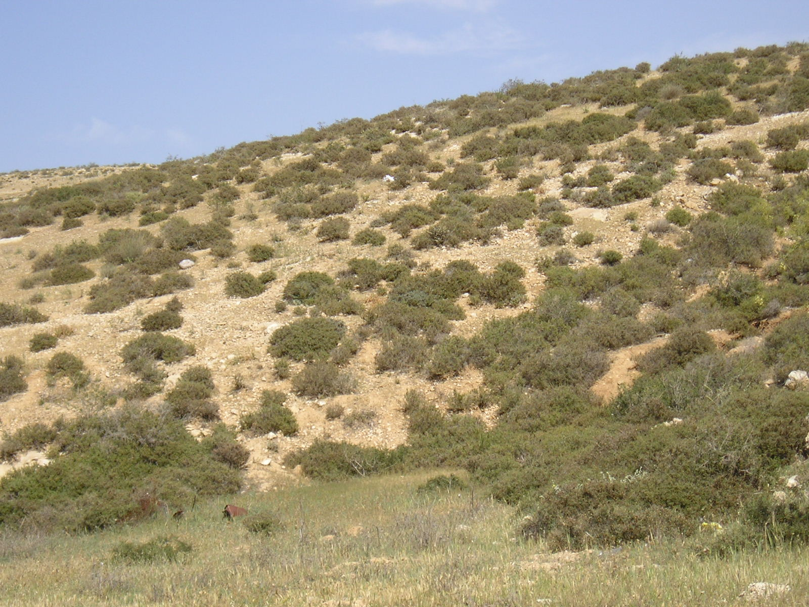
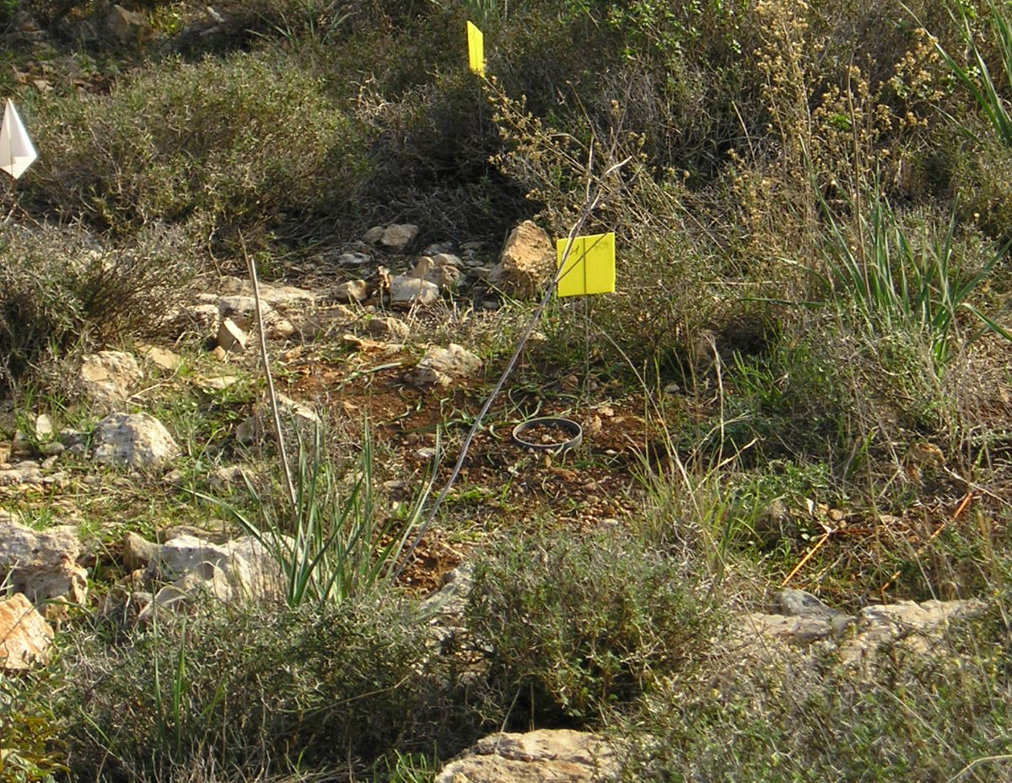
The physical properties of the Levant (SE Mediterranean)
Biomes/ecosystem types
Shrubland as spatially heterogeneous, mosaic-type ecosystem composed of different microsites

Slide 6
Outline of questions
Can we predict ecosystem functioning across a precipitation range with common biological and abiotic drivers?
What processes control carbon pools and fluxes when it gets drier?
Do climate-change experiments reveal tipping points in ecosystem structure and functioning?
What can we learn from climate-extremes studies in drylands?
Where are we going from here?

Slide 7
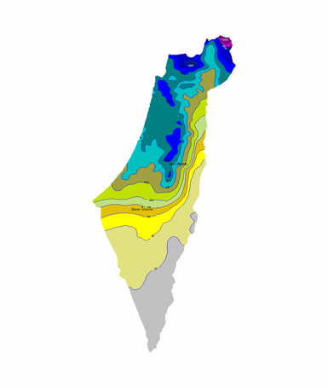
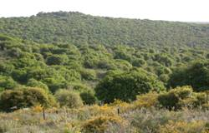
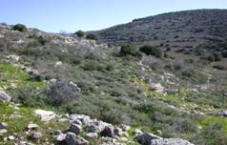
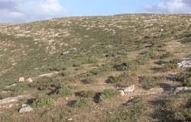
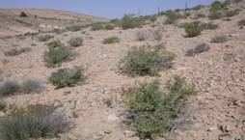
Rainfall manipulations along an aridity gradient
Aridity gradient – GLOWA Jordan River project
Biomes/ecosystem types
Mesic Mediterranean: 780 mm, CV 22%
  South facing slopes
  shallow soil (Terra Rossa to lithosol) on
  similar bedrock
  Similar seasonal temperture range
  Eight-fold difference in mean annual rainfall
  Large difference in rainfall variability
~ 245 km
Mediterranean: 540 mm, CV 30%
Semiarid: 300 mm, CV 37%
Arid: 90 mm, CV 51%
Notes:
7

Slide 8
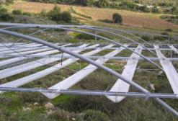
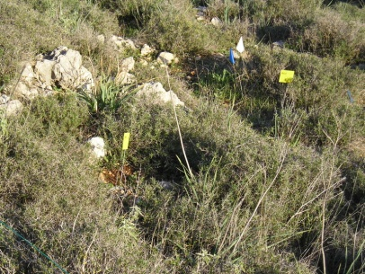
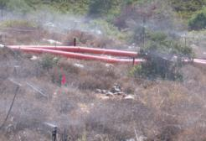
Rainfall manipulations along an aridity gradient
Rainfall manipulations
Semiarid
Mediterranean
300 mm
550 mm
Experimental rainfall manipulations
-30%
Control
+30%

Slide 9
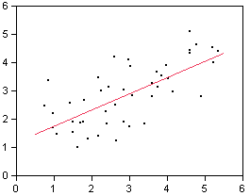

Can we predict ecosystem functioning across a precipitation range with common biological and abiotic drivers?
Soil respiration at the herbaceous microsite during the growing season?
two sites, three climate-change treatments
Site- and treatment- specific equations
→ better fits
Predicted R_{s} (μmol m⁻² s⁻¹)
r² = 0.48
Observed R_{s} (μmol m⁻² s⁻¹)
Prediction:
Overall inter-site and inter-treatment controls?
R_{s} = soil respiration; T_{s} = soil temperature; θ = soil moisture
Talmon et al. 2011 GCB

Slide 10
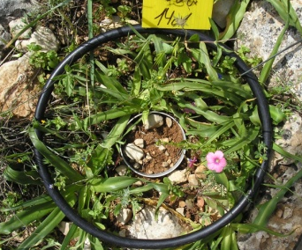
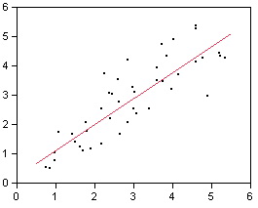
Prediction of ecosystem functioning with common biological and abiotic drivers?
Addition of vegetation cover as a driver of soil respiration
T_{s} , θ
Predicted R_{s} (μmol m⁻² s⁻¹)
r² = 0.48
T_{s} , θ , cover
Observed R_{s} (μmol m⁻² s⁻¹)
Predicted R_{s} (μmol m⁻² s⁻¹)
Vegetation cover is a factor that explains part of the inter-site and inter-treatment variation in soil respiration → climate change modeling
r² = 0.73
Observed R_{s} (μmol m⁻² s⁻¹)

Slide 11
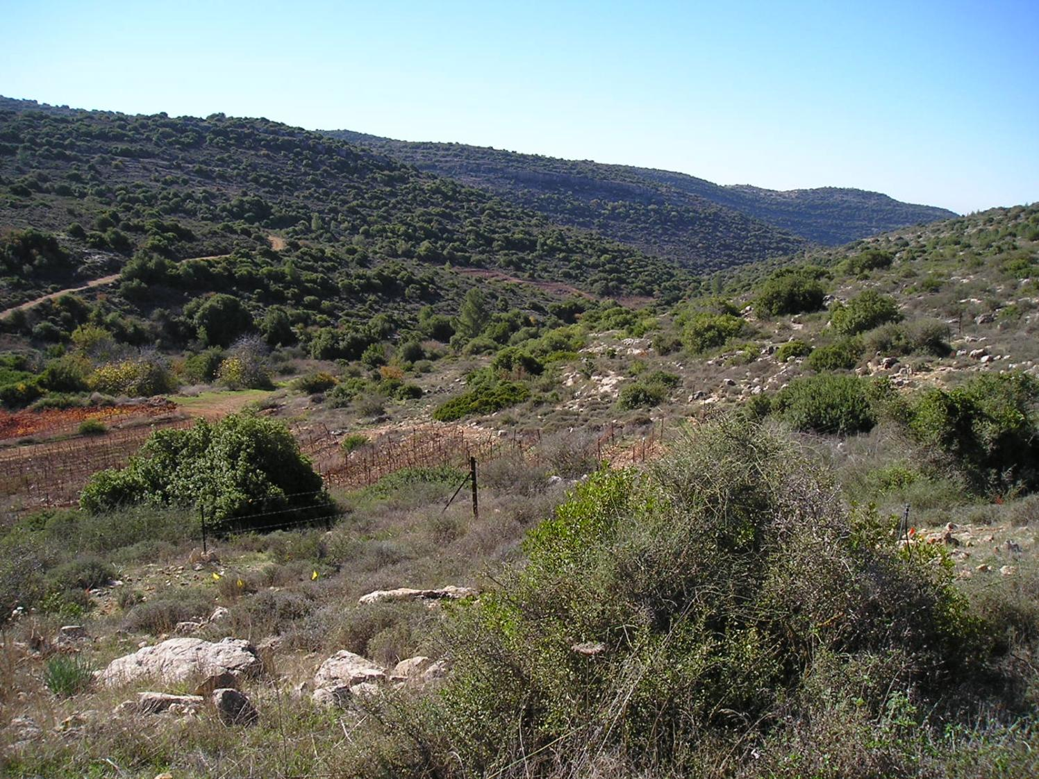
What processes control carbon pools and fluxes when it gets drier?
Soil organic carbon stocks at the herbaceous microsite along the aridity gradient
Talmon et al. 2011 GCB

Slide 12
What processes control carbon pools and fluxes when it gets drier?
Carbon loss
Carbon addition

Slide 13
What processes control carbon pools and fluxes when it gets drier?
Changes in plant strategies with increasing aridity
Unweighted community mean
90
300
550
780
90
300
550
780
Mean annual precipitation (mm)
Mean annual precipitation (mm)
Sternberg & Lebrija

Slide 14

What processes control carbon pools and fluxes when it gets drier?
Alternative drivers of litter decay in the dry season
Solar radiation
Dew
Water vapor
< saturation
Dirks et al. 2010 GCB

Slide 15
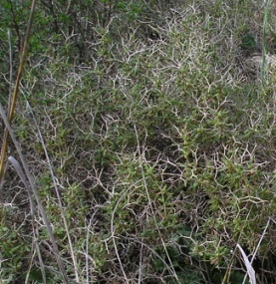
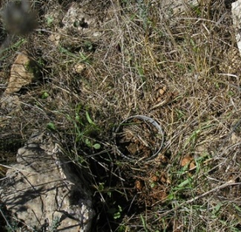
What processes control carbon pools and fluxes when it gets drier?
To what extent is soil respiration along the aridity gradient directly controlled by changes in climatic variables and indirectly controlled by shifts in shrub cover?

Slide 16
What processes control carbon pools and fluxes when it gets drier?
Shrub cover
13% 35% 55% 75%
-12%
-15%
-20%
-21%
-60%
-64%

Slide 17
Do climate-change experiments reveal tipping points in ecosystem structure and functioning?
Kigel & Konsens

Slide 18
Do climate-change experiments reveal tipping points in ecosystem structure and functioning?
Sternberg & Navon

Slide 19
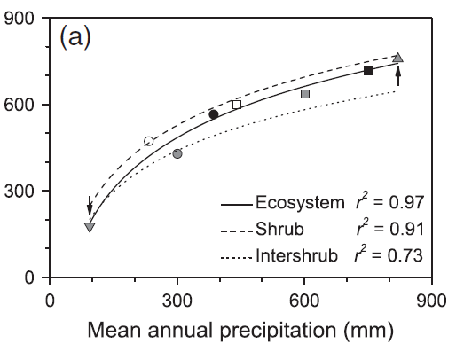
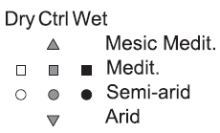
Do climate-change experiments reveal tipping points in ecosystem structure and functioning?
Talmon et al. 2011 GCB

Slide 20
Do climate-change experiments reveal tipping points in ecosystem structure and functioning?
Rainfall manipulations had no significant effect on species diversity at the semiarid site (same for the Mediterranean site)
Year ***
Treatment NS
T x Y *
Year ***
Treatment NS
T x Y *
Year
Kigel et al., unpublished

Slide 21
Do climate-change experiments reveal tipping points in ecosystem structure and functioning?
Species diversity along the aridity gradient
Station *** Year *** S x Y ***
Station *** Year *** S x Y **
Species richness
Species diversity (H’)
arid
semiarid
Mediter.
mesic Mediter.
Species evenness (J’)
Station *** Year *** SxY **

Slide 22
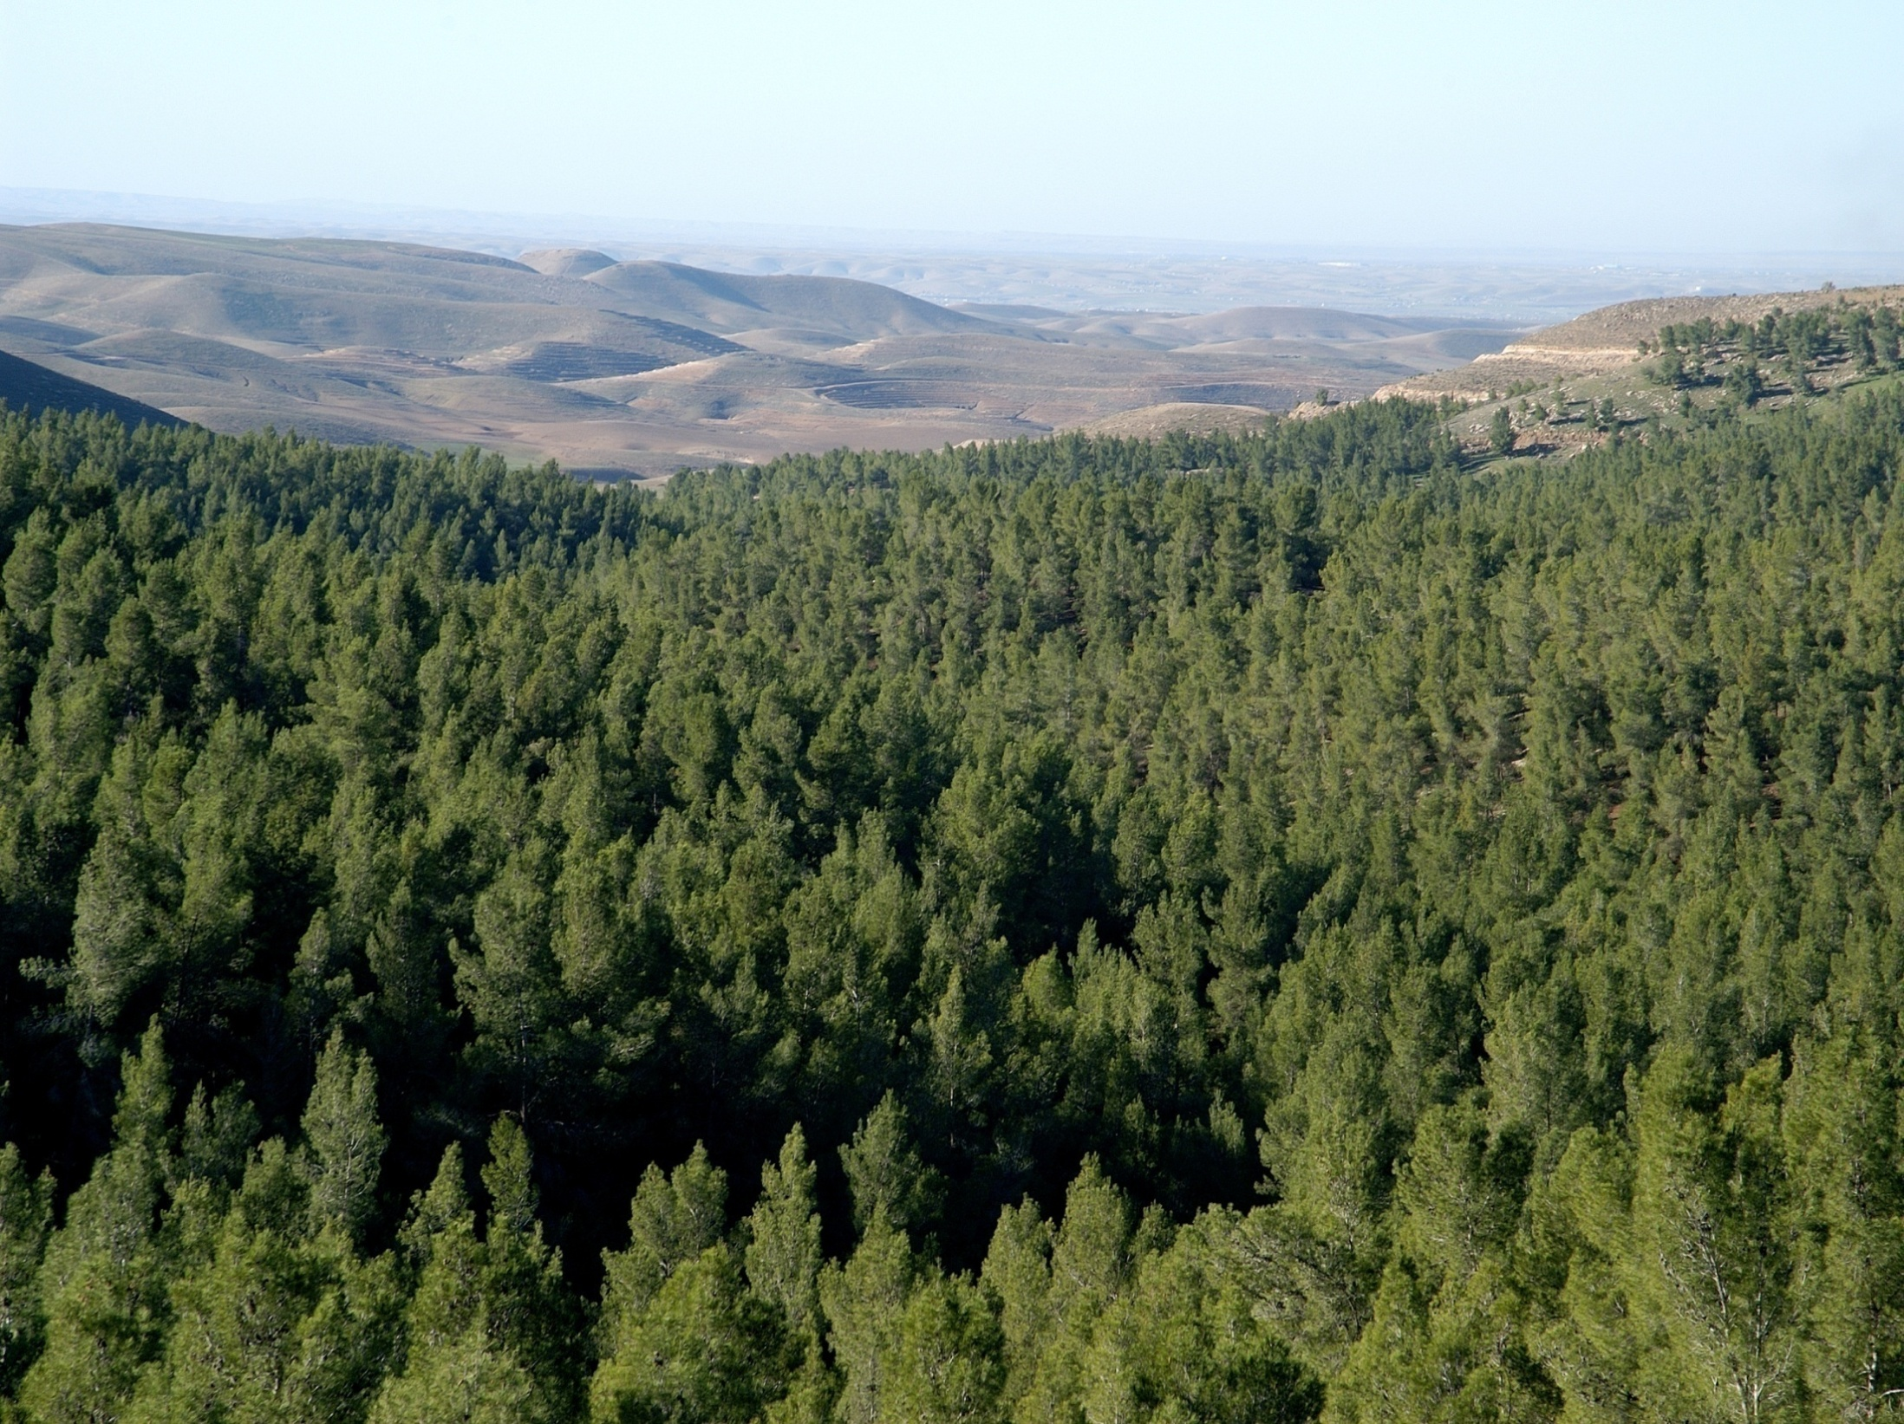
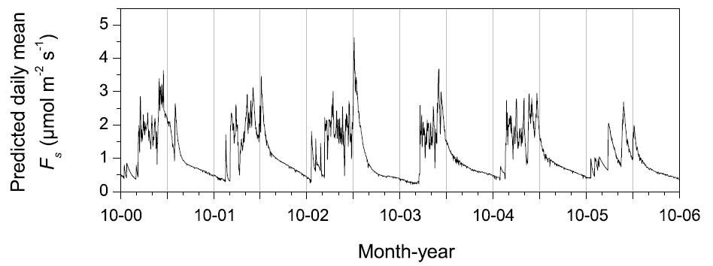
What can we learn from climate-extremes studies in drylands?
R_{s}
Grünzweig et al. 2009 JGR
Dry season:
Moist season:
R_{s} = soil respiration; T_{s} = soil temperature; θ = soil moisture; PPFD = photon flux density

Slide 23
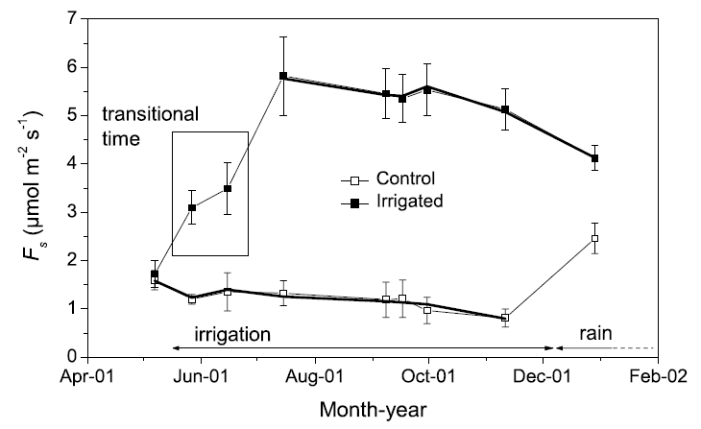

Testing extreme conditions: irrigation during the hot summer
R_{s}
Grünzweig et al. 2009 JGR
Predictions
Control:
Irrigation:
R_{s} = soil respiration; T_{s} = soil temperature; θ = soil water content; PPFD = photon flux density

Slide 24

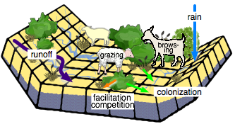

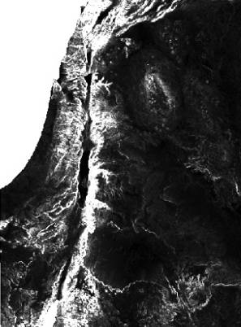
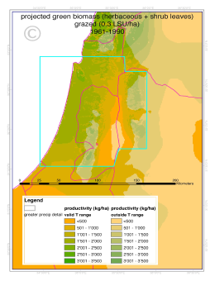
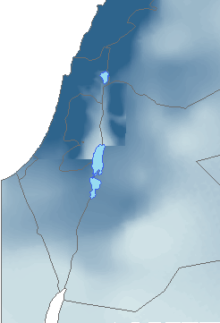
Scaling of output: the model Wadiscape
Modeling (semi-) natural vegetation
global circulation models
pattern (GLOWA)
topographic and
geographic variation
Spatial information
1.0 km
Experiments (GLOWA)
Surveys (GLOWA)
Literature
Experts (GLOWA)
GIS
MAP
(characterization of region by mean annual precipitation )
slopes (DEM)
Katja Geissler, Martin Köchy, Florian Jeltsch, Dan Malkinson
Notes:
24
To say, something like that:
Process based spatial explicit modelling of vegetation growth can be used for regional upscaling (siehe Abfolge der grünen Pfeile) and for projections into the future under climate and land use changes. The model Wadiscape is based on … (siehe rosa Kasten: meines Wissens wurden durchaus Ergebnisse eures jordanischen )

Slide 25
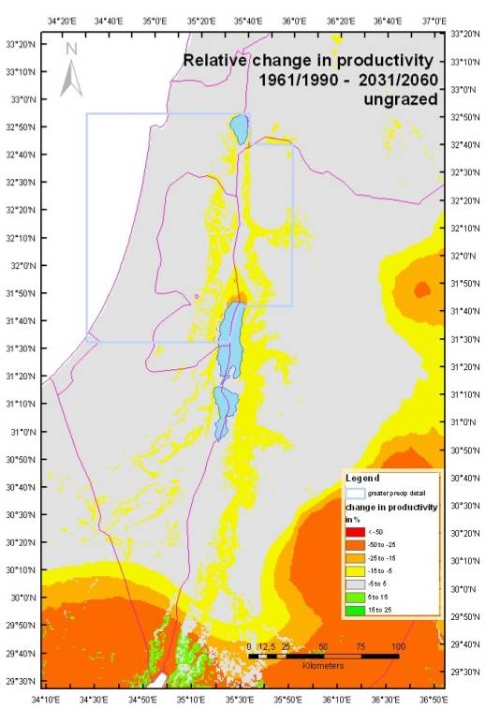
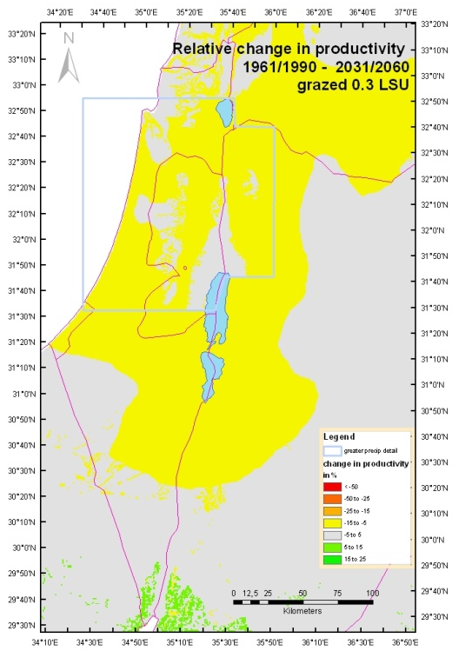
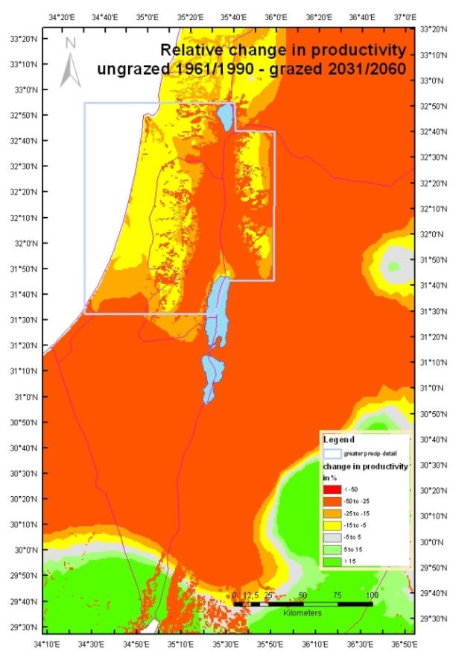
Modeling (semi-) natural vegetation
(Over)grazed vegetation is highly vulnerable to climate change
climate change, moderate grazing
climate change, current grazing
climate change
Katja Geissler, Martin Köchy, Florian Jeltsch
Notes:
25
To say:
In contrast to the effect of Climate change, what really matters is the effect of grazing. Just realize these huge areas in orange.
Shown is the future time period 2031-2060.
Thus, maintaining animal density at stocking capacity of about 3 shepp per hectar greatly reduces landscape productivity

Slide 26
Summary
Vegetation cover is a driver of soil respiration together with climatic drivers.
The relative distribution of vegetation types has a small impact on ecosystem-scale soil respiration under a drier climate; the decrease in soil respiration is mainly driven by the decline in biological activity.
The decrease in soil organic carbon storage with increased aridity is related to greatly reduced productivity and less drastically reduced decomposition; alternative drivers start to become important under drier conditions.
Climate change studies might reveal tipping points in species richness.

Slide 27
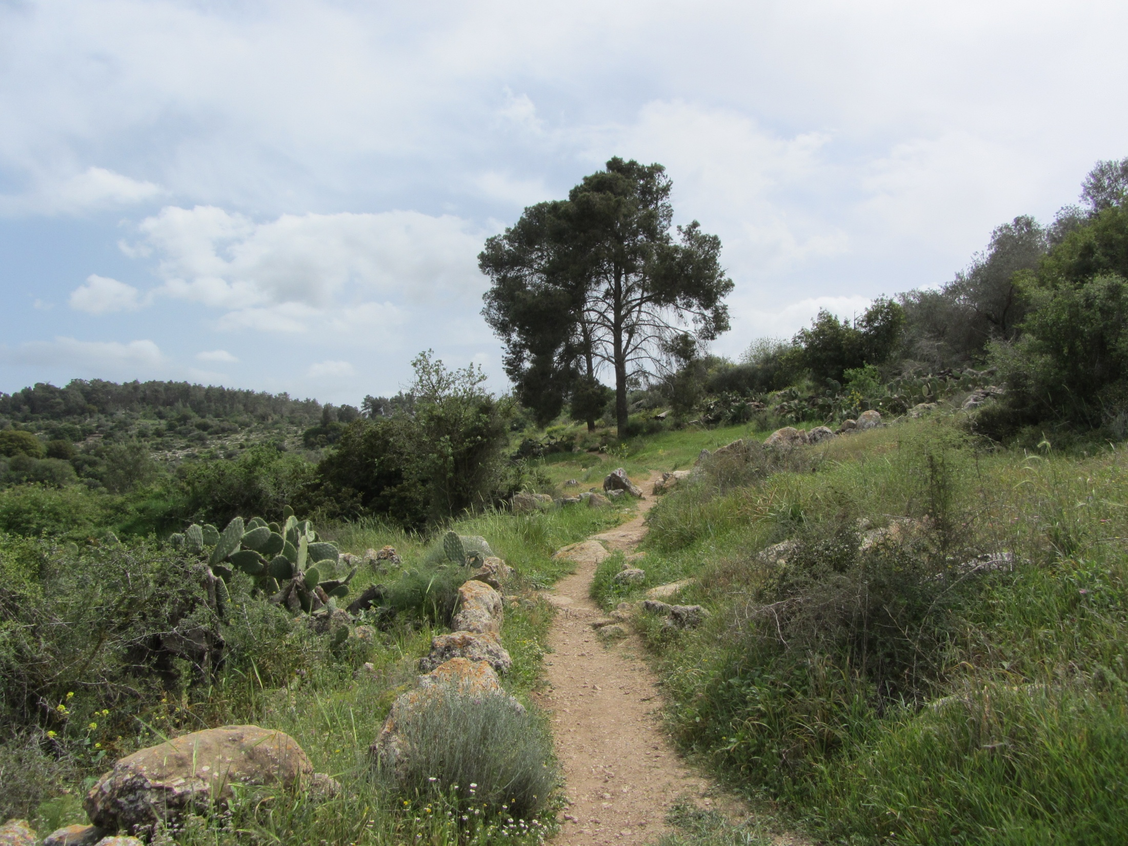
Where are we going from here?
Climate-change studies in systems adapted to drought provide better understanding of ecosystem functioning under more realistic conditions
Climate-extremes studies, even unrealistic ones, can teach us about processes and potentially about thresholds and tipping points

Slide 28
Acknowledgements
Collaborators
Hebrew University Tel Aviv University Haifa University
Jaime Kigel Yael Navon Dan Malkinson
Yiftach Talmon Edwin Lebrija
Irit Konsens
Rita Dumbur
Funding sources
International Arid Lands Consortium(IALC)
Climate Change and Impact Research: the Mediterranean Environment (CIRCE) (EU FP6)
German Federal Ministry of Education and Research (BMBF)
Israeli Ministry of Science and Technology (MOST)

Slide 29
Thank you for your attention!

