Slide 1

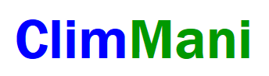



Spatial, temporal and biological scales
in ecological climate change research
Carl Beierkuhnlein
CLIMMANI & INTERFACE
Workshop
Mikulov, Czech Republic
June 4–7, 2013

Slide 2
Structure
Epistemology and Heuristic Quality of Experiments
Spatial Scales
Temporal Scales
Bio-ecological Scales
Perspectives for Experimental Ecology
Notes:
situated at 34°N and 3°W at the edge of the North-eastern Moroccan high plateau (Plateau du Rekkam) about 100 km from the Algerian border as well as from the Mediterranean Sea and at heights a.s.l. between 1550 and 1670m.

Slide 3
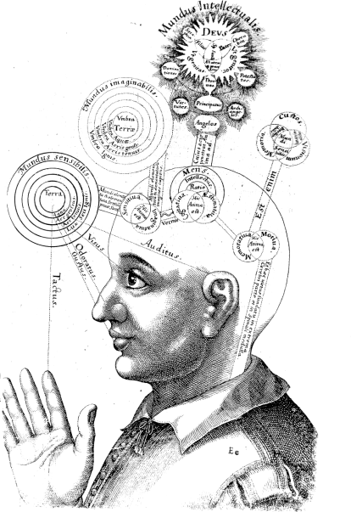
Epistemology
Robert Fludds microcosm diagram of the human mind and knowledge (1619)

Slide 4

Epistemology
„Actually the systems we
isolate mentally are not only
included as parts of larger ones, but they also overlap, interlock and interact with one another.
The isolation is partly artificial, but it is the only possible way we can proceed.“
Sir Arthur Tansley
(1882-1960)
How much abstraction is needed
and how much can be tolerated?

Slide 5
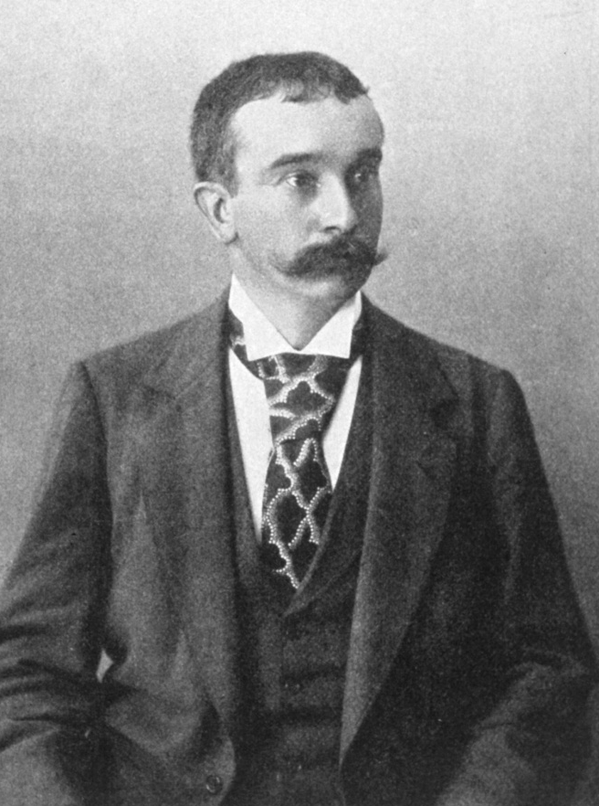
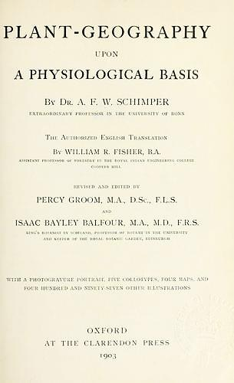
Epistemology
„Plant Geography (…) requires exact knowledge about the living conditions of plants, which can only be provided by experiments.“
Andreas Franz Wilhelm
Schimper (1856-1901)

Slide 6
Epistemology
Filters
Reality / Nature
(climatical and ecological complexity)
Filters
Perception; Accessibility
Empirical Findings
(observation of non-stochastic patterns)
Knowledge;
Mistakes
Theory
(state of knowledge and understanding)
Assumptions; Bias
Interpretation
Hypotheses
(reasonable, innovative, and falsifiable)
Selection of Methods
Errors; Mistakes
Experimental Test
(process, system, design, treatments)
Jentsch, A., Beierkuhnlein C (2010). Simulating the Future. Nova Acta Leopoldina NF 112 (384): 89-98

Slide 7
Epistemology
Filters
Reality / Nature
(climatical and ecological complexity)
Filters
Perception; Accessibility
MONITORING
Knowledge;
Mistakes
Theory
(state of knowledge and understanding)
Assumptions; Bias
Interpretation
Hypotheses
(reasonable, innovative, and falsifiable)
Selection of Methods
Errors; Mistakes
EXPERIMENTS
Jentsch, A., Beierkuhnlein C (2010). Simulating the Future. Nova Acta Leopoldina NF 112 (384): 89-98

Slide 8


Epistemology
Significance ! Repeatability ! Controlledness !
Artificiality ? Singularity ?
Experiments
Monitoring
Theoretical concepts to connect both approaches are needed!
Reality ! Complexity !
Relevance !
Autocorrelation? Coincidence ?

Slide 9
Epistemology
Replicates and controls!
Specific questions!
Small plots and short duration?
Experiments
Monitoring
Scales have to be adjusted, too!
Large scale and long-term!
Holistic integration of all drivers?

Slide 10
Epistemology
Reality / Nature
(climatical and ecological complexity)
MONITORING
THEORY
MODELLING
Hypotheses
(reasonable, innovative, and falsifiable)
EXPERIMENTS
Jentsch, A., Beierkuhnlein C (2010). Simulating the Future. Nova Acta Leopoldina NF 112 (384): 89-98

Slide 11
Epistemology
Observational studies are generating knowledge by searching for patterns in nature and for their explanation, leading to theories and concepts.
Experiments are questioning and proving knowledge by testing theories and concepts via specific hypotheses under controlled conditions.
Modelling approaches are making use of knowledge in order to project beyond manageable biocomplexity and spatio-temporal scales .
Notes:
situated at 34°N and 3°W at the edge of the North-eastern Moroccan high plateau (Plateau du Rekkam) about 100 km from the Algerian border as well as from the Mediterranean Sea and at heights a.s.l. between 1550 and 1670m.

Slide 12
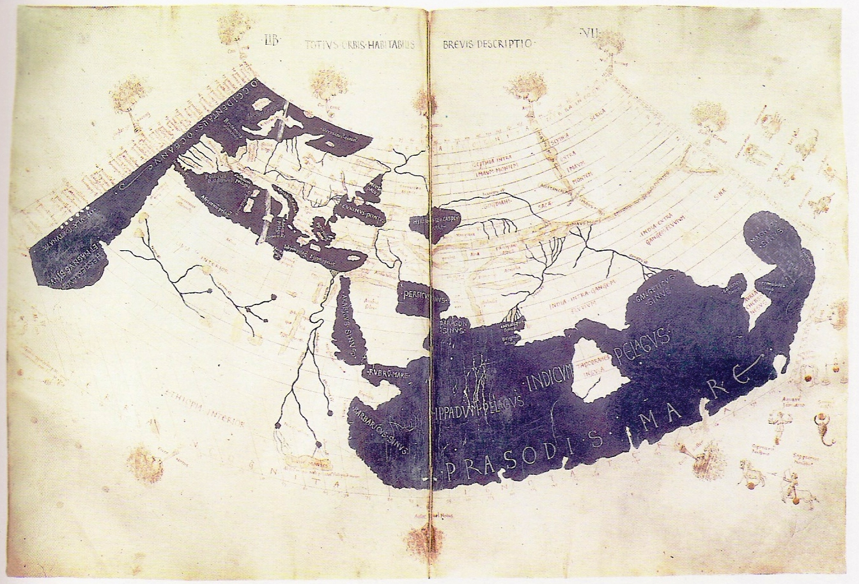
Spatial Scales

Slide 13
Spatial Scales
Nested Sampling, Grain and Plot Size
Arrangement and Positioning
Distance Decay and Autocorrelation
Heterogeneity and Homogeneity
Large-Scales

Slide 14
Nested Sampling
Nested Sampling Design applied in Long-Term Monitoring Studies in Eastern-Morocco (Gaada de Debdou)
Area
2,60
10,39
23,38
41,57
64,95
93,53
166,28
1
N
6
2
5
3
4
8 m
Notes:
this year i made some methodological work from which i’d like to show you some results. and we went to the spots several times during the vegetation period (which is rather short in the region where we worked and which i will introduce to you on the next slide) to examine the temporal change in vegetation patterns on the sample plot scale (which is done by a diploma student) but this provided the opportunity to get those data: at first visit i increased the area of the Sample-Plot from 1m side-length to the end-size of 8m (which was used before and determined after a pilot survey in 2002 and with ecological expertise and based on literature). Increase wasn’t doubling but meter steps because of convenience. anyway, as you can see in the table at the left it is often almost a doubling if you just leave out the first and the step before the last one.
Second time we went there this year i recorded more detailed data on species than before noting species after there occurrence on the 6 even sided triangles which actually form the whole plot after marking to obtain frequency data on that (to test whether this might increase performance in relation to other environmental variables)

Slide 15
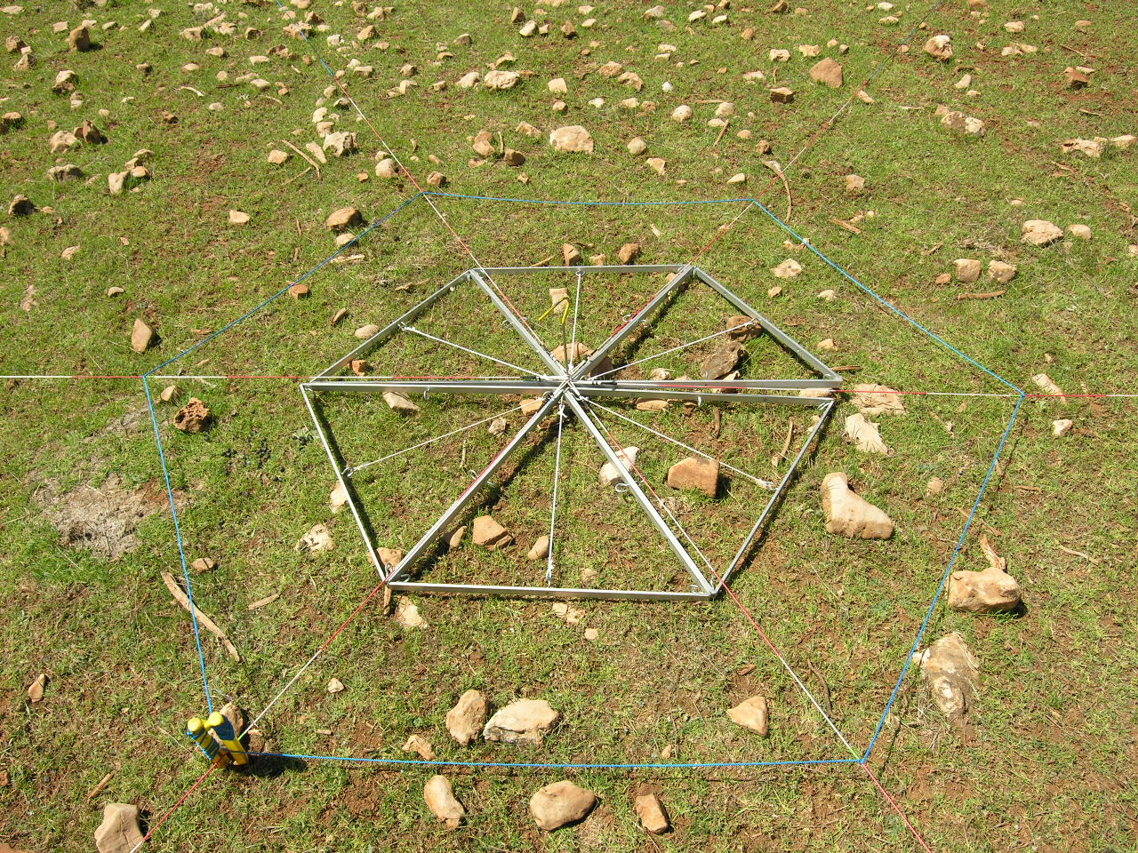
Nested Sampling
Notes:
this year i made some methodological work from which i’d like to show you some results. and we went to the spots several times during the vegetation period (which is rather short in the region where we worked and which i will introduce to you on the next slide) to examine the temporal change in vegetation patterns on the sample plot scale (which is done by a diploma student) but this provided the opportunity to get those data: at first visit i increased the area of the Sample-Plot from 1m side-length to the end-size of 8m (which was used before and determined after a pilot survey in 2002 and with ecological expertise and based on literature). Increase wasn’t doubling but meter steps because of convenience. anyway, as you can see in the table at the left it is often almost a doubling if you just leave out the first and the step before the last one.
Second time we went there this year i recorded more detailed data on species than before noting species after there occurrence on the 6 even sided triangles which actually form the whole plot after marking to obtain frequency data on that (to test whether this might increase performance in relation to other environmental variables)

Slide 16
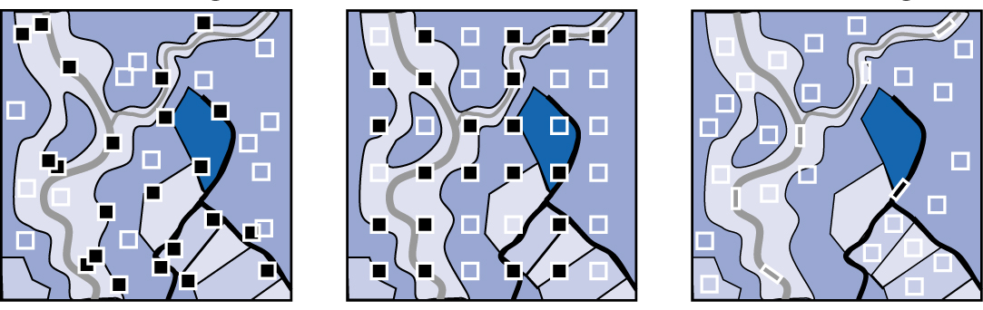
Spatial Arrangement
Stochastic
Systematic
Preferential
N = 36
Homogeneous = 14
Heterogeneous = 22
N = 36
Homogeneous = 15
Heterogeneous = 21
N = 36
Homogeneous = 36
Heterogeneous = 0
The spatial distribution of plots decides upon the results!
Beierkuhnlein 2007 Biogeographie, Eugen Ulmer Verlag.
Notes:
Gaada again: where exactly are the plots sitiuated in the landscape. this is just at the top of the step: here the plateau is highest. and it is slowly going down in south eastern direction until it comes to sahara
on this slide i’d like to expalin the distance levels we implemented in the second year of our study, so this is the original grid - plim - which we extended in the second year with those inner and these outer Plots. Because we wanted to see which influence this distance might have for patterns and their drivers respectively.. explaining the DL... 360, 720, 1440m

Slide 17
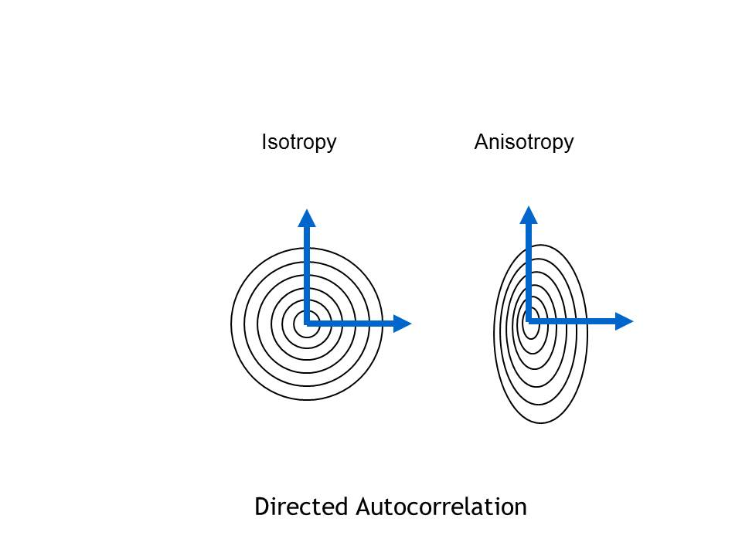
Spatial Arrangement
Anisotropy as a consequence of hidden gradients.
Isotriopy
Anisotriopy
Directed Autocorrelation
Notes:
The question is, whether this pattern holds true for all directions or whether there is an geographical impact, therefore i ordered the data into direction classes and checked for anisotropy: (klick)
And it is sure the pattern strongly depends on geographical direction... Even though there are pronounced differences between the 4 general directions, the common drop occurs in each of them. This seems to be a hint on the intrinsic geographical structure of the investigation area. Interestingly we have much less distance decay in direction SW-NE than in all other directions

Slide 18
Distance-Decay
„Everything is related to everything else, but nearby things are more related than distant things.“
Waldo R. Tobler (1970)
„The Law of Distance – Decay“
„First Law of Geography“
Dissimilarity (and reduced comparability) grows with spatial distance as a consequence of less intense functional interaction.
Notes:
18

Slide 19
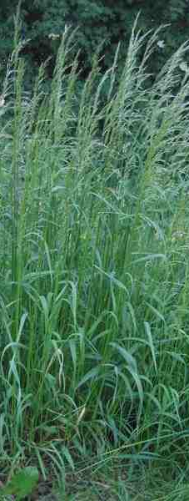
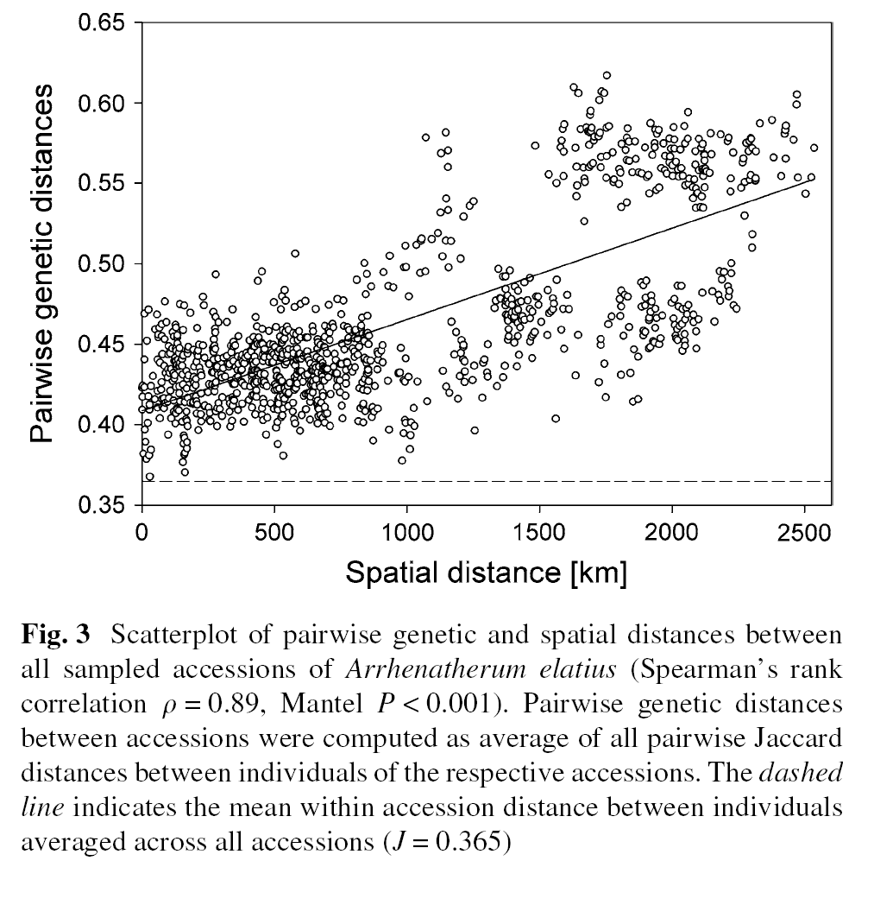
Distance-Decay
Although, being subject to anthropogenic land use, European key grass species in permanent grasslands perform spatio-genetic patterns.
Arrhenatherum elatius
Michalski, SG; Durka, W; Jentsch, A; Kreyling, J; Pompe, S; Willner, E; Beierkuhnlein, C (2010) Evidence for genetic differentiation and divergent selection in an autotetraploid forage grass (Arrhenatherum elatius)
Theoretical and Applied Genetics 120, 1151-1162

Slide 20
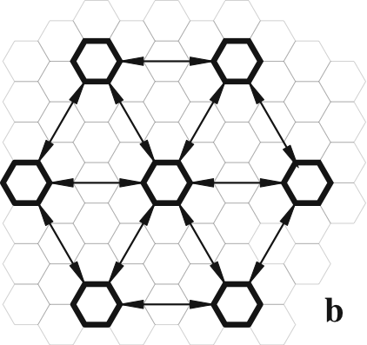
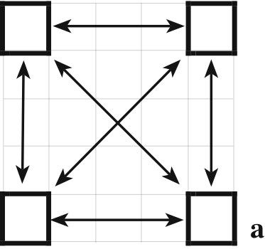
Distance-Decay
simple approach
traditional
Good for assessments of alpha-diversity patterns and gamma-diversity
equidistant neighbours
no cross-similarities
Good for assessments of
alpha-diversity and
beta-diversity patterns and gamma-diversity
Jurasinski G; Beierkuhnlein C (2006) Spatial patterns of biodiversity - Assessing vegetation using hexagonal grids. Proceedings of the Royal Irish Academy 106B, 401-411
Notes:
problem of equal centre point distances to the neighbours (similarity space >> proximity measures) (see analysis)
(circle and hexagon >> no complete nesting) is it necessary to cover the entire surface?? in each case we create an artificial similarity space!!
There have been various attempts to find a proper plot-shape for vegetation-analysis. After the nested quadrat (Mueller-Dombois and Ellenberg 1974) Shmida (1984) proposed a nested design with different plot sizes and shapes inside a large rectangular plot (Whittaker-Plot) whilst Stohlgren et al. (1995) introduced a Modified-Whittaker plot to correct some "design-flaws" after they experimented with a long-thin rectangular plot stimulated by Bormanns work (1953) who showed that a long-thin rectangular plot contains more species than a square or circle plot of the same area especially if the vegetation is rather heterogeneous. This is now widely used to analyse plant diversity patterns at multiple spatial scales. It is appropriate if the variation in vegetation shall be revealed. But in our approach where heterogeneity is described through the calculation of similarity (or dissimilarity) measures between plots those plots should be rather homogeneous. Circles would be ideal but they remain problematic if it’s not wood free ecosystems (where you could use compasses to mark plots out in the field).. Schmidtlein who is now a member of our group in Bayreuth used a triangular (or hexagonal) grid with overlapping circle plots to characterise vegetation structure in the German Alps. But in the calculation they turned to hexagons. So why not use hexagons from the beginning when they provide some more advantages (as i will present to you later on)

Slide 21
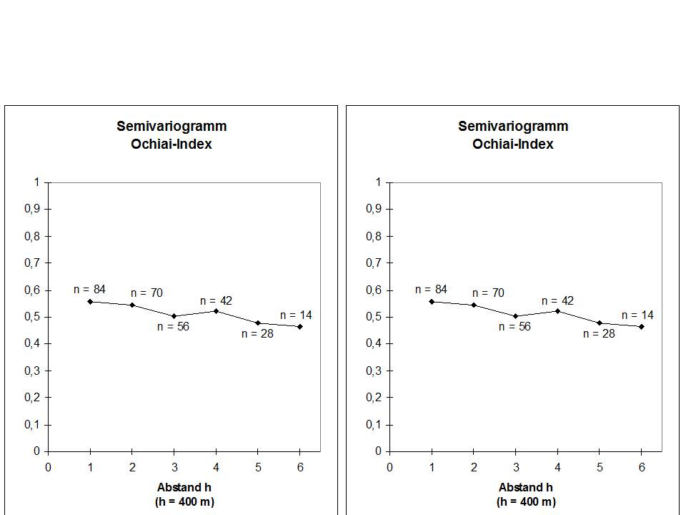
Distance-Decay
Ochiai Similarity Index
Identify minimum distance between plots
Identify maximum distance between plots
Distance
Distance
Autocorrelation (e.g. nugget effect) and non-comparability (transition zones) must be avoided right from the start when designing replications for field experiments.

Slide 22

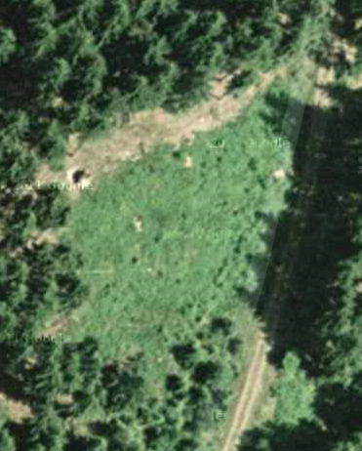
Autocorrelation
If space is limited (e.g. piece of land available for experiments), and if spatial autocorrelation demands for certain spatial distance between plots in old growth stands, then the number of replicates can be limited below a statistically valid threshold or plot size must be reduced.
Mostly this is ignored or the decision is implicitely made for statistics and not for validity!

Slide 23
Autocorrelation
If space is limited (e.g. piece of land available for experiments), and if spatial autocorrelation demands for certain spatial distance between plots in old growth stands, then the number of replicates can be limited below a statistically valid threshold or plot size must be reduced.
Mostly this is ignored or the decision is implicitely made for statistics and not for validity!

Slide 24
Autocorrelation
If space is limited (e.g. piece of land available for experiments), and if spatial autocorrelation demands for certain spatial distance between plots in old growth stands, then the number of replicates can be limited below a statistically valid threshold or plot size must be reduced.
Mostly this is ignored or the decision is implicitely made for statistics and not for validity!

Slide 25
Heterogeneity
Heterogenity is related to a specific dataset (e.g. area, time). Considering this dataset as one unit, we may analyse the variability (range of data) within this unit.
Scales differ. We may relate heterogeneity to
one specific plot
one area of investigation.

Slide 26

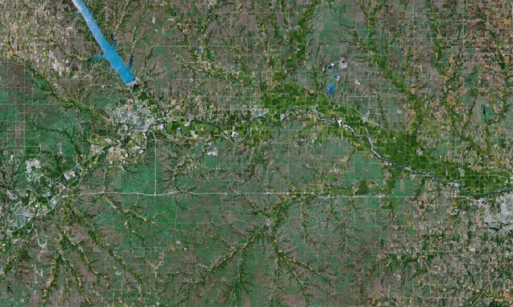
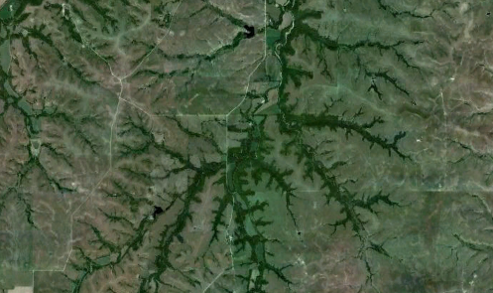
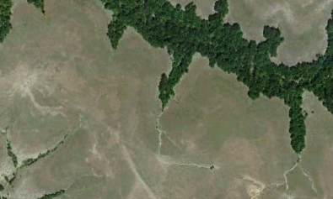
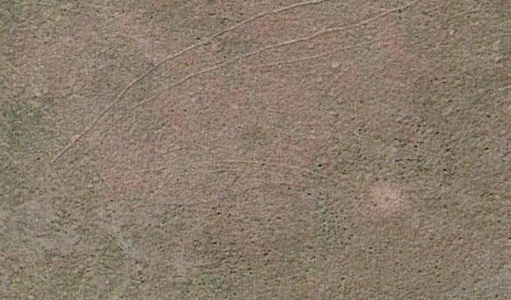
Patterns
Background
100 km
10 km
Heterogeneity
Homogeneity
Pattern
Noise
1 km
100 m

Slide 27
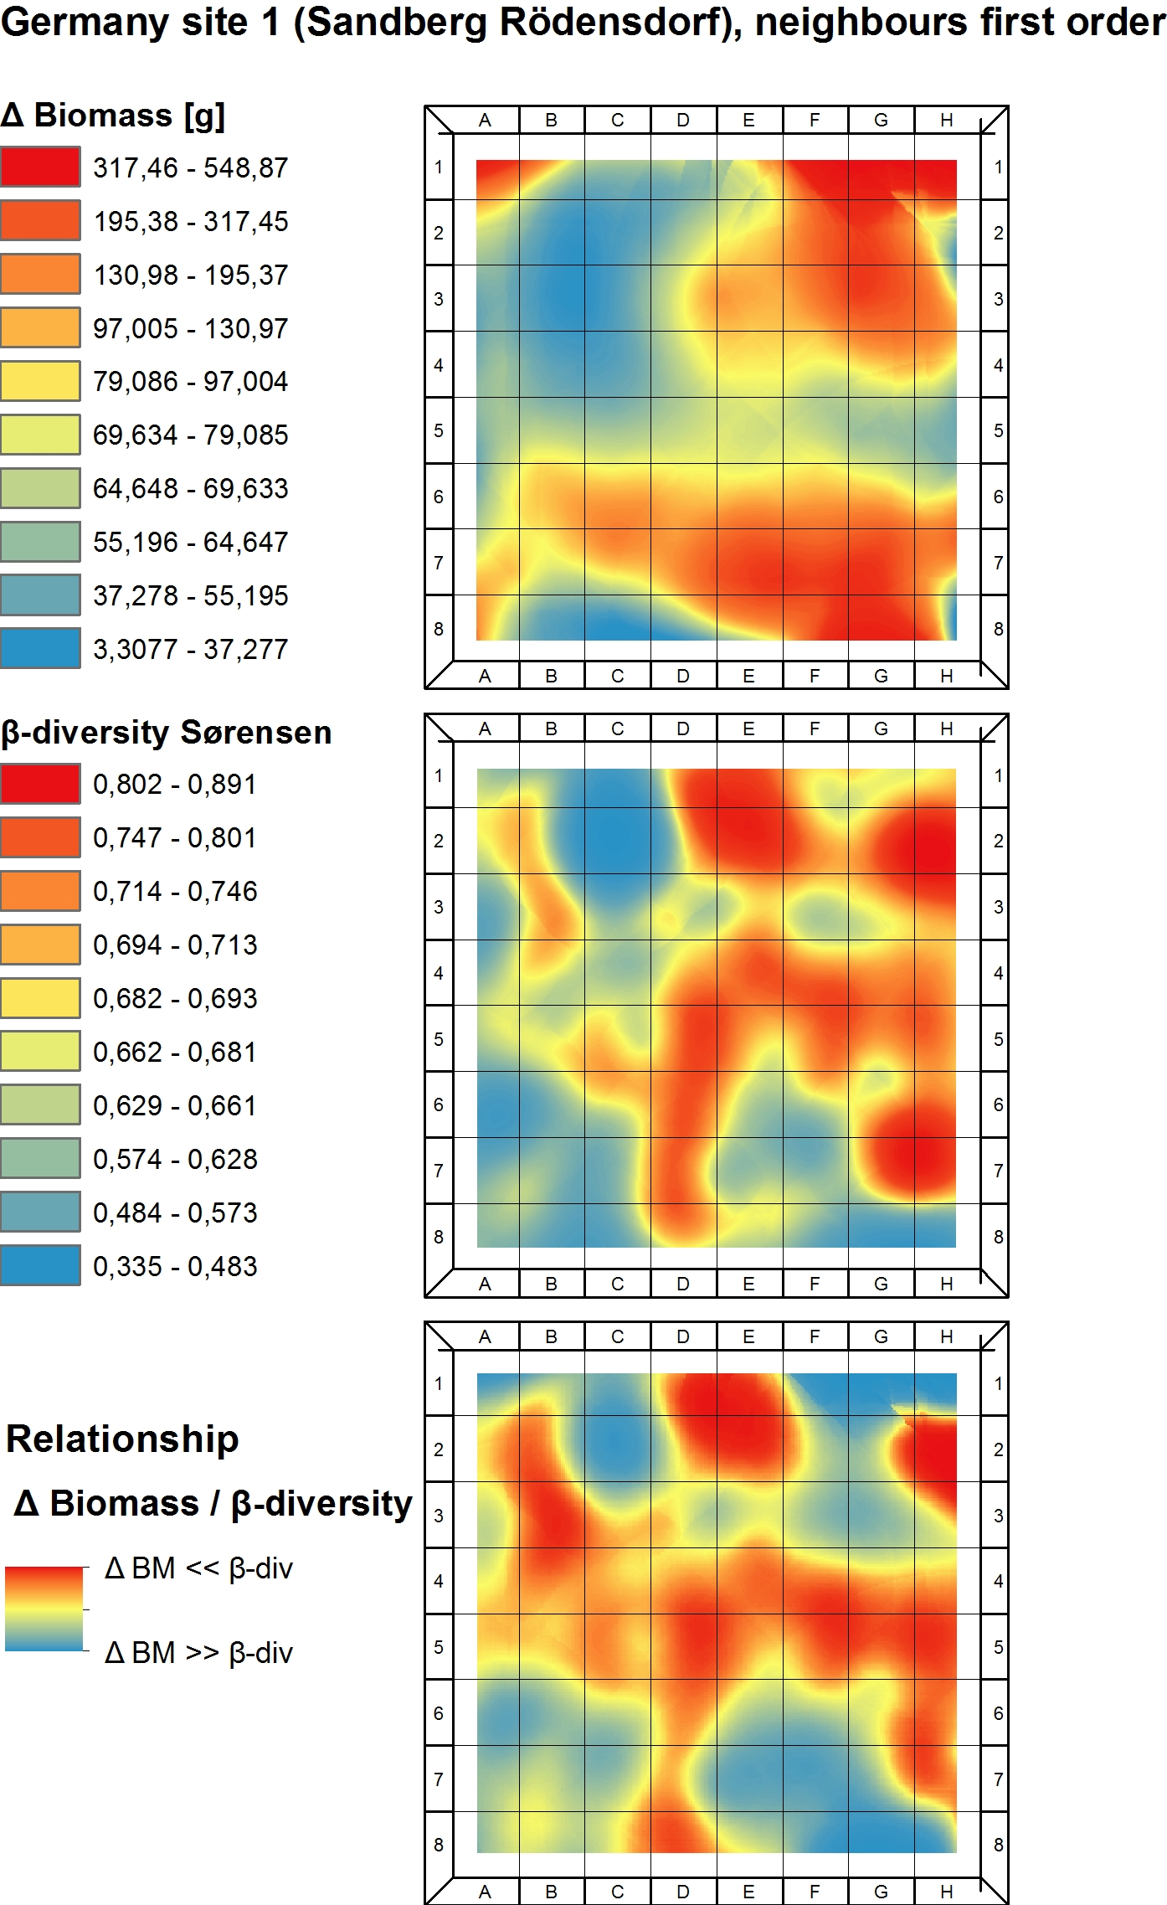


Small-Scale Heterogeneity
Beta-Diversity
Differences in Biomass
1m² grid
Plot size 8x8m
Geostatistical interpolation (Kriging) of beta-diversity and delta biomass values in a low productive but highly diverse grassland plot in Northern Bavaria (Part of the Global Coordinated Experiments).

Slide 28
Patterns
Pattern detection depends on the applied algorithms.

Slide 29
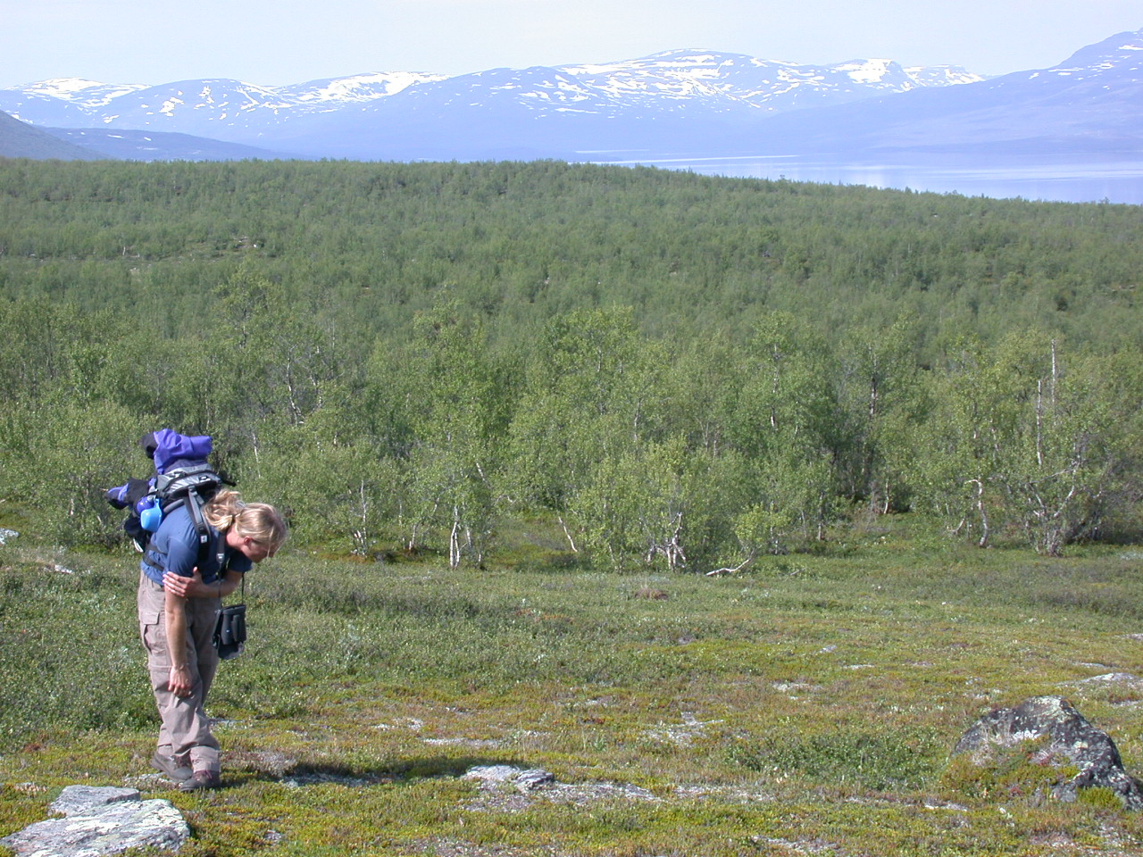
Patterns
Key species as drivers for similarity patterns in the boreal zone (Abisko, Sweden).
2 km
Betula pubescens

Slide 30
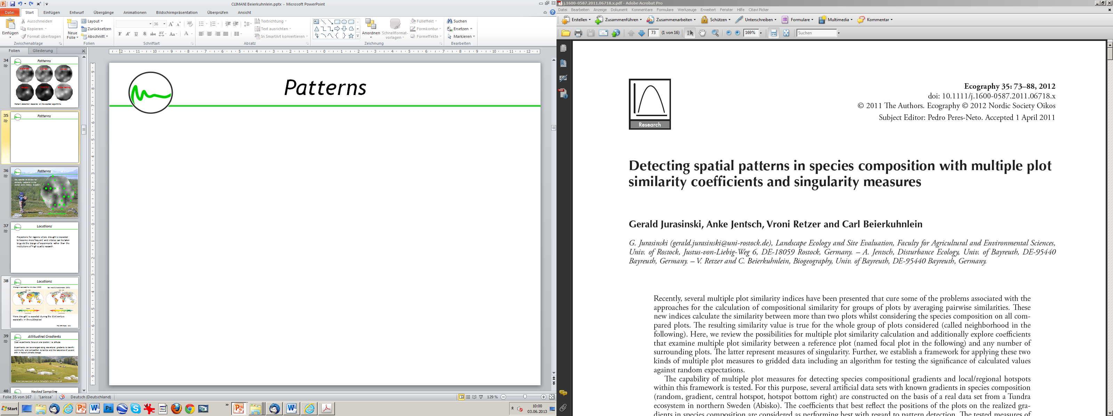
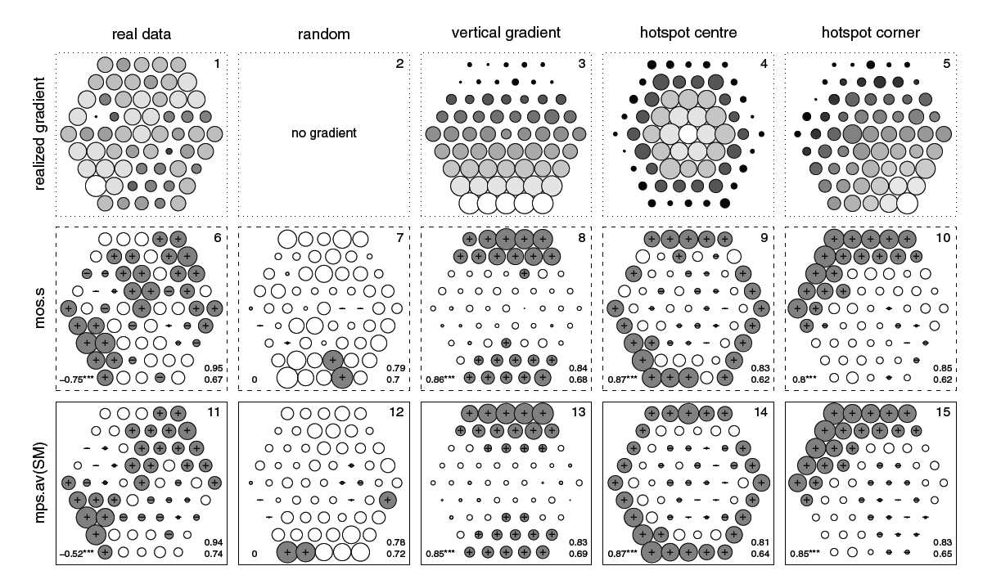
Patterns

Slide 31
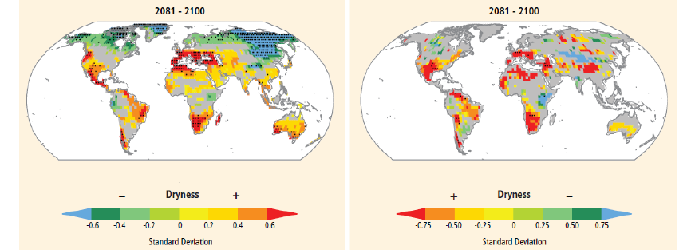
Large Scales
Change in consecutive dry days (CCD)
Soil moisture anomalies (SMA)
More drought is expected during the 21st century especially in the subtropics! This can be taken to guide the design of experiments
IPCC SREX Report, 2012

Slide 32
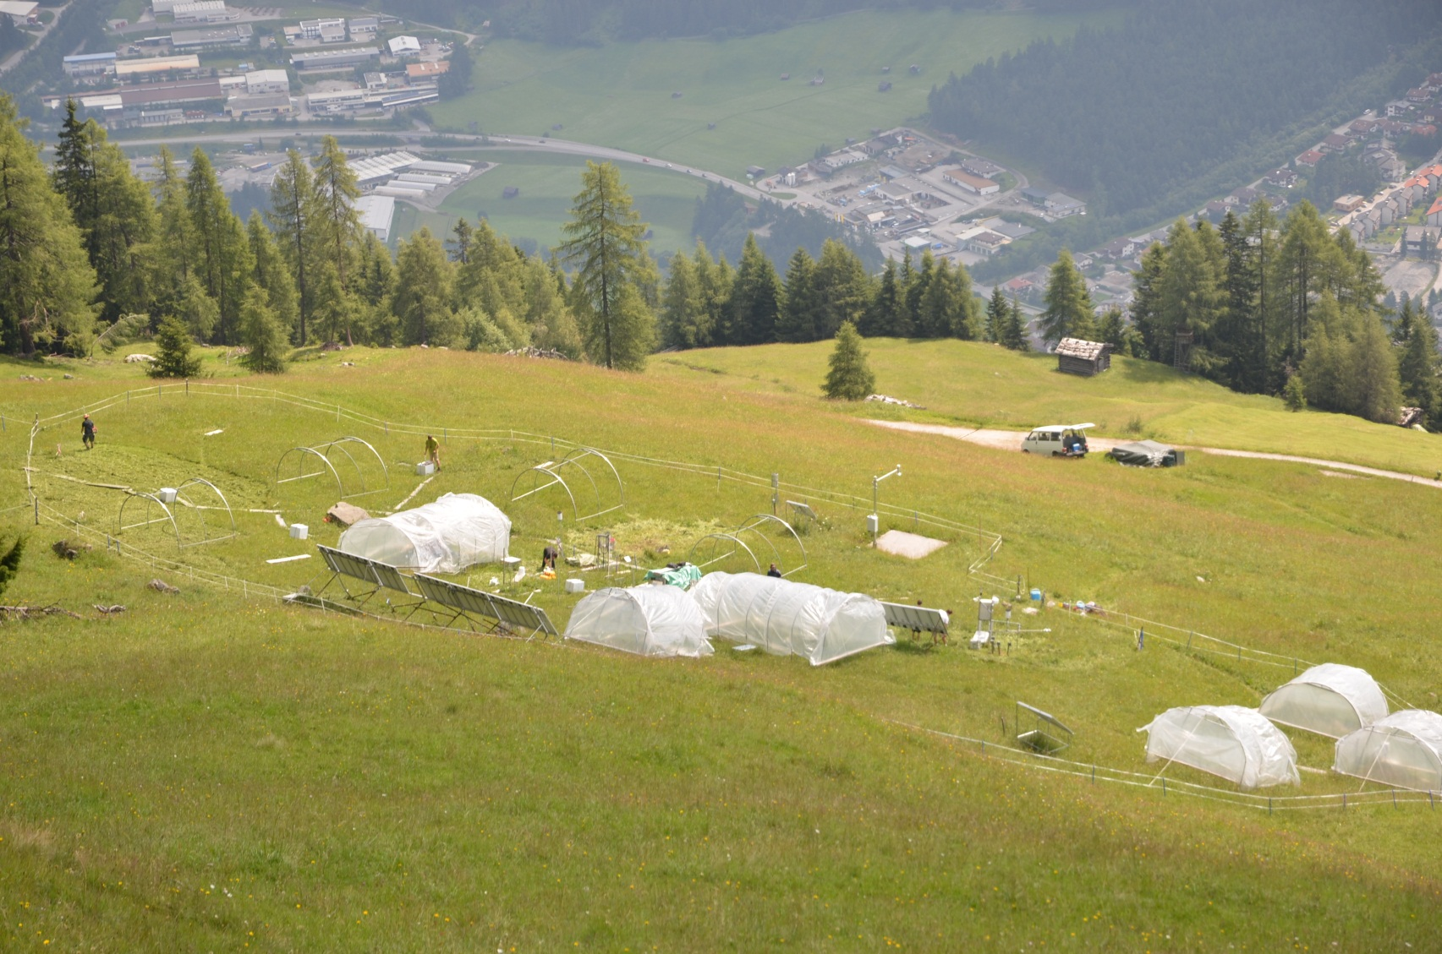
Large Scales
Most experiments focus on one location i.e. altitude.
Experiments can be arranged along elevational gradients to identify community and competition dynamics and the relevance of upward shift in face of climate change.
Stubai Valley experiment, Austria, Michael Bahn, Univ. of Innsbruck

Slide 33
Large Scales
Examples of different rainfall manipulation methods conducted on grasslands with corresponding locations. (a) Bayreuth, Germany;
(b) Tel Aviv, Israel; (c) Kamloops, Canada.
Fraser L; Henry H; Carlyle CN; White S; Beierkuhnlein C; Cahill J; Casper, B; Cleland E; Collins S; Dukes J; Knapp A; Lind E; Long R; Luo Y; Reich P; Smith M; Sternberg M; Turkington R 2013: Coordinated Distributed Experiments: an emerging tool for testing global hypotheses in ecology and environmen-tal science. Frontiers in Ecology and the Environment 11, 147–155

Slide 34
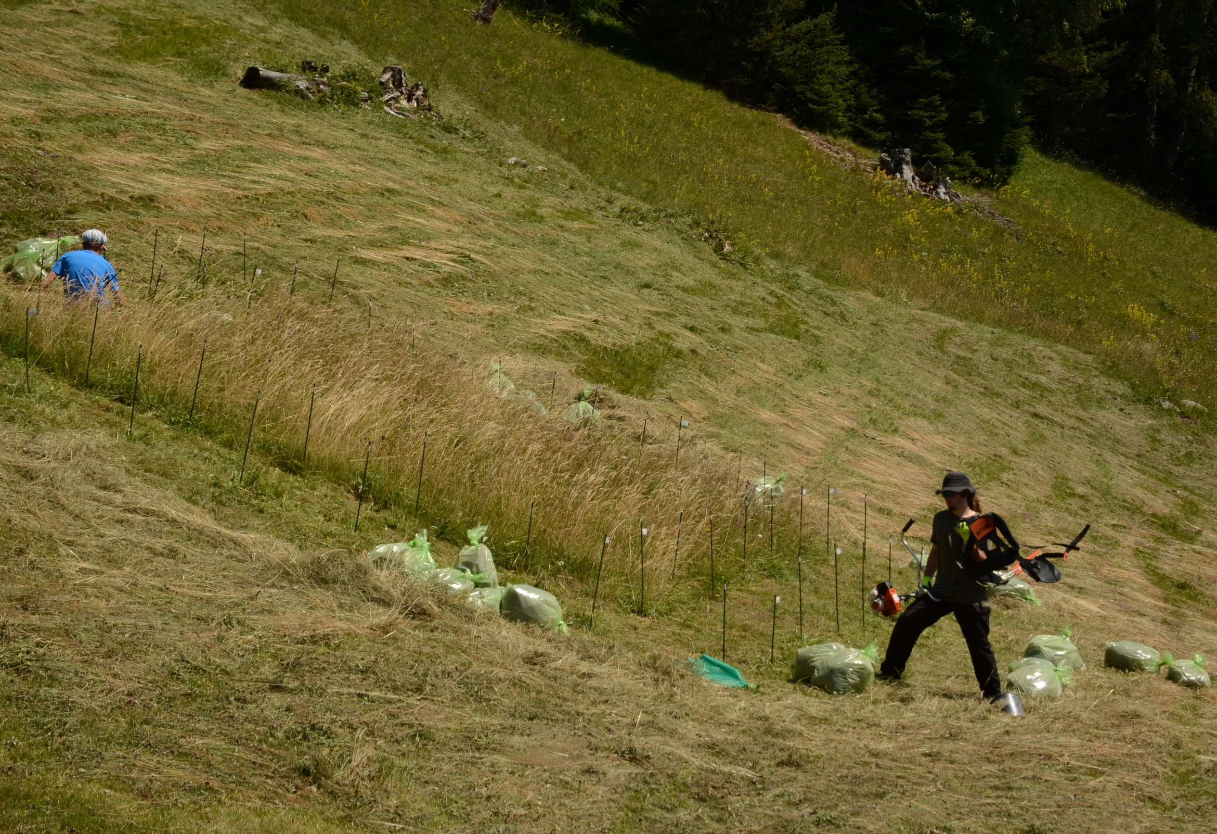
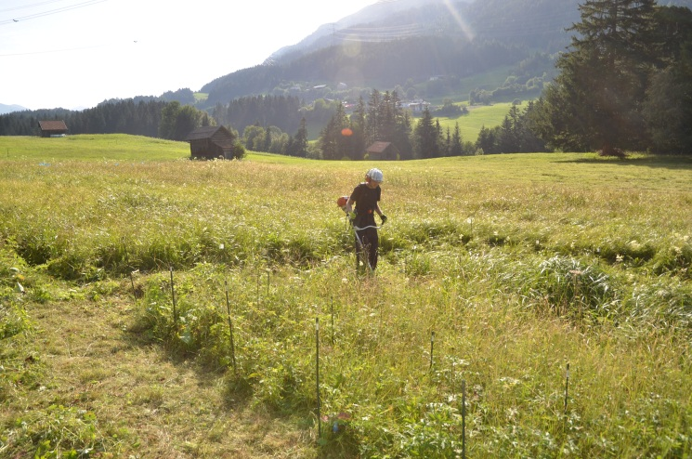
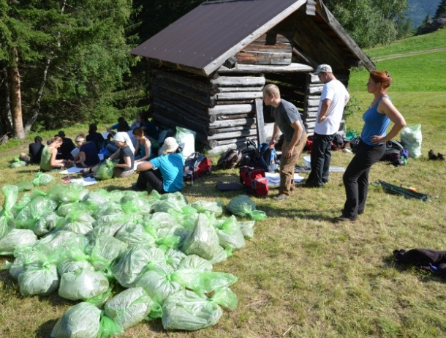
Multi-Site Experiments
Coordinated Distributed Experiments
Fraser L; Henry H; Carlyle CN; White S; Beierkuhnlein C; Cahill J; Casper, B; Cleland E; Collins S; Dukes J; Knapp A; Lind E; Long R; Luo Y; Reich P; Smith M; Sternberg M; Turkington R 2013: Coordinated Distributed Experiments: an emerging tool for testing global hypotheses in ecology and environmen-tal science. Frontiers in Ecology and the Environment 11, 147–155

Slide 35

Temporal Scales

Slide 36
Temporal Scales
History (predisposition, species pool, ghost of competition past etc.)
Short-term events and disturbances (local extinction, damage, regeneration niche, outbreaks, delayed responses etc.)
Intra- and inter-annual variability (regularity of rhythms, dormancy, fluctuations etc.)
Long-term trends (successional trajectories, biodiversity loss, shifts in species composition, adaptation etc.)

Slide 37
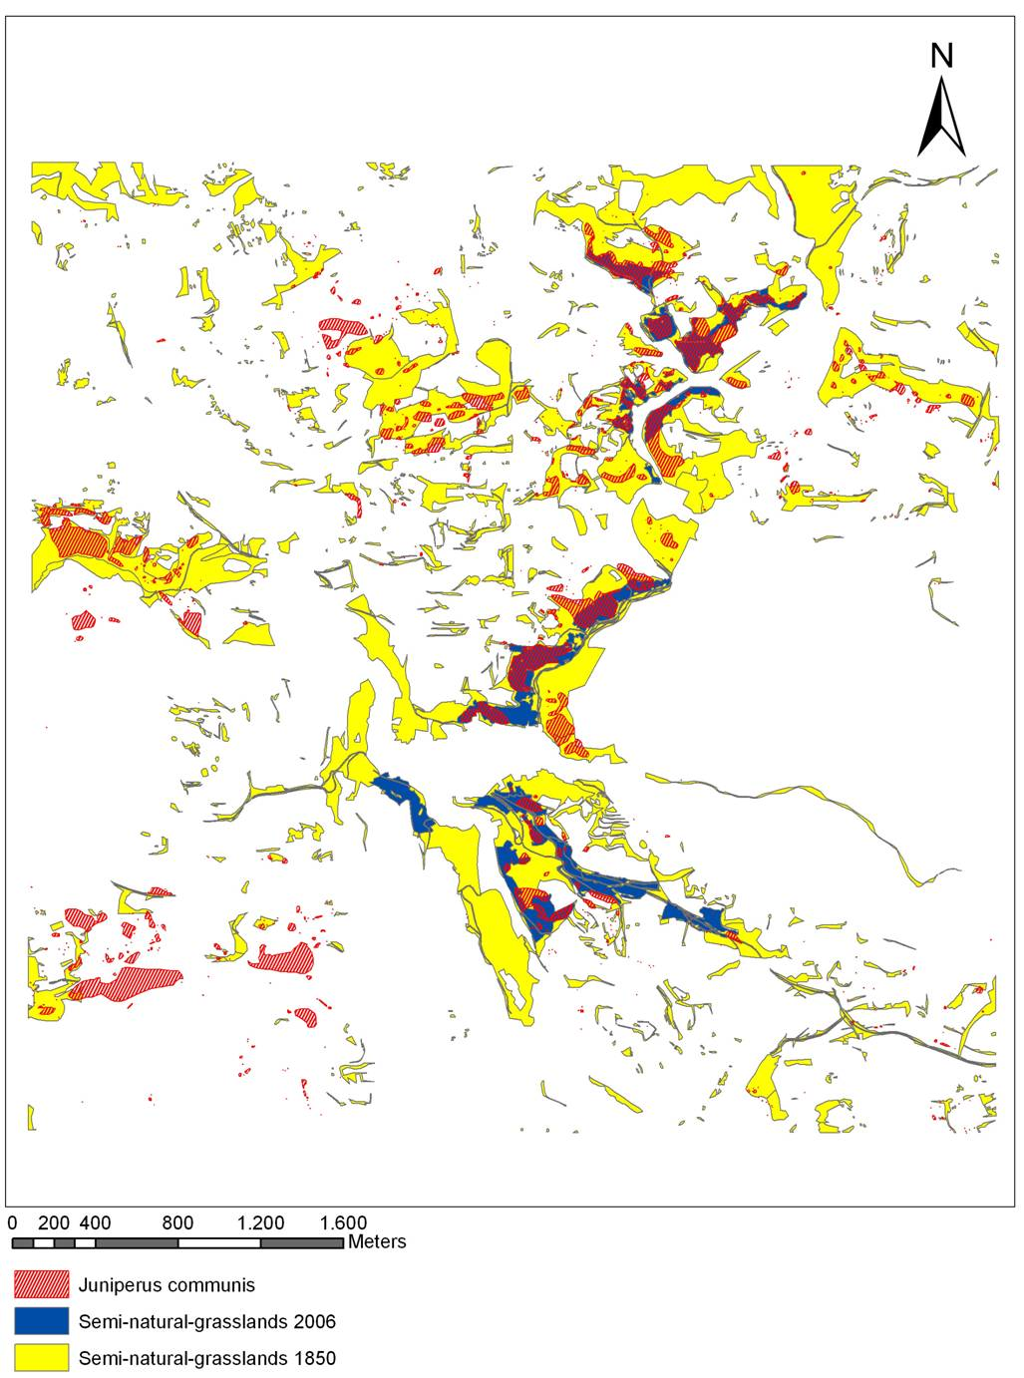
History
Occurrence of Juniper in a Franconian landscape
related to historical land use.
The legacy of former pastures is still effective after more than 150 years!

Slide 38
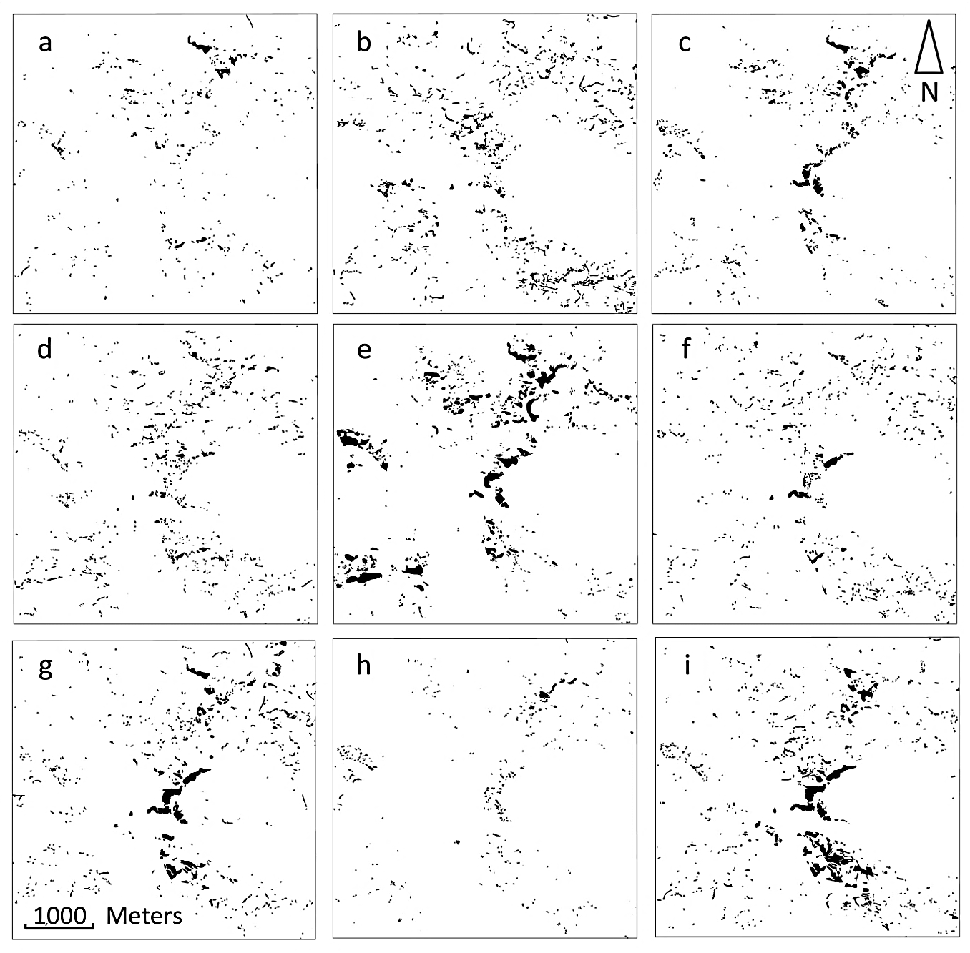
History
Current biodiversity patterns are largely influenced by history.
a – Anthyllis vulneraria,
b – Centaurea scabiosa,
c – Cirsium acaule,
d – Dianthus carthusianorum,
e – Juniperus communis,
f – Ononis repens,
g – Sanguisorba minor,
h – Scabiosa columbaria,
i – Thymus pulegioides
Heubes, Retzer, Schmidtlein, Beierkuhnlein 2011 Historical land use explains current distribution of calcareous grassland species. Folia Geobotanica 46, 1-16

Slide 39
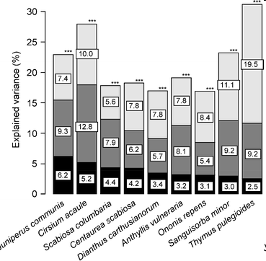
History
Explained variance of species distribution.
Current land use
Combined current / historical land use
Historical land use
Heubes, Retzer, Schmidtlein, Beierkuhnlein 2011 Historical land use explains current distribution of calcareous grassland species. Folia Geobotanica 46, 1-16

Slide 40
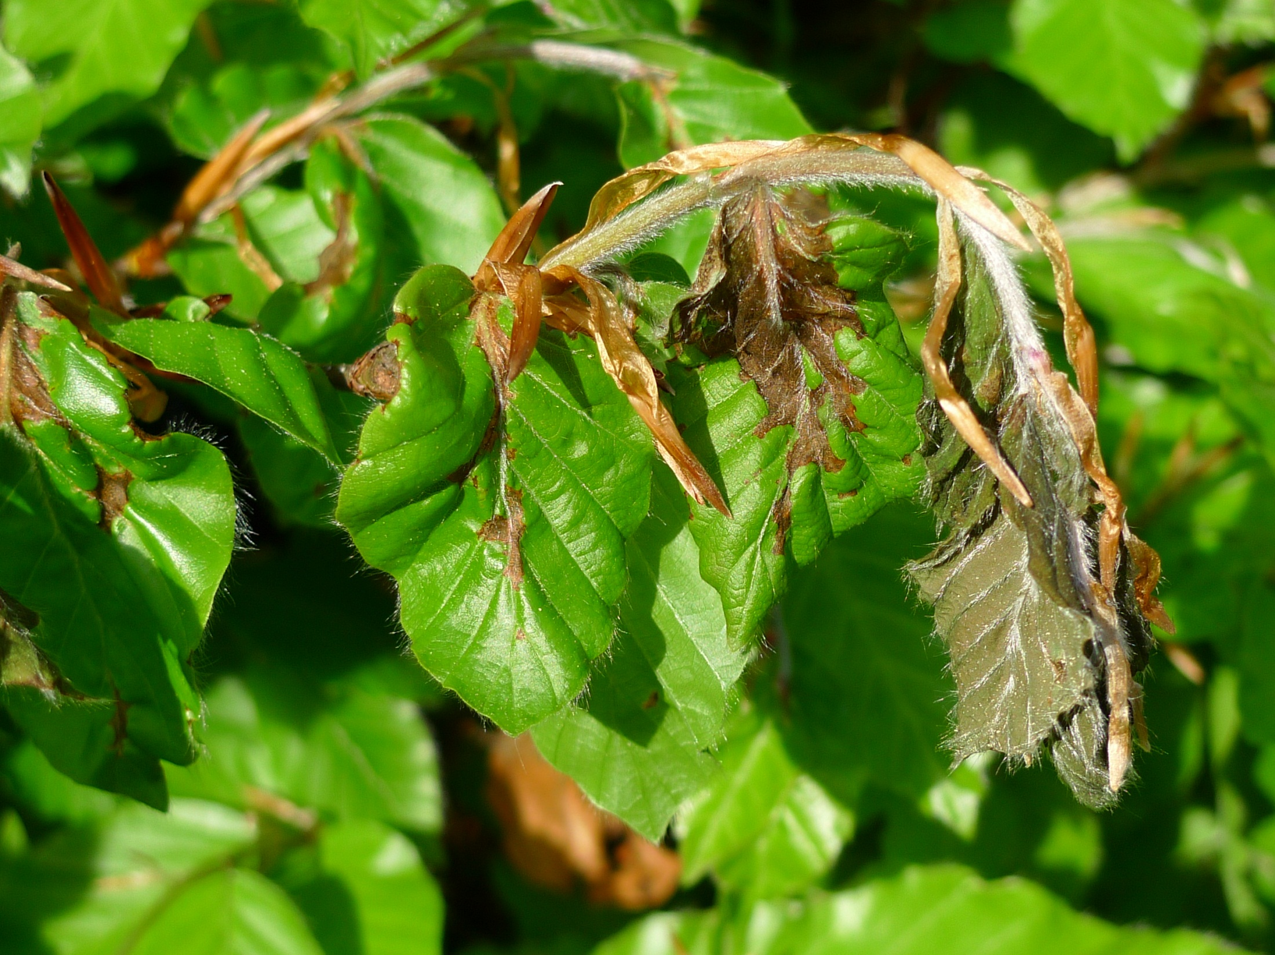
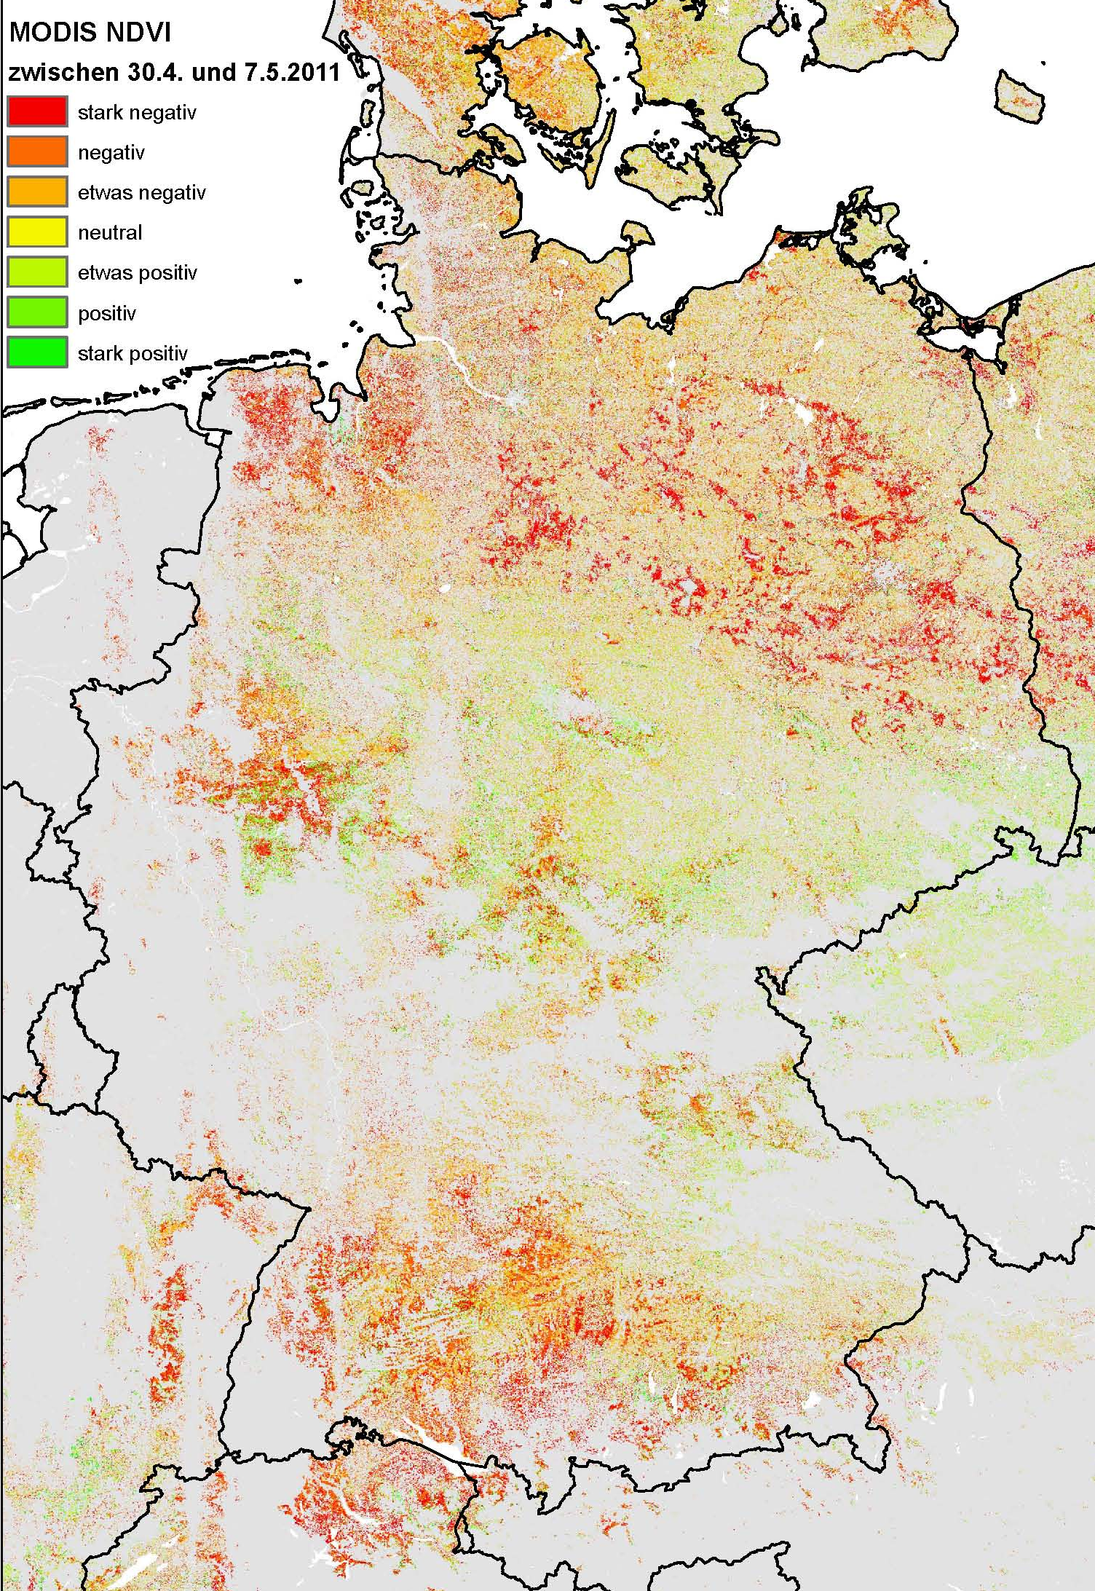
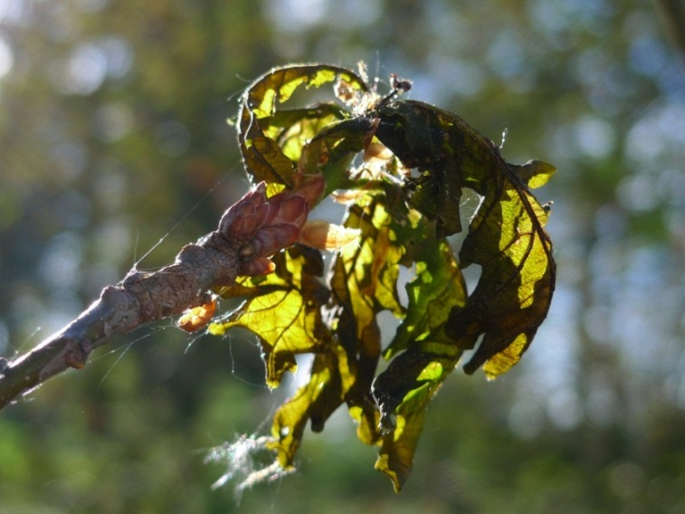
Late Frost
10th May 2011
Fagus sylvatica
Quercus robur

Slide 41

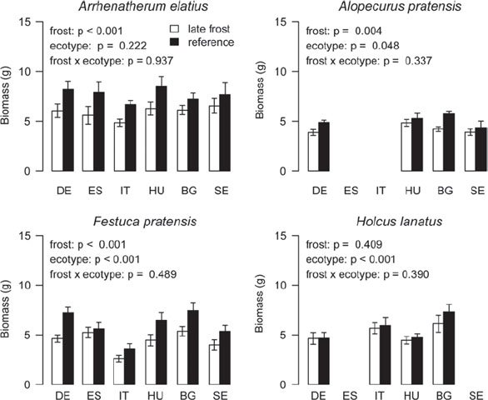
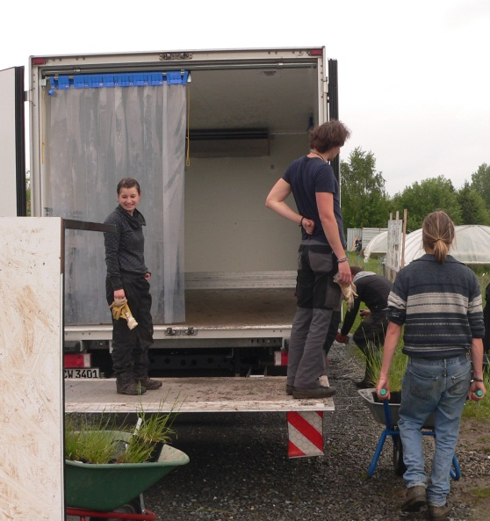
3
Late Frost
Late frost
Reference
European grass species decreased in biomass production (July 6) on average by 20% in response to a single experimental late frost event (May 29) lasting less than three hrs.
Kreyling, Thiel, Simmnacher, Willner, Jentsch, Beierkuhnlein 2012 Geographic origin and past climatic experience influence the response to late spring frost in four common grass species in Central Europe. Ecography 35, 268-275.

Slide 42
Events
Climate
Time
„Extremeness“ of climatic conditions is a relative term, depending on the time sequence before ...
Hegerl H, Hanlon H, Beierkuhnlein C 2011 Elusive Extremes. Nature Geoscience 4, 143-143.

Slide 43
Events
Climate
Time
„Extremeness“ of climatic conditions is a relative term, depending on the time sequence before and after the event.
Hegerl H, Hanlon H, Beierkuhnlein C 2011 Elusive Extremes. Nature Geoscience 4, 143-143.

Slide 44
Events
Climate
Time
„Extremeness“ of climatic conditions is a relative term, depending on the time sequence before and after the event.
Hegerl H, Hanlon H, Beierkuhnlein C 2011 Elusive Extremes. Nature Geoscience 4, 143-143.

Slide 45
Extremes ?
There is no clear definition of „extreme“ conditions.
Extreme value statistics is influenced by the duration of the time series of a weather station (e.g. 50 vs. 150 y).
Extreme values of today are no longer „extreme“ in the future just by the underlying trend.
Climatic variability is a moving target.

Slide 46
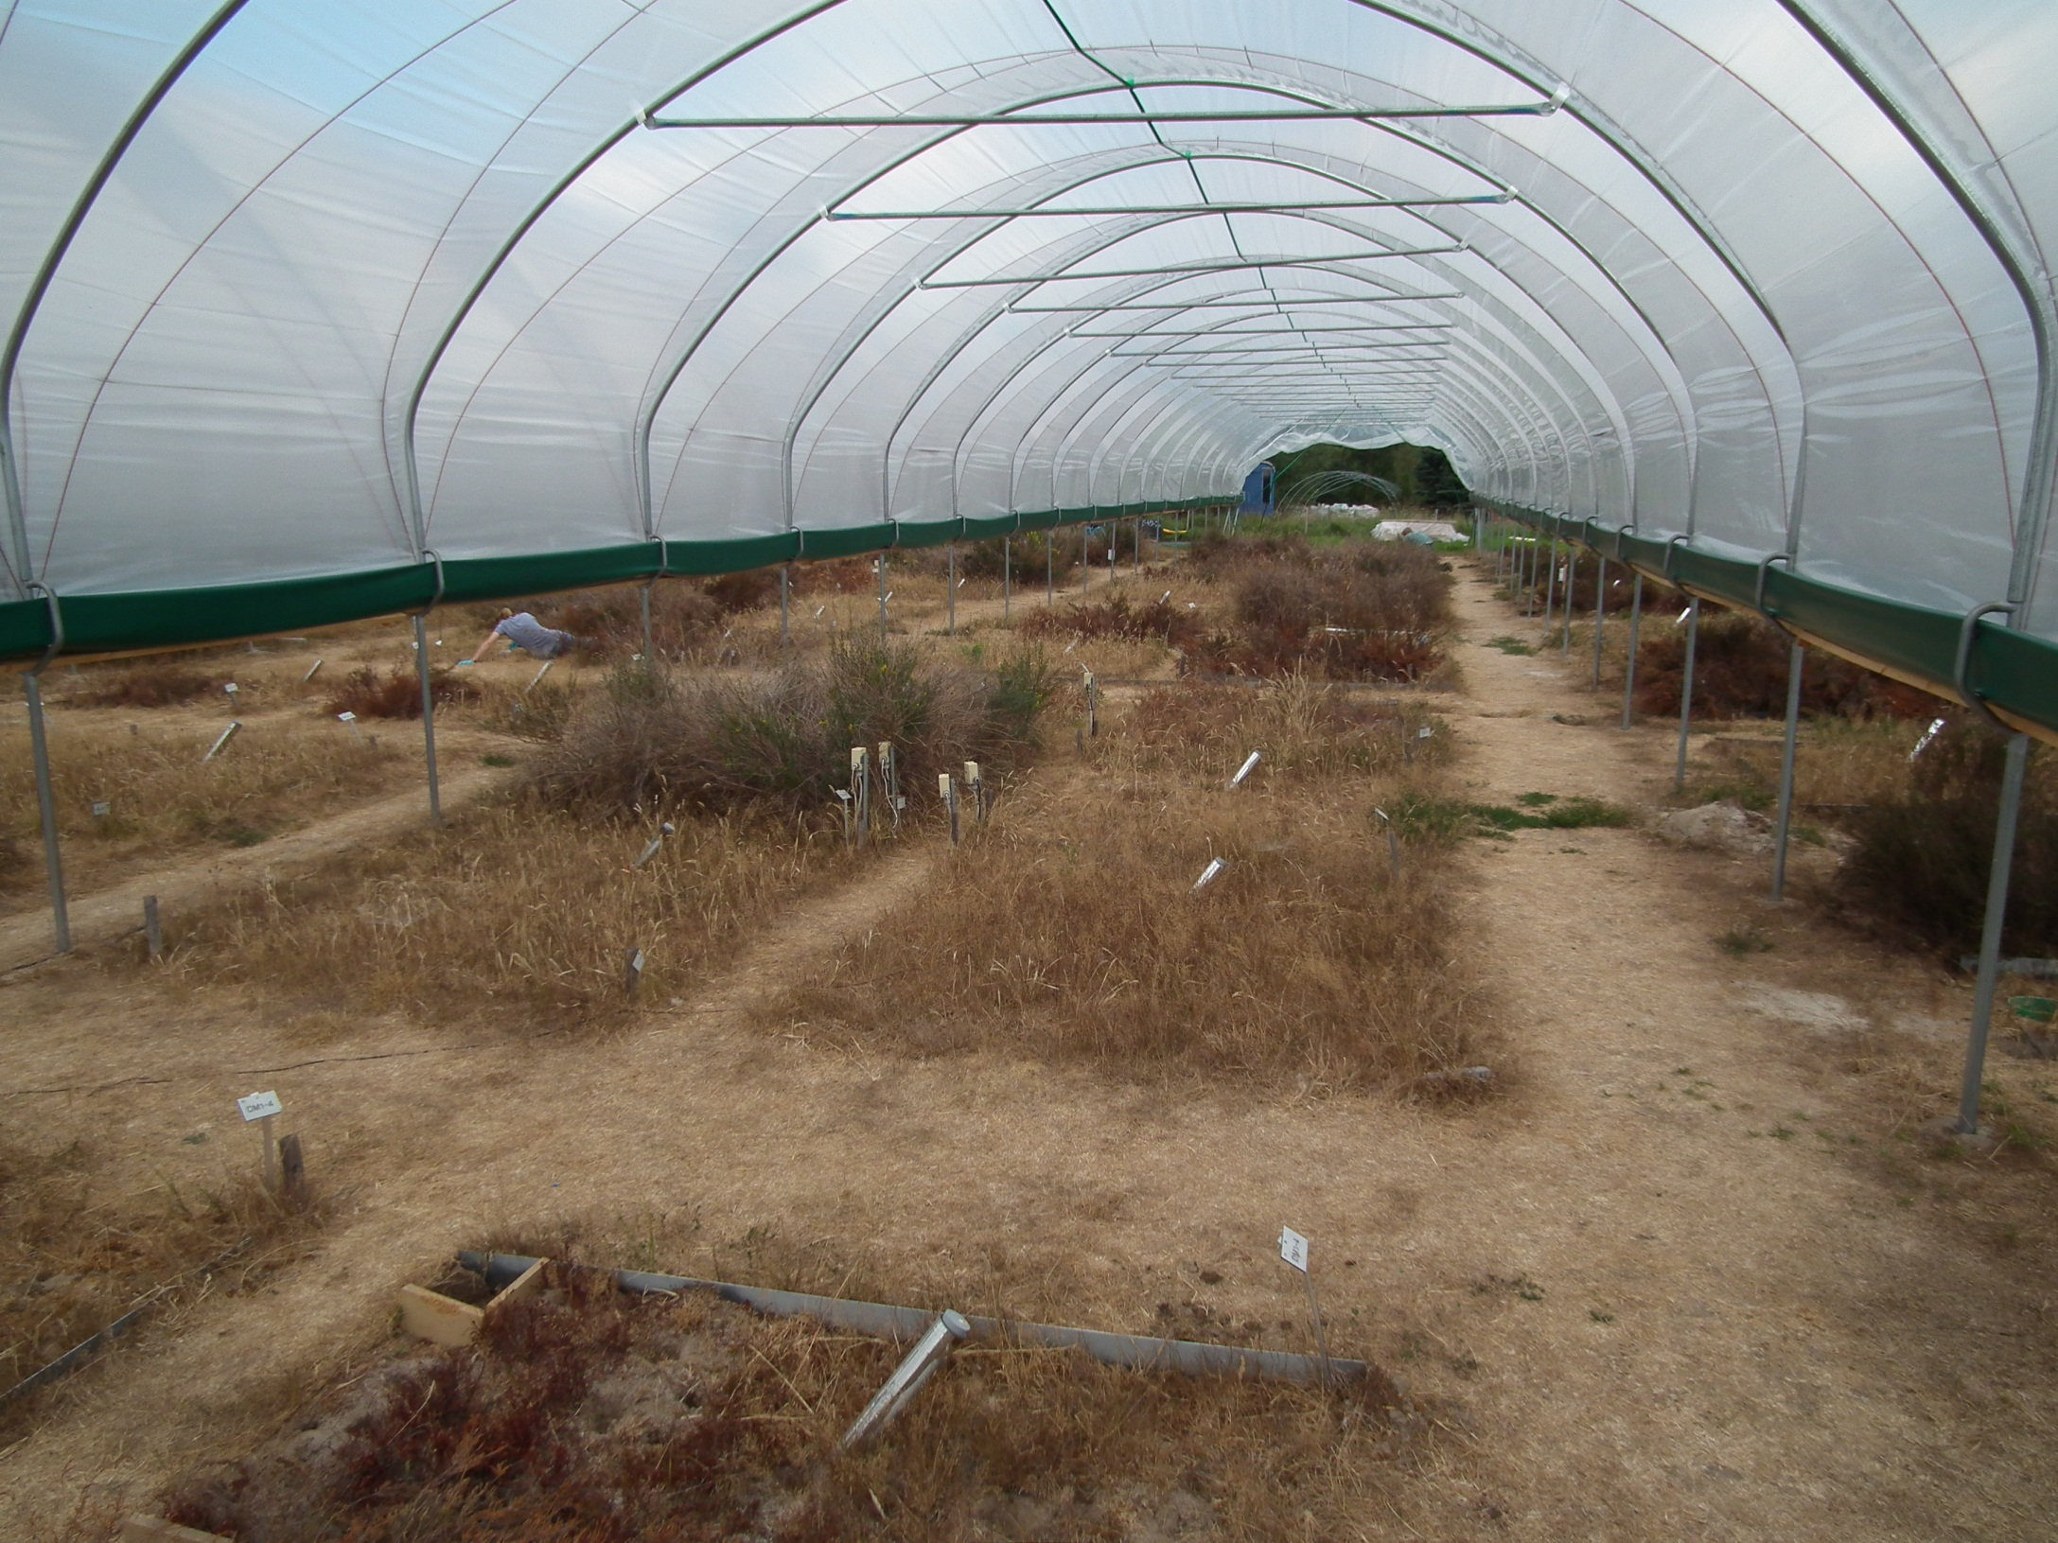
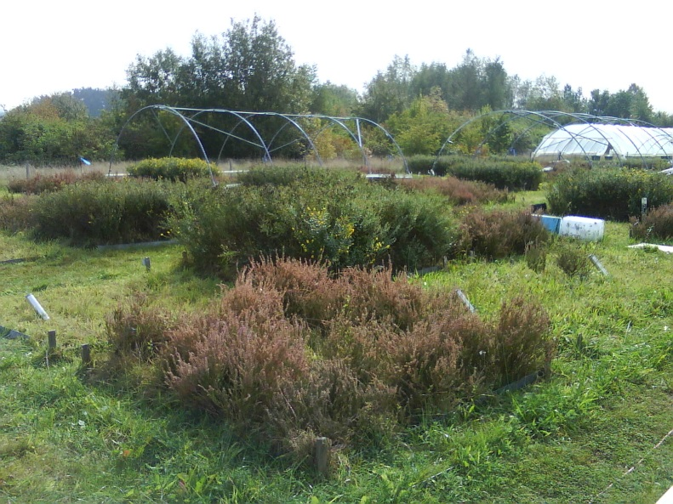
6
Duration of „Events“
25.08.2012
Terminal drought for 3.5 month
Notes:
All following data sampled at 8 dates throughout the drought treatment (every two weeks until drought week 16)

Slide 47
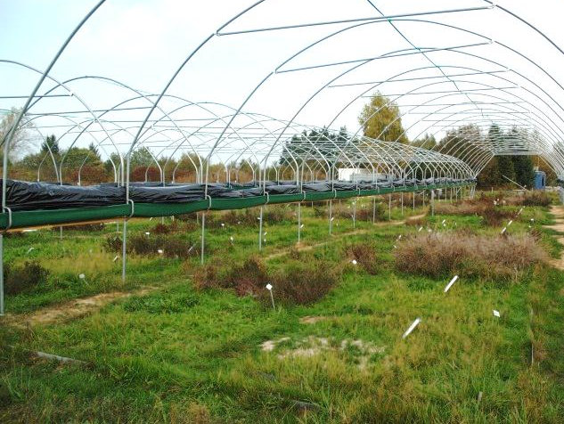
6
Duration of „Events“
Rewatering: Regrowth of all species by resprouting and/or seed bank germination!
Seedbank fully depleted after recovery => novel synchrony ?
19.10.2012

Slide 48
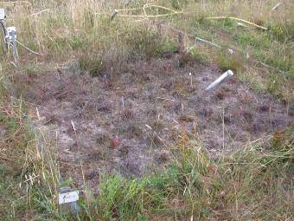
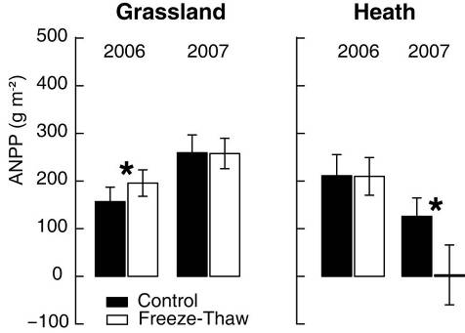
1
Lagged Response
Speed (and direction) of response can strongly vary between vegetation types
Experiments need to monitor response years after end of the treatments
Response to five additional soil freeze-thaw- cycles (applied once in winter 2005/06):
Aboveground Net Primary Production (ANPP) over each growing season (mean values and standard errors). Freeze-thaw manipulation took place only in Winter 2005/06. An asterisk marks significant treatment effects (ANOVA, Tukey HSD post hoc comparison: p < 0.05). n = 15 for each bar.
Kreyling et al 2008 New Phytologist; 2010 BasicApplEcol

Slide 49




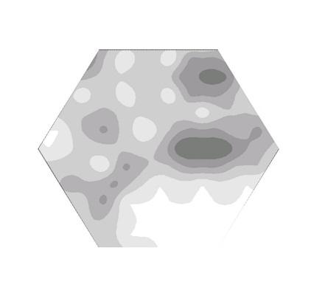



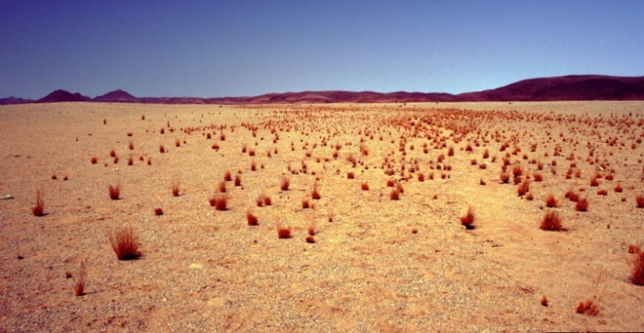
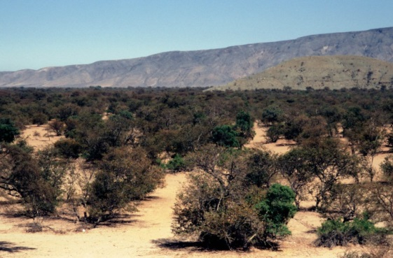
Seasonality
Sørensen
values
Purros ZooDesert Warmquelle Mbakondja
Namibia
Dry season
Rainy season
50-100 100-150 150-200 200-250 Average Precipitation [mm/a]
Hassler S, Kreyling J, Beierkuhnlein C, Eisold J, Samimi C, Wagenseil H, Jentsch A 2010 Vegetation pattern divergence between dry and wet season in a semiarid savanna - spatio-temporal dynamics of plant diversity in northwest Namibia. Journal of Arid Environments 74, 1516-1524

Slide 50
Intra- vs. Interannual
There is increasing evidence not only for increasing intra-annual variability (extreme events, modified seasonality) but also for increasing differences between years (e.g. European spring and early summer 2011 vs. 2013).
Ecosystems may recover after and even adapt to short-term extreme events. However, it is more difficult to cope with a sequence of extremely different years (e.g. hot and warm year followed by a wet and cold year).
This type of extreme variability between years is hardly addressed by experiments until now.

Slide 51
Inter-annual variability
Year 1
Reference
Reference
Reference
Reference
Reference
Reference
+
+
+
+
No treatment
Year 2
Control
-
-
-
-
+
+
+
+
+
Year 3
Control
-
-
-
-
-
Year 4

Slide 52
Legacy of inter-annual variability
Year 1
Reference
Reference
Reference
Reference
Reference
Reference
+
+
+
+
No treatment
Year 2
Control
-
-
-
-
+
+
+
+
+
Year 3
Control
-
-
-
-
-
Cumulative
response ?
Compen-sation?
Additive effects ?
Memory effect ?
etc.
Year 4
Timing ?

Slide 53
5
Succession
‚Clementsian‘ concepts for temporal trajectories of plant communities were actualistic, linear and deterministic.
This philosophy is reflected in the concepts of „potential natural vegetation“ (hypothetical) and „séries bioclimatiques“ (where succession must not reach a climax stage).
Today: increasing need for projective vegetation models in face of ongoing climatic changes.

Slide 54
5
Succession
Are trajectories of succession deterministic?
depending on community composition and environmental conditions at a given starting point
and depending on the climatic conditions during succession

Slide 55
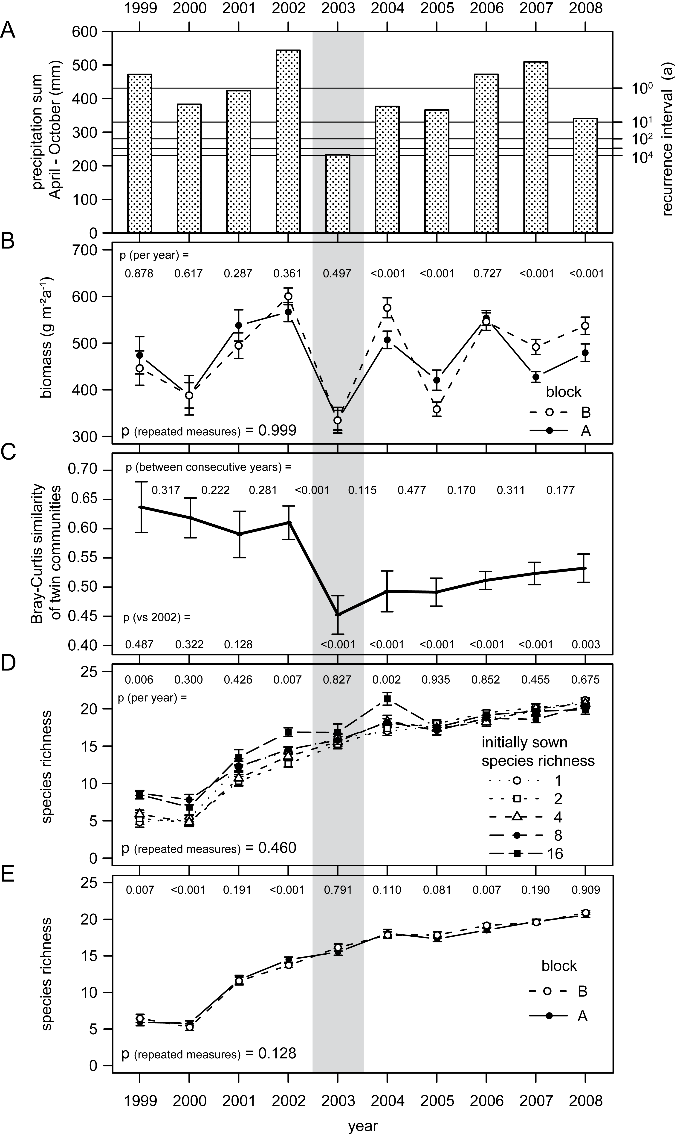
5
Long-Term Studies
Extreme dry summer in 2003.
Kreyling, Jentsch, Beierkuhnlein (2011) Ecology Letters 14, 758-764
Notes:
55
based on General Extreme Value Distribution on 48 years

Slide 56
5
Long-Term Studies
Similarity between twin communities based on aboveground species-specific biomass was high until 2003, but then …
Kreyling, Jentsch, Beierkuhnlein (2011) Ecology Letters 14, 758-764
Notes:
56
Mean Bray-Curtis similarity between the twin communities showed a strong and lasting decrease in 2003. Significances based on Monte-Carlo permutation procedures.

Slide 57

Biological Scales

Slide 58
Bio-Ecological Scales
Connections between Levels of Organisation
Variability within Units (e.g. species)

Slide 59
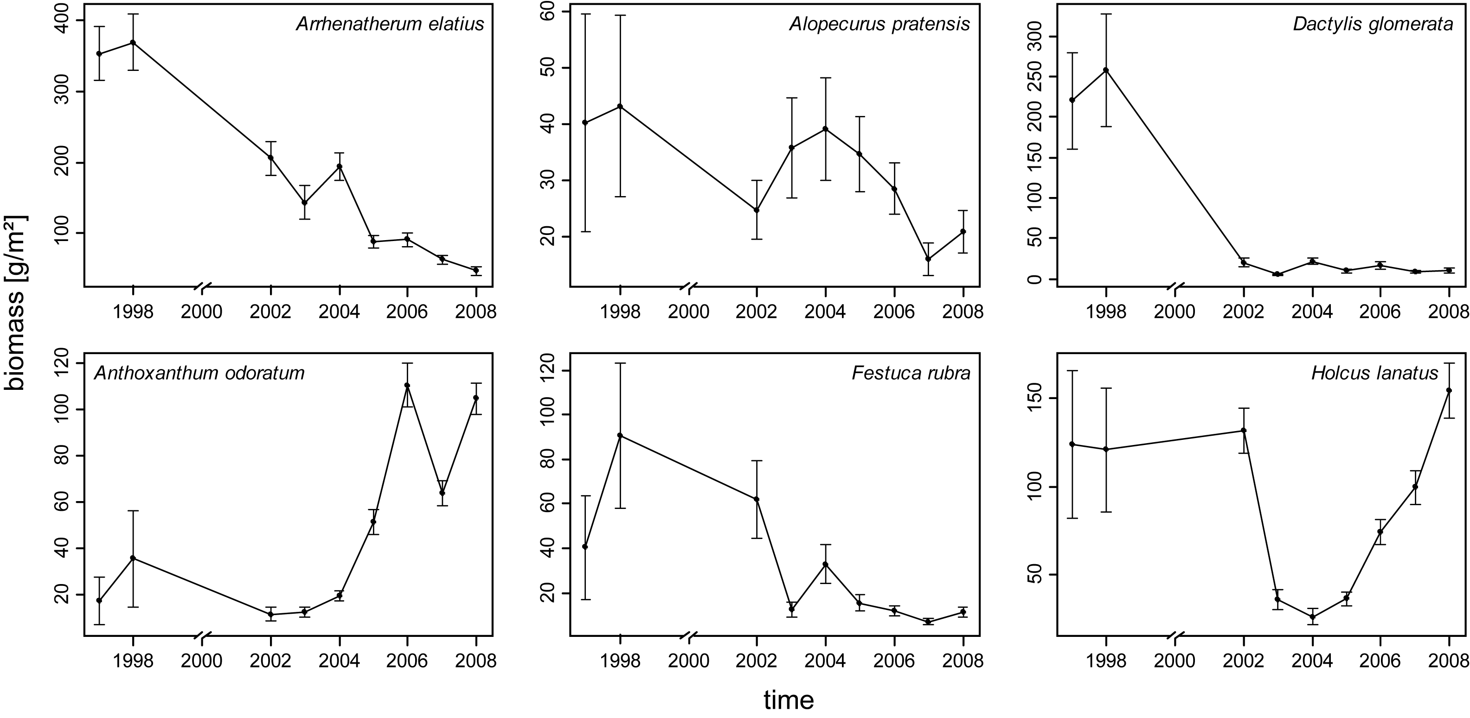
5
Long-Term Studies
BIODEPTH
2003
Trajectories of mean annual biomass of important grass species.
Individual trajectories

Slide 60
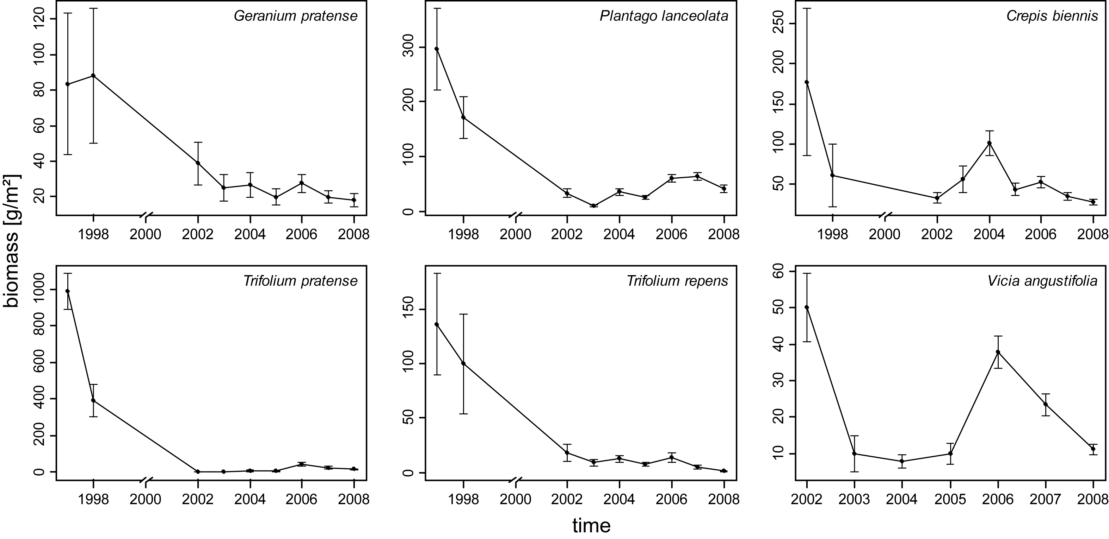
5
Long-Term Studies
BIODEPTH
2003
Not sown
Trajectories of mean annual biomass of important herbaceous species.
Decreasing contribution

Slide 61
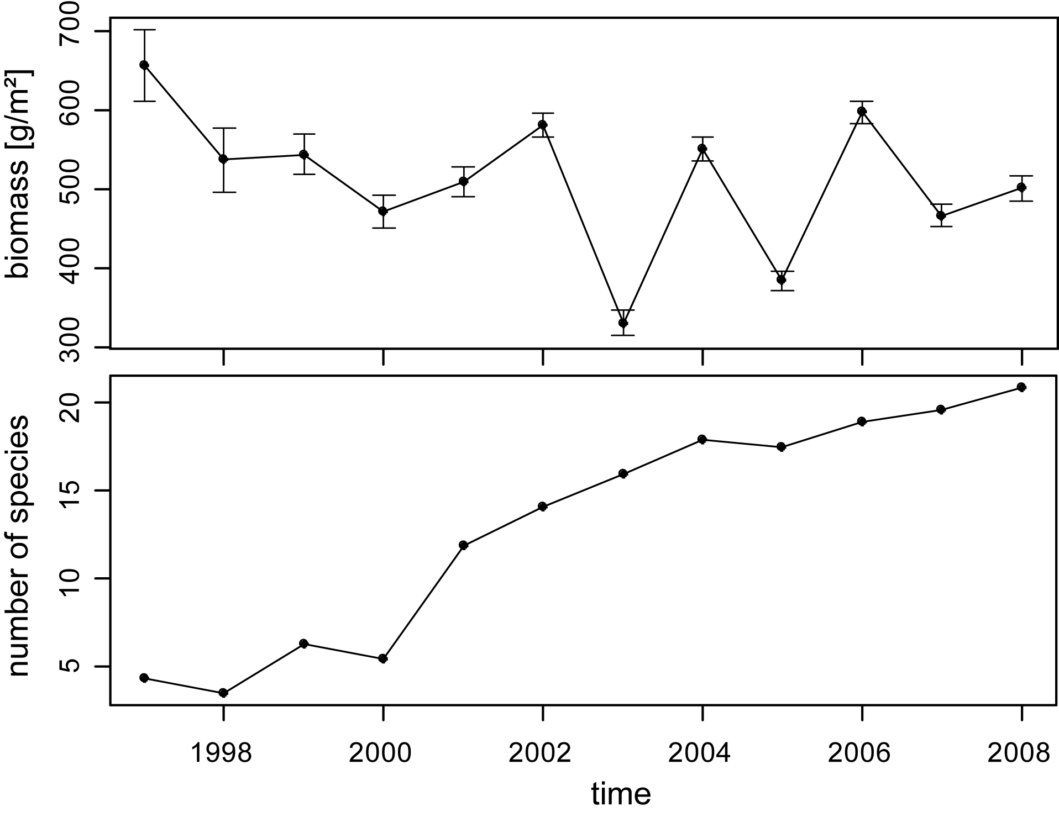
5
Long-Term Studies
BIODEPTH
2003
no trend
mean
trend
mean
Biomass was fluctuating but not decreasing
- species diversity was increasing.

Slide 62

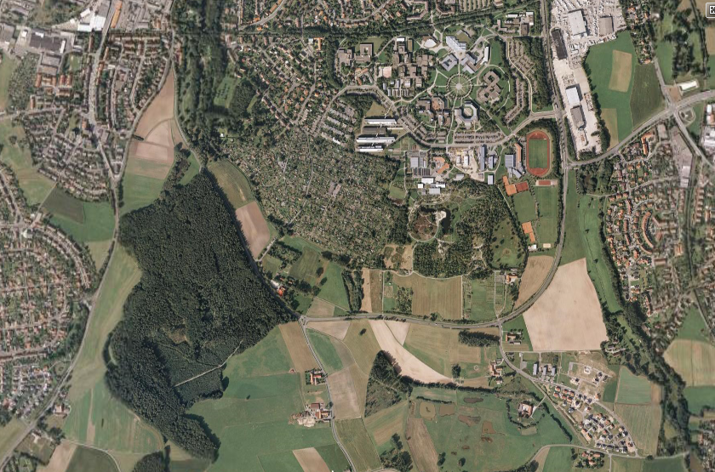
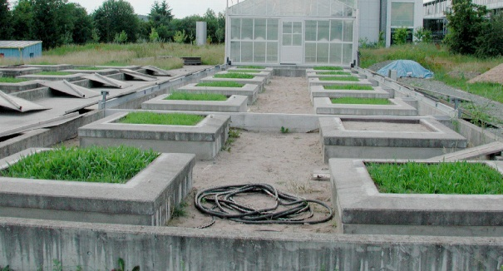
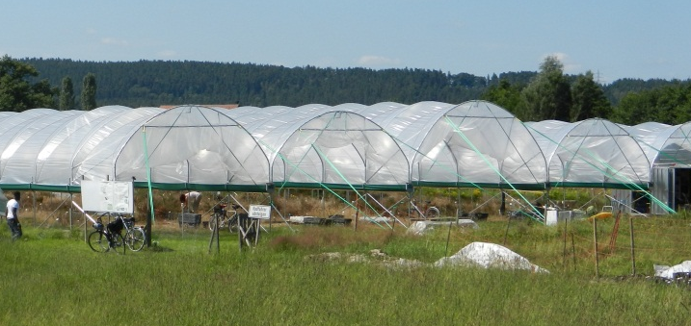




- Experiments
EVENT IV
EVENT VI
IV
EVENT I
SIGNAL
EVENT V
VI
I
II
S
III
EVENT III
EVENT II
V

Slide 63

- Experiments
 | EVENT I | EVENT II | EVENT III | EVENT IV | EVENT V
Begin | 2005 | 2008 | 2008 | 2010 | 1996 / 2009
# Replicates | 5 | 5 | 21 | 5 | 2
# Plots / Pots | 150 | 225 | 2352 | 140 | 64
Communities | grassland, shrubland | grassland | - | grassland, shrubland | grassland
Functional Types | grasses, herbs, legumes, shrubs | grasses, herbs, legumes | grasses, trees | grasses, shrubs | grasses, herbs, legumes
species diversity (# species / plot) | artificial 1, 2, 4 | natural 9 - 32 | none | artificial 1,2,4 | Init. 1 – 16, now 16 - 26
Funct. diversity | 1, 2, 3 | none | none | 1, 2, 3 | 1, 2, 3
Total # species | 10 | 55 | 4 + 3 | 4 | 54
Biodiversity
Jentsch, A., Beierkuhnlein C (2010) Simulating the future responses of ecosystems, key species and European provenances to expected climatic trends and events. Nova Acta Leopoldina NF 112 (384): 89-98

Slide 64
- Experiments
 | EVENT I | EVENT II | EVENT III | EVENT IV | EVENT V
Summer precip. | X | X | X
Summer drought | X | X | X
Frost-thaw-cycles | X |  |  | X
Summer warming |  | X | X
Winter warming | X | X
+ Winter-rain |  | X |  |  | X
Ambient control | X | X |  | X | X
Artefact control | X |  | X
Average control | X | X
Warming / drought |  | X | X
Warming / heavy rain |  | X | X
Warming / land use |  | X
Extremes
Trends
Controls
Combin.
Jentsch, A., Beierkuhnlein C (2010) Simulating the future responses of ecosystems, key species and European provenances to expected climatic trends and events. Nova Acta Leopoldina NF 112 (384): 89-98

Slide 65






Variability within Species
England
Norway
Switzer-land
Poland
Hungary
Slovakia
Common garden experiment with geographic provenances of Poa pratensis L., the most widespread and most commonly sown European grass species.

Slide 66

3
Variability within Species
Drought is most important for Biomass.
Within-species variation differs strongly.
Beierkuhnlein, C., Kreyling, J., Thiel, D., Jentsch, A. (2010) Species-specific and provenance-specific responses of key grass species to extreme climatic events. Journal of Ecology 99, 703-713.

Slide 67
3
Variability within Species
Regional pools of phenotypes are assumed to be best adapted to a given (historic) environment.
However, they represent only a part of a species’ ecological range.
Genetic pool of local populations is limited by dispersal history or filters.
Species specific niches are occupied, which creates inertia for the immigration from members of other populations of the same species.

Slide 68

1
Ecosystem Scale
Jentsch et al (2011) Climate extremes initiate ecosystem regulating functions while maintaining productivity. Journal of Ecology 99, 689-702.
5

Slide 69
1
Ecosystem Scale
Overall system performance remains stable even if single species and processes respond significantly to climatic extremes.
Jentsch et al (2011) Climate extremes initiate ecosystem regulating functions while maintaining productivity. Journal of Ecology 99, 689-702.
5

Slide 70

Perspectives

Slide 71
Experimental Design
As money and time is scarce, and as rapid research output is asked for, experimental ecology often must ignore basic requirements to assign experimental results to larger scales.

Slide 72
Experimental Design
Experimental ecology assumes and defines the right scales based on feasibility and arguments (e.g. 3 years project with plots of 2x2 m).
Split plot design, # of replicates and controls are generally accepted as experimental prerequisites. Statistical analyses and rapid publications are the major criteria for the design of experiments.
Methodological approaches to test whether more space and/or time modifies results or if more ecological complexity leads to contrasting results are under-developed.

Slide 73
Experimental Design
Increasingly, experiments must be designed to cover large continental gradients (e.g. latitudinal or continentality gradients).
This requires the development of standards which consider also scale problems.

Slide 74
Moving Targets
Ecosystems are moving targets that do not stay constant during experiments and have not been constant before.
And before installing experiments:
History of landuse must be identified.
Perennial species may have established under favourable conditions in the past, but do have vital populations any more.
The role (explained variance) of current site conditions which are manipulated must be identified.

Slide 75
Long-Term Studies
Successional trajectories of community assembly can be modified by one single event!
Individual responses of communities may occur! Delayed responses are likely to occur as well, especially at the scale of ecosystems.
Deterministic concepts and models based on single observations would ignore this.

Slide 76


Biological Scales
Direct upscaling from selected species to communities and ecosystems or higher is limited or even impossible!

Slide 77
Biological Scales
Biological units exhibit high variability.
A rose is NOT a rose is NOT a rose…
Classification is necessary but variability within units (such as ecosystems) cannot be ignored.

Slide 78

Pattern is a matter of scale
Identifying spatio-temporal patterns and effects of climatic manipulations depends on the spatial, temporal and bio-ecological scale of experiments.
„The problem of pattern and scale
is the central problem in ecology“
Levin, 1992
Notes:
78

Slide 79
Data Policy
Too many experiments yield data that are not or not efficiently analysed. Time and money is too short in our field of research!
Full access to experimental data should be granted and regulations that make sure that the rights of the owners of data are respected (e.g. priorities in publication, authorship).
Global data networks and data banks must be established and managed. Research policy should implement programs for this.

Slide 80
Spatial Scales
Spatial Representativity of the Location
Spatial Representativity of the Treatment
Size of Plots
Size of Treatments
Homogeneity of Plots
Homogeneity of Treatments
Arrangement of Plots
Distance between Plots
Edge Effects
Position of Measurements within Plots

Slide 81
Time
Representativity and
Age of the Plots
Temporal Reference for Treatments
Before Treatment History of Plots
Duration of Treatments
Continuity of Treatments
Temporal Variability
within Plots
Seasonal Timing of Treatments
Phenological Phase
Carry-Over Effects
Timing of Measurements within Plots

Slide 82
Biology
Representativity of the Species Pool
Biological Relevance
of Treatments
Assembly Rules
Physiology of Treatments
Before Treatment History of Populations
Temporal Variability of Species
Ecological Memory
Focus of Measurements within Plots

