Slide 1


Impacts of including trait variation on predictions of global carbon fluxes and vegetation distribution
Peter van Bodegom
Department of Systems Ecology
VU University Amsterdam
The Netherlands

Slide 2
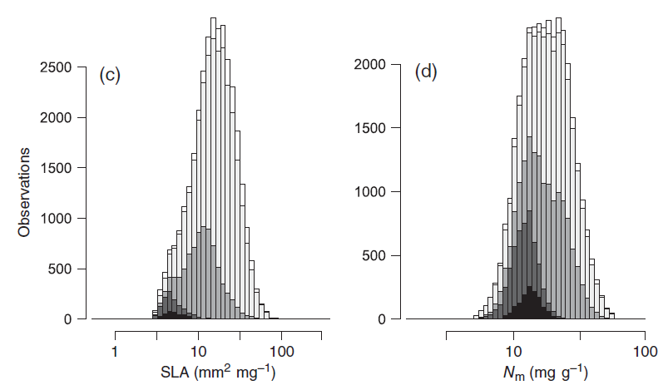
Traits vary considerably within and between communities
Kattge et al. 2011 GCB

Slide 3
Traits also tend to respond to climate manipulations
Cornelissen et al. 2007 EcolLett;
Aerts, van Bodegom and Cornelissen 2012 New Phytol

Slide 4
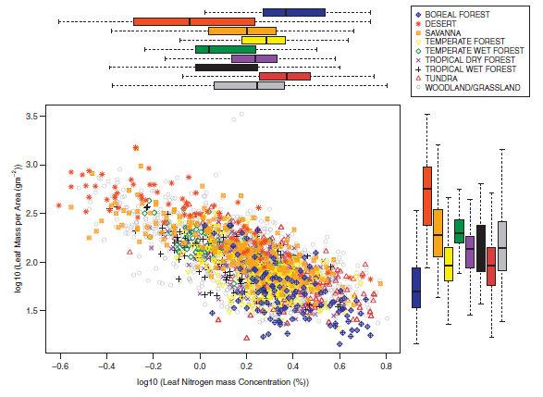
This trait variation is not well-captured by classification in biomes/PFTs
Van Bodegom et al. 2012 GEB

Slide 5
Keeping trait values PFT-constant within DGVMs has various disadvantages
Constant trait values in modelling hampers:
including acclimation and adaptation processes
Accounting for non-random species turnover
Quantifying vegetation-environment feedbacks
For these reasons, trait variation/responses are
increasingly incorporated into the DGVMs
Van Bodegom et al. 2012 GEB

Slide 6
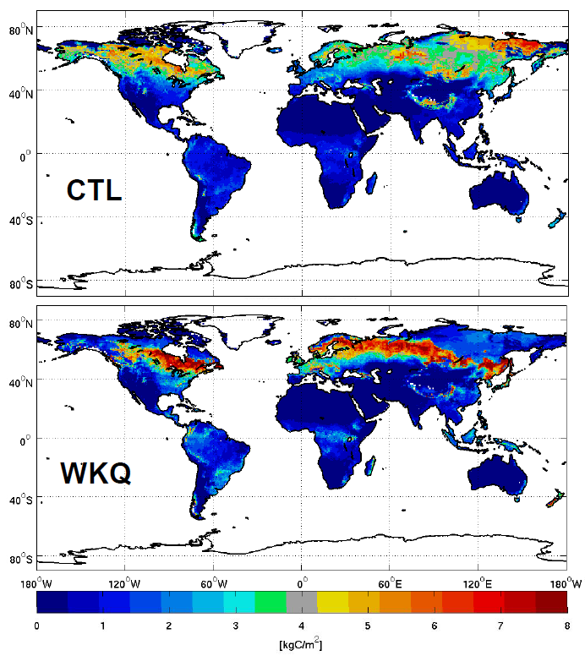
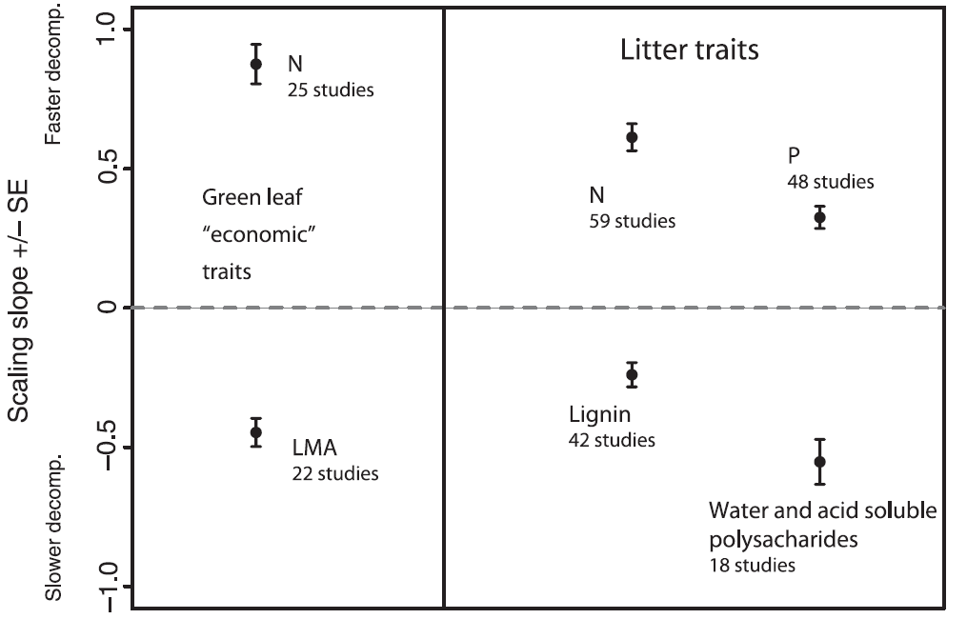
A partial solution: incorporation of observation-driven trait/process estimates
Cornwell et al. 2008 EcolLett
Global litter stocks
Brovkin et al. 2012 Biogeosciences

Slide 7
Potential solutions for further incorporating trait responses/ranges into DGVMs
more PFTS
Incorporating variation within PFTs:
  Based on habitat filtering principles
  Based on evolutionary principles
3. Fully traits-based approach

Slide 8
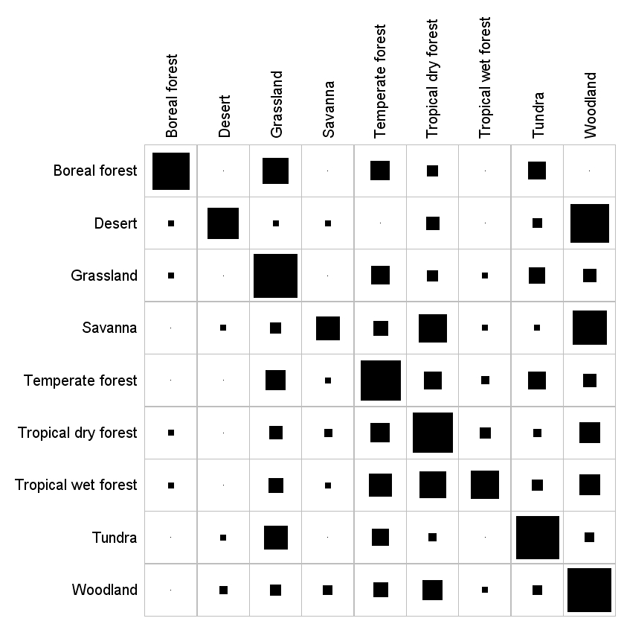
1. More PFTs may not be a fruitful approach given functional redundancy
observed
predicted

Slide 9
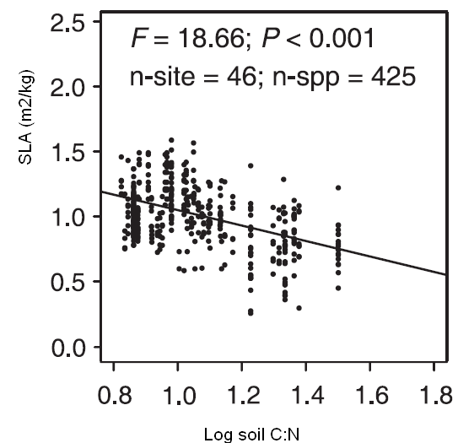
2a. Incorporation of trait variation within PFTs: habitat filtering principles
Based on assembly theory: environment acts a ‘filter’
Potential range of trait values
Filtering by environment
Trait range in habitat 1
Trait range in habitat 2
Ordonez et al. 2009 GEB

Slide 10
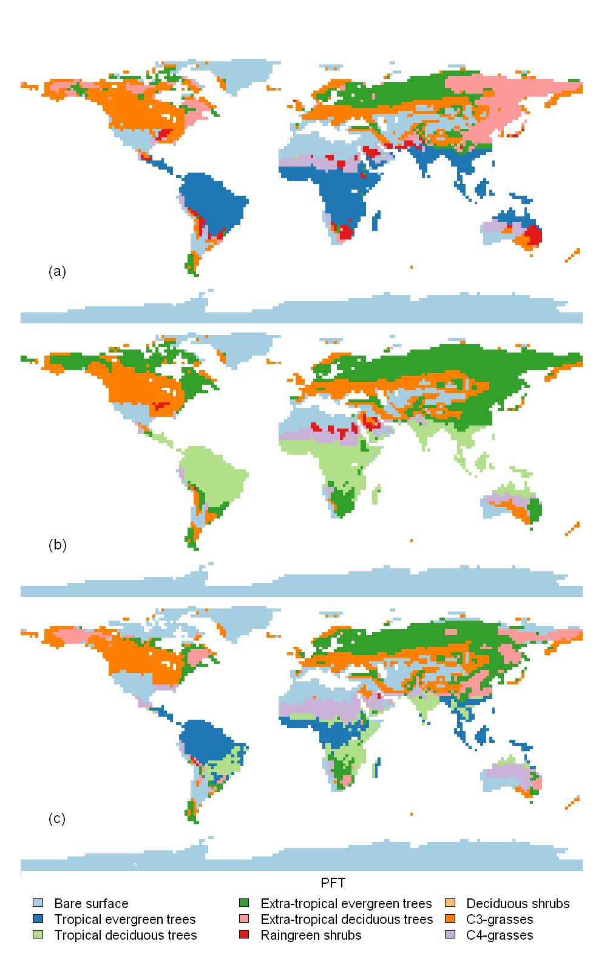
2a. Incorporation of habitat filtering principles into JSBACH
For PFT 1: trait X = a * temperature + b * radiation + CO₂-acclimation
C3-grasses
C3-grasses
Default: fixed traits
variable traits responses
Verheijen et al. 2012 Biogeosci.Disc.

Slide 11
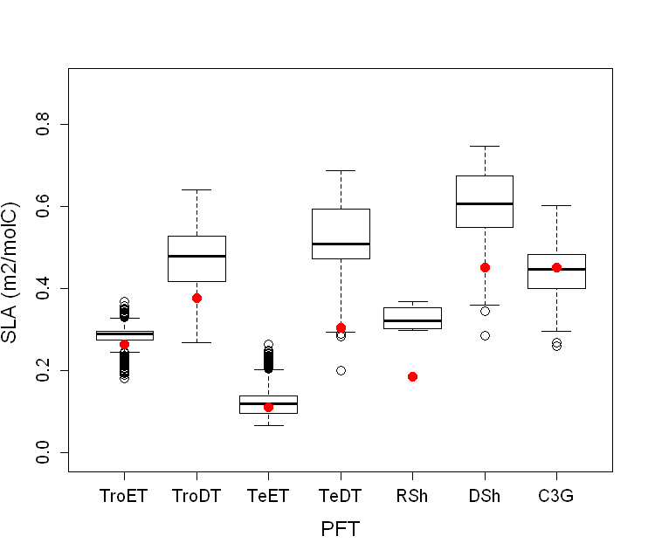
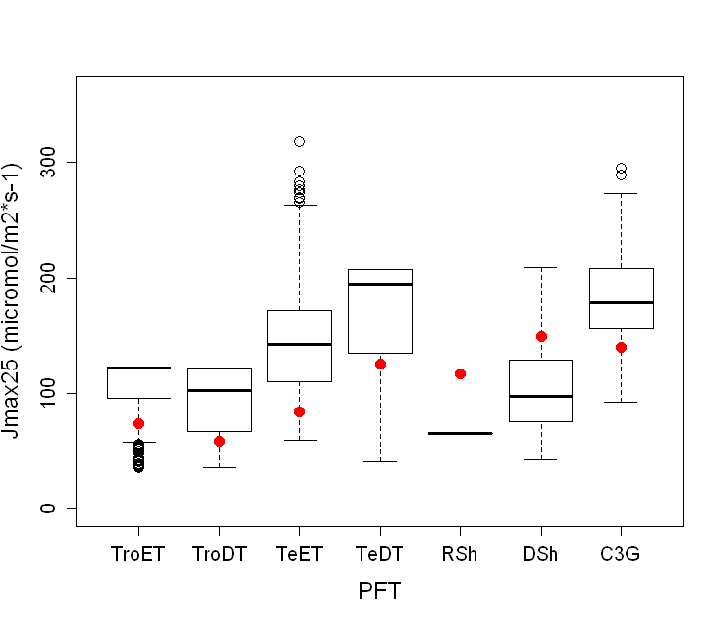
2a. JSBACH-simulated trait variation based on habitat filtering
Red dots: fixed values from default setting
Verheijen et al. 2012 Biogeosci.Disc.

Slide 12
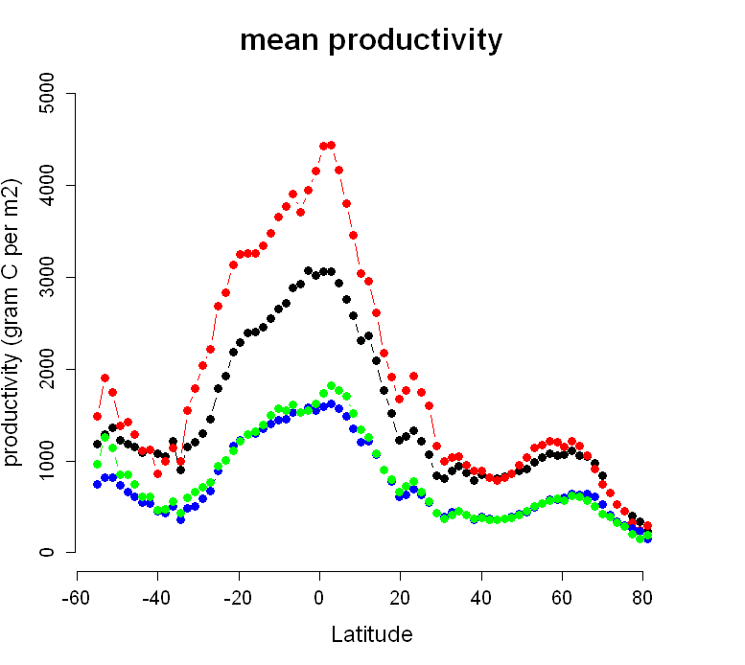
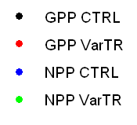
2a. Impacts of JSBACH-simulated trait variation on productivity
Verheijen et al. 2012 Biogeosci.Disc.

Slide 13
2a. Impacts of JSBACH-simulated trait variation on vegetation distribution
default
variable traits

Slide 14
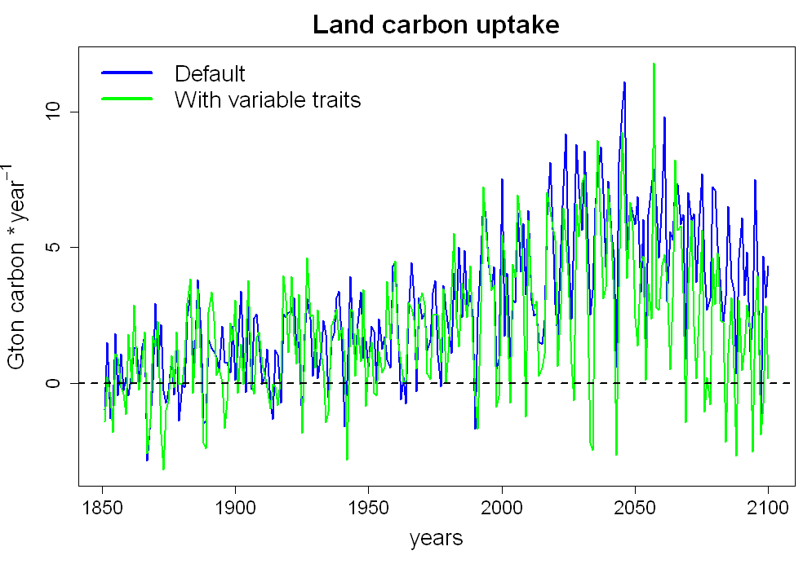
2a. Impacts of JSBACH-simulated trait variation on future carbon sink
Verheijen et al. 2012 in prep.

Slide 15
2b. Incorporation of trait variation based on evolutionary principles
- Forest stand model
- No water limitation
- Maximizing net growth
& reproduction
Van Bodegom & Franklin in prep.

Slide 16
2b. Incorporation of trait variation based on evolutionary principles: on-site evaluation of variable allocation
Fixed allocation
Optimal allocation
Van Bodegom & Franklin in prep.

Slide 17
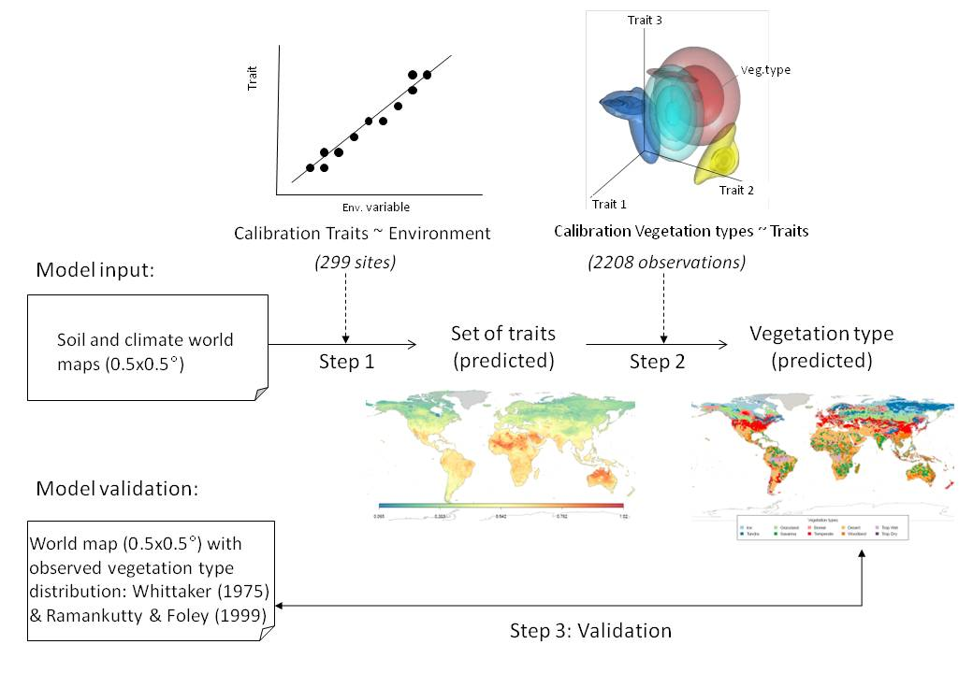
3. A fully traits-based approach: separating trait predictions from vegetation distribution predictions
Douma et al 2012 Ecography
Van Bodegom et al. in revision

Slide 18
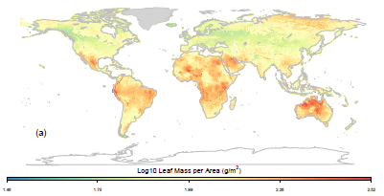
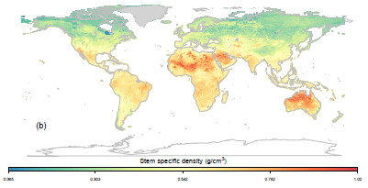
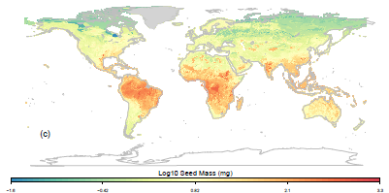
3. Trait predictions based on trait-environment relationships
Van Bodegom et al. in revision

Slide 19
3. Predicting vegetation probabilities from traits: kernel density fitting
SSD
SSD
Biome A
Biome B
Biome C
LMA
LMA
Seed mass
Seed mass
For each position in trait space, multiple plant functional types may in principle be possible.
The probability of each is described by Gaussian kernels
Douma et al 2012 Ecography
Van Bodegom et al. in revision

Slide 20
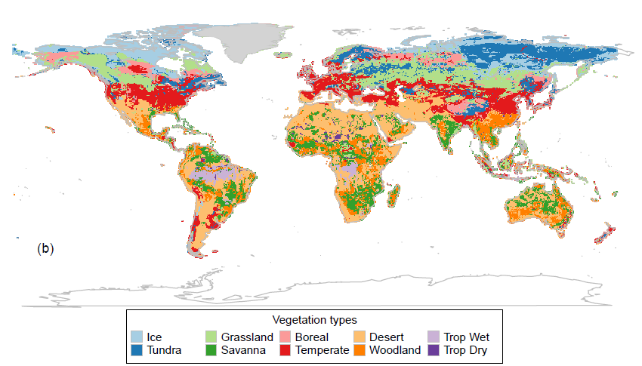
3. Predicting vegetation probabilities from traits: global vegetation distribution
Van Bodegom et al. in revision

Slide 21
Conclusions
Trait responses to climate (manipulations) are
important and strong impact (predictions
of ) vegetation distribution and functioning.
There are multiple ways to continue refining DGVMs.
Exchange of ideas between modellers and
experimentalists will remain essential for more
reliable predictions of our future climate.

Slide 22
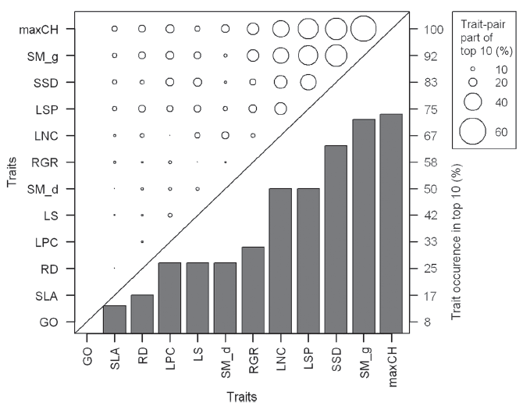
Douma et al 2012b Ecography

Slide 23
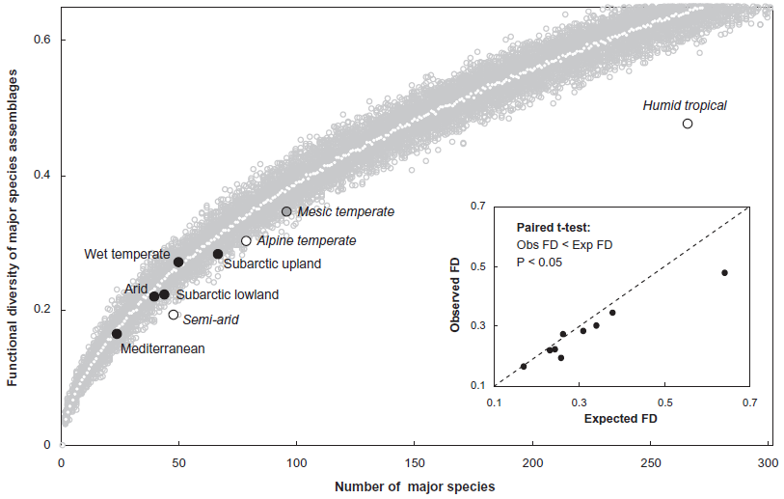

Slide 24
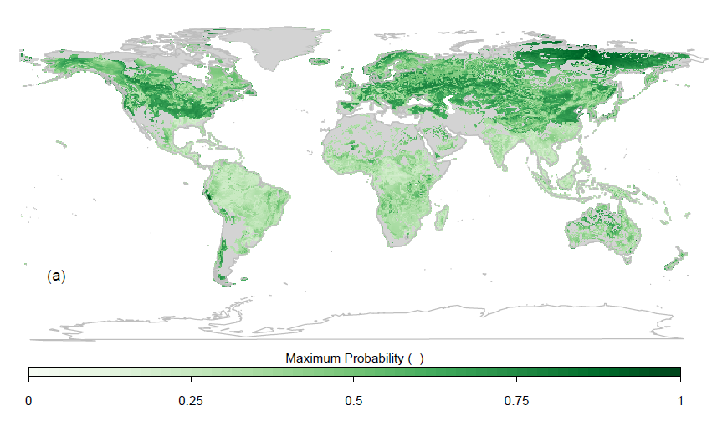

Slide 25
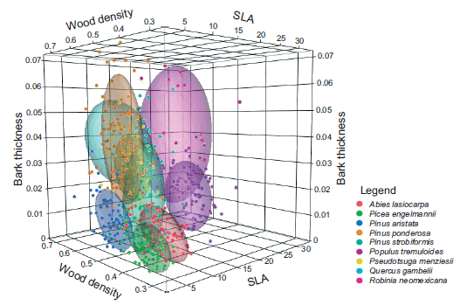

Slide 26
