Slide 1
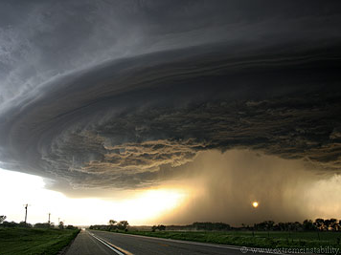

Conceptual understanding of the ecological consequences of climate extremes and extreme climatic events
Melinda D. Smith
Department of Biology
Graduate Degree Program in Ecology
Colorado State University
CLIMMANI & INTERFACE Workshop, Czech Republic
6 June 2013

Slide 2
Outline
A conceptual framework for climate extremes research in ecology
A case study of the ecological consequences of climate extremes
Future research challenges

Slide 3
Outline
A conceptual framework for climate extremes research
A case study of the ecological consequences of climate extremes
Future research challenges

Slide 4
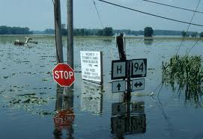
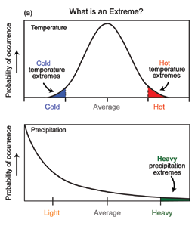
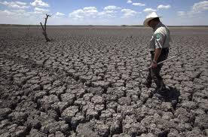
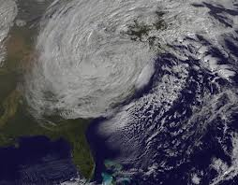
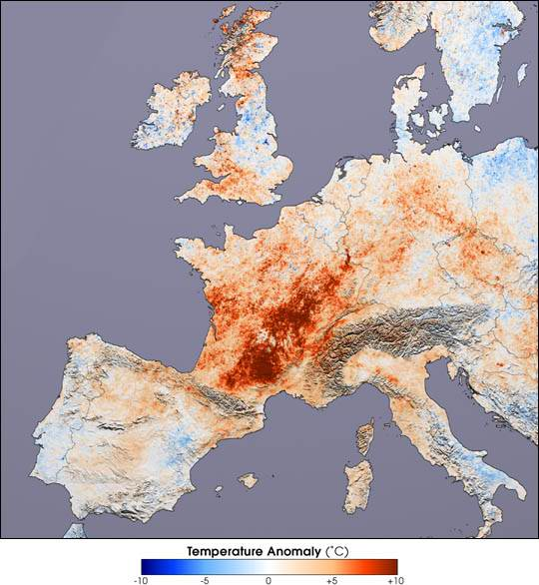

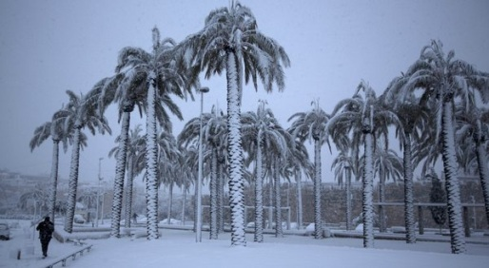
What are climate extremes?
Floods
Drought
Hurricane Sandy
Heat wave
Nemo
A weather or climate event or period that, with respect to the long-term record of climate, is notable, rare, unique, profound or otherwise significant.
Snow in Jerusalem

Slide 5
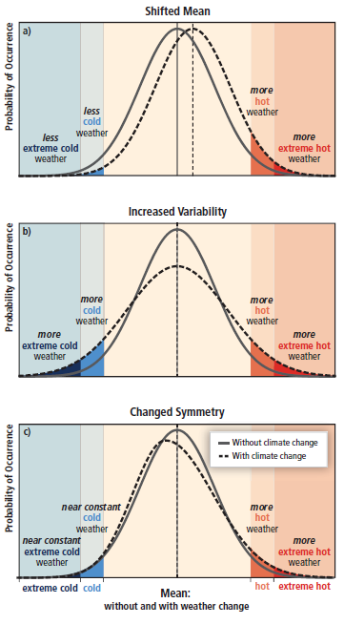
Climate change and climate extremes
With forecast climate changes, there is a high probability of increased frequency and magnitude of climate extremes.
Current
Future
Mean
Mean
Mean
With changes in means, variability and distributions of climate parameters, the expectation is an increase in extreme climate conditions, such as heat waves and drought (IPCC 2012).

Slide 6
Ecological impacts of climate extremes
Naturally-occurring climate extremes are difficult to study due to their unpredictability and rarity
Until recently, most studies have been observational and have focused on those climate extremes that have resulted in large (“extreme”) ecological impacts
Surprisingly, recent experiments often show moderate to little effects of climate extremes, such as drought and heat waves.

Slide 7
Ecological impacts of climate extremes
The variable responses to climate extremes may, in part, be caused by species- or system-specific attributes that make them more or less susceptible to particular climate extremes.
Alternatively, it may be that a climate extreme was actually not imposed on the system.
Both point to the complexity of studying climate extremes, particularly their context-dependence
  With respect to the climate record and what the system has experienced in the past

Slide 8
Climate extremes vs. extreme climatic events
Climate
Response
Current
Future
Climate extreme
‘Extreme’ Response
Climate parameter
Response parameter
Climate extreme – statistically rare or unusual occurrence with respect to the historic distribution of climate parameters of a system (e.g., heat waves, drought)
Extreme ecological response – statistically rare or unusual occurrence with respect to the historic distribution of ecological response(s) of a system
Extreme climatic event
Extreme climatic event (ECE) – an episode or occurrence in which a statistically rare or unusual climatic period alters ecosystem structure and/or function well outside the bounds of what is considered typical or normal variability.
Smith 2011

Slide 9
A framework for identifying extreme climatic events
D. State change
Species loss/
invasion
State change
C. Prolonged recovery
Species
re-ordering
Characteristics of an ECE
Statistically extreme climate conditions leading to…
Ecosystem response outside the bounds of typical variation with the…
Potential for prolonged recovery and/or state change with hysteresis
Ecosystem response (+/-)
Extreme response
threshold
B. Transient impacts with rapid recovery
Individual/
population
Recovery
A. No ecosystem effects
Time
Climate extreme
Smith 2011

Slide 10
Outline
Outline
A framework for climate extremes research
Case study of the ecological impacts of climate extremes
  Climate extreme or extreme climatic event?
Future research challenges

Slide 11
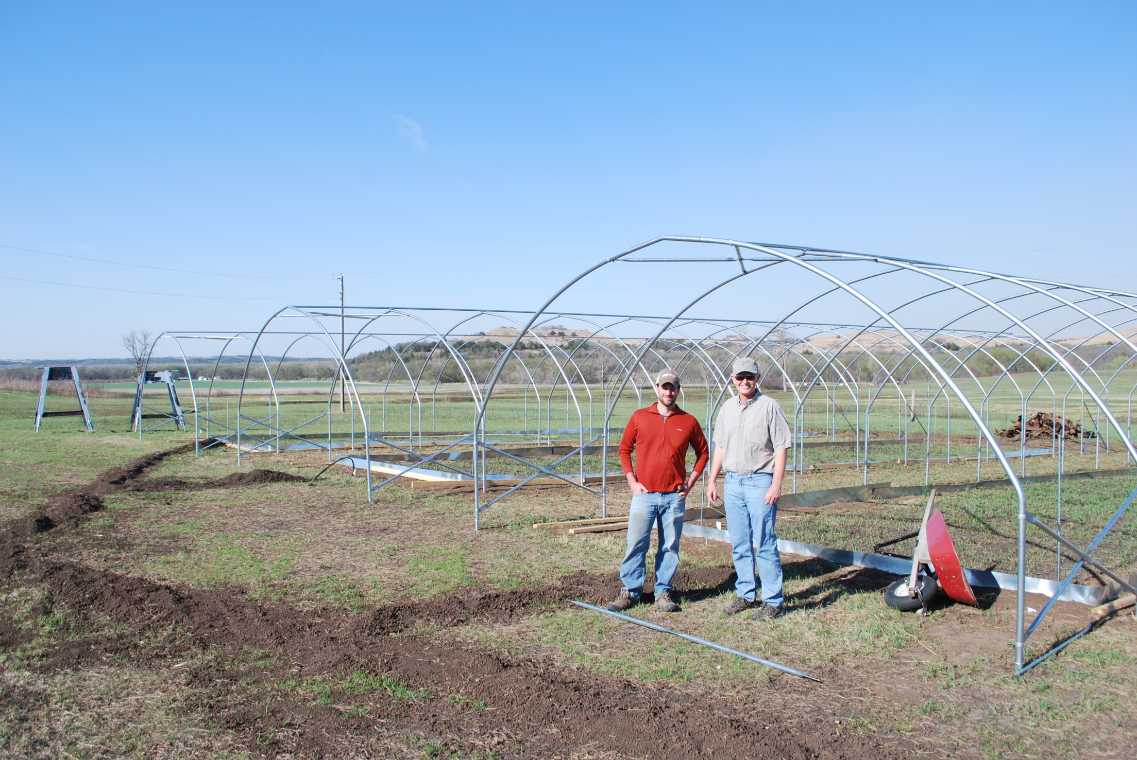
Climate Extremes Experiment (CEE)
Assess impacts of severe drought and heat waves on ecosystem function
Identify potential thresholds of ecosystem response to climate extremes
Dave Hoover
Alan Knapp

Slide 12
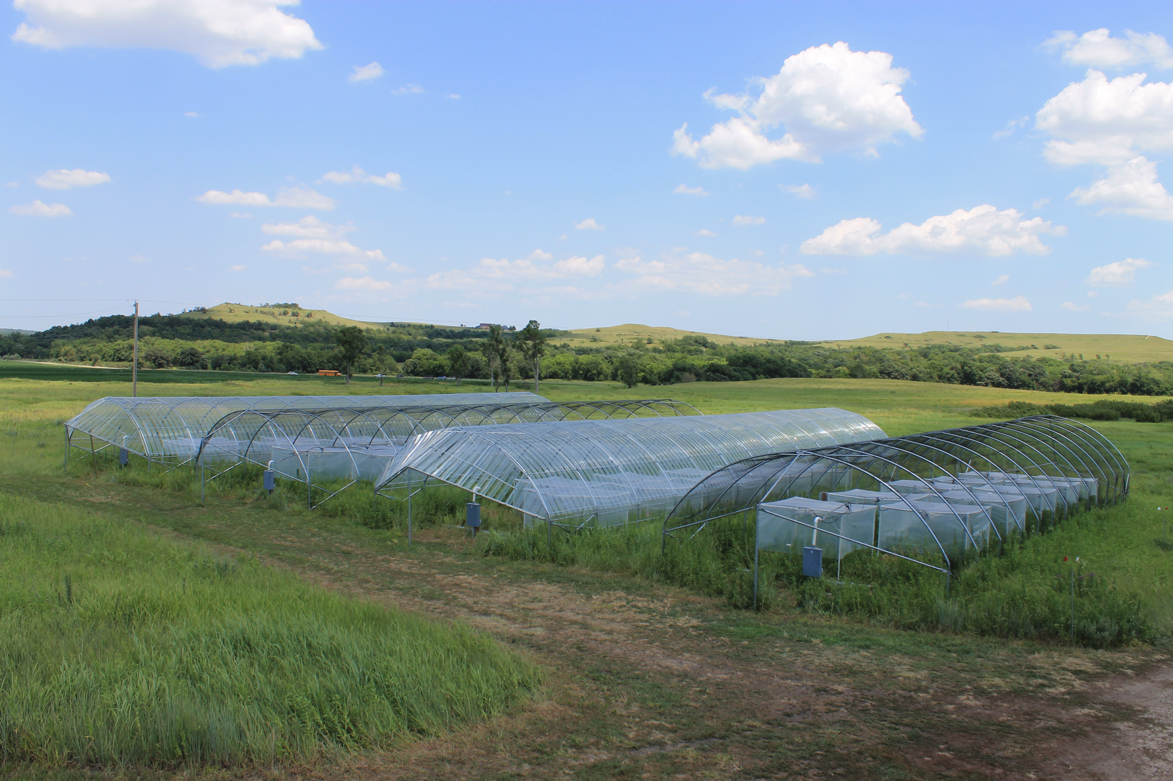
Climate Extremes Experiment (CEE)
Two growing season precipitation treatments: Control and Drought (-66% of ambient)
A two-week heat wave mid-summer at four temperature levels
Annually burned, lowland tallgrass prairie
Relatively deep soils
Co-dominated by Andropogon gerardii and Solidago canadensis

Slide 13
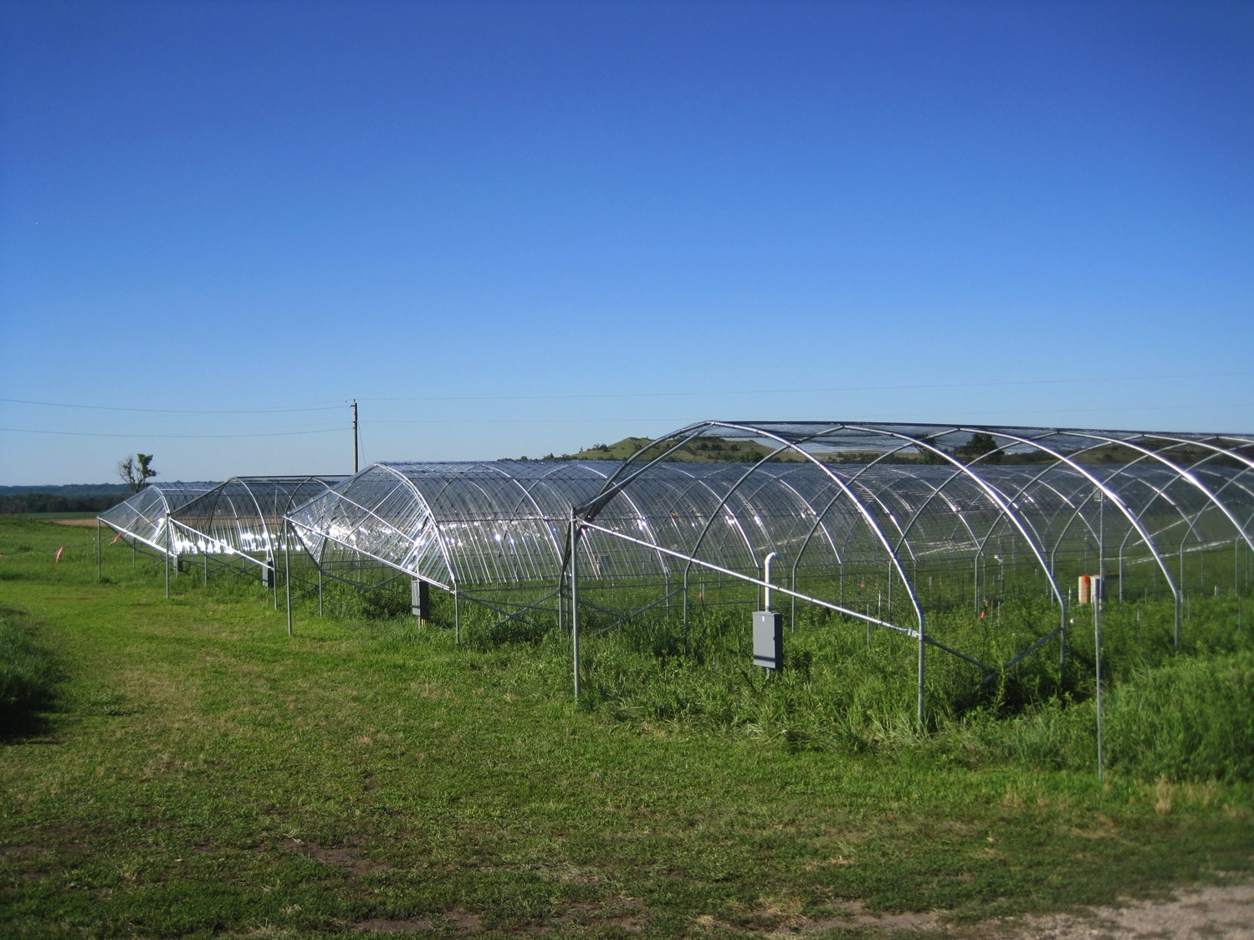
Drought treatment
2010
2011
Heat
wave
Heat
wave
-50%

Slide 14
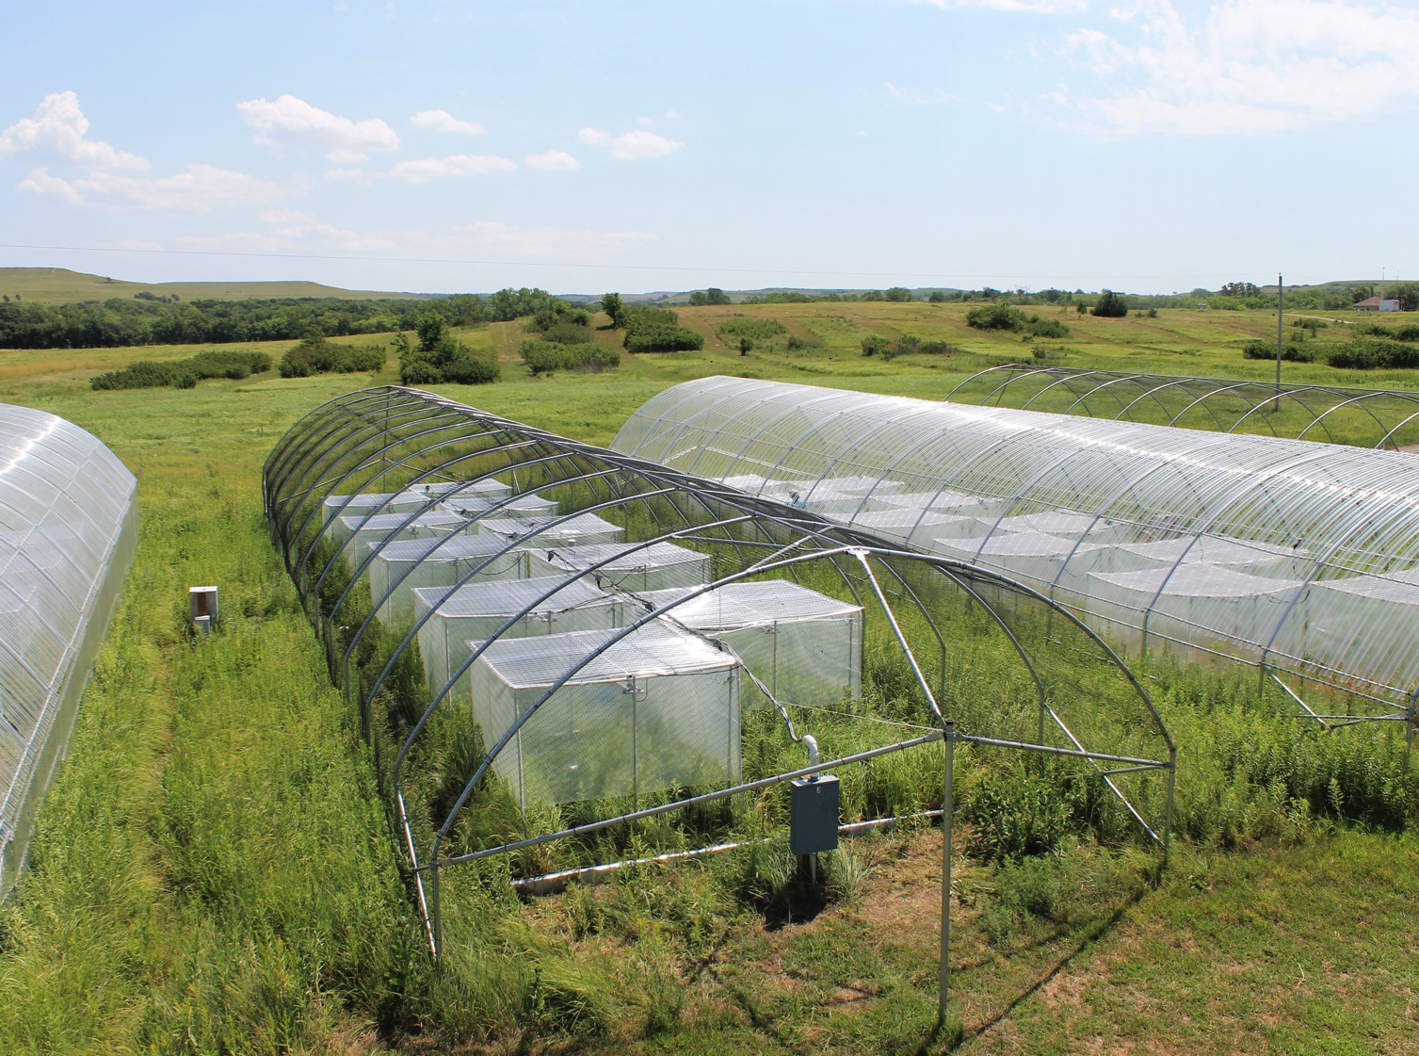
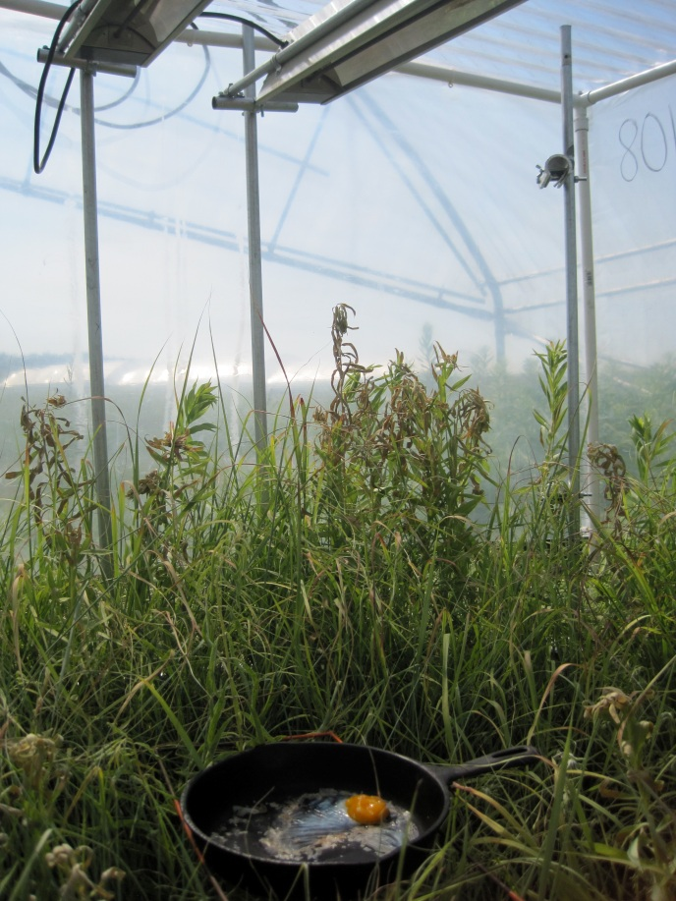
Heat wave treatments
Heat Wave Treatments
2010
2011
+11
+6
+8
+3
+4
+8
+2
+4
+2
State
Record

Slide 15
Ecosystem Responses: ANPP
Ecosystem responses: ANPP
Drought significantly reduced ANPP both years
Surprisingly, heat wave treatments had no significant effects, nor did they interact with drought
*
-20%
*
-59%

Slide 16
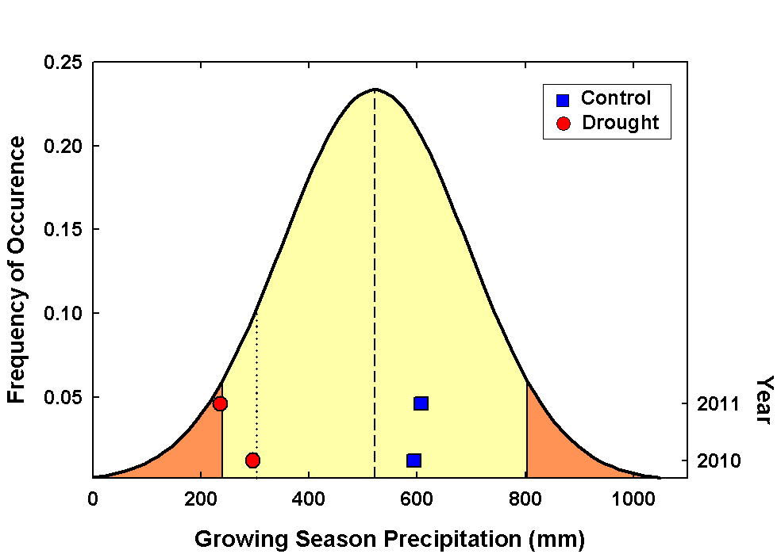
Was the drought extreme?
5%
10%
90%
95%
Growing season precipitation over a 2-year period:
  Driest on record: 561.4 mm (1933-34)
  CEE: 533.4 mm (2010-11)
Yes, growing season precipitation was outside the 10% for 2010 and the 5% for 2011.

Slide 17
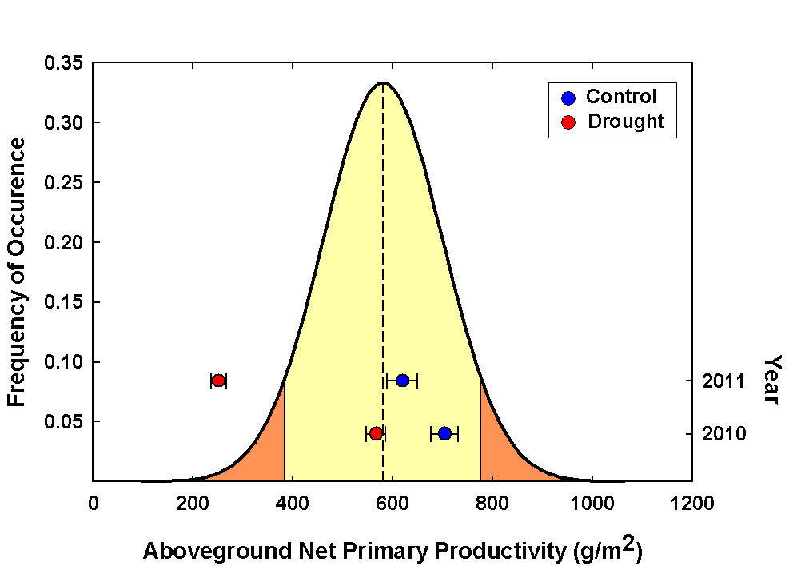
Was the response in ANPP extreme?
Was the response of ANPP extreme?
5%
95%
ANPP was near average in 2010, but was well outside the 5% in 2011.

Slide 18
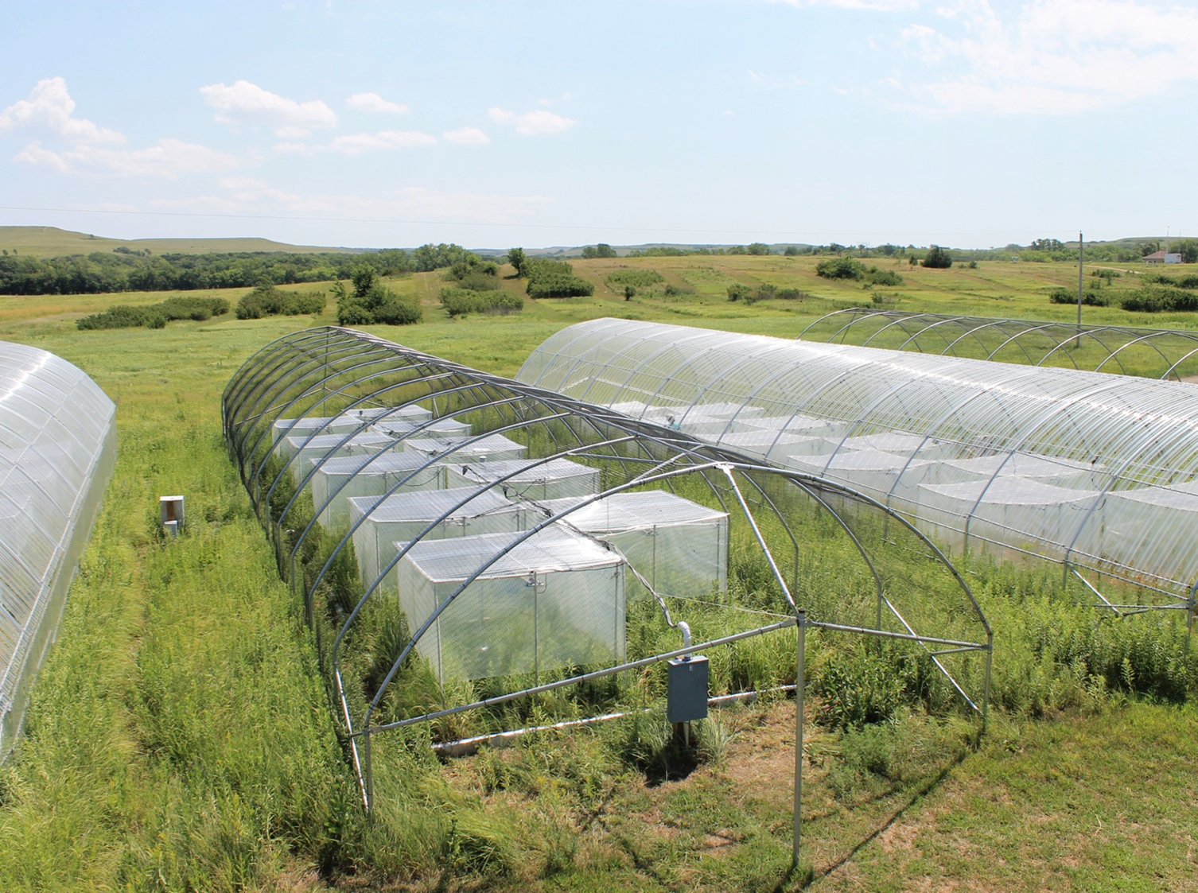
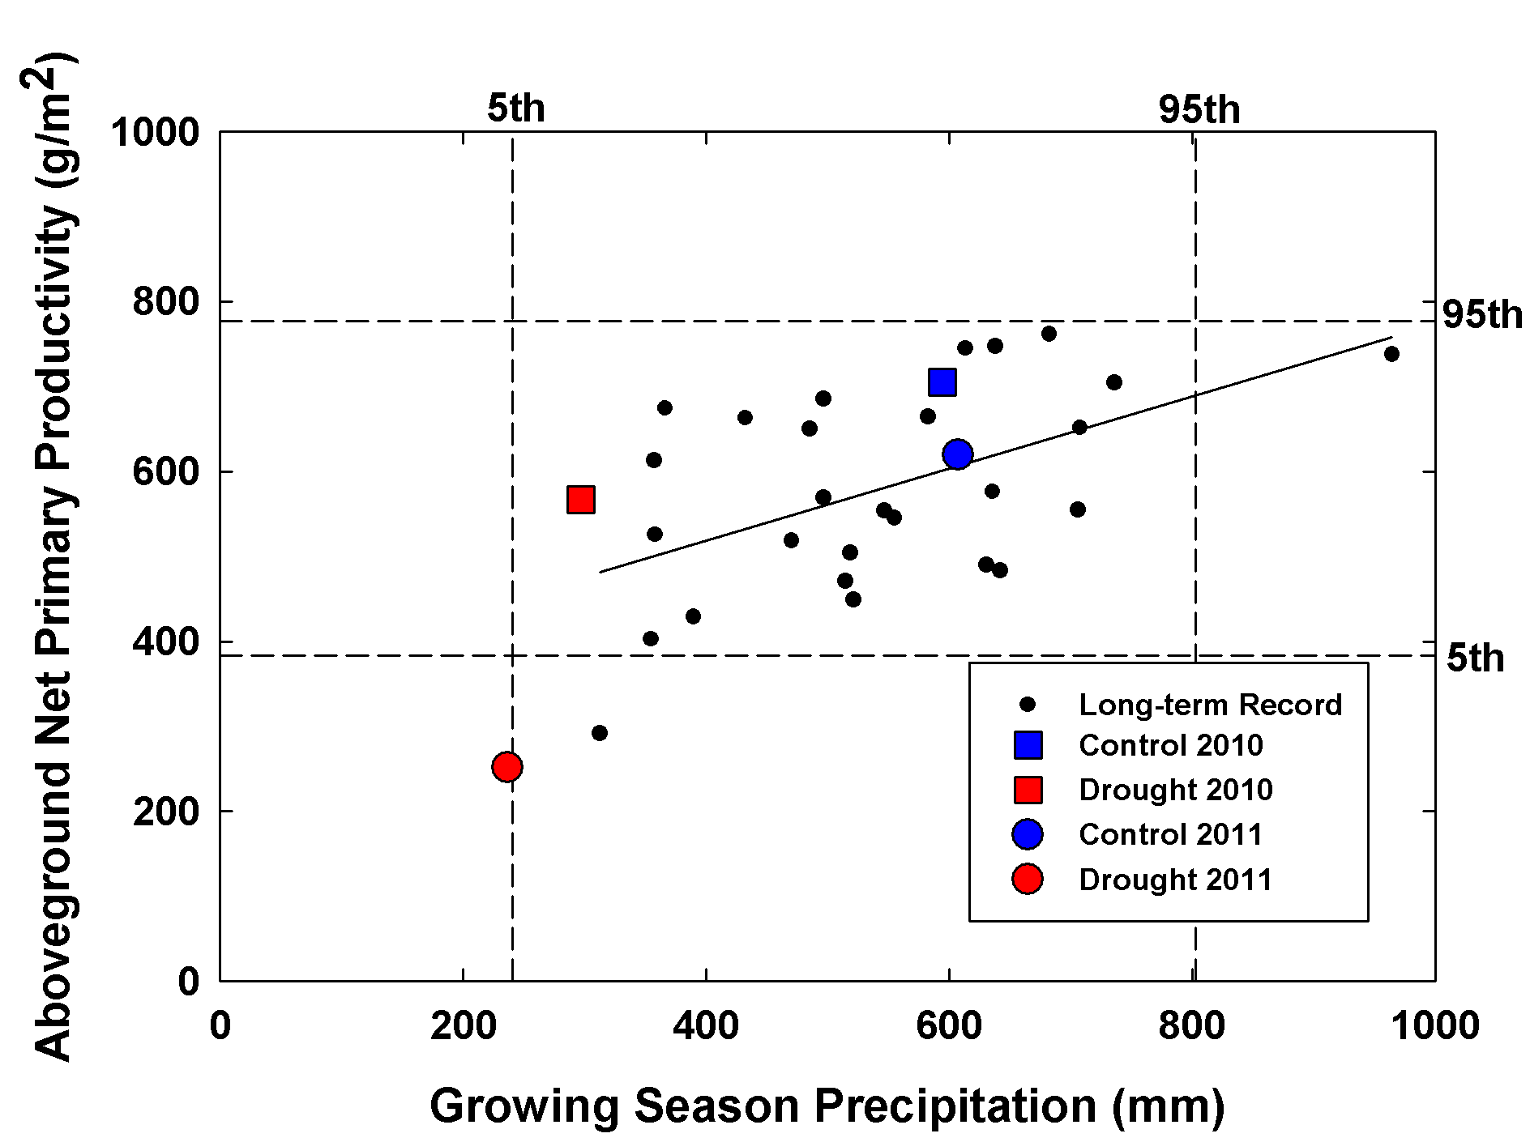
Did we observe an ECE?
Did we observe an extreme climatic event?
Yes, we were able to attribute an extreme ANPP response to a period of climate extremity.

Slide 19
Did we observe an extreme climatic event?
What were the mechanisms underlying the extreme response?
D. State change
Species loss/
invasion
State change
C. Prolonged recovery
Species
re-ordering
Ecosystem response (+/-)
Extreme response
threshold
Individual/
population
B. Transient impacts with rapid recovery
Recovery
A. No ecosystem effects
Time
Climate extreme

Slide 20
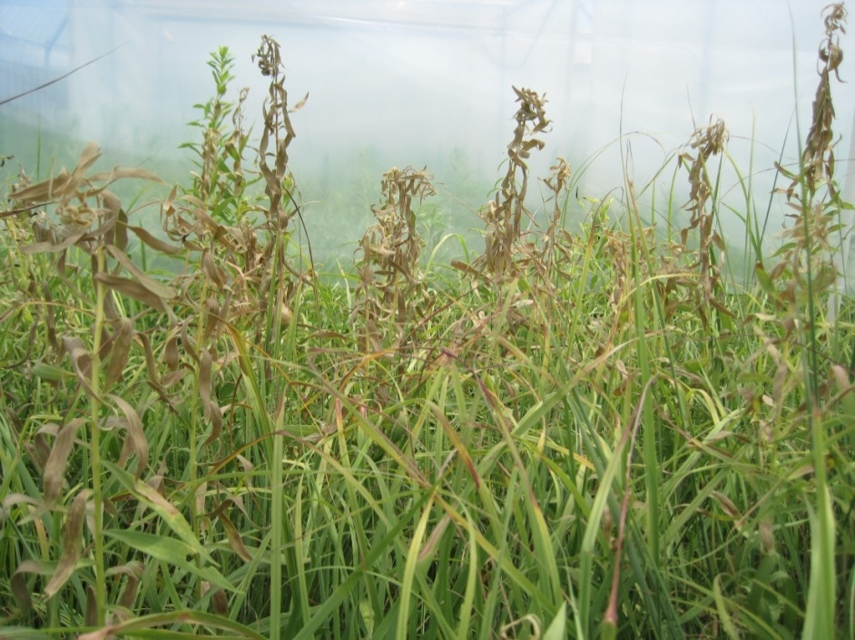
Response mechanisms
Did ANPP recover after drought?
*
-45%
-20%
*
-54%
-59%
-76%
Solidago canadensis

Slide 21
Did we observe an extreme climatic event?
What happened after the severe drought?
D. State change
Species loss/
invasion
State change
C. Prolonged recovery
Species
re-ordering
Ecosystem response (+/-)
Extreme response
threshold
Individual/
population
B. Transient impacts with rapid recovery
Recovery
A. No ecosystem effects
Time
Climate extreme

Slide 22
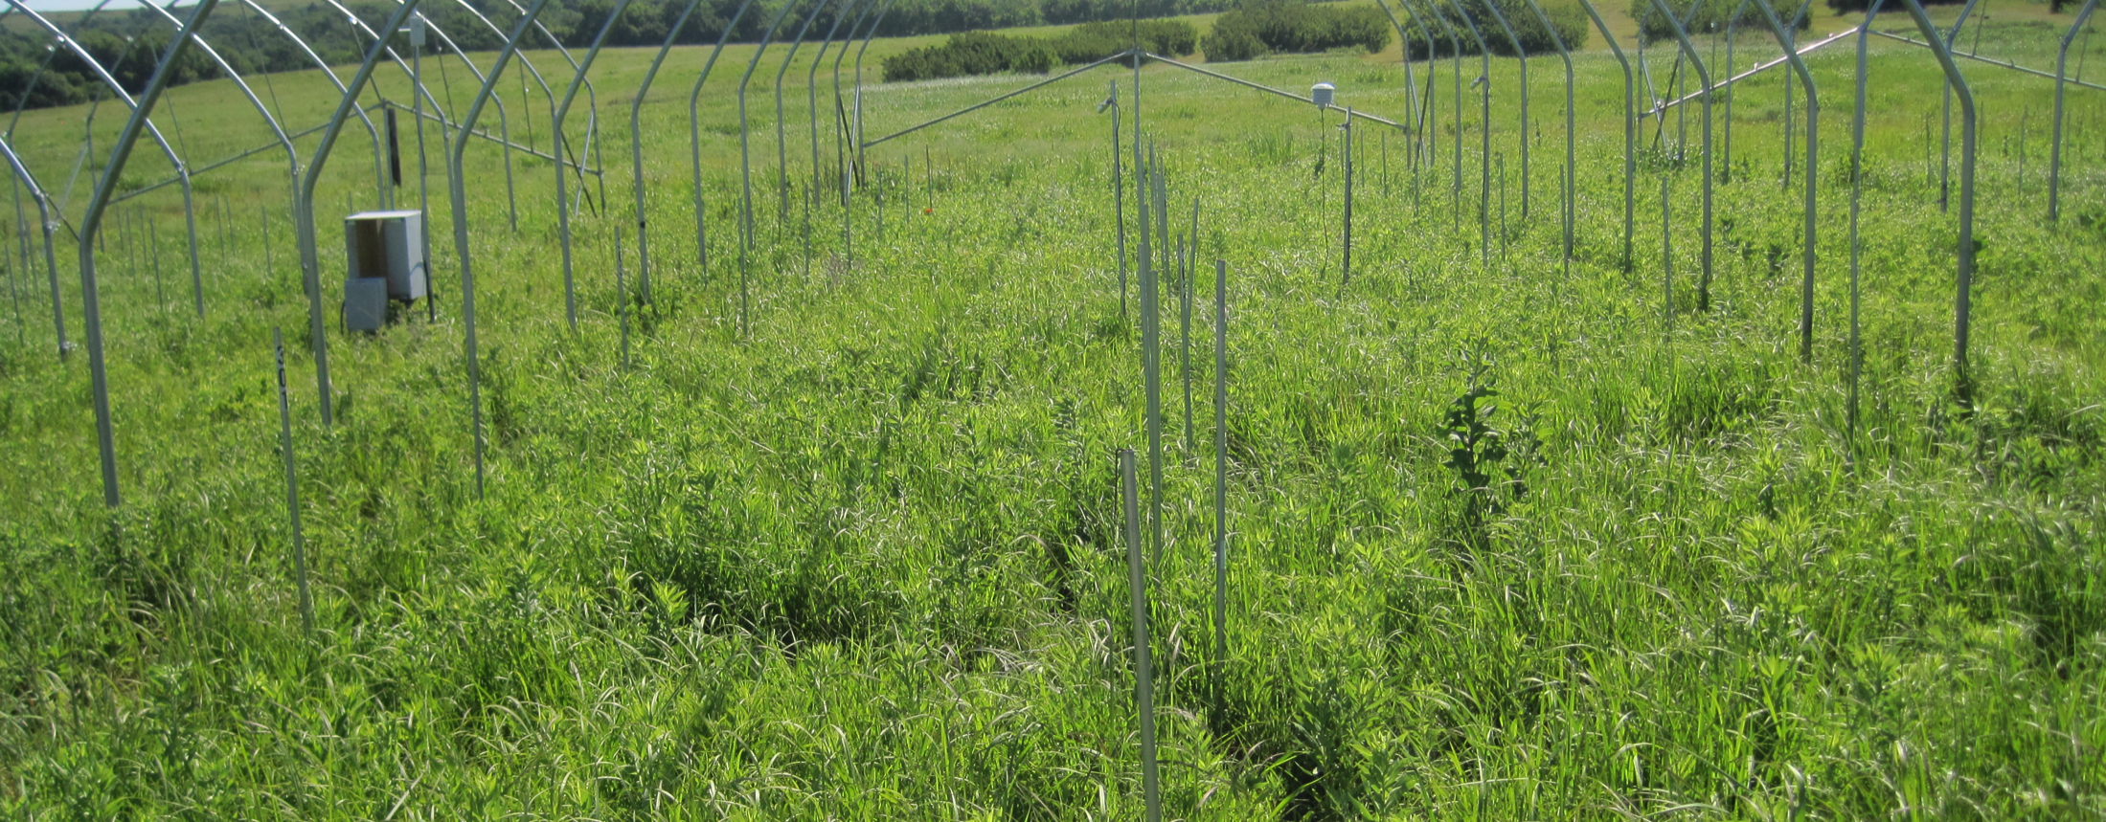
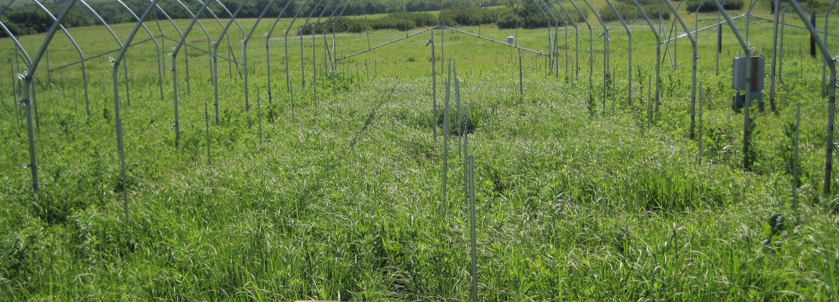
Did ecosystem recovery occur?
Did ANPP recover after drought?
What led to complete recovery?
*
*
Ambient
Drought

Slide 23
Rapid demographic response drove recovery
Did ANPP recover after drought?
+46%
+38%
Ambient
-73%
-80%
Drought

Slide 24
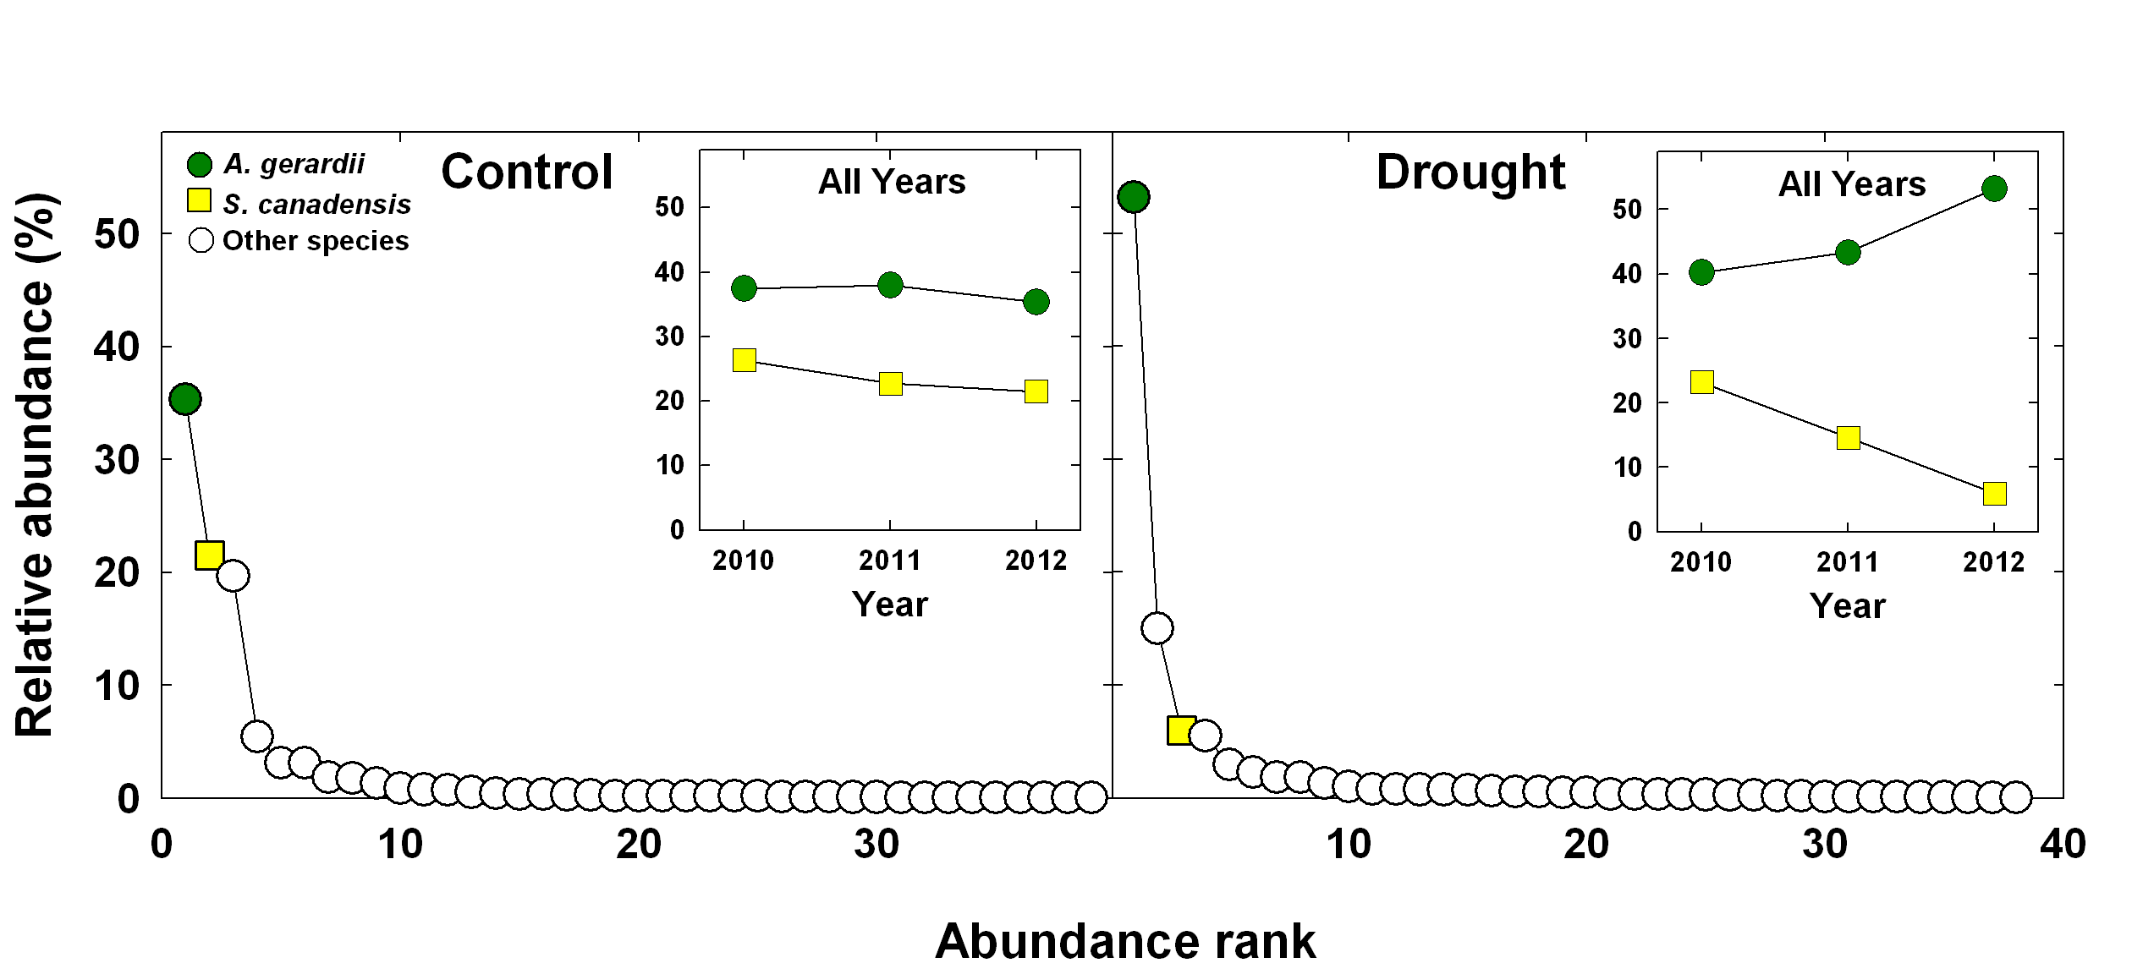
Evidence for species re-ordering
Did ANPP recover after drought?
After 2 years of drought, large shift in abundance of the co-dominants.
Ambient
Drought

Slide 25
Did we observe an extreme climatic event?
We did observe an ECE but…
D. State change
Species loss/
invasion
?
C. Prolonged recovery
Species
re-ordering
Ecosystem response (+/-)
Extreme response
threshold
B. Transient impacts with rapid recovery
Individual/
population
Recovery
A. No ecosystem effects
Time
Climate extreme
Notes:
Its not what is taken out but left behind

Slide 26
Outline
Outline
A framework for climate extremes research
Case study of the ecological impacts of climate extremes
  Climate extreme or extreme climatic event?
Future research challenges

Slide 27
Often we do not have the historic context to assess ecological extremity…
Need experiments that can assess ecological thresholds heuristically
  Regression rather ANOVA approaches
  E.g., Include a broad range of drought levels (moderate to extreme from a statistical perspective)
Need to be able to assess recovery dynamics over the long-term
  Difficult to identify mechanisms without assessing both response and recovery dynamics

Slide 28
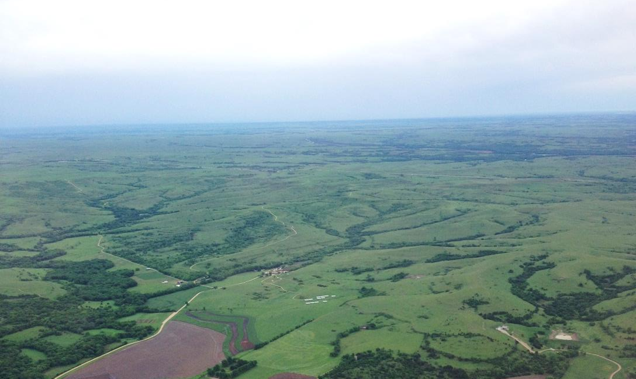
How do we make small-scale experiments relevant for large-scale models?
Are ecological responses similar or different within and between biome types?
Are the mechanisms driving responses similar or different?
Meta-analyses can assess generality in responses but are limited in their ability to elucidate mechanisms.
Coordinated experiments can assess generality in responses and mechanisms.

Slide 29
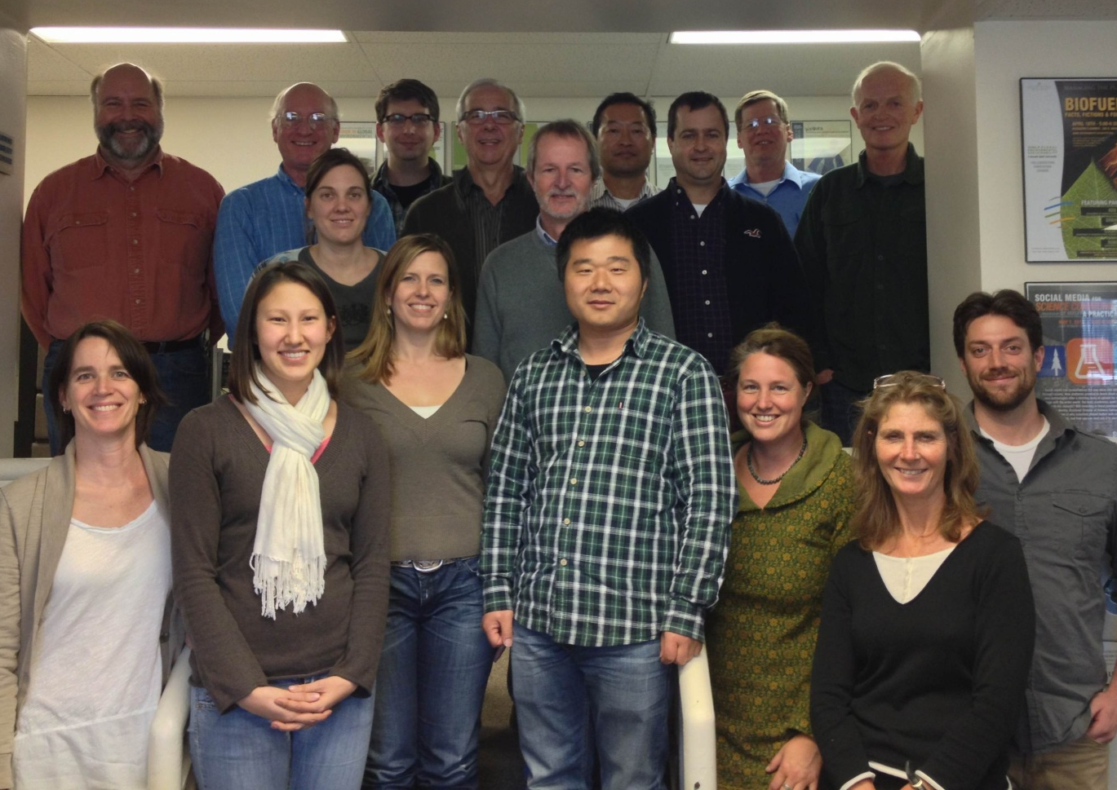
Ecosystem Sensitivity to Rainfall Experiment (EcoSeRE)
What are the mechanisms of differential sensitivity of terrestrial ecosystems to severe drought?
The Nutrient Network
Distributed, highly coordinated network capturing a broad range of ecosystem types
Core treatment: 67% reduction in annual rainfall using passive rainfall shelters
Minimum of three years duration for the drought, with one year of pre-treatment data collection

