Slide 1
Soil-mediated effects of a CO₂ gradient on grassland productivity: Interactions with resources and species change.
Philip A. Fay
USDA-ARS Grassland, Soil, and Water Lab
Temple, Texas U.S.A.
Collaborators:
Wayne Polley (USDA-ARS)
Virginia Jin (USDA-ARS)
Robert Jackson (Duke University)
Richard Gill (Brigham Young University)
Jack Morgan (USDA_ARS)
Beth Newingham (University of Idaho)
Notes:
Good afternoon
I’d like to thank the organizers for the opportunity to participate in this workshop.
In my talk I’d like to review our work on a CO2 concentration gradient in a mesic grassland.
Our findings illustrate some potential ways that soils may create spatial variability in the trajectory of grassland responses to CO₂ enrichment.
I’ll compare our findings with those of CO₂ experiments from more arid systems to examine how these trajectorys and their drivers may vary on larger climatic gradients
I hope you’ll find this study to illustrate some sources of spatial variability we might observe in CO2 effects in this ecosystem.
----------------------------------------

Slide 2
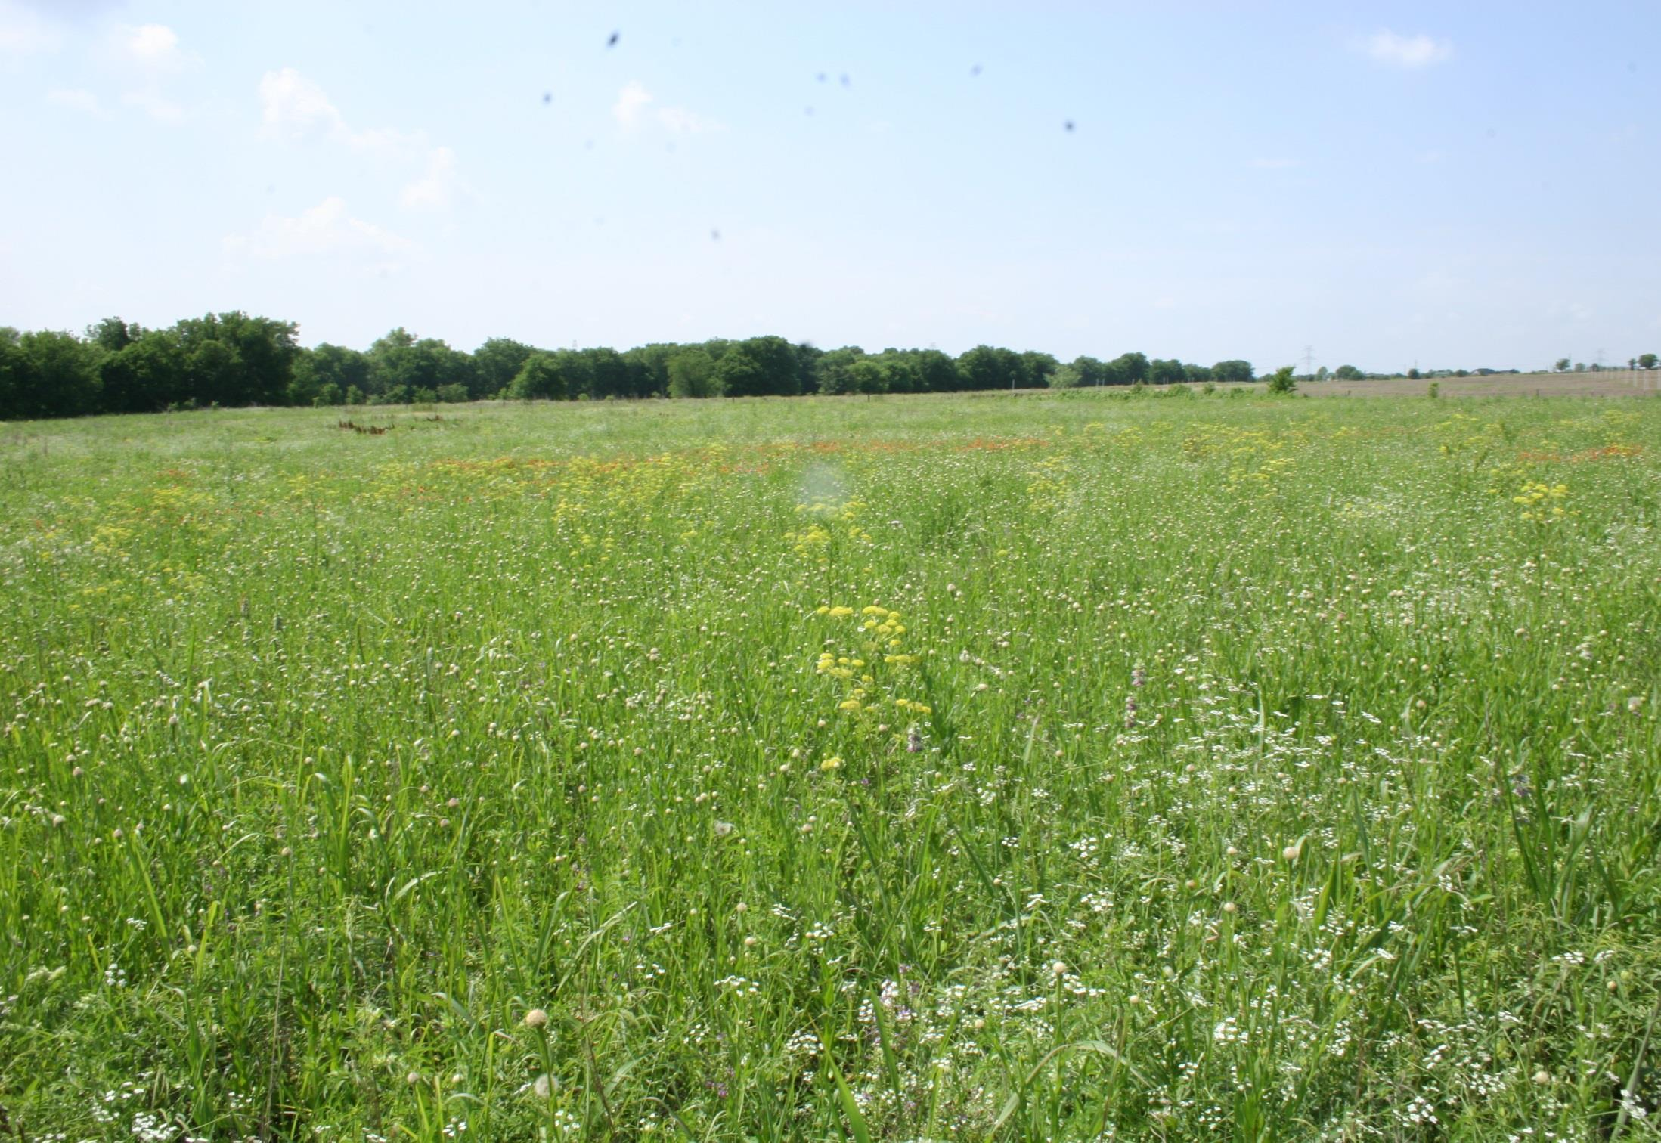
Controls on ecosystem responses to CO₂
CO₂
Ecosystem Function
Species change
Resources
Notes:
We all recognize that are multiple interacting factors that can influence the trajectory of ecosystem responses to CO₂.
We have plenty of theory and field evidence now for nutrients and water as mediators of CO2 effects on ecosystems, and for the culmination of resource changes into species changes that can ultimately affect ecosystem processes.

Slide 3

Which? Where? When?
Which resources (nutrients/water)?
Which species?
Where are each of these more/less important?
When do they become important ?
Sources of spatial variability:
Soils Climate
CO₂
Ecosystem Function
Species change
Resources
Notes:
Many questions remain.
We might boil these down to: Which, When, and Where.
Which resources?
Which species?
Where and when do species/resources become important to the CO2 response.
To approach these questions I’ll focus on two among many possible gradients:

Slide 4
Working model
Mesic
Aridity
Xeric
Fine
Soils
Coarse
CO₂
Water
Physiology
Species
ANPP
Nutrients
Notes:
To do this, I’m going nto us ethis simple conceptual model,
Where we can think of CO2 directly altering ecosystem function such as ANPP, as a consequence of basic plant physiological responses
And we can also think of those physiological responses altering resources and species, which in turn alter ecosystem function.
And I want to consider how these various intereactions are altered as move along grandients in soils, say from fine textured to coarse textured, holding climate constant
And how these interactions are altered as we move from more mesic to more xeric ecosystems.

Slide 5
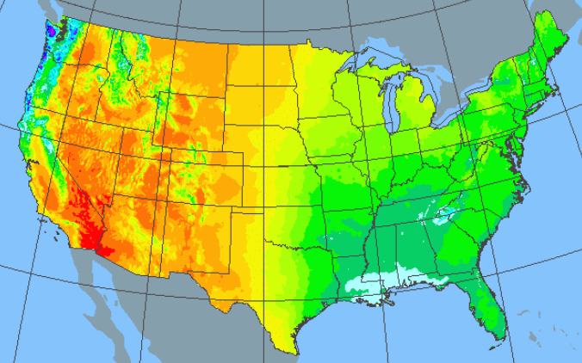
Experiments
Mojave Desert
MAP: 135 mm y⁻¹
Semi-arid Grassland
MAP: 400 mm y⁻¹
Mesic Grassland
MAP: 850 mm y⁻¹
Notes:
To do that, I’ll consider three CO2 experiments in the U.S., differing widely in rainfall and aridity:
Tallgrass prairie in Texas, the wettest of the three experiments at 850 mm per year, and exposed for five years to CO2 enrichment.
Second, in semi arid mixed-grass prairie in southeastern Wyoming receiving about 400 mm per year precipitation, also treated for five years to CO2 enrichment.
Third, in the Mojave desert in southern Nevada, the driest ecosystem in North America at 135 mm per year rainfall, and exposed for 11 years to CO2.

Slide 6
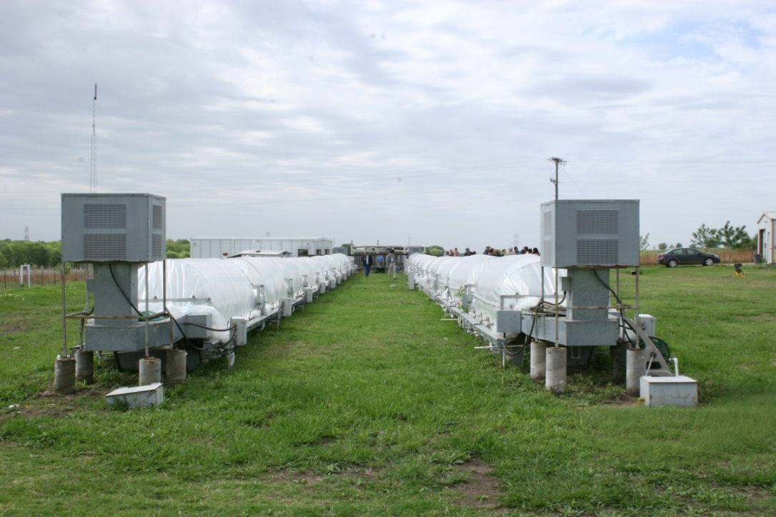
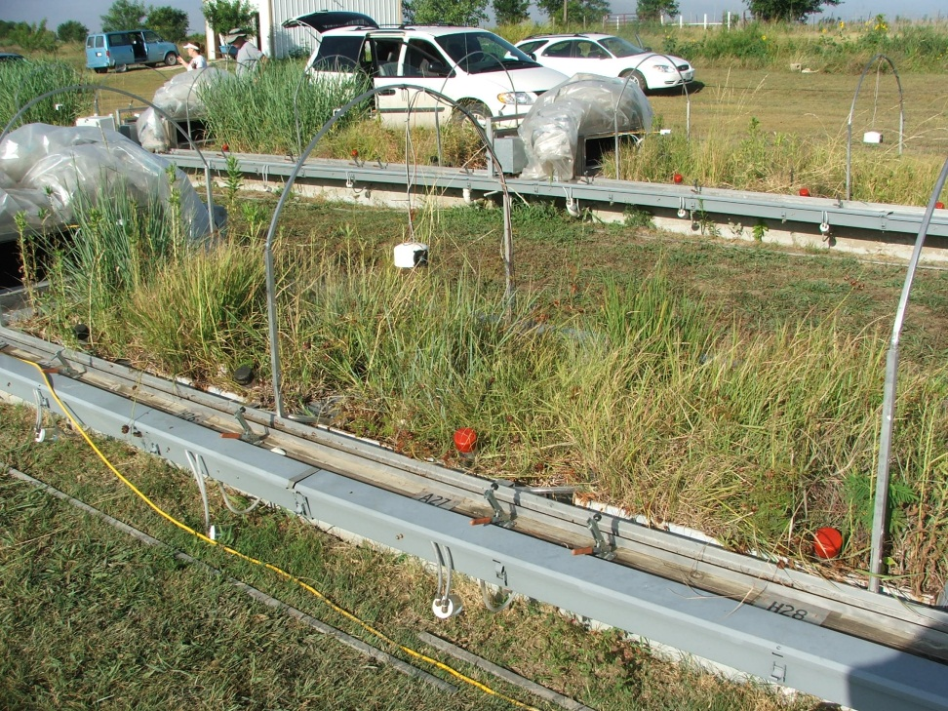
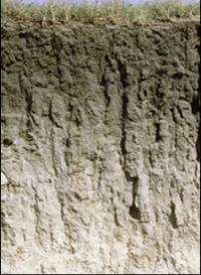
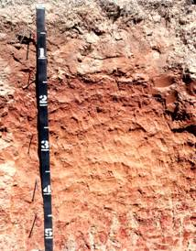
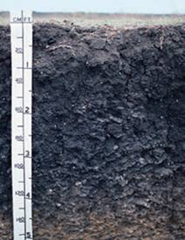
Mesic grassland
CO₂ gradient since 2006
  250 to 500 µL L⁻¹
Ambient temperature, average precipitation
C₄ vegetation
3 soil types, 20 reps
Silty clay
Sandy loam
Clay
Fay et al. 2009 Ecosystems
Mollisol
Alfisol
Vertisol
Notes:
This is the CO2 experiment that I work on together with my colleague Wayne Polley.
Maintain a continuous subambient to enriched CO2 gradient on experimental prairie communities planted on intact hydrologically isolated soil monoliths of three soils
A mixture of C4 grasses and forbs

Slide 7
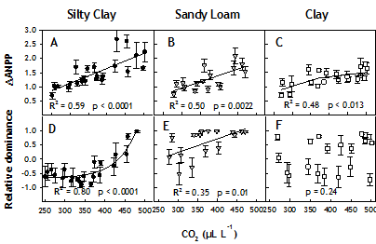
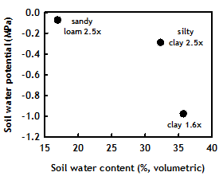
Mesic grassland
Strongest CO₂ effect on soils where:
  High plant availability of soil moisture
  Increased soil water content with CO₂ (not shown)
  A more productive grass became dominant.
Which resource? Water
Fay et al. 2012,
Nature-Climate Change
Notes:
ANPP (here corrected for pre-CO2 productivity) increased strongly with CO2 on the silty clay and sandy loam, soils, which were the more coarse-textured, and had high soil water potential. The response was attenuated on fine-textured clay, which had high soil water content but relatively lower soil water potential.
At the same time, on the two more responsive soils there was a major switch in grass dominance, with a more productive tallgrass assuming dominance at high CO2, and a more drought adapted midgrass assuming dominance at depleted CO2. This species switch did not occur on the clay soil.

Slide 8
Mesic grassland
Fine
Soils
Coarse
Clay
Silty Clay
Sandy Loam
CO₂
Soil water
CO₂
Soil water
CO₂
Soil water
Physiology
Species
ANPP
Physiology
Species
ANPP
Physiology
Species
ANPP
Nitrogen
Nitrogen
Nitrogen
Greater ANPP-CO₂ response when direct + indirect effects present.
More CO₂ effects present on coarser-textured soils.
Fay et al. 2012,
Nature-Climate Change
Notes:
We used a structural equation modeling approach to ascertain the causal relationships among CO2, soil moisture, species change and ANPP. We also considered soil N in our study.
The models showed that one the two more responsive soils, a direct Co2 effect was accompanied by a second, indirect effect:
soil water content on the sandy loam, and by change in dominant grass species on the silty clay. In contrast, on the less responsive soil, only the direct effect was found…there were no significant indirect effects of CO2 on ANPP.
So the importance of soil moisture varied among the soils, and was generally higher on the most coarse-textured soil.
What about in the semi-arid grassland?

Slide 9
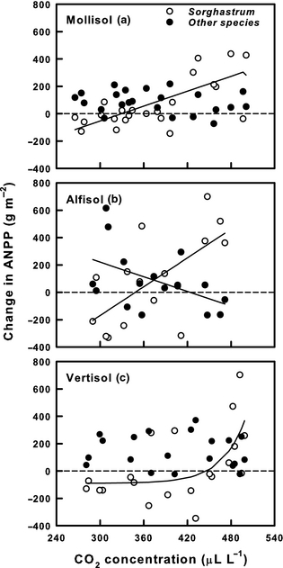
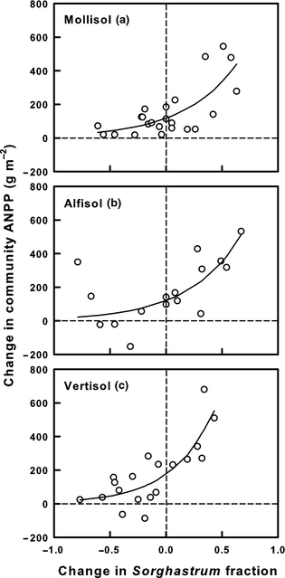
Mesic grassland
Which species?
  Sorghastrum nutans (Indiangrass)
  Explains 45 – 65% of variation in ANPP
Silty Clay
Sandy Loam
Clay
Polley et al. 2012,
Global Change Biol.
Notes:
Lets look in more detail at the species change. This is Wayne Polley’s work. One of the C4 grasses, Sorghastrum nutans, clearly stands out as the major player. On each of the soils, the biomass of Sorghastrum strongly increases with CO₂ concentration, and on the two soils change in ANPP over five years of CO₂ treatment is clearly associated with changes in Sorghastrum. Furthermore, on the two soils where ANPP responded more strongly to CO₂, the Sorghastrum increase is strong and linear, and on the water limited sandy soil other species declined while Sorghastrum increased.
And the change in the abundance of Sorghastrum explains 45 to 65% of the variation in total ANPP.
Relationships between the 5‐year change in ANPP of the dominant grass species
Sorghastrum and of all remaining (other) species in prairie communities combined and CO
₂ concentration for each of three soil types. Change in ANPP was calculated by subtracting the ANPP for the year prior to CO
₂ treatment (2005) from ANPP following year 5 of treatment (2010). Lines are significant linear or exponential regression fits to changes in species ANPP for Mollisol (
Sorghastrum, r
² = 0.45, P = 0.0003, n = 23), Alfisol (
Sorghastrum, r
² = 0.39, P = 0.006; other species, r
² = 0.16, P = 0.07, n = 16), and Vertisol soils, respectively (
Sorghastrum, r
² = 0.29, P = 0.02, n = 20; r
² = 0.17, P = 0.09 following exclusion of a single point for which the change in ANPP > 600 g m⁻²). The regression model with greatest r
² value was selected. The change in combined ANPP of species other than
Sorghastrum was not related to CO
₂ for the Mollisol (P = 0.29) or Vertisol soils (P = 0.72), consequently no lines are shown.
© This slide is made available for non-commercial use only. Please note that permission may be required for re-use of images in which the copyright is owned by a third party.

Slide 10
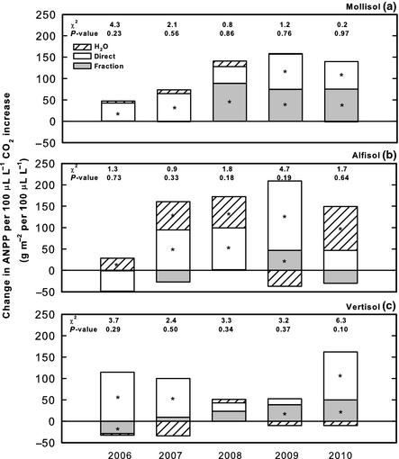
Mesic grassland
When?
Silty Clay
Soil water
Species
Sandy Loam
Clay
Polley et al. 2012,
Global Change Biol.
Notes:
Wayne then went on to use structural equation modeling to partition the contributions to the ANPP response to CO2 into Direct CO2 effects, indirect effects mediated by water, and indirect effects mediated by the change in Sorghastrum .
The Sorghastrum fraction grew to be an important contributor to the CO2 ANPP response over the first five years of treatment, especially on the two clay soils, while on the sandy soil water was the dominant.
Suggesting there will be considerable spatial variation in the controls on ANPP response to CO2 on a spatial scale corresponding to variation in soil series. Similar degrees of soil variation can be found on a scale of a few hundred meters or less.
Direct and indirect components of the CO
₂ effect on ANPP of prairie communities that were grown on each of three soil types for 5 years. CO
₂ effects were partitioned using SEM (Table S1, Fig. S1). Indirect effects of CO
₂ on ANPP were mediated through changes in soil water content (H₂O) and the fractional contribution of the dominant C₄ grass species
Sorghastrum to community productivity (fraction). Values for each effect were calculated using unstandardized path coefficients and are expressed as the change in ANPP (g m⁻²) per 100 μL L⁻¹ increase in CO
₂ concentration. Significant effects are denoted with an asterisk. An indirect effect was considered significant if coefficients for one or more pathways linking CO
₂ to ANPP were significant. The overall effect of CO
₂ on ANPP as mediated by species change, for example, represents the sum of the effects derived from paths linking CO
₂ to ANPP through the
Sorghastrum fraction. Chi‐square (χ²) and P‐values for the full SEM model are listed. The full model is considered to be consistent with data when the P‐value of the chi‐squared statistic is >0.05. The df = 3 for all soils except the Alfisol in 2007–2008 for which a simplified version of the SEM was required (df = 1).
© This slide is made available for non-commercial use only. Please note that permission may be required for re-use of images in which the copyright is owned by a third party.

Slide 11
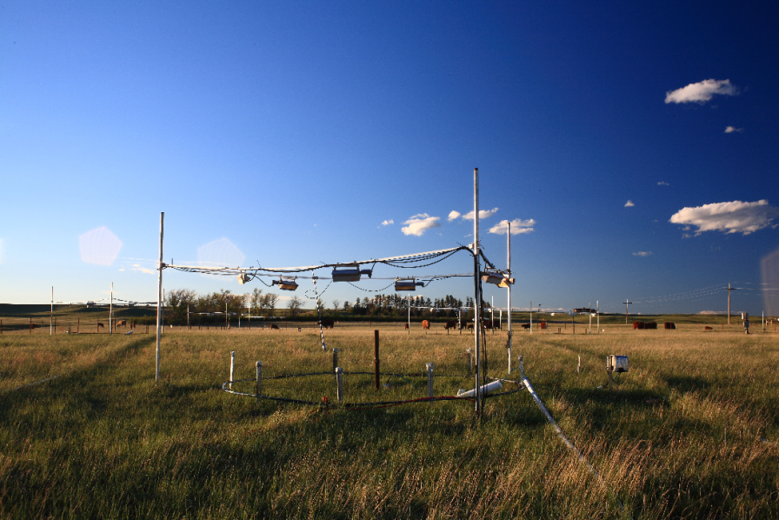
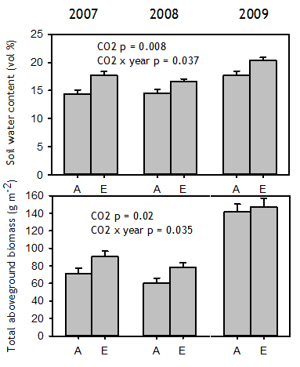
Semi-arid grassland
Mixed-grass prairie: 400 mm yr⁻¹ MAP
C₃ dominated, 600 ppm CO₂ treatment
CO₂ enrichment: increased: photosynthesis, soil moisture and aboveground biomass.
No change in plant N or community composition
CO₂
Soil Water
Physiology
Species
ANPP
Nitrogen
Morgan et al. 2011,
J. Morgan pers. Comm.
Notes:
Let’s briefly consider a couple of additional systems where CO2 experiments have been conducted. These are some data from the Prairie Heating and CO2 experiment that were kindly provided by Jack Morgan. This is a mid-grass prairie, drier than the tallgrass prairie at about 400 mm yr_1 rainfall.
Here, over three years of CO2 manipulation, elevated CO₂ increased both soil moisture and total ANPP, and so far they see no change in plantN, or in community composition, suggesting that, at least so far, nutrient limitation or species change have not been big factors in the overall CO2 response. (confirming this with Jack).
Here are data from the PHACE experiment from 2007 – 2009.
Elevated CO2 significantly increased soil moisture and total aboveground biomass overall, with total biomass more responsive in the drier years.
There was also a trend (p = 0.06) toward an increase in biomass of C3 grasses averaged over all years, all though no significant CO2 effects on other components of the plant community.
In addition, there is evidence for a CO2 effect on root biomass.
So in this semi-arid mixed grass prairie, the evidence suggests a role for both CO2 (direct) effects and indirect effects mediated by soil moisture. Morgan et al. Nature 2011.

Slide 12
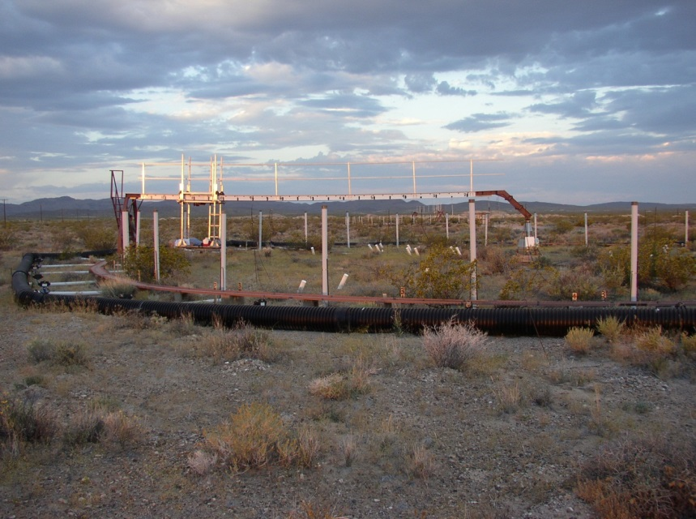
More xeric systems
Mojave Desert: 135 mm yr⁻¹ MAP
550 ppm CO₂ enrichment (FACE):
  Increased photosynthesis (wet years)
  Increased LAI
  No effect on soil moisture, total aboveground biomass, or species biomass or cover.
Treatment = 0.81
Species < 0.0001
Treatment x Species = 0.84
CO₂
Soil Water
Physiology
Species
ANPP
Nitrogen
Nowak et al. 2004
Newingham et al. 2012.
Notes:
Let’s briefly consider a couple of additional systems where CO2 experiments have been conducted. These are some data from the Prairie Heating and CO2 experiment that were kindly provided by Jack Morgan. This is a mid-grass prairie, drier than the tallgrass prairie at about 400 mm yr_1 rainfall.
Here, over three years of CO2 manipulation, elevated CO₂ increased both soil moisture and total ANPP, and so far they see no change in plantN, or in community composition, suggesting that, at least so far, nutrient limitation or species change have not been big factors in the overall CO2 response. (confirming this with Jack).
Here are data from the PHACE experiment from 2007 – 2009.
Elevated CO2 significantly increased soil moisture and total aboveground biomass overall, with total biomass more responsive in the drier years.
There was also a trend (p = 0.06) toward an increase in biomass of C3 grasses averaged over all years, all though no significant CO2 effects on other components of the plant community.
In addition, there is evidence for a CO2 effect on root biomass.
So in this semi-arid mixed grass prairie, the evidence suggests a role for both CO2 (direct) effects and indirect effects mediated by soil moisture. Morgan et al. Nature 2011.

Slide 13
Summary
Soils
Fine
Coarse
Clay
Silty Clay
CO₂
Sandy Loam
CO₂
Soil water
Soil water
CO₂
Soil water
Physiology
Species
ANPP
Physiology
Species
ANPP
Physiology
Species
ANPP
Nitrogen
Nitrogen
Nitrogen
Interactions more numerous on coarser soils
Aridity/Precipitation
Mesic
Xeric
Mesic
Grassland
Semi-arid
Grassland
Desert
CO₂
Soil water
CO₂
Soil water
CO₂
Soil water
Physiology
Species
ANPP
Physiology
Species
ANPP
Physiology
Species
ANPP
Nitrogen
Nitrogen
Nitrogen
Soils
Interactions fewer with increasing aridity
Notes:
To summarize,
A comparative review of these three CO2 experiments suggests:
In mesic our mesic system, CO2 effects on ecosystem function (here, ANPP) appear to be stronger when direct effects are augmented by indirect effects. In the midgrass prairie, these multiple effects are not evident; it’s a soil moisture story; at the driest site, CO2 effects at the physiological level can no longer cause soil moisture accrual or other indirect effects. Only a direct effect remains.
Caveat: these are the overall patterns…year to year variation in these effects occurs and is important.
We plan to use an SEM approach to test these models for the three different sites to learn more about how the causal influences of CO2, soil moisture, and other factors may be changing across this range of water limitation.

Slide 14
Conclusion
Local soils and regional climate are two important sources of spatial variability in the drivers of ecosystem responses to CO₂ enrichment.
More interactions that way
Drier this way

Slide 15
Controls on ecosystem responses to CO₂
Multiple Factors: Interactive effects among multiple drivers determine CO2 effects (after Norby and Luo 2004, Polley et al. 2010)
Regional/
Continental
climate
Disturbance
Ecosystem
processes
Atmospheric CO2
Plant Populations/
Communities
Soils
water/nutrients

Slide 16
Tallgrass prairie
Strongest CO₂ effect on ANPP where direct CO₂ effect and an indirect effect.
Soil moisture and species, but not Nitrogen
Silty Clay
Clay
Soil water content
Soil water content
0.283
0.393
CO₂
0.395
ANPP
0.286
0.632
CO₂
0.420
ANPP
0.386
Sonu:Bocu
Sonu:Bocu
Soil inorganic N
Soil inorganic N
Sandy Loam
Soil water content
0.598
0.344
0.479
0.473
CO₂
ANPP
0.296
-0.303
Sonu:Bocu
Soil inorganic N
0.316
Fay et al. 2012,
Nature-Climate Change
Notes:
We used a structural equation modeling approach to ascertain the causal relationships among CO2, soil moisture, species change and ANPP. We also considered soil N in our study.
The models showed that one the two more responsive soils, a direct Co2 effect was accompanied by a second, indirect effect:
soil water content on the sandy loam, and by change in dominant grass species on the silty clay. In contrast, on the less responsive soil, only the direct effect was found…there were no significant indirect effects of CO2 on ANPP.
So the importance of soil moisture varied among the soils, and was generally higher on the most coarse-textured soil.
What about in the semi-arid grassland?

Slide 17
‘Direct Effects’
‘Indirect Effects’
CO₂
Soil moisture
Physiological effects
Community change
Ecosystem Function
Soil N
Notes:
Relationships between the 5‐year change in ANPP of prairie communities and change in the fractional contribution of
Sorghastrum to community ANPP for each of three soil types. Change in ANPP or
Sorghastrum fraction was calculated by subtracting values measured the year prior to CO
₂ treatment (2005) from values measured after 5 years of treatment (2010). Lines are exponential regression fits to changes in community ANPP for Mollisol (r
² = 0.53, P < 0.0001, n = 23), Alfisol (r
² = 0.45, P = 0.003, n = 16), and Vertisol soils, respectively (r
² = 0.66, P < 0.0001, n = 19).
© This slide is made available for non-commercial use only. Please note that permission may be required for re-use of images in which the copyright is owned by a third party.

Slide 18
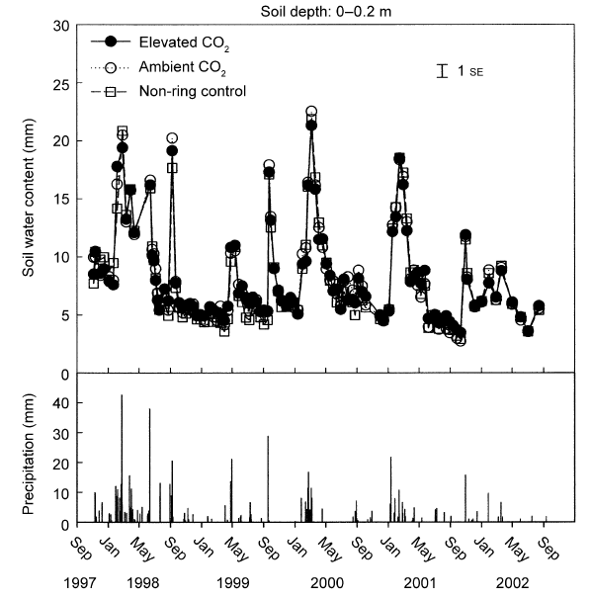
Mojave desert
No overall CO₂ effect (0.2, 0.5, 1.75 m)
CO₂ significant on a few dates
  Elevated CO₂ drier than ambient
Nowak et al. 2004 Ecology
Notes:
Let’s take this one step further, and consider an even drier system, the Mojave desert and the Nevada Desert FACE facility. MAP here is ~135 mm yr⁻¹.
Here, CO2 causes no overall effect on soil moisture, and wehre there were occasionally dates with significant differences, elevated CO2 reduced soil moisture.
s
Soil moisture-
Soil moisture was not significantly different between ambient and elevated CO2 overall at 0-20cm, 0-50cm, or below this to 1.75m.
On individual dates, where the CO2 effect was significant, elevated CO2 was drier than ambient.

Slide 19
Summary
Mesic
Xeric
Tallgrass Prairie
Midgrass Prairie
Mojave Desert
CO₂
Soil moisture
CO₂
Soil moisture
CO₂
Soil moisture
Physiological effects
Community change
ANPP
Physiological effects
Community change
ANPP + BNPP
Physiological effects
Community change
Soil C
Soil N
Soil N
Soil N
Soils
ANPP response to CO₂ when both direct + indirect effects occur.
Indirect effects may be due to spatial (soils, regional MAP) or temporal (rainfall) variation.
Requires species able to capitalize on the altered growing conditions.
In xeric environments, indirect effects may not be possible – there’s just not enough water around.
Next Steps: Structural equation modeling.
Notes:
To summarize,
A comparative review of these three CO2 experiments suggests:
In mesic our mesic system, CO2 effects on ecosystem function (here, ANPP) appear to be stronger when direct effects are augmented by indirect effects. In the midgrass prairie, these multiple effects are not evident; it’s a soil moisture story; at the driest site, CO2 effects at the physiological level can no longer cause soil moisture accrual or other indirect effects. Only a direct effect remains.
Caveat: these are the overall patterns…year to year variation in these effects occurs and is important.
We plan to use an SEM approach to test these models for the three different sites to learn more about how the causal influences of CO2, soil moisture, and other factors may be changing across this range of water limitation.

Slide 20
Summary
Mesic
Xeric
Tallgrass Prairie
Midgrass Prairie
Mojave Desert
CO₂
Soil moisture
CO₂
Soil moisture
CO₂
Soil moisture
Physiological effects
Community change
ANPP
Physiological effects
Community change
ANPP + BNPP
Physiological effects
Community change
Soil C
Soil N
Soil N
Soil N
Soils
ANPP response to CO₂ when both direct + indirect effects occur.
Indirect effects may be due to spatial (soils, regional MAP) or temporal (rainfall) variation.
Requires species able to capitalize on the altered growing conditions.
In xeric environments, indirect effects may not be possible – there’s just not enough water around.
Next Steps: Structural equation modeling.
Notes:
To summarize,
A comparative review of these three CO2 experiments suggests:
In mesic our mesic system, CO2 effects on ecosystem function (here, ANPP) appear to be stronger when direct effects are augmented by indirect effects. In the midgrass prairie, these multiple effects are not evident; it’s a soil moisture story; at the driest site, CO2 effects at the physiological level can no longer cause soil moisture accrual or other indirect effects. Only a direct effect remains.
Caveat: these are the overall patterns…year to year variation in these effects occurs and is important.
We plan to use an SEM approach to test these models for the three different sites to learn more about how the causal influences of CO2, soil moisture, and other factors may be changing across this range of water limitation.

