Slide 1


The integrated ecology, biogeochemistry, and hydrology of the terrestrial biosphere – an earth system model perspective
Gordon Bonan
National Center for Atmospheric Research
Boulder, Colorado
1 March 2011
1st INTERFACE Workshop
Captiva Island, Florida
NCAR is sponsored by the National Science Foundation

Slide 2
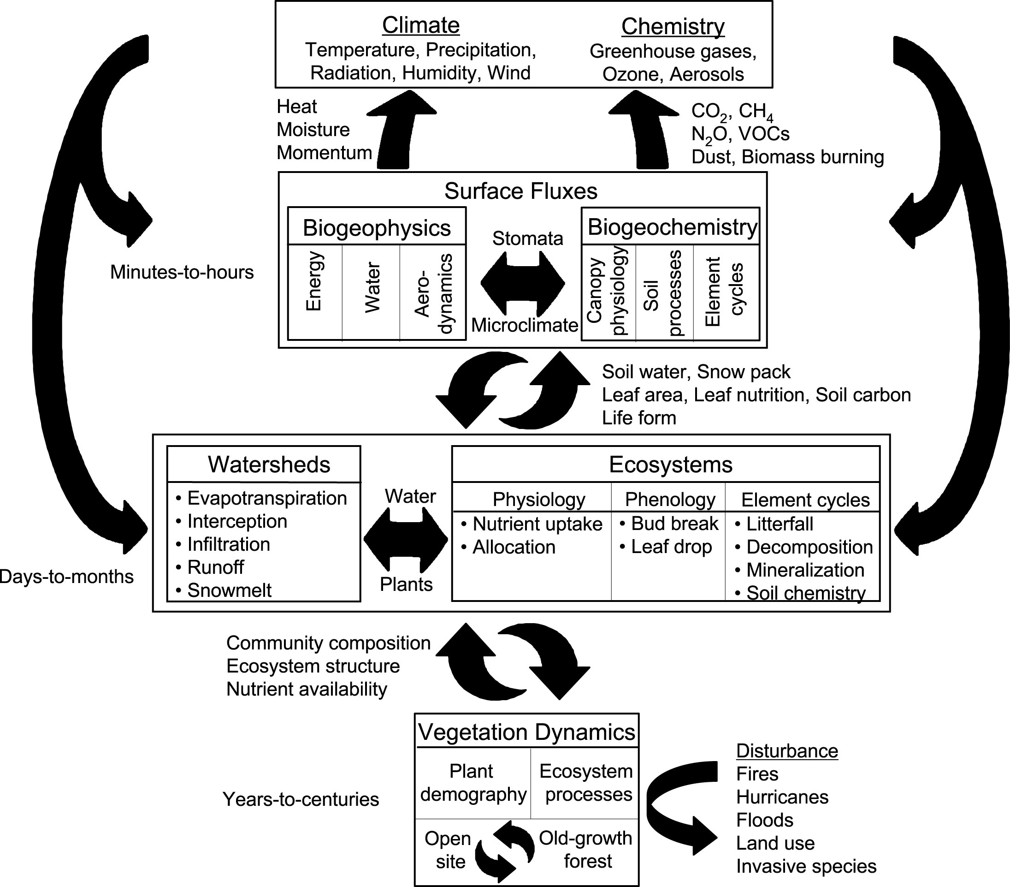
1. Introduction
Multi-disciplinary science
Terrestrial ecosystems influence climate through physical, chemical, and biological processes that affect planetary energetics, the hydrologic cycle, and atmospheric composition
Earth system science spans traditional disciplines
Three examples
Anthropogenic land cover change
Photosynthesis-transpiration
Leaf area index
Bonan (2008) Ecological Climatology, 2nd ed (Cambridge Univ. Press)

Slide 3
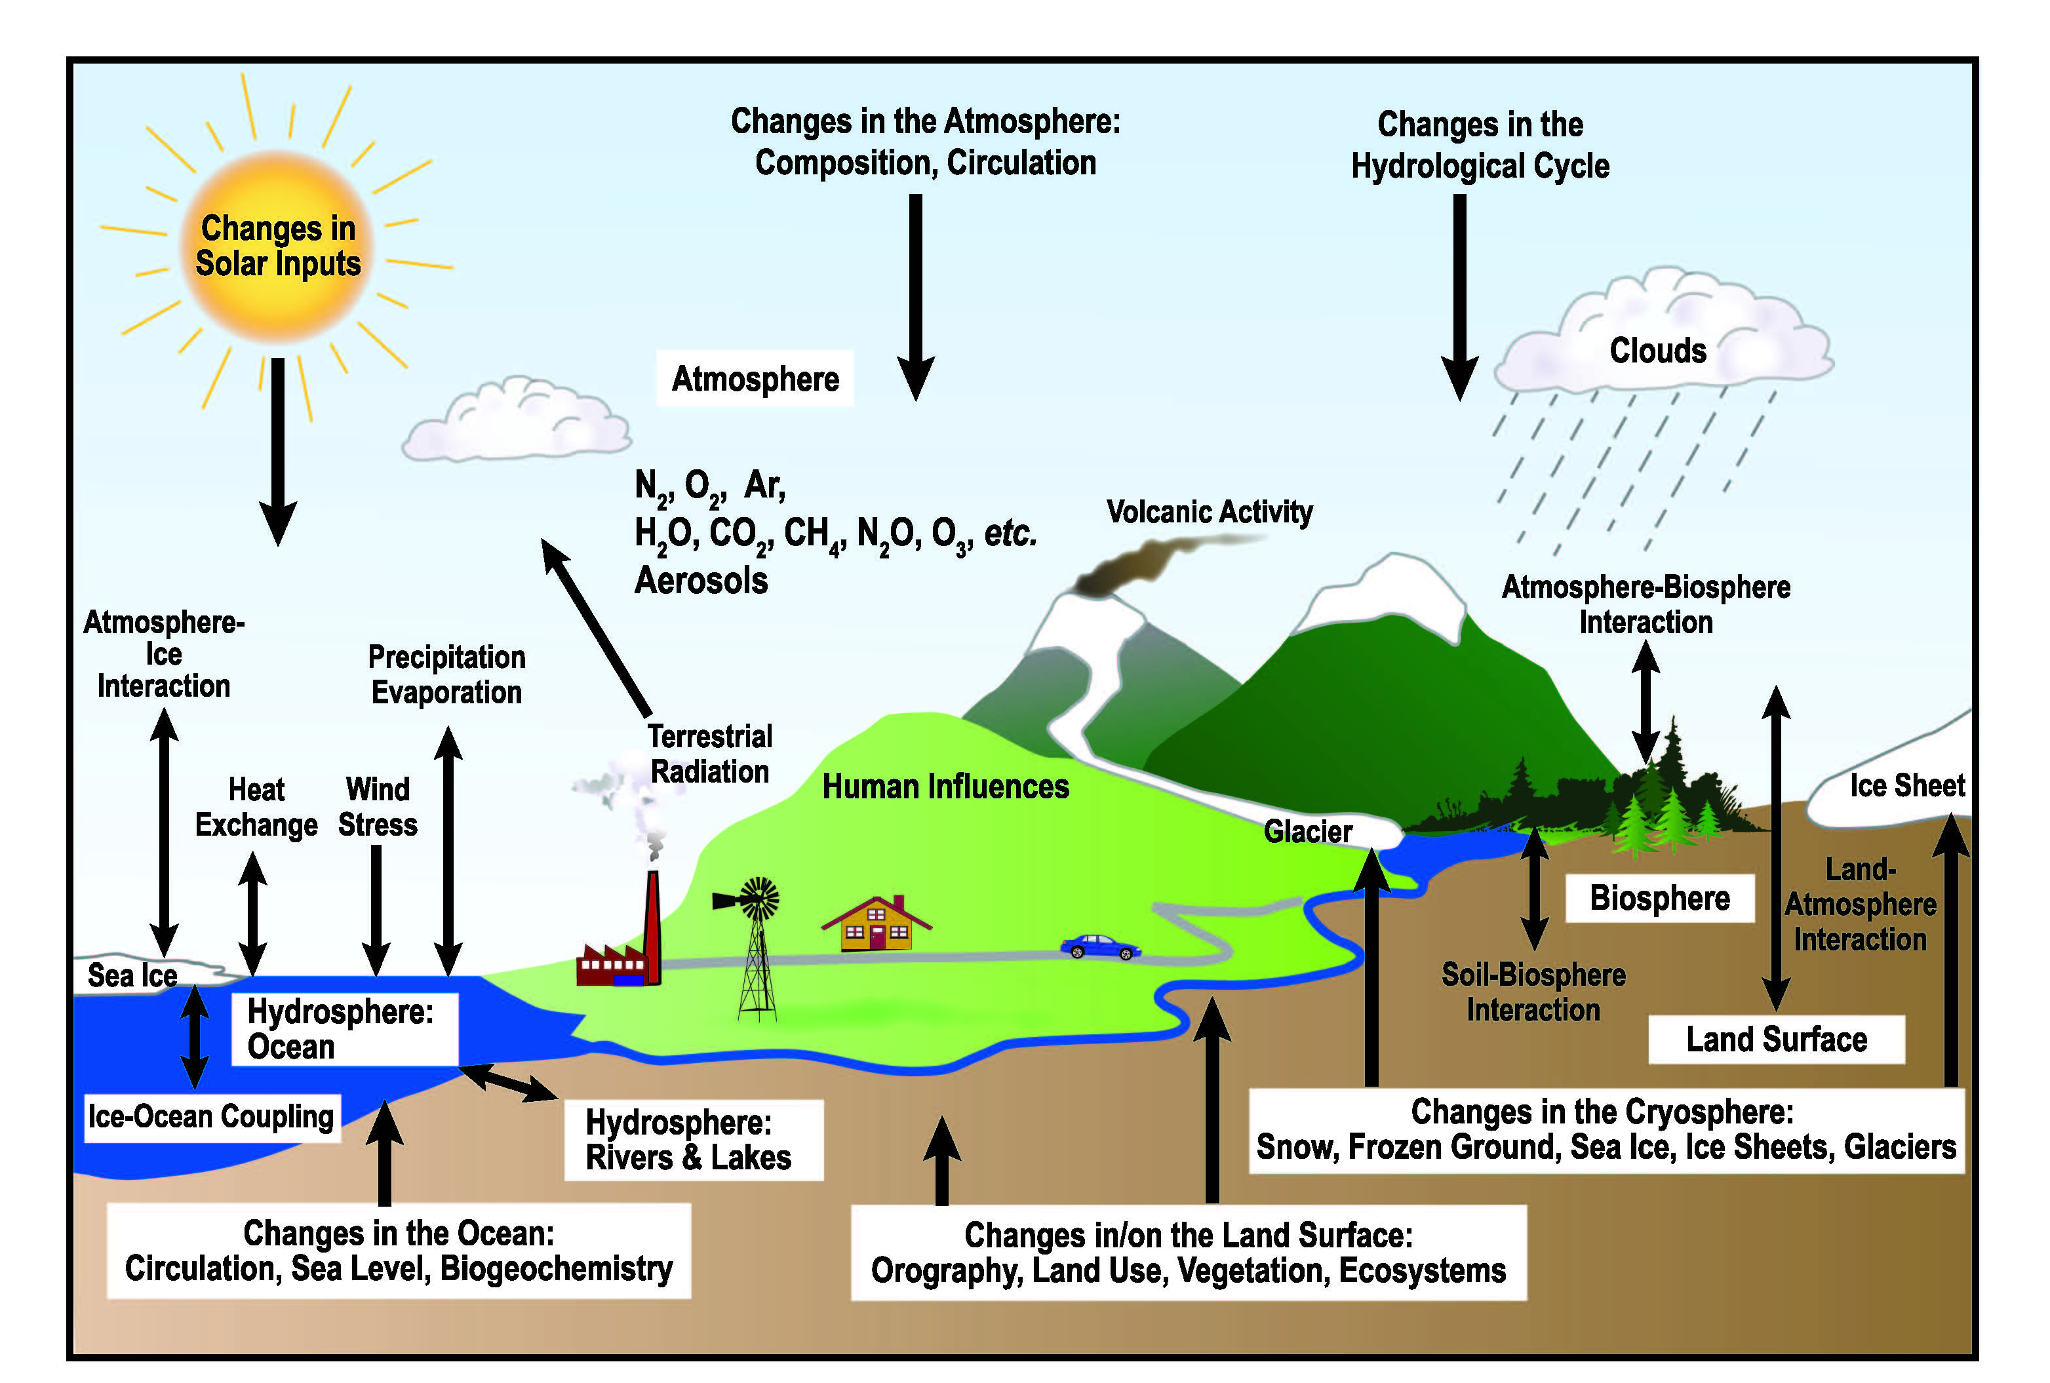
2. Models
The Community Earth System Model
Earth system models use mathematical formulas to simulate the physical, chemical, and biological processes that drive Earth’s atmosphere, hydrosphere, biosphere, and geosphere
A typical Earth system model consists of coupled models of the atmosphere, ocean, sea ice, and land
Land is represented by its ecosystems, watersheds, people, and socioeconomic drivers of environmental change
The model provides a comprehensive understanding of the processes by which people and ecosystems feed back, adapt to, and mitigate global environmental change
(IPCC 2007)

Slide 4
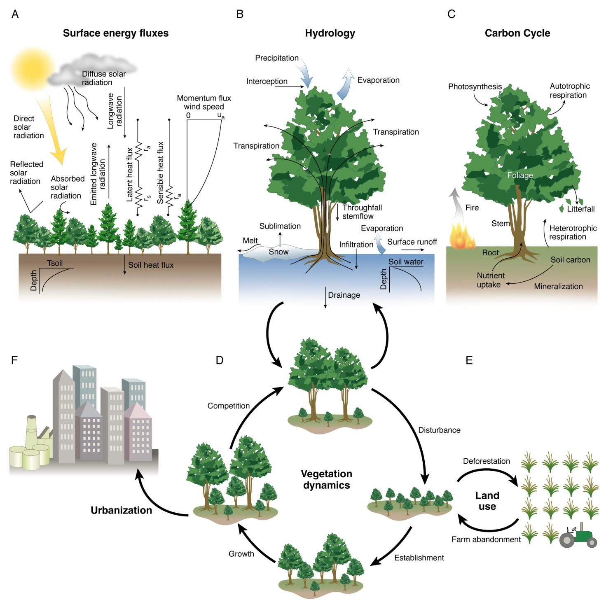
2. Models
The Community Land Model (CLM4)
Fluxes of energy, water, and carbon and the dynamical processes that alter these fluxes
Oleson et al. (2010) NCAR/TN-478+STR
Lawrence et al. (2011) JAMES, in press
Spatial scale
1.25º longitude × 0.9375º latitude (288 × 192 grid)
2.5º longitude × 1.875º latitude (144 × 96 grid)
Temporal scale
30-minute coupling with atmosphere
Seasonal-to-interannual (phenology)
Decadal-to-century climate (disturbance, land use, succession)
Paleoclimate (biogeography)
Bonan (2008) Science 320:1444-1449

Slide 5
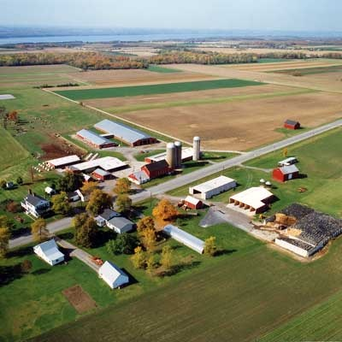
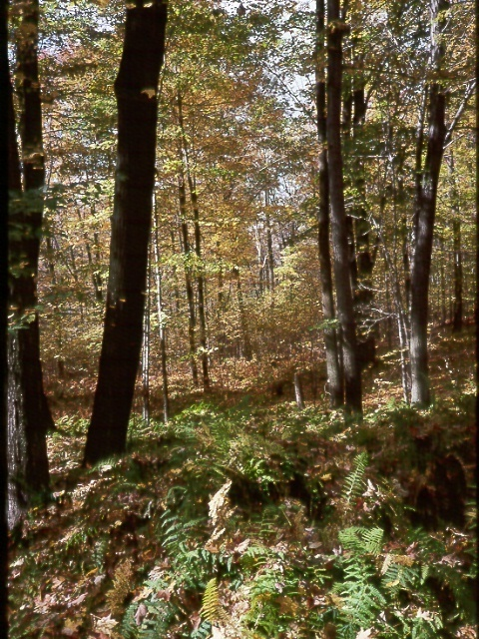
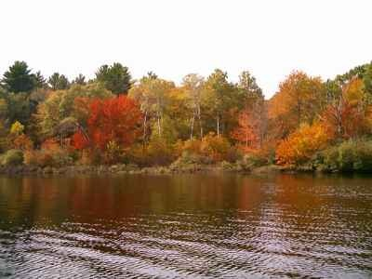
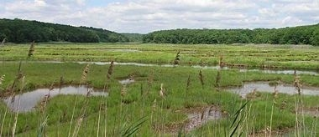
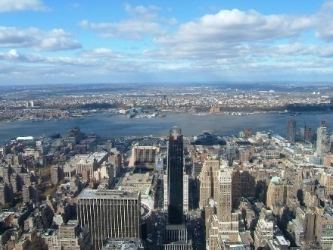
2. Models
Land surface heterogeneity
Subgrid land cover and plant functional types
CLM represents a model grid cell as a mosaic of up to 6 primary land cover types. Vegetated land is further represented as a mosaic of plant functional types
Glacier
16.7%
Vegetated
43.8%
Lake
16.7%
0.9375º in latitude (~100 km)
Wet-
land
8.3%
Urban
8.3%
Crop 6.2%
1.25º in longitude (~100 km)
Bonan et al. (2002) GBC, 16, doi:10.1029/2000GB001360

Slide 6
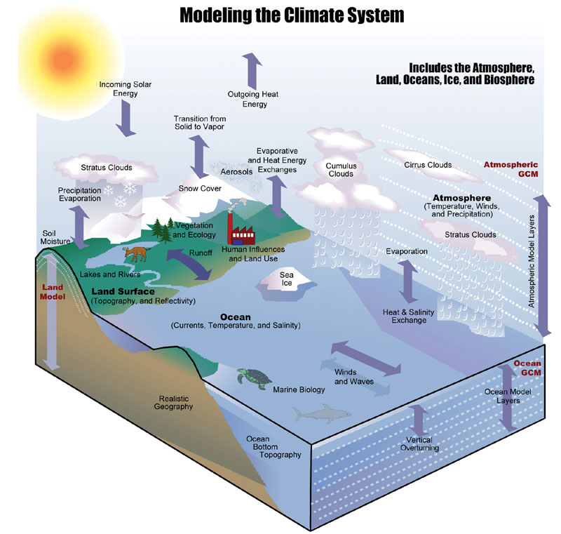
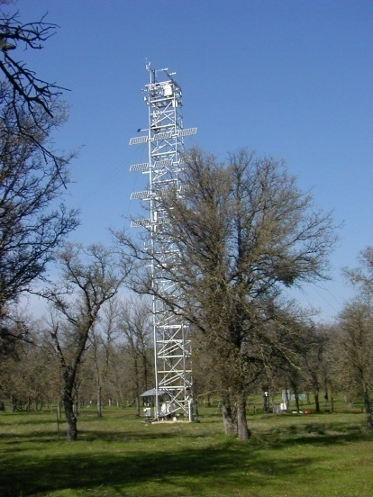
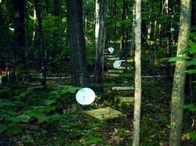
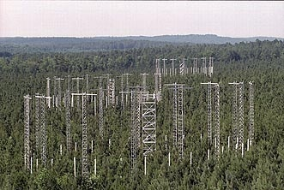

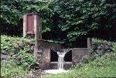
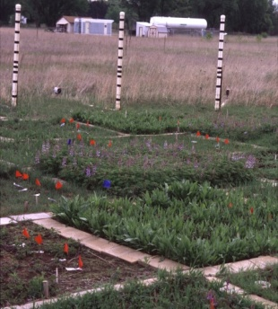
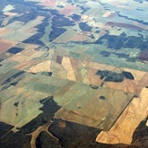

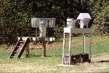
2. Models
Integrate ecological studies with earth system models
Environmental Monitoring
Experimental Manipulation
Soil warming, Harvard Forest
Eddy covariance flux tower
(courtesy Dennis Baldocchi)
CO₂ enrichment, Duke Forest
CO₂ × N enrichment, Cedar Creek
Hubbard Brook Ecosystem Study
Planetary energetics
Planetary ecology
Planetary metabolism
Test model-generated hypotheses of earth system functioning with observations

Slide 7
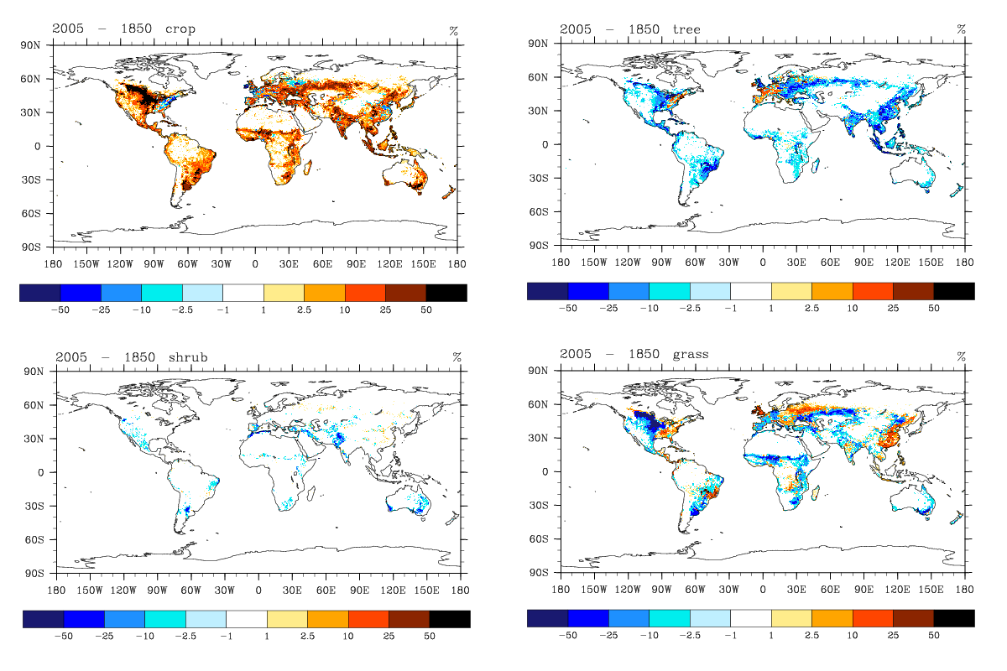
3. Land use
Historical land cover change,
1850 to 2005
Crop PFT
Tree PFTs
Lawrence et al. (2011) J. Climate, in prep.
Prevailing paradigm
Anthropogenic land cover change cools mid-latitude climate, primarily from increased surface albedo
Land use carbon emissions warms climate
How does this understanding depend on hydrology?

Slide 8
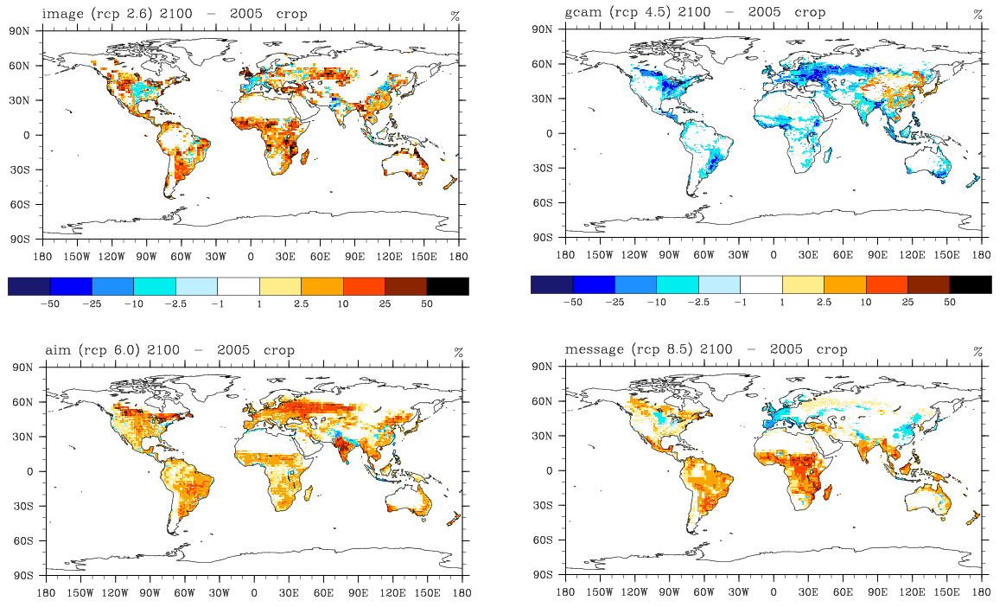
3. Land use
Future land cover change,
2005 to 2100
IMAGE (RCP 2.6 W m⁻²)
MINICAM (RCP 4.5 W m⁻²)
AIM (RCP 6.0 W m⁻²)
MESSAGE (RCP 8.5 W m⁻²)
Lawrence et al. (2011) J. Climate, in prep.

Slide 9
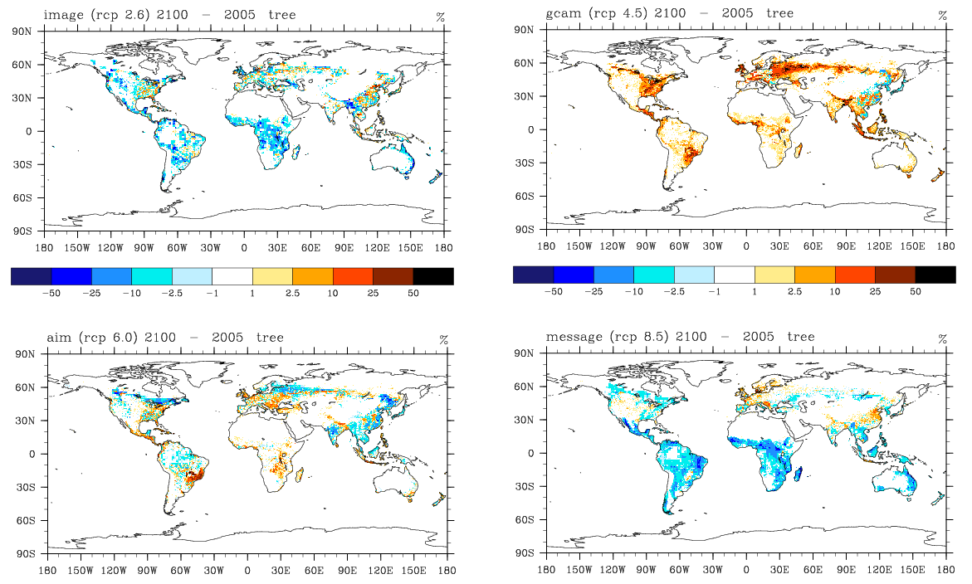
3. Land use
Future land cover change,
2005 to 2100
IMAGE (RCP 2.6 W m⁻²)
MINICAM (RCP 4.5 W m⁻²)
AIM (RCP 6.0 W m⁻²)
MESSAGE (RCP 8.5 W m⁻²)
Lawrence et al. (2011) J. Climate, in prep.

Slide 10
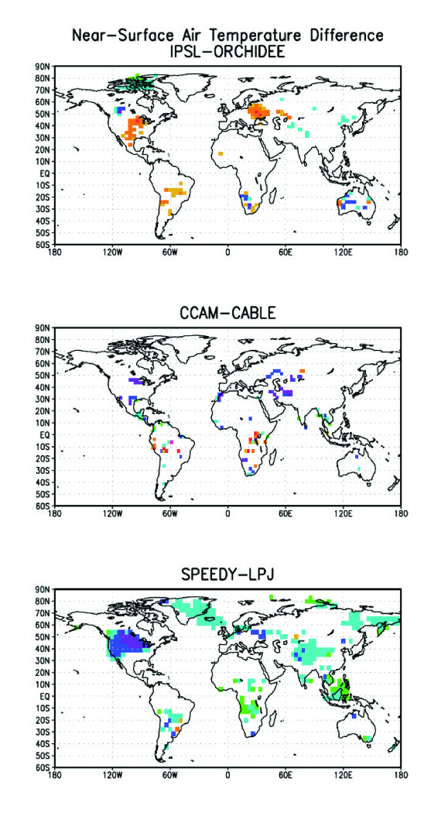
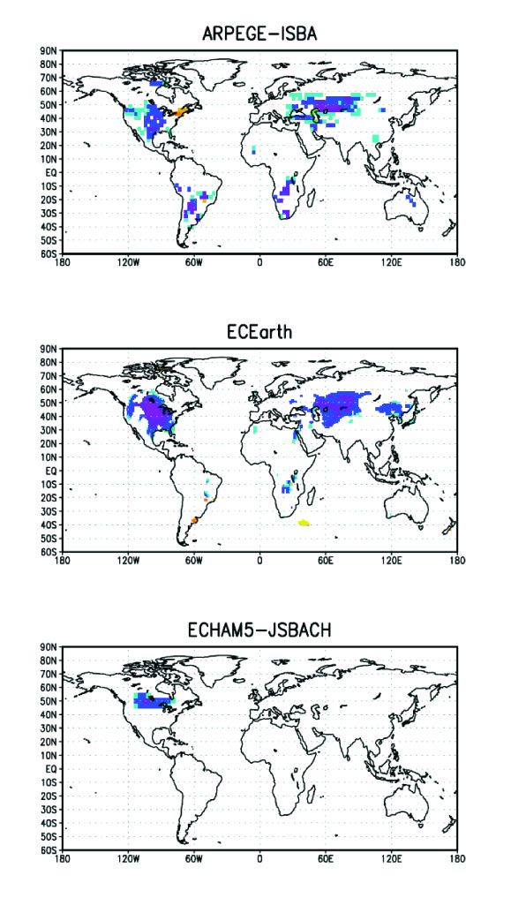
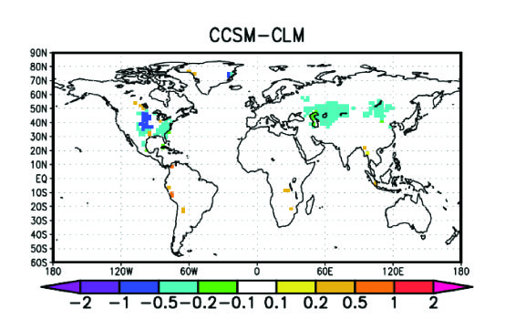
3. Land use
The LUCID intercomparison study
Change in JJA near-surface air temperature (°C) resulting from land cover change (PD – PDv)
Pitman, de Noblet-Ducoudré, et al. (2009) GRL, 36, doi:10.1029/2009GL039076

Slide 11
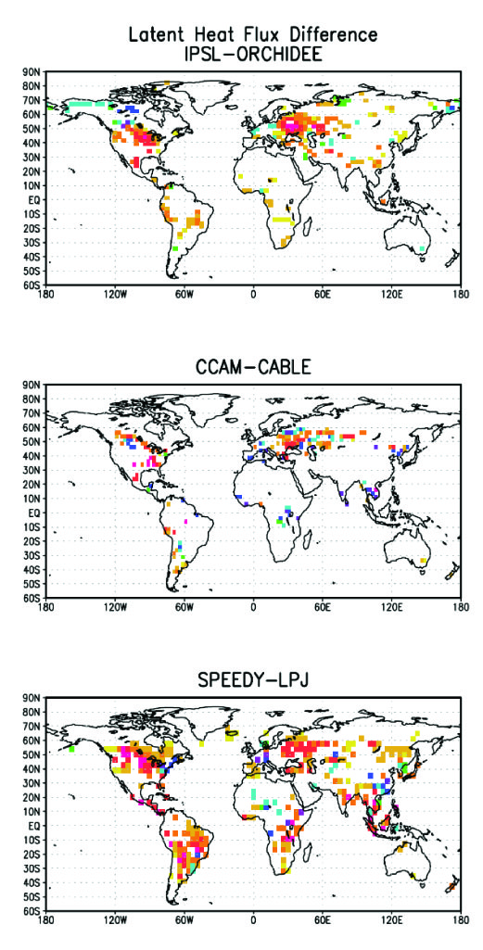
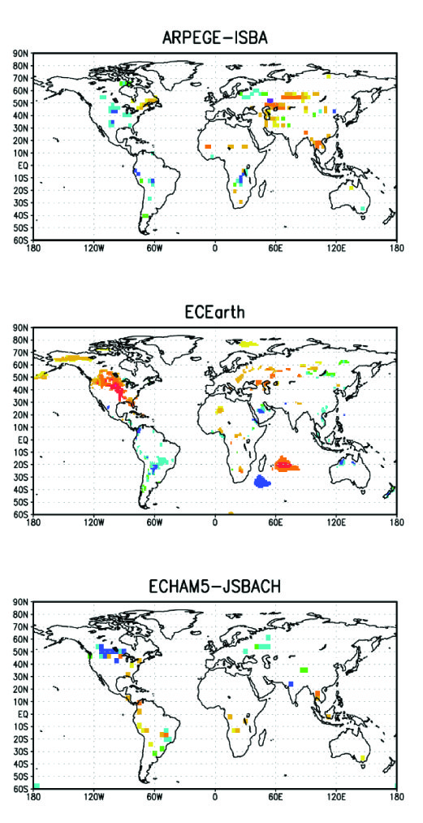
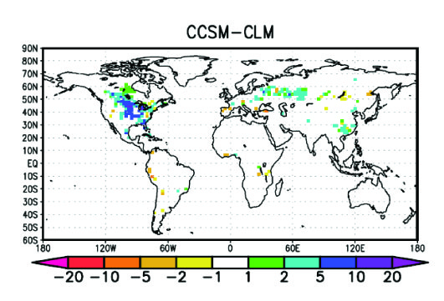
3. Land use
The LUCID intercomparison study
Change in JJA latent heat flux (W m⁻²) resulting from land cover change (PD – PDv)
CLM – Crops vs trees
Higher albedo and g_{s}
Lower z₀, LAI, and SAI
Root profile not important
Soils are wet; no deep roots or hydraulic redistribution
Latent heat flux increases, mostly in soil evaporation
Pitman, de Noblet-Ducoudré, et al. (2009) GRL, 36, doi:10.1029/2009GL039076

Slide 12
3. Land use
Land cover change and evapotranspiration
Prevailing model paradigm
Crops
Low latent heat flux because of:
Low roughness
Shallow roots decrease soil water availability
Trees
High latent heat flux because of:
High roughness
Deep roots allow increased soil water availability
Dry soil
Wet soil
Tropical forest – cooling from higher surface albedo of cropland and pastureland is offset by warming associated with reduced evapotranspiration
Temperate forest - higher albedo leads to cooling, but changes in evapotranspiration can either enhance or mitigate this cooling
Bonan (2008) Science 320:1444-1449

Slide 13
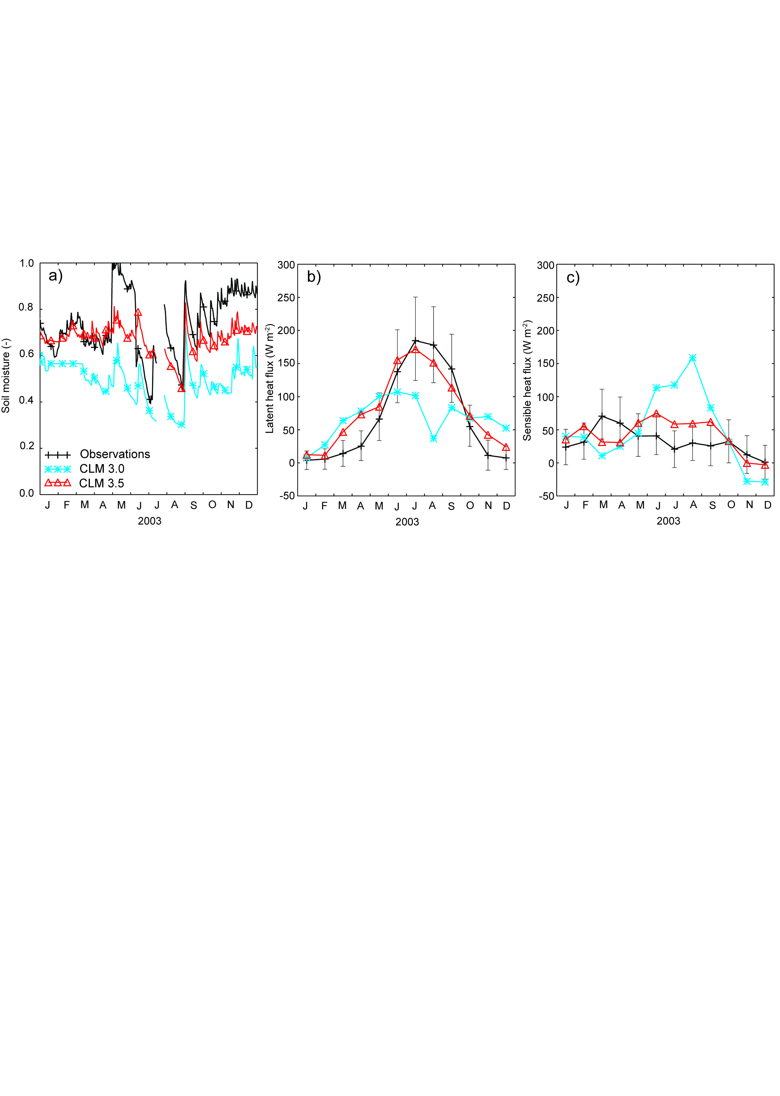
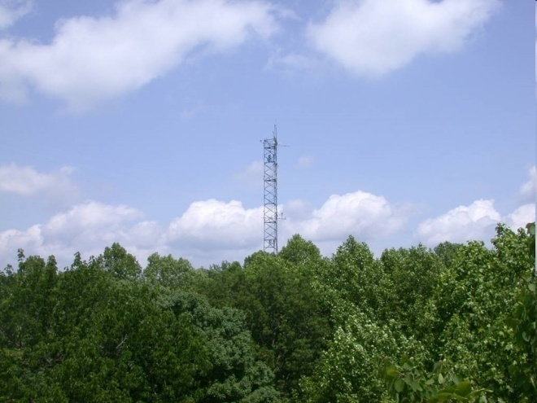
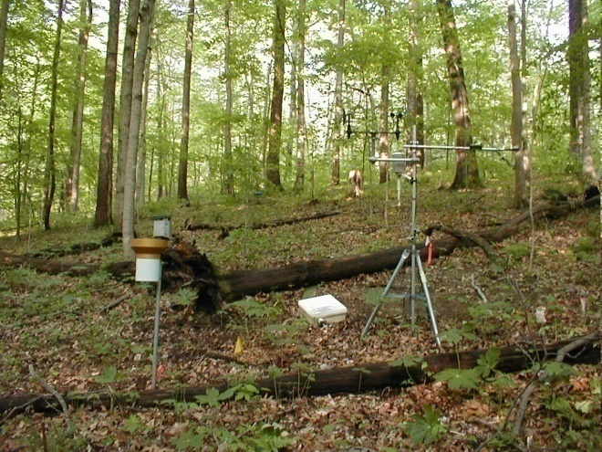
4. Model testing
Flux tower measurements – temperate deciduous forest
Morgan Monroe State Forest, Indiana
CLM3.0 – dry soil, low latent heat flux, high sensible heat flux
CLM3.5 – wetter soil and higher latent heat flux
Stöckli et al. (2008) JGR, 113, doi:10.1029/2007JG000562

Slide 14
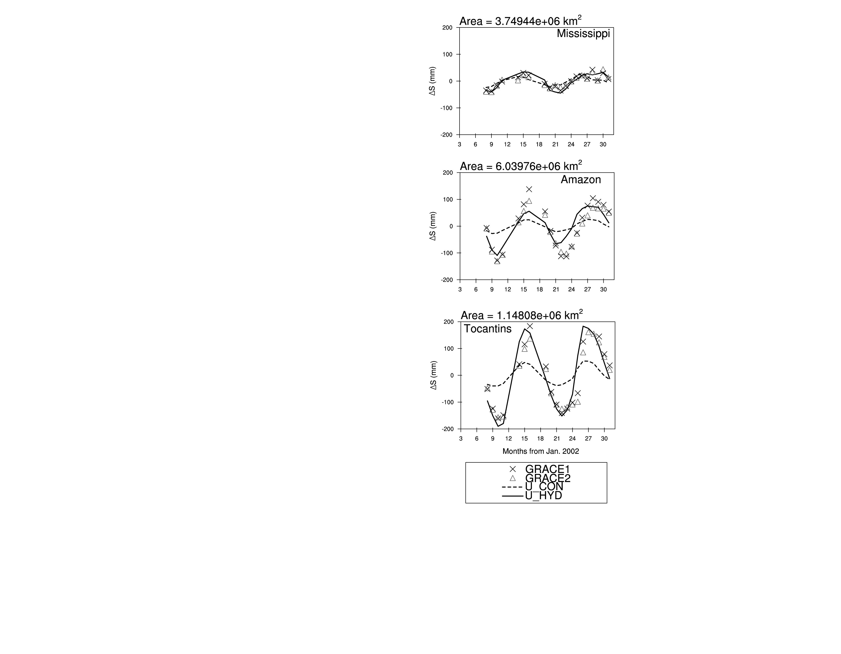
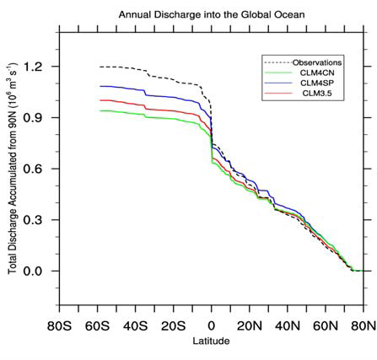
4. Model testing
Large-scale hydrologic cycle
Basin-scale water storage
Global runoff
Oleson et al. (2008) JGR, 113,
doi:10.1029/2007JG000563
CLM3.0 – dry, weak annual cycle of water storage
CLM3.5 – wet, stronger annual cycle of water storage, high ET
CLM4 – reduced ET and greater runoff
Accumulated runoff from 90N
Lawrence et al (2011) JAMES, in press

Slide 15
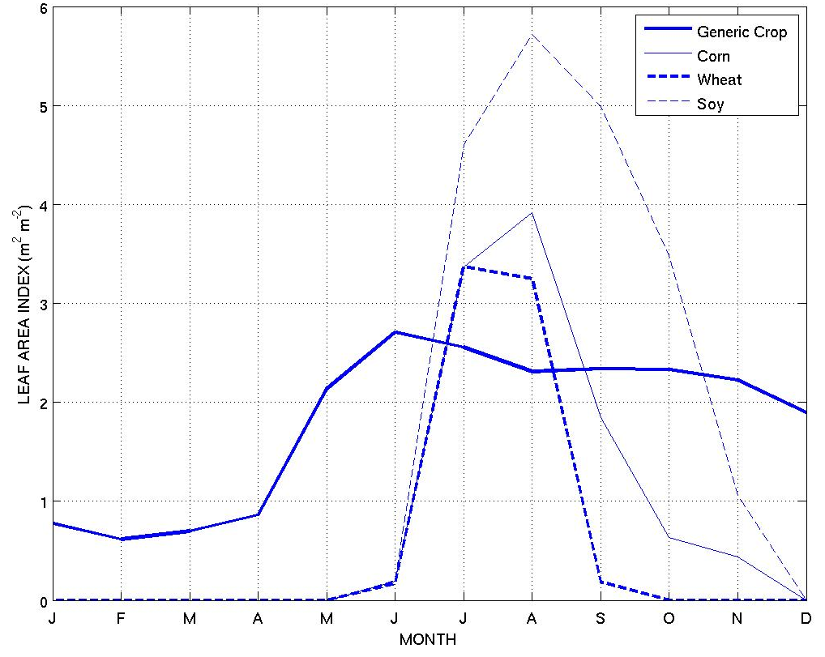
5. Crops
Crop model improves leaf area phenology
Midwestern North America
Levis & Bonan (2011) J. Climate, in prep.
Notes:
Many earth system models now include models of crop systems. The CLM crop model shows significant improvement in leaf area compared with the standard crop represented in the model

Slide 16
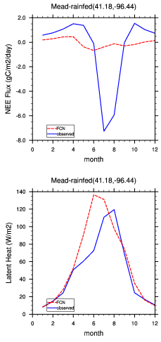
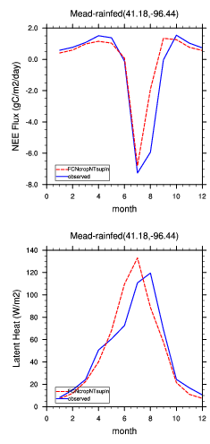
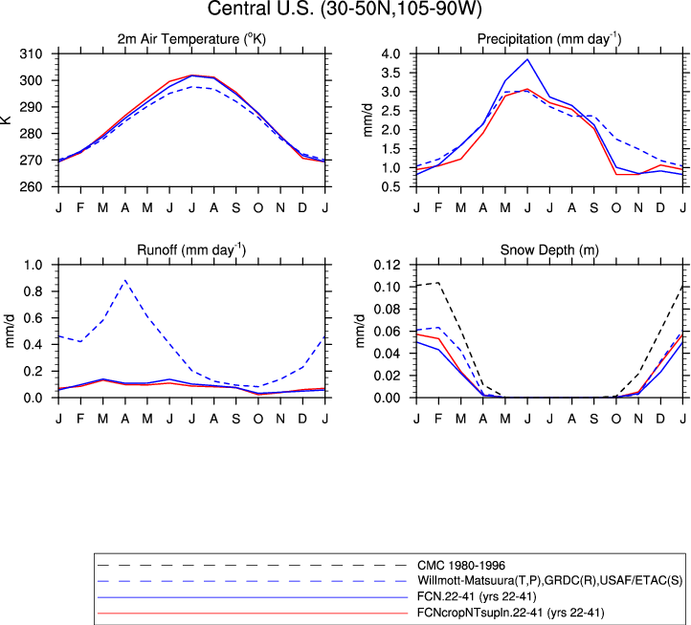
5. Crops
Crop model improves surface fluxes and climate
Generic crop
Crop model
OBS
OBS
Generic crop
OBS
Crop model
OBS
Observations
Generic crop
Crop model
Levis & Bonan (2011) J. Climate, in prep.

Slide 17
5. Crops
Crop model improves annual CO₂ cycle
Barrow, Alaska
Kumakahi, Hawaii
Levis & Bonan (2011) J. Climate, in prep.

Slide 18
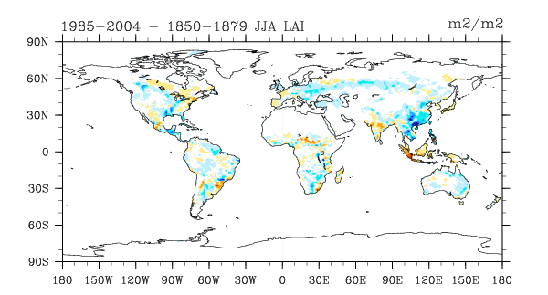
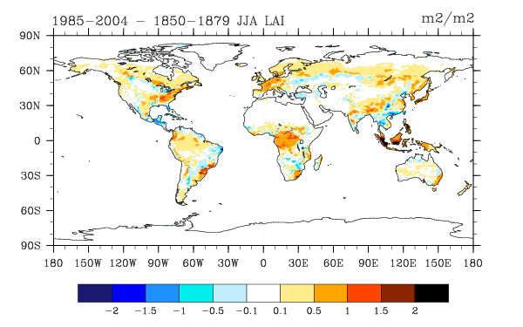
5. Land use
Opposing trends in vegetation
Simulated leaf area index
(Present-day – Pre-industrial)
Single forcing simulation
Land cover change only
Loss of leaf area, except where reforestation
All forcing simulation
CO₂
Climate
Nitrogen deposition
Land cover change
Increase in leaf area, except where agricultural expansion

Slide 19
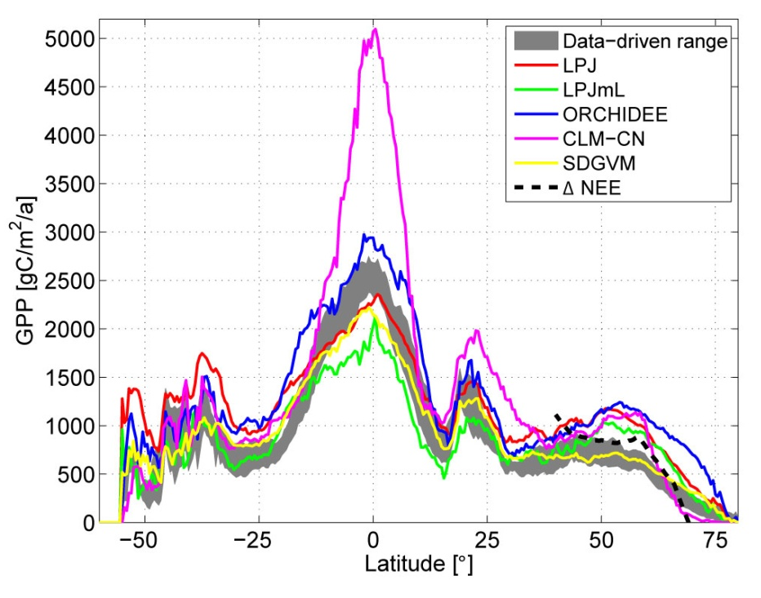
6. GPP and ET
Gross primary production biases
CLM4 (purple line) overestimates annual gross primary production (GPP) compared with data-driven estimates and other models
Causes of GPP bias
Model structural error
Canopy radiative transfer
Photosynthesis-stomatal conductance
Canopy integration
Model parameter uncertainty
Vcmax
Bonan et al. (2011) JGR, doi:10.1029/2010JG001593, in press
Beer et al. (2010) Science 329:834-838

Slide 20
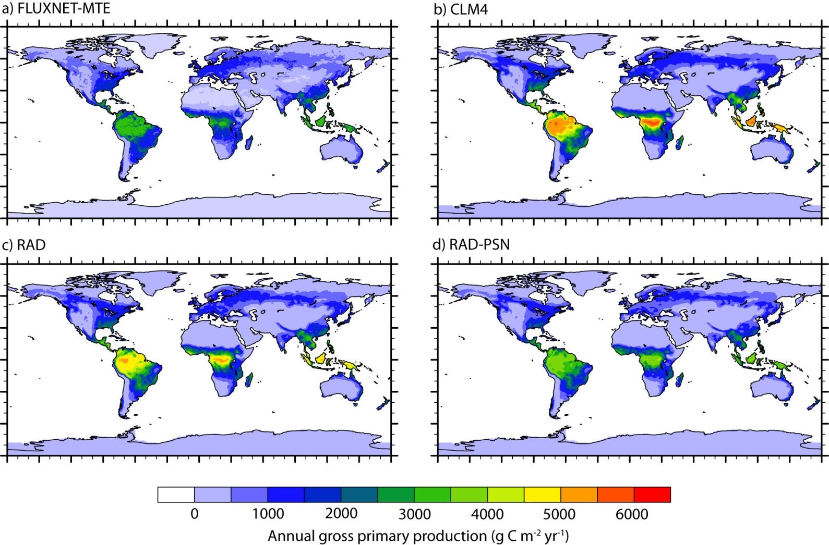
6. GPP and ET
Gross primary production bias reduction (1982-2004)
117 Pg C yr⁻¹
165 Pg C yr⁻¹
Control
155 Pg C yr⁻¹
132 Pg C yr⁻¹
Radiative transfer and photo-synthesis
Radiative transfer
Model improvements (RAD-PSN [CLM4a]) reduce annual GPP biases in tropics and extra-tropics compared with CLM4. Similar improvements are seen in monthly fluxes.
FLUXNET-MTE data from Martin Jung and Markus Reichstein (M-P-I Biogeochemistry)
Bonan et al. (2011) JGR, doi:10.1029/2010JG001593, in press

Slide 21
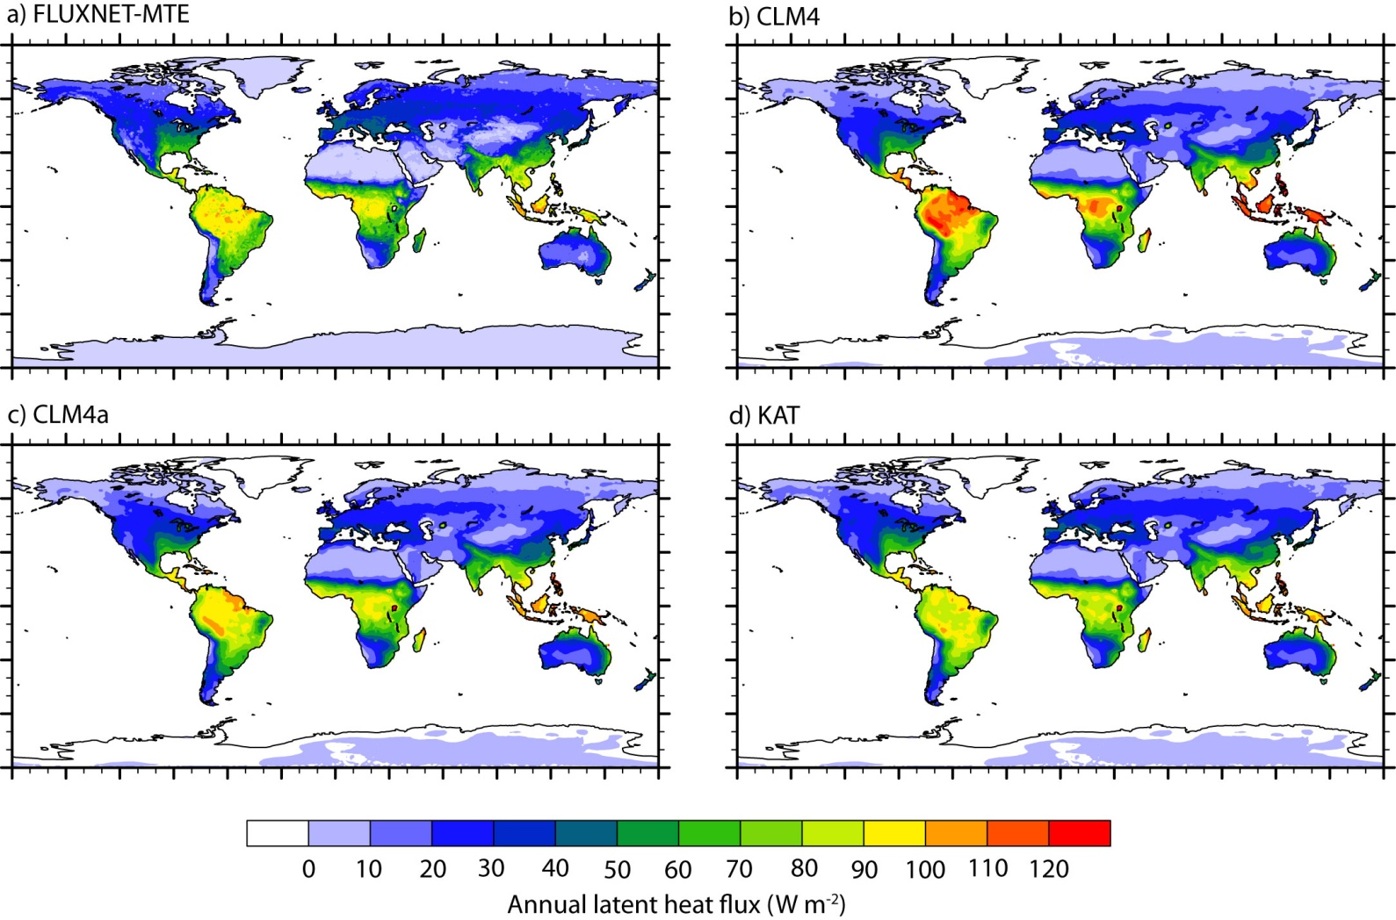
6. GPP and ET
Improved annual latent heat flux
65 x 10³ km³ yr⁻¹
68 x 10³ km³ yr⁻¹
65 x 10³ km³ yr⁻¹
67 x 10³ km³ yr⁻¹
Vcmax
sensitivity
Model improvements (CLM4a) reduce ET biases, especially in tropics, and improve monthly fluxes
Bonan et al. (2011) JGR, doi:10.1029/2010JG001593, in press

Slide 22
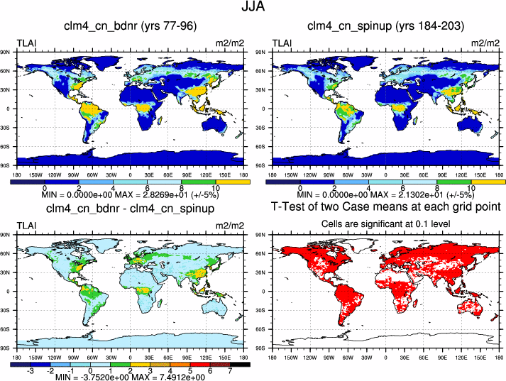
7. LAI
Is the model not obviously wrong?
Simulated leaf area index (Jun, Jul, Aug)
N fertilization experiment
CLM4 control (prognostic LAI)
N fertilization - control

Slide 23
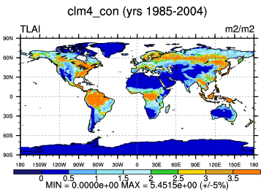
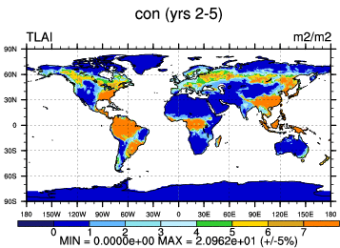
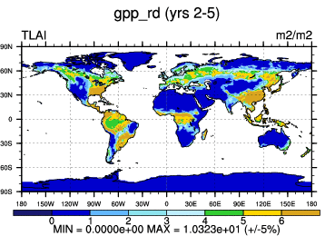
7. LAI
Is the model obviously better?
CLM4 MODIS LAI
CLM4 control (prognostic LAI)
Satellite LAI
Prognostic LAI
CLM4 – improved canopy

Slide 24
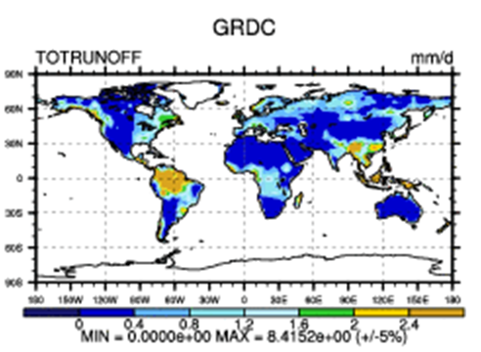
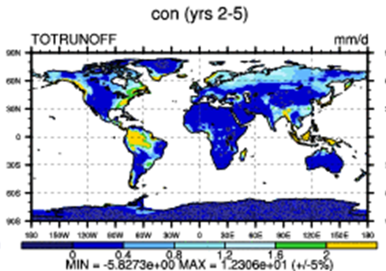

7. LAI
Better LAI leads to improved hydrology
CLM4 control
CLM4 – improved canopy
CLM4 – High LAI leads to high ET and low runoff
Improved canopy – Lower LAI leads to less ET and more runoff

Slide 25
8. Conclusions
Conclusions
Integrated ecology, biogeochemistry, and hydrology
Cannot evaluate the carbon cycle independent of the hydrologic cycle, or vice versa, and must also consider N (and P) cycles
How do we further advance earth system models?
Move beyond model experimentation that diagnoses model behavior and towards parameterization or structural experimentation to understand model responses
Do not just report how a model responds to a perturbation; report why it responds as it does
To do this requires:
Model structure and parameterizations grounded in theory
Strong understanding of the consequences of different theories
Key model experiments and datasets to critically assess the model

